Slide 1
Introducing the Trimble® X7

Slide 2
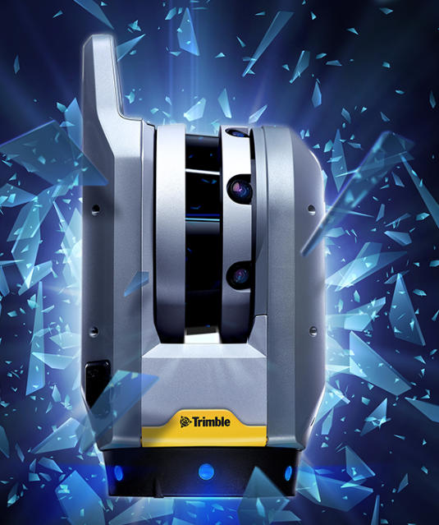
Trimble X7 3D Laser Scanner
A well balanced solution for effective performance in the field
Simple
Exceptional innovations that boost user confidence and ease of use
Smart
Breakthrough technology and features deliver precise, efficient in-field data collection empowering users
Professional
Instrument and data quality you can trust
Complete workflows to drive efficiency and reduce downtime

Slide 3
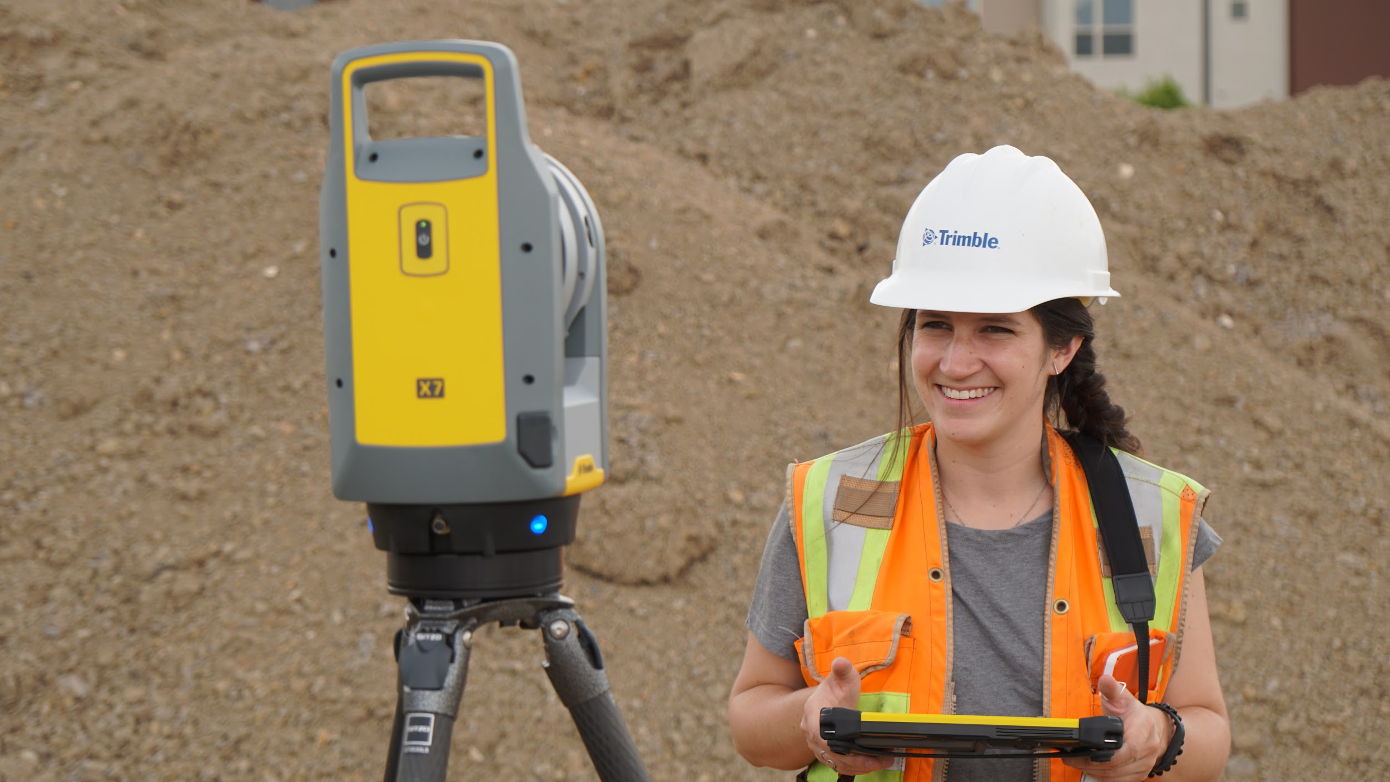
Trimble X7 Key Messages
Simple
Reliable field workflows suitable for all users
Intuitive Perspective software to operate, manage, view and validate scan data
Fast image capture with Trimble VISION™ technology
Compact and lightweight for easier transport and mobility

Slide 4
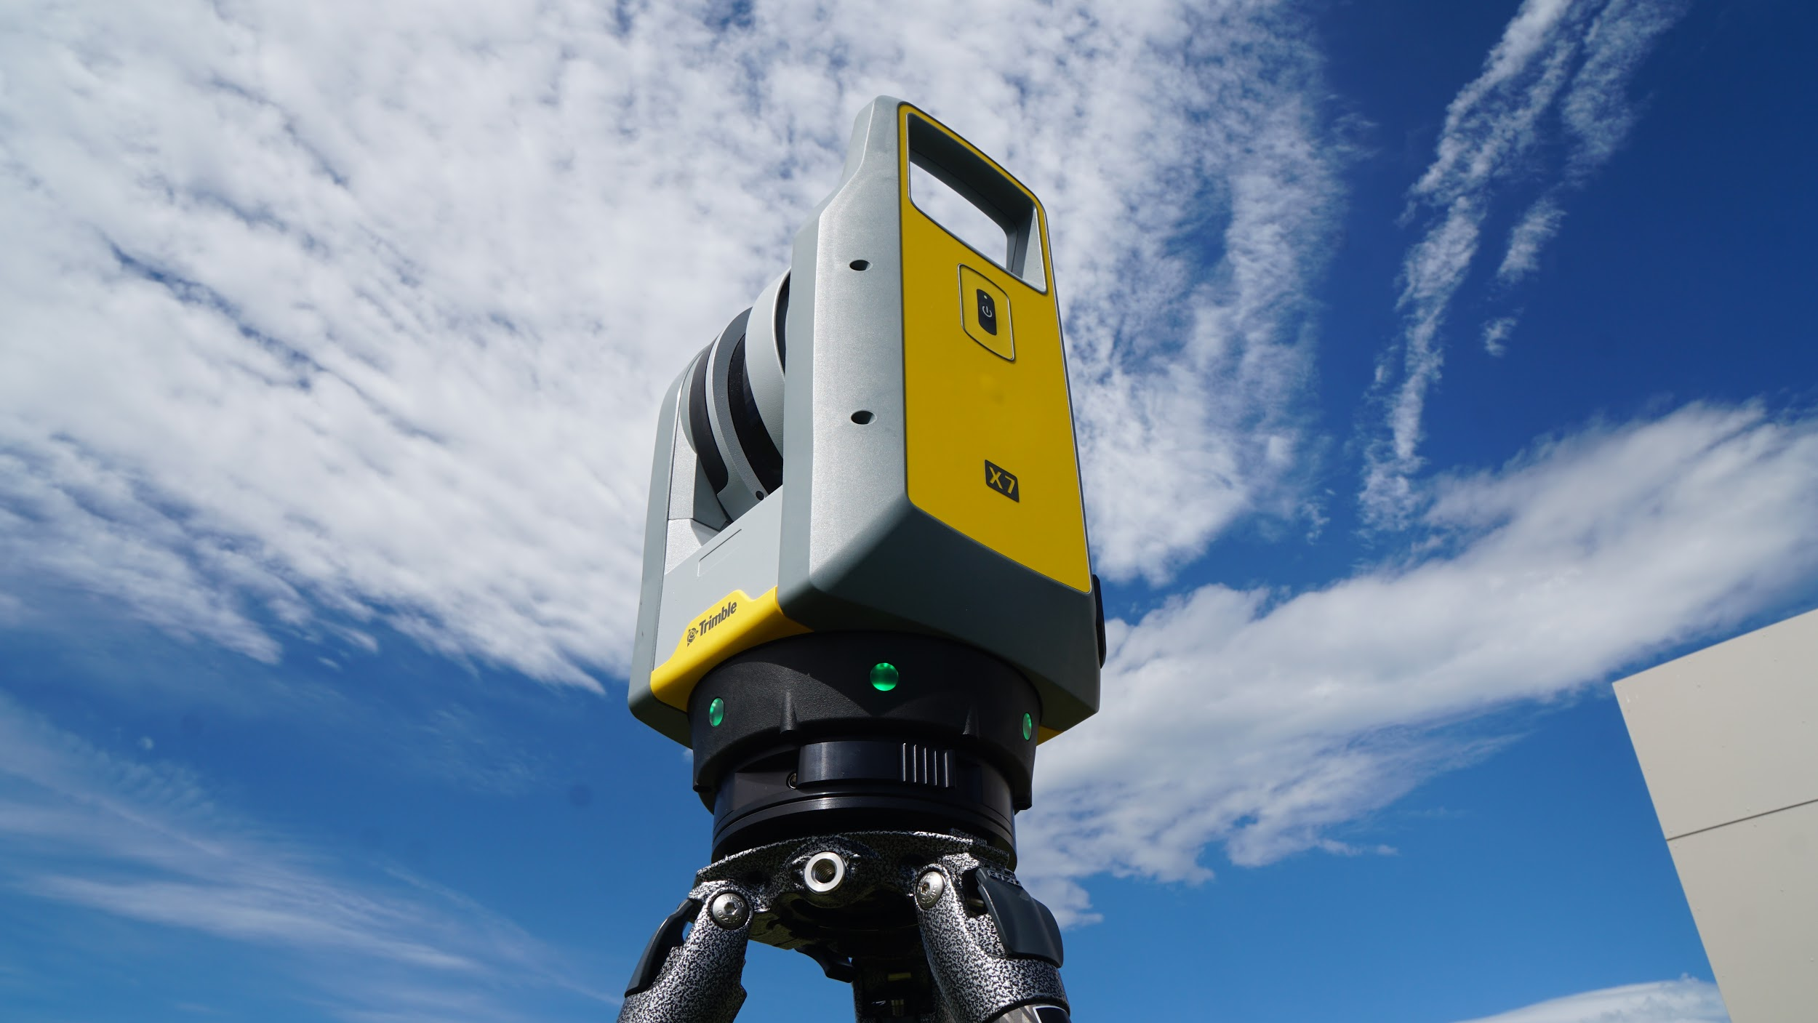
Trimble X7 Key Messages
Smart
Breakthrough innovations for reliable data collection
New Trimble X-Drive enables automatic calibration to ensure accuracy on every scan and reduce downtime.
Trimble Registration Assist for full automatic registration, refinement and reporting to leave the site with confidence.
Automatic survey grade level compensation
Flexible operation with tablet or one-button workflow

Slide 5
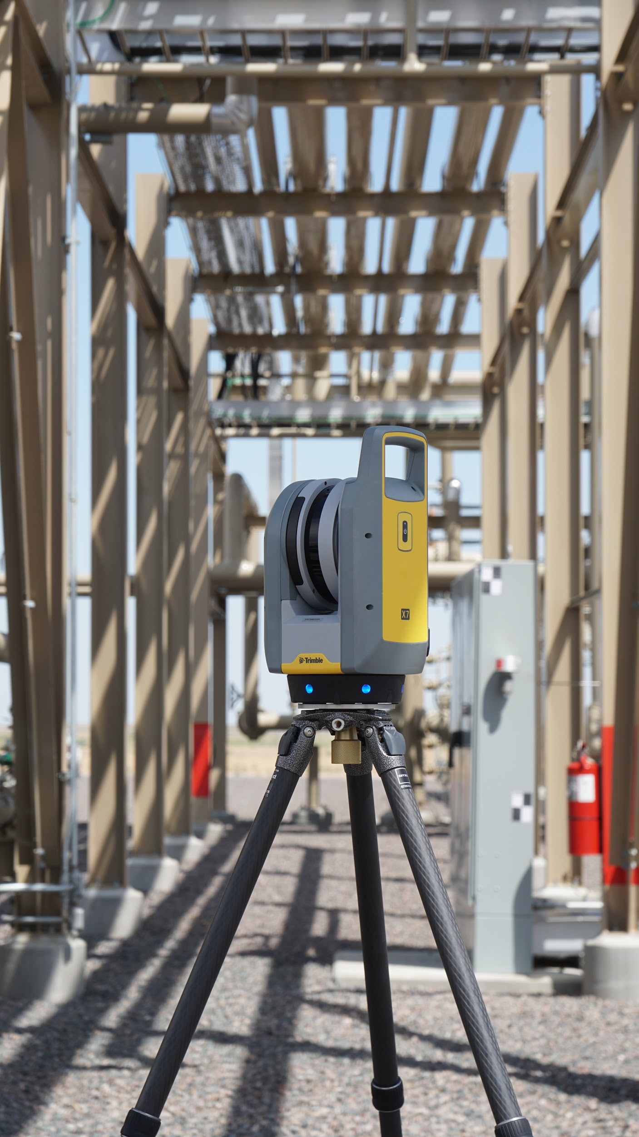
Trimble X7 Value Proposition
Professional
Reliable IP55 rating
Industry leading 2-year warranty
High sensitivity time-of-flight EDM to effectively capture dark and reflective surfaces
Full data redundancy onboard SD card and on Tablet
Data integration with Trimble and non-Trimble software
Operating temperatures -20°C → +50°C

Slide 6
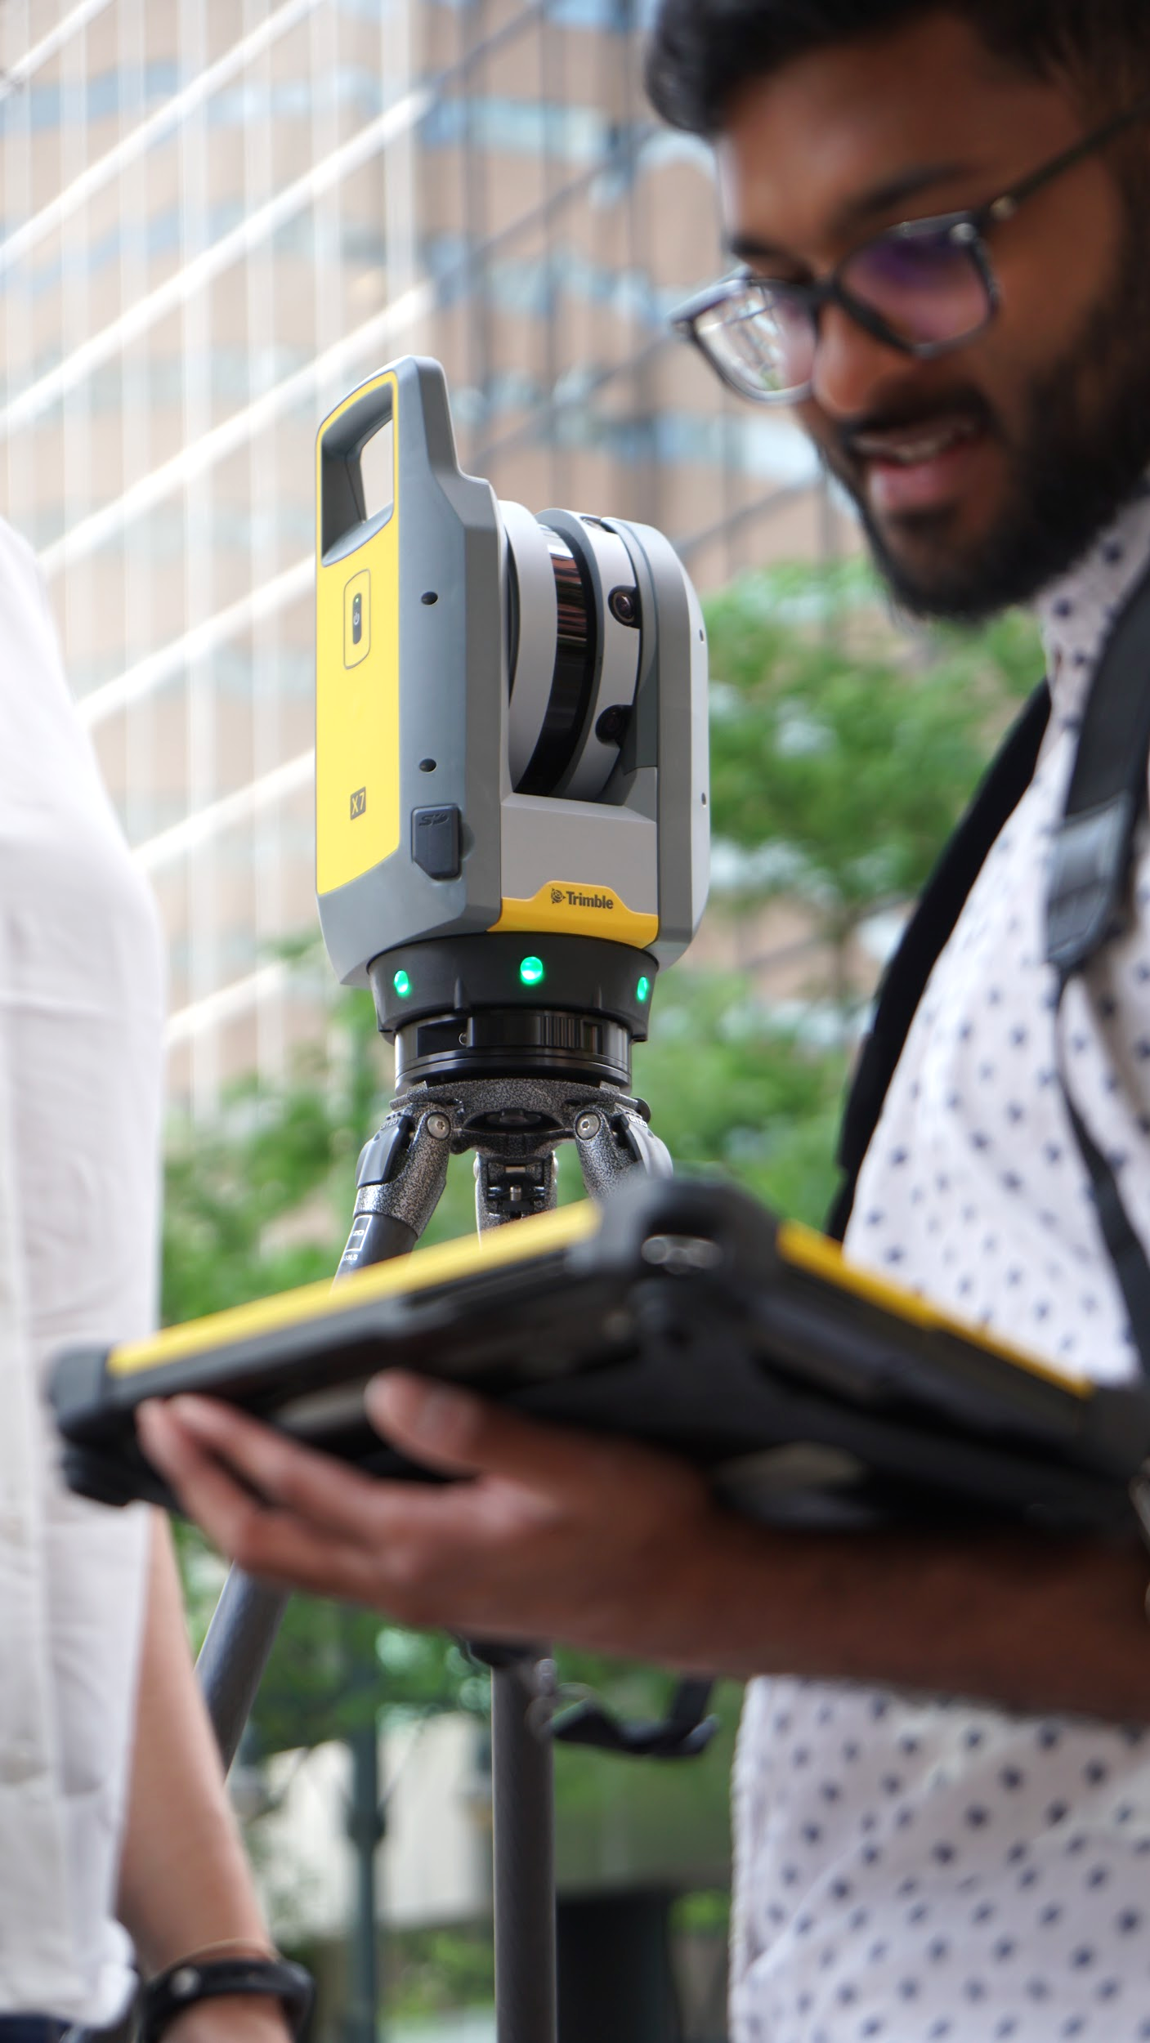
X7 Technical Overview
Speed, Spacing, Duration, Points
Digital Time of Flight EDM
360° x 282° FOV
Scan Duration
1:34 - 14:57 min:sec
Point Spacing
3.5 - 11.4mm @ 10m
Number of Points/Scan
12 - 125 million
500kHz or 166kHz
Environmental
IP55
Operating Temperature
-20°C to +50°C (-4°F to 122°F)
5.8kg (including battery)
2-year Warranty
VISION
3 integrated cameras
Speed: Fast 1 min - Quality 2 min
Resolution: Fast 158 MP - Quality 316 MP
Features
Automatic Calibration
Trimble Registration Assist
Survey Grade Self Leveling
3” accuracy
Measurement Range
0.6m - 80m
Accuracy
3D point accuracy
3.5mm @ 20m
Range Noise
<3mm @ 60m on 80% albedo
Communications
Dual Band WiFi
USB cable

Slide 7
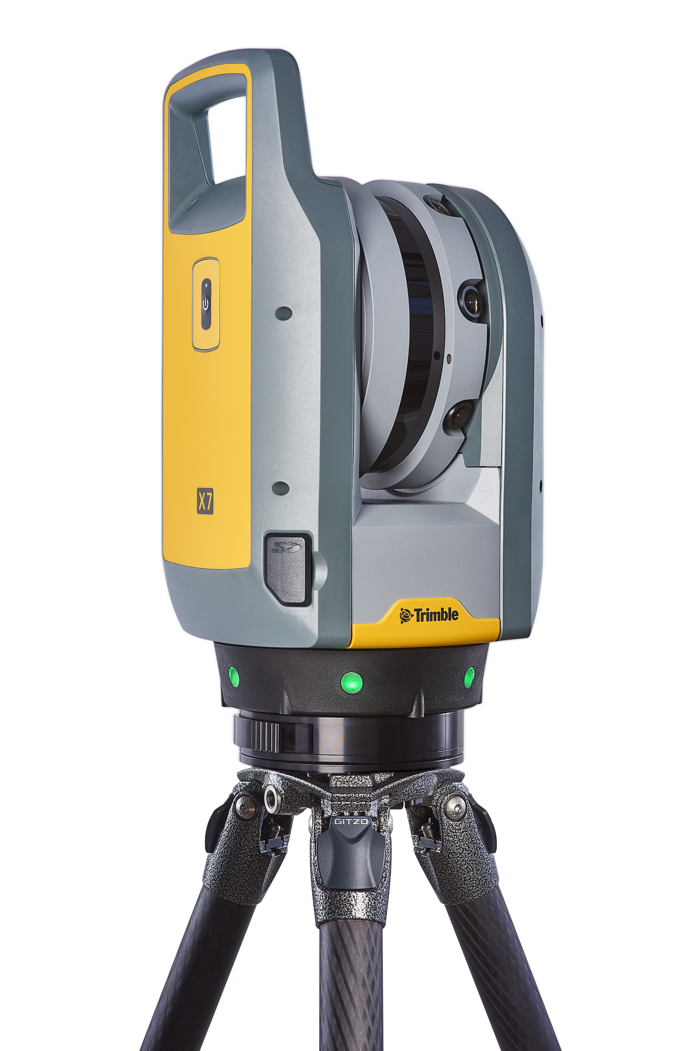
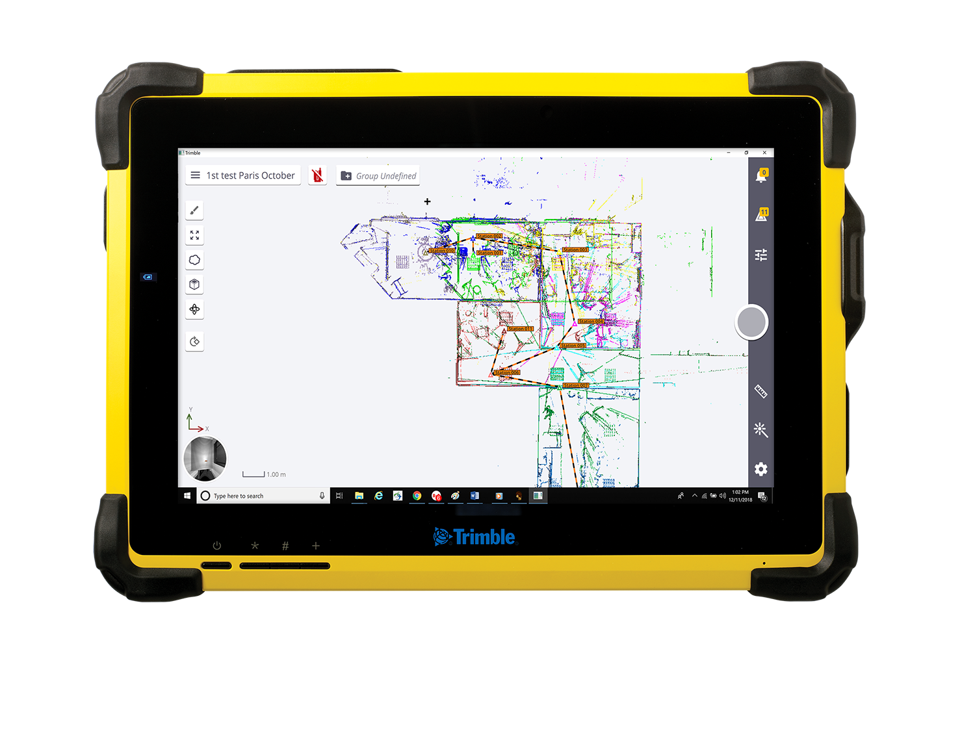
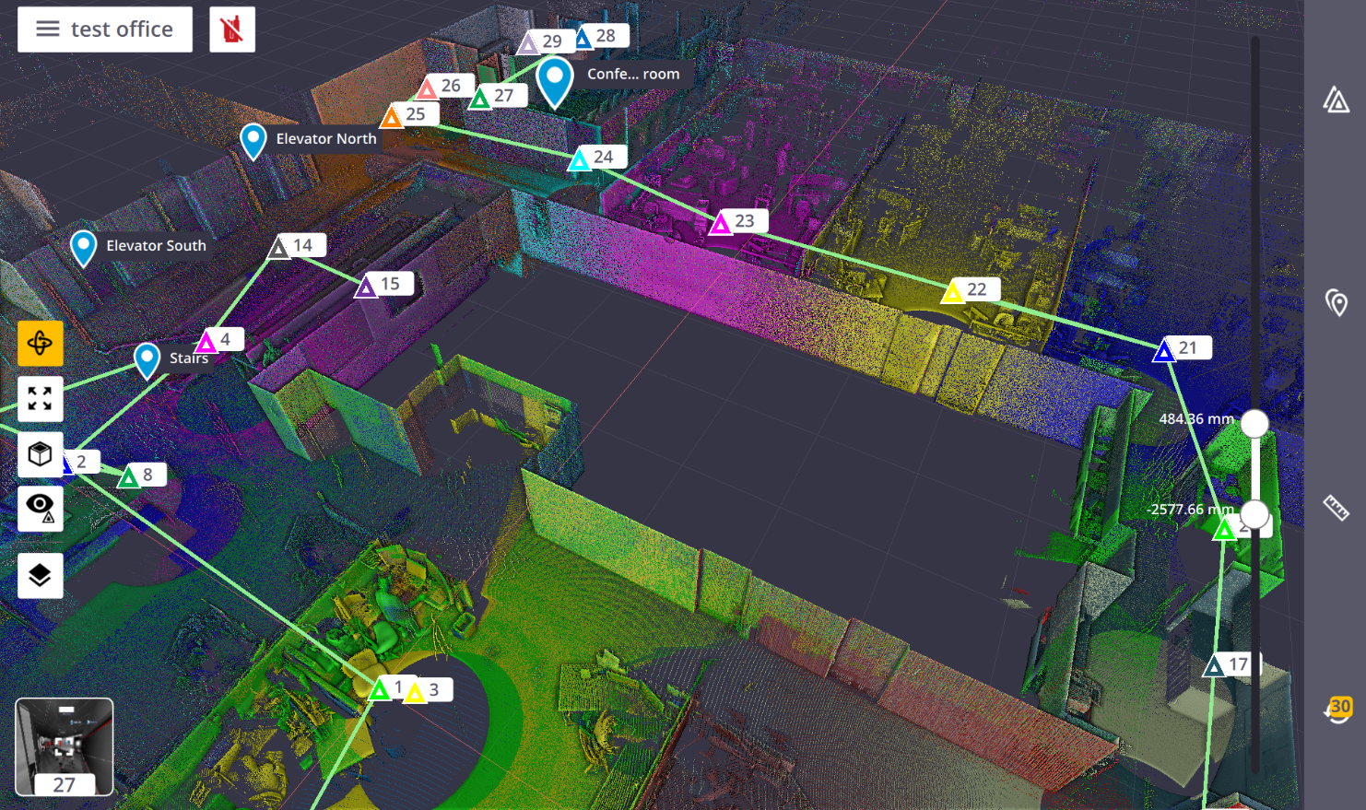
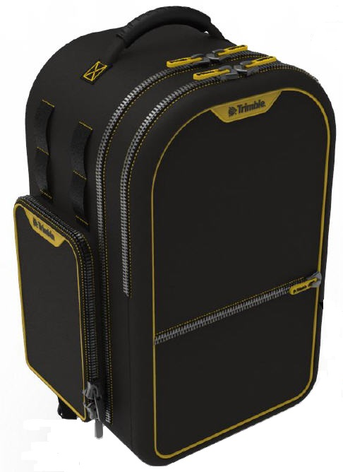
Trimble X7 System Overview
High-speed 3D laser scanning system with new innovations to simplify adoption, increase efficiency and provide confidence in the field.
Trimble X7 System
Trimble X7 3D Laser Scanner
Trimble Perspective Field Software
Custom Gitzo Series 3 Tripod
Custom Gitzo QR adapter
Custom Trimble Backpack
Additional System Components
Standard Trimble optical battery
Trimble RealWorks® and Trimble Business Center

Slide 8
Trimble X7 Key Features

Slide 9
Smart - Trimble X-Drive
World’s first dual vertical deflection scanning drive system integrating…
Survey-grade servo drive +
High speed laser scanning
Smart co-axial camera system
All in a protected center unit to enable…
First-ever auto-calibrating laser scanner
Productive image capture
Minimized parallax between scans and images

Slide 10
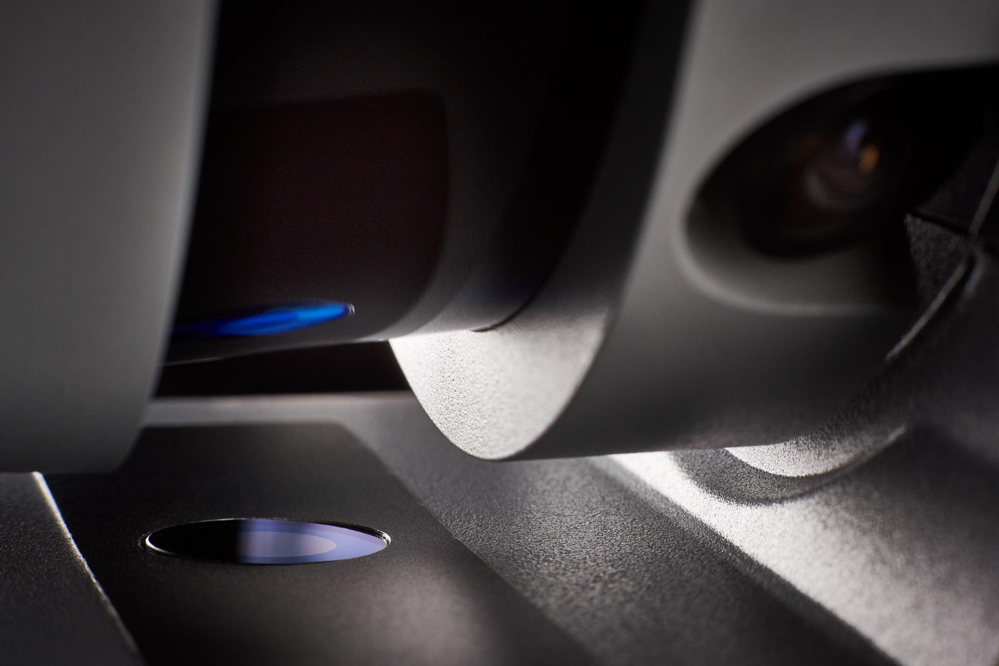
Smart - Trimble X-Drive: Auto Calibration
25 second Auto-calibration without targets
Ensure data accuracy on every scan
SMART calibration monitors instrument and environmental change to optimize the calibration process
Eliminate downtime from annual calibration service
Reduces maintenance cost
Lowers overall cost of ownership
Enables 2 year standard warranty

Slide 11
Simple - Trimble Perspective
Trimble Perspective Software, 3D scanning simplified
easy to adopt for new users
sophisticated control for experts
Intuitive user interface
3D data visualization
Automated Registration
Annotation and measurement
Seamless data integration

Slide 12
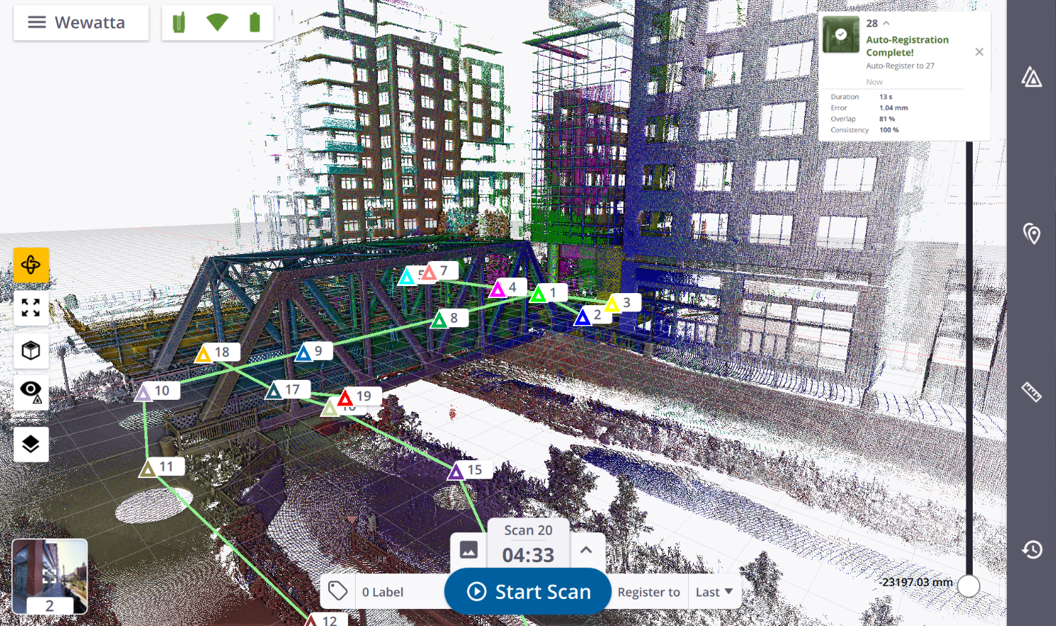
Smart - Automated Registration
Trimble Registration Assist
Automated IMU based registration
Register in the field to save time in the office
Ensure data is complete and correct before you leave the project site
Avoid costly rework and additional site revisits
Notes:
One of the most powerful features of Trimble Perspective Software is the Trimble Registration Assist. Combined with the scanners IMU, Trimble Registration Assist will automatically register scans as the are acquired. By default it will attempt to register to the previous scan. However, you may find that you need to move around your project in such a way that you may not be close to the last scan. In this case the software allows you to select which scan station you would like to register to. In the case that you don’t have an overlapping scan to register to Trimble Registration Assist will create a registration group which you can then register later.

Slide 13
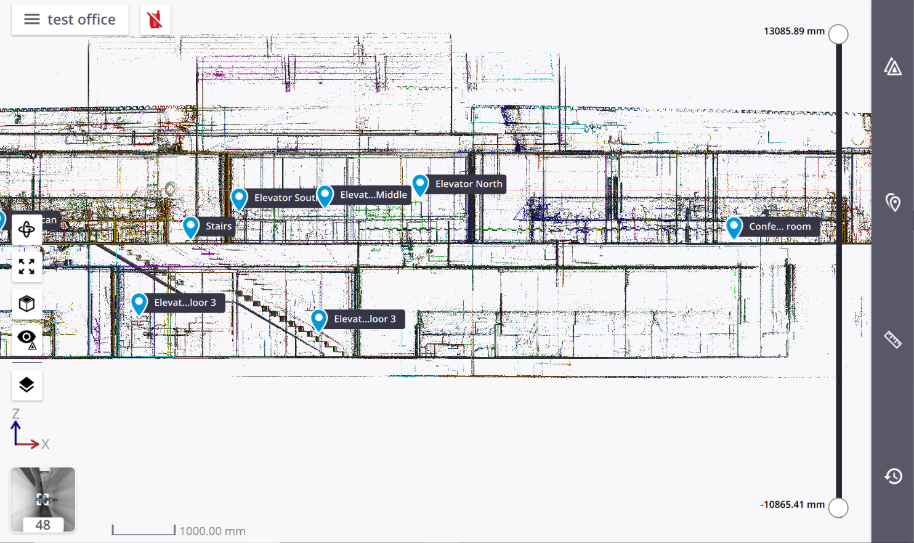
Professional - Labels and Annotations
Ensure field productivity, while ensuring data quality and accuracy
Document to control registration and project orientation
Help office personnel understand the scene
Available in both 3D and Station-based views

Slide 14
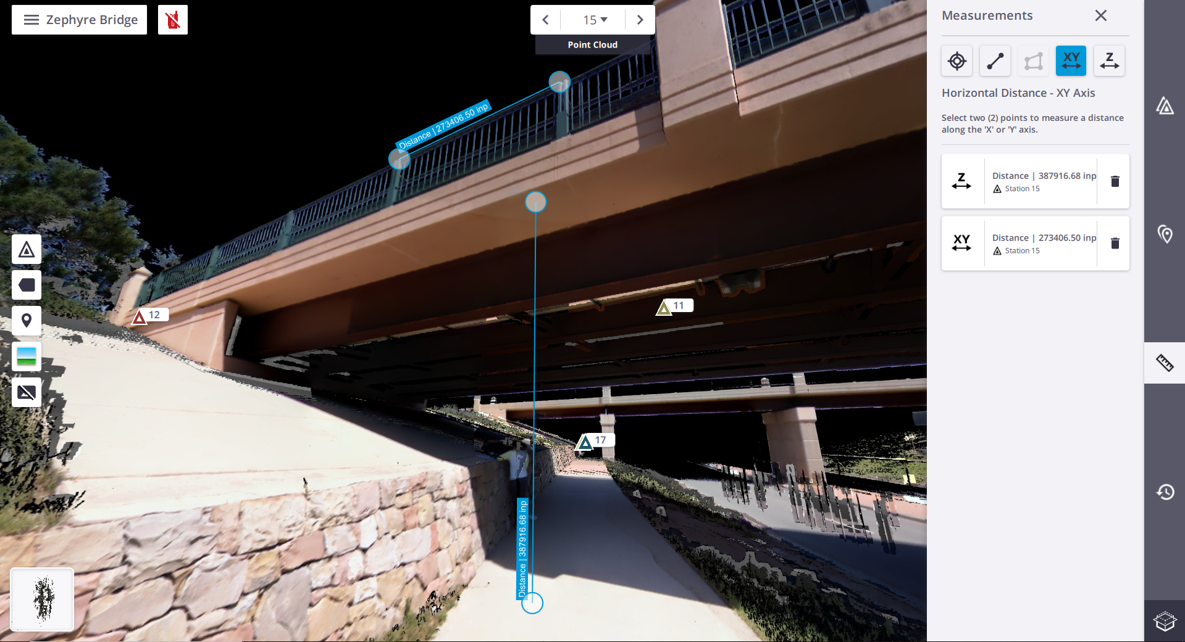
Measurement Types
Make decisions in the field
Constrained
Horizontal - station view only
Vertical - station view only
Area - top view only
Unconstrained
Single point coordinates - all views
Point to point - top view, side view, or station view
Notes:
Single point coordinate x,y,z from 3D, locked top/side view or station view
Point to Point measurement - locked top/side view or station view
Area - locked top view
constrained z clearance - station view only
constrained point to point in XY plane - station view only

Slide 15
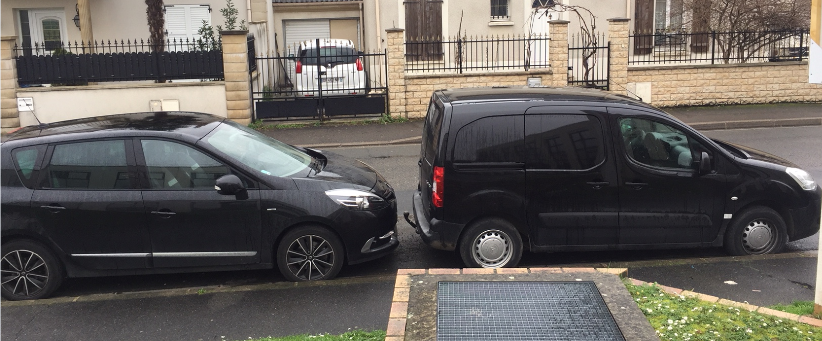
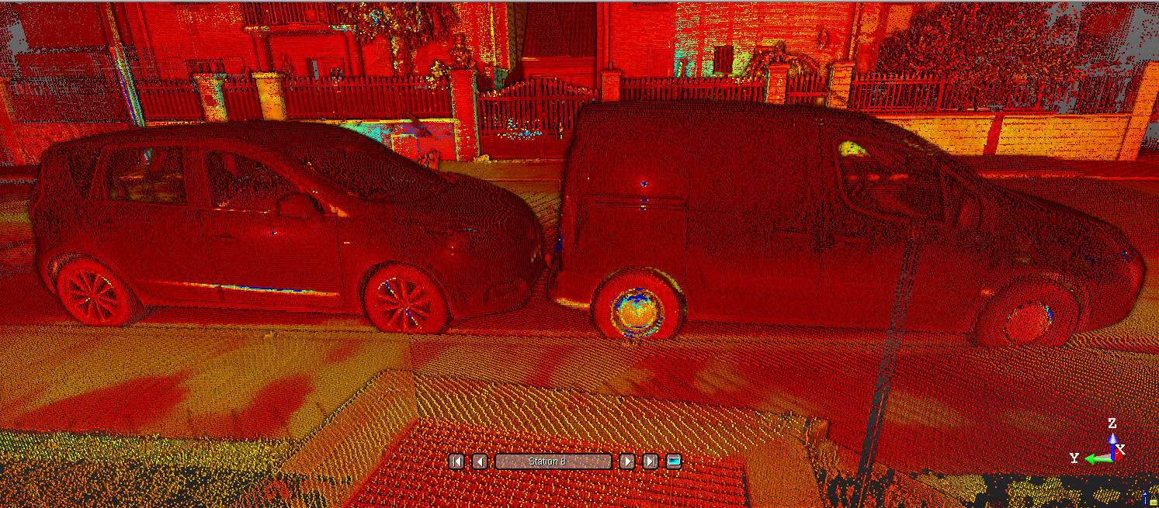
Digital Time of Flight EDM
Standard 500kHz
High Sensitivity mode 166kHz
Minimum range 0.6m
Maximum range 80m
Range accuracy 2mm
Range noise
<3mm @ 60m on 80% albedo
Field of view
360° x 282°
Capture difficult surfaces
Dark
Reflective
Shiny

Slide 16
Simple - Scan Duration and Spacing
Standard (STD) - simple, short range or light surfaces
High Sensitivity (HS) - complex, long range or dark surfaces
Duration¹ (Min) | Scan Mode | Spacing (mm) @ 10m | Spacing (mm) @ 35m | Spacing (mm) @ 50m | Number of Points (Mpts) | Max File Size (MB)
2 | Standard | 11 | 40 | 57 | 12 | 160
4 | Standard | 5 | 18 | 26 | 58 | 420
 | High Sensitivity | 9 | 33 | 47 | 17 | 190
7 | Standard | 4 | 12 | 18 | 125 | 760
 | High Sensitivity | 6 | 21 | 30 | 42 | 330
15 | High Sensitivity | 4 | 13 | 19 | 109 | 710
1 - Duration is rounded up to the nearest minute and includes longest calibration time

Slide 17
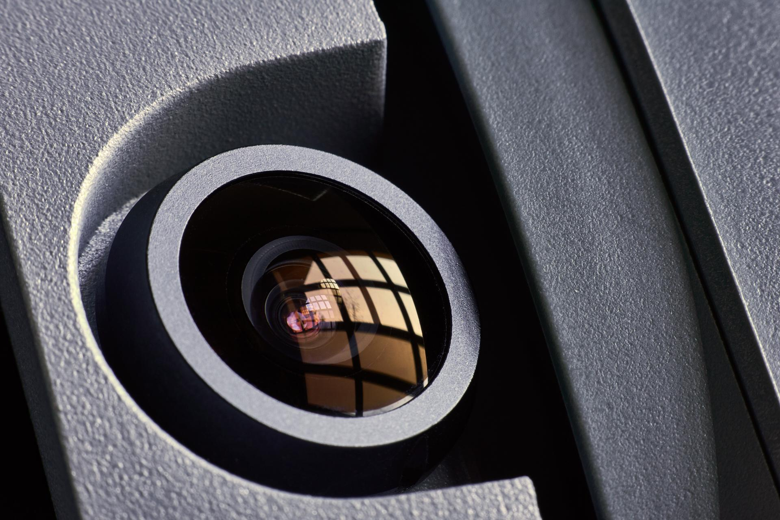
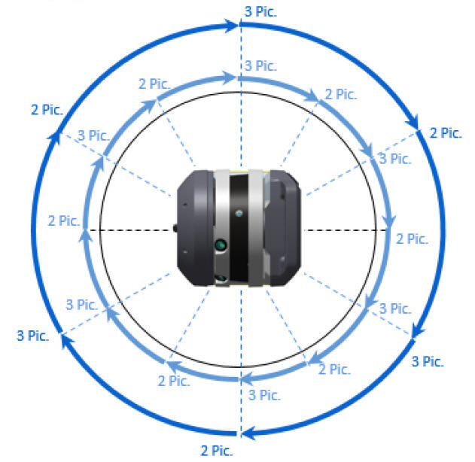
Smart - Trimble VISION 360
3 Coaxial 10MP integrated cameras
Fast image capture
Fast 15 images (6 positions) in 1 min
Quality 30 images (12 positions) in 2 min
360° x 282° FOV
Fast mode 158 MP (Raw data capture)
Quality mode 316 MP (Raw data capture)
White Balance
Indoor and Outdoor Presets
Auto
Notes:
KEY: THIS DOESN’T INCREASE THE MPX RESOLUTION OF THE PANO. THE PANO IS 65MP EITHER WAY!

Slide 18
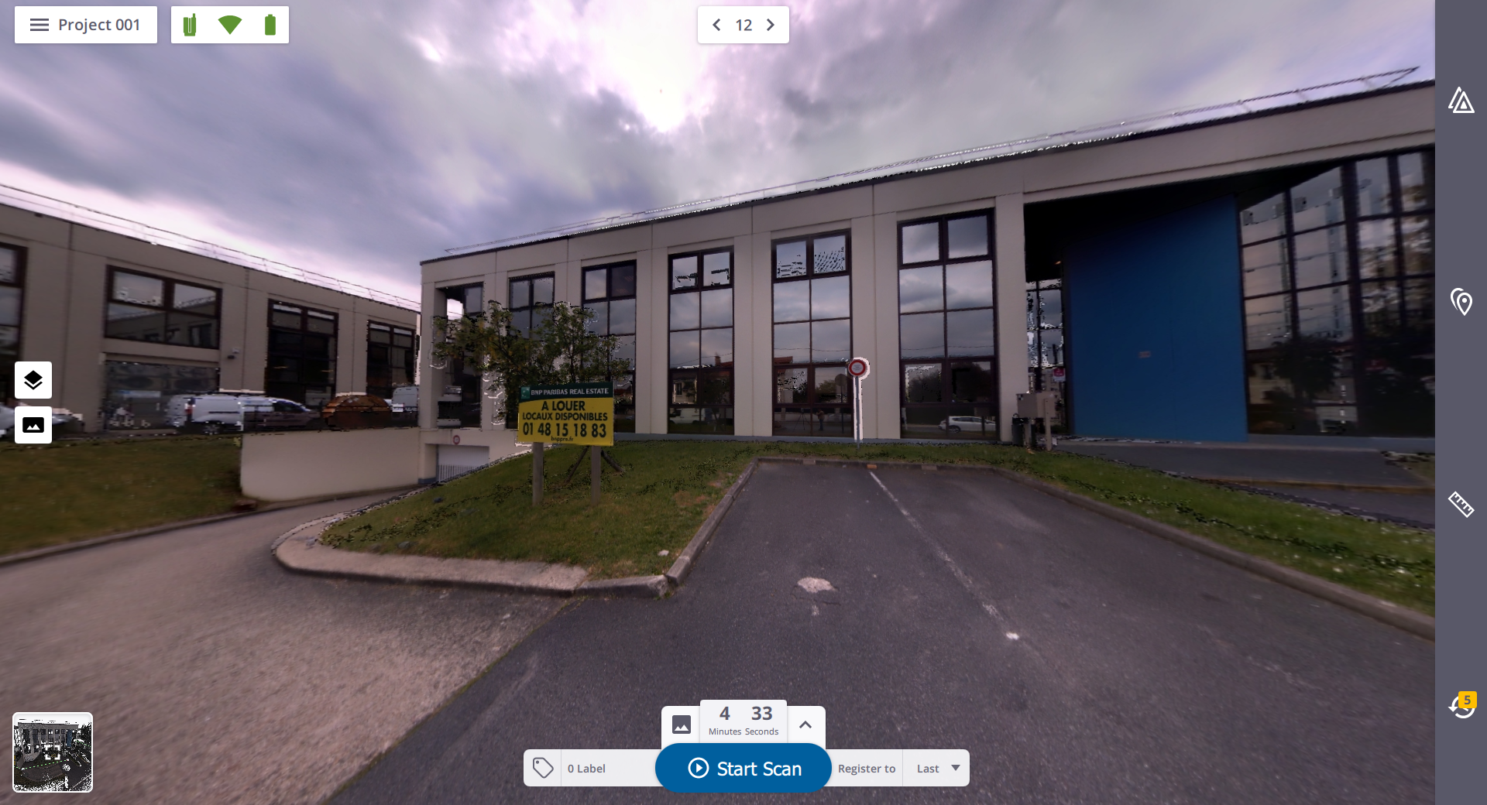
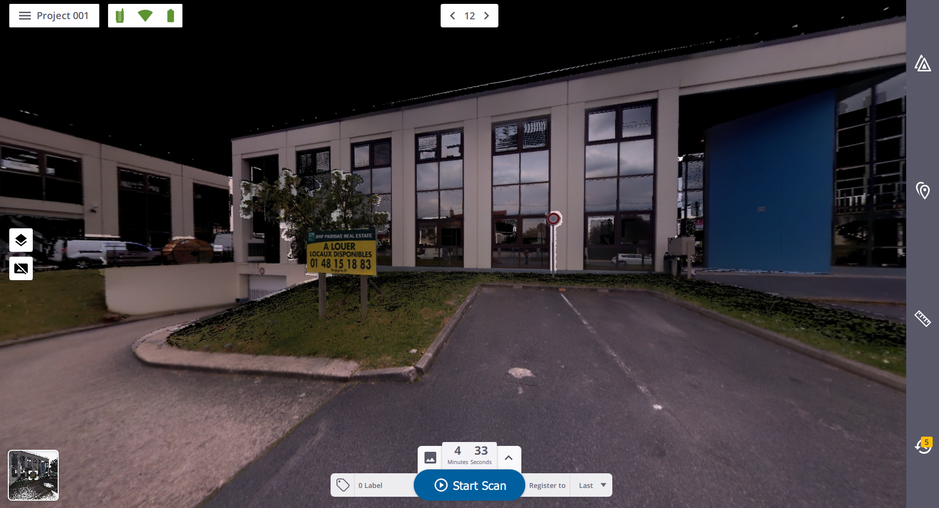
Smart - Trimble VISION 360
Fast, clear color imagery
Full field of view panoramas
Colorized point clouds

Slide 19
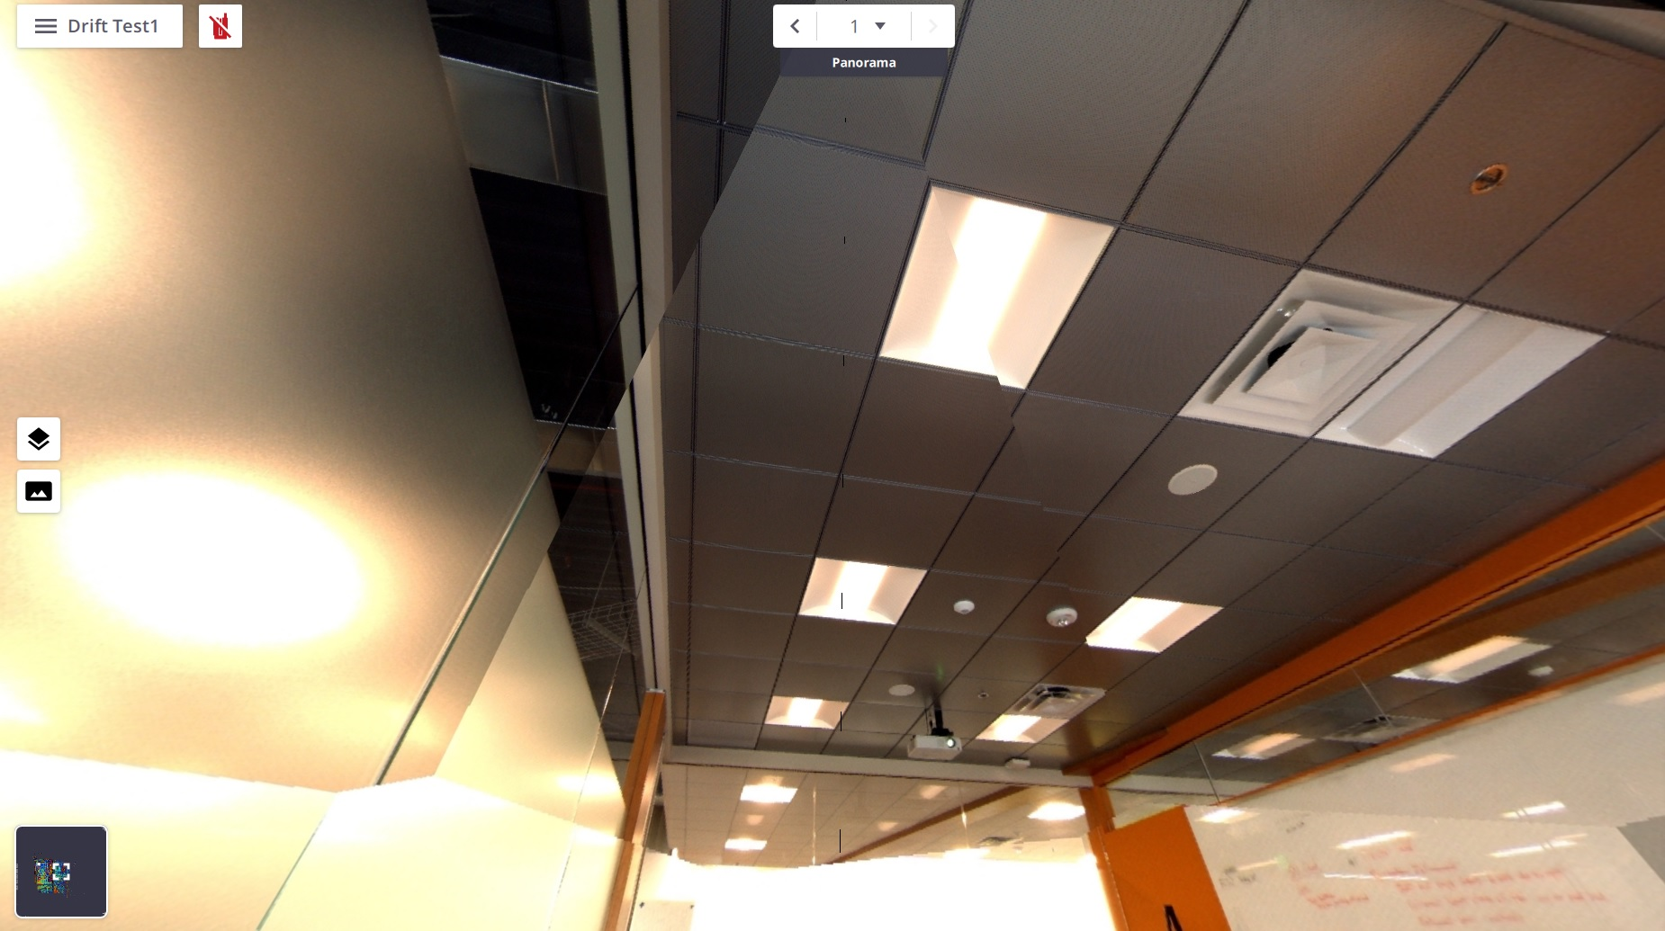
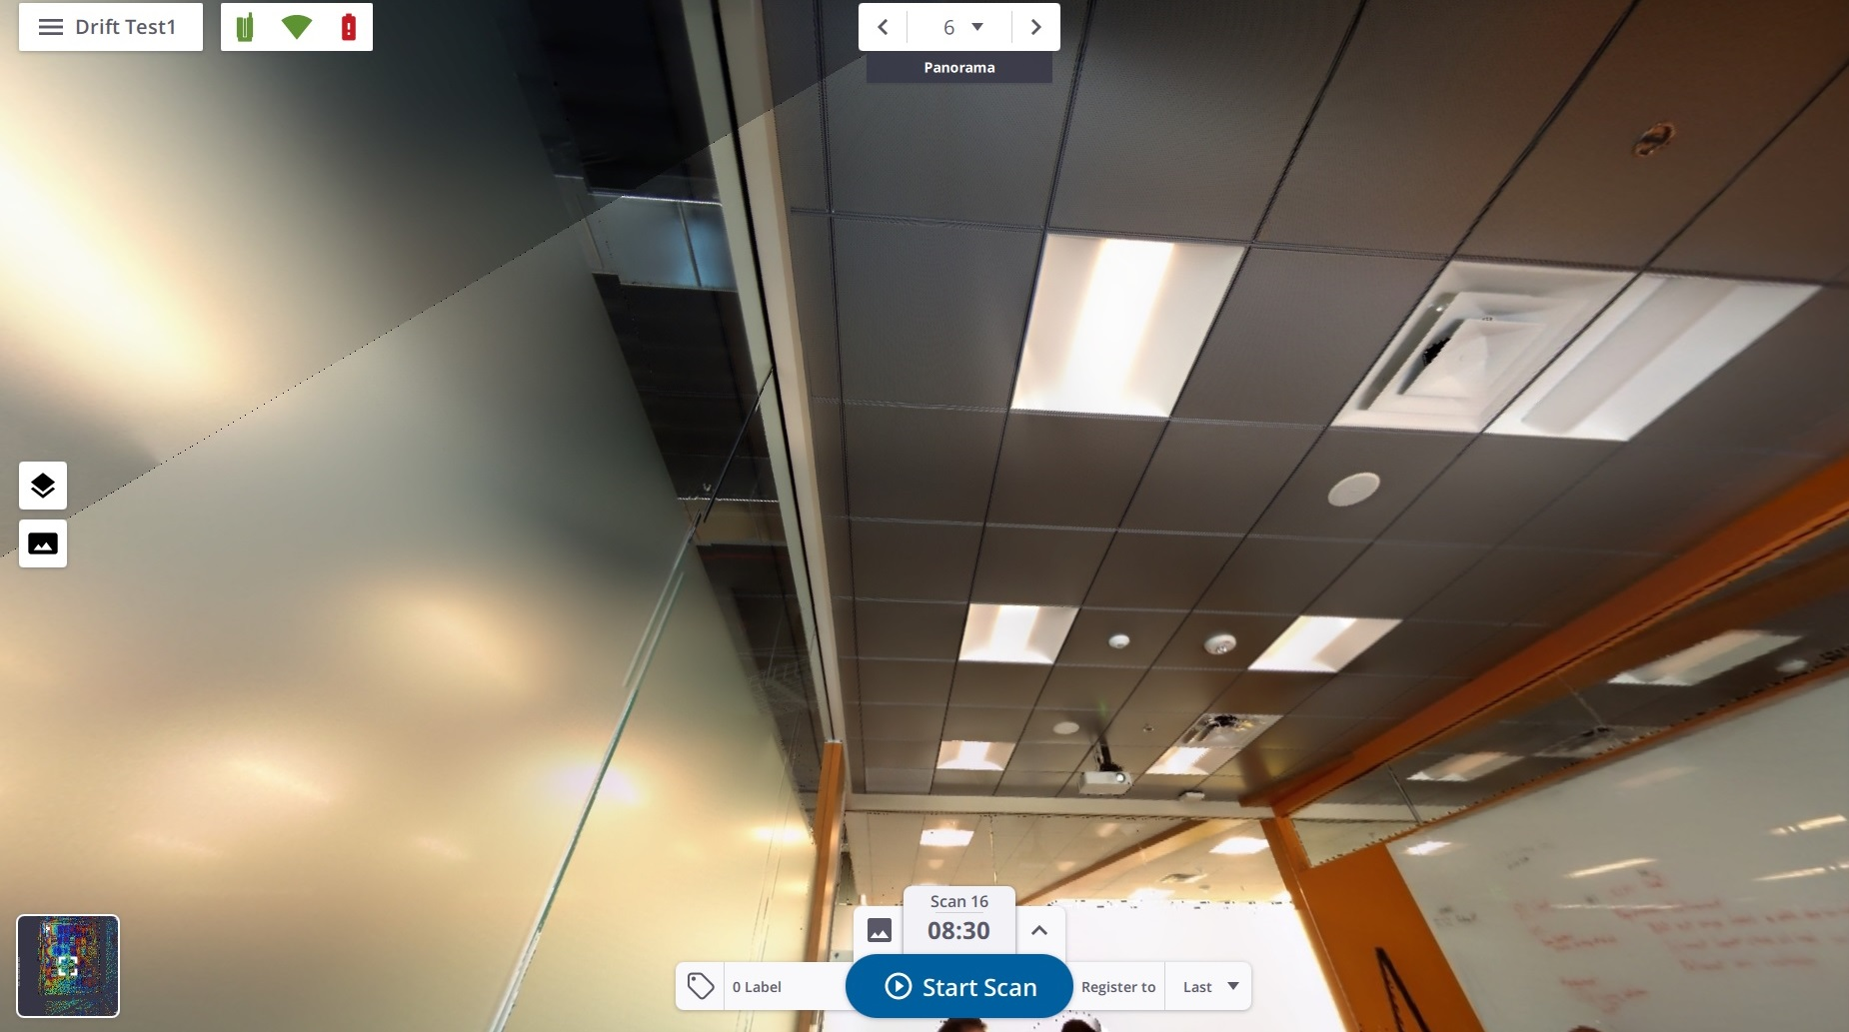
Smart - Panorama Creation
Fast & Quality Panorama creation
Fast in-field Panorama creation
Uses fixed distance to minimize mismatches
No blending or occlusion correction
Better for simple scenes
Fast to preserve battery power
Quality export panorama creation
Uses the real pointcloud distance to minimize mismatches.
Better on complex scenes
Blending to smooth discontinuities between images
Quality to give the best customer experience

Slide 20
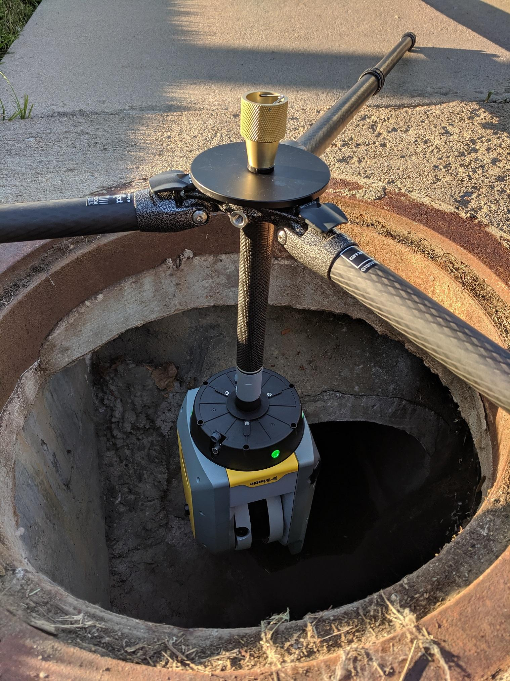
Smart - Automatic Level Compensation
No compromise between accuracy and Productivity
Survey-grade accuracy < 3 arc seconds within ±5°
Level accuracy on setups > ±5°
Working range up to 45° tilt for coarse leveling
Automates field workflows to reduce error and save time
Less field expertise required
User configurable On/Off
Note: Off will disable auto-registration
Real time level monitoring stops scan if disrupted
Notes:
Discuss best practices for Trade show during the presentation.

Slide 21
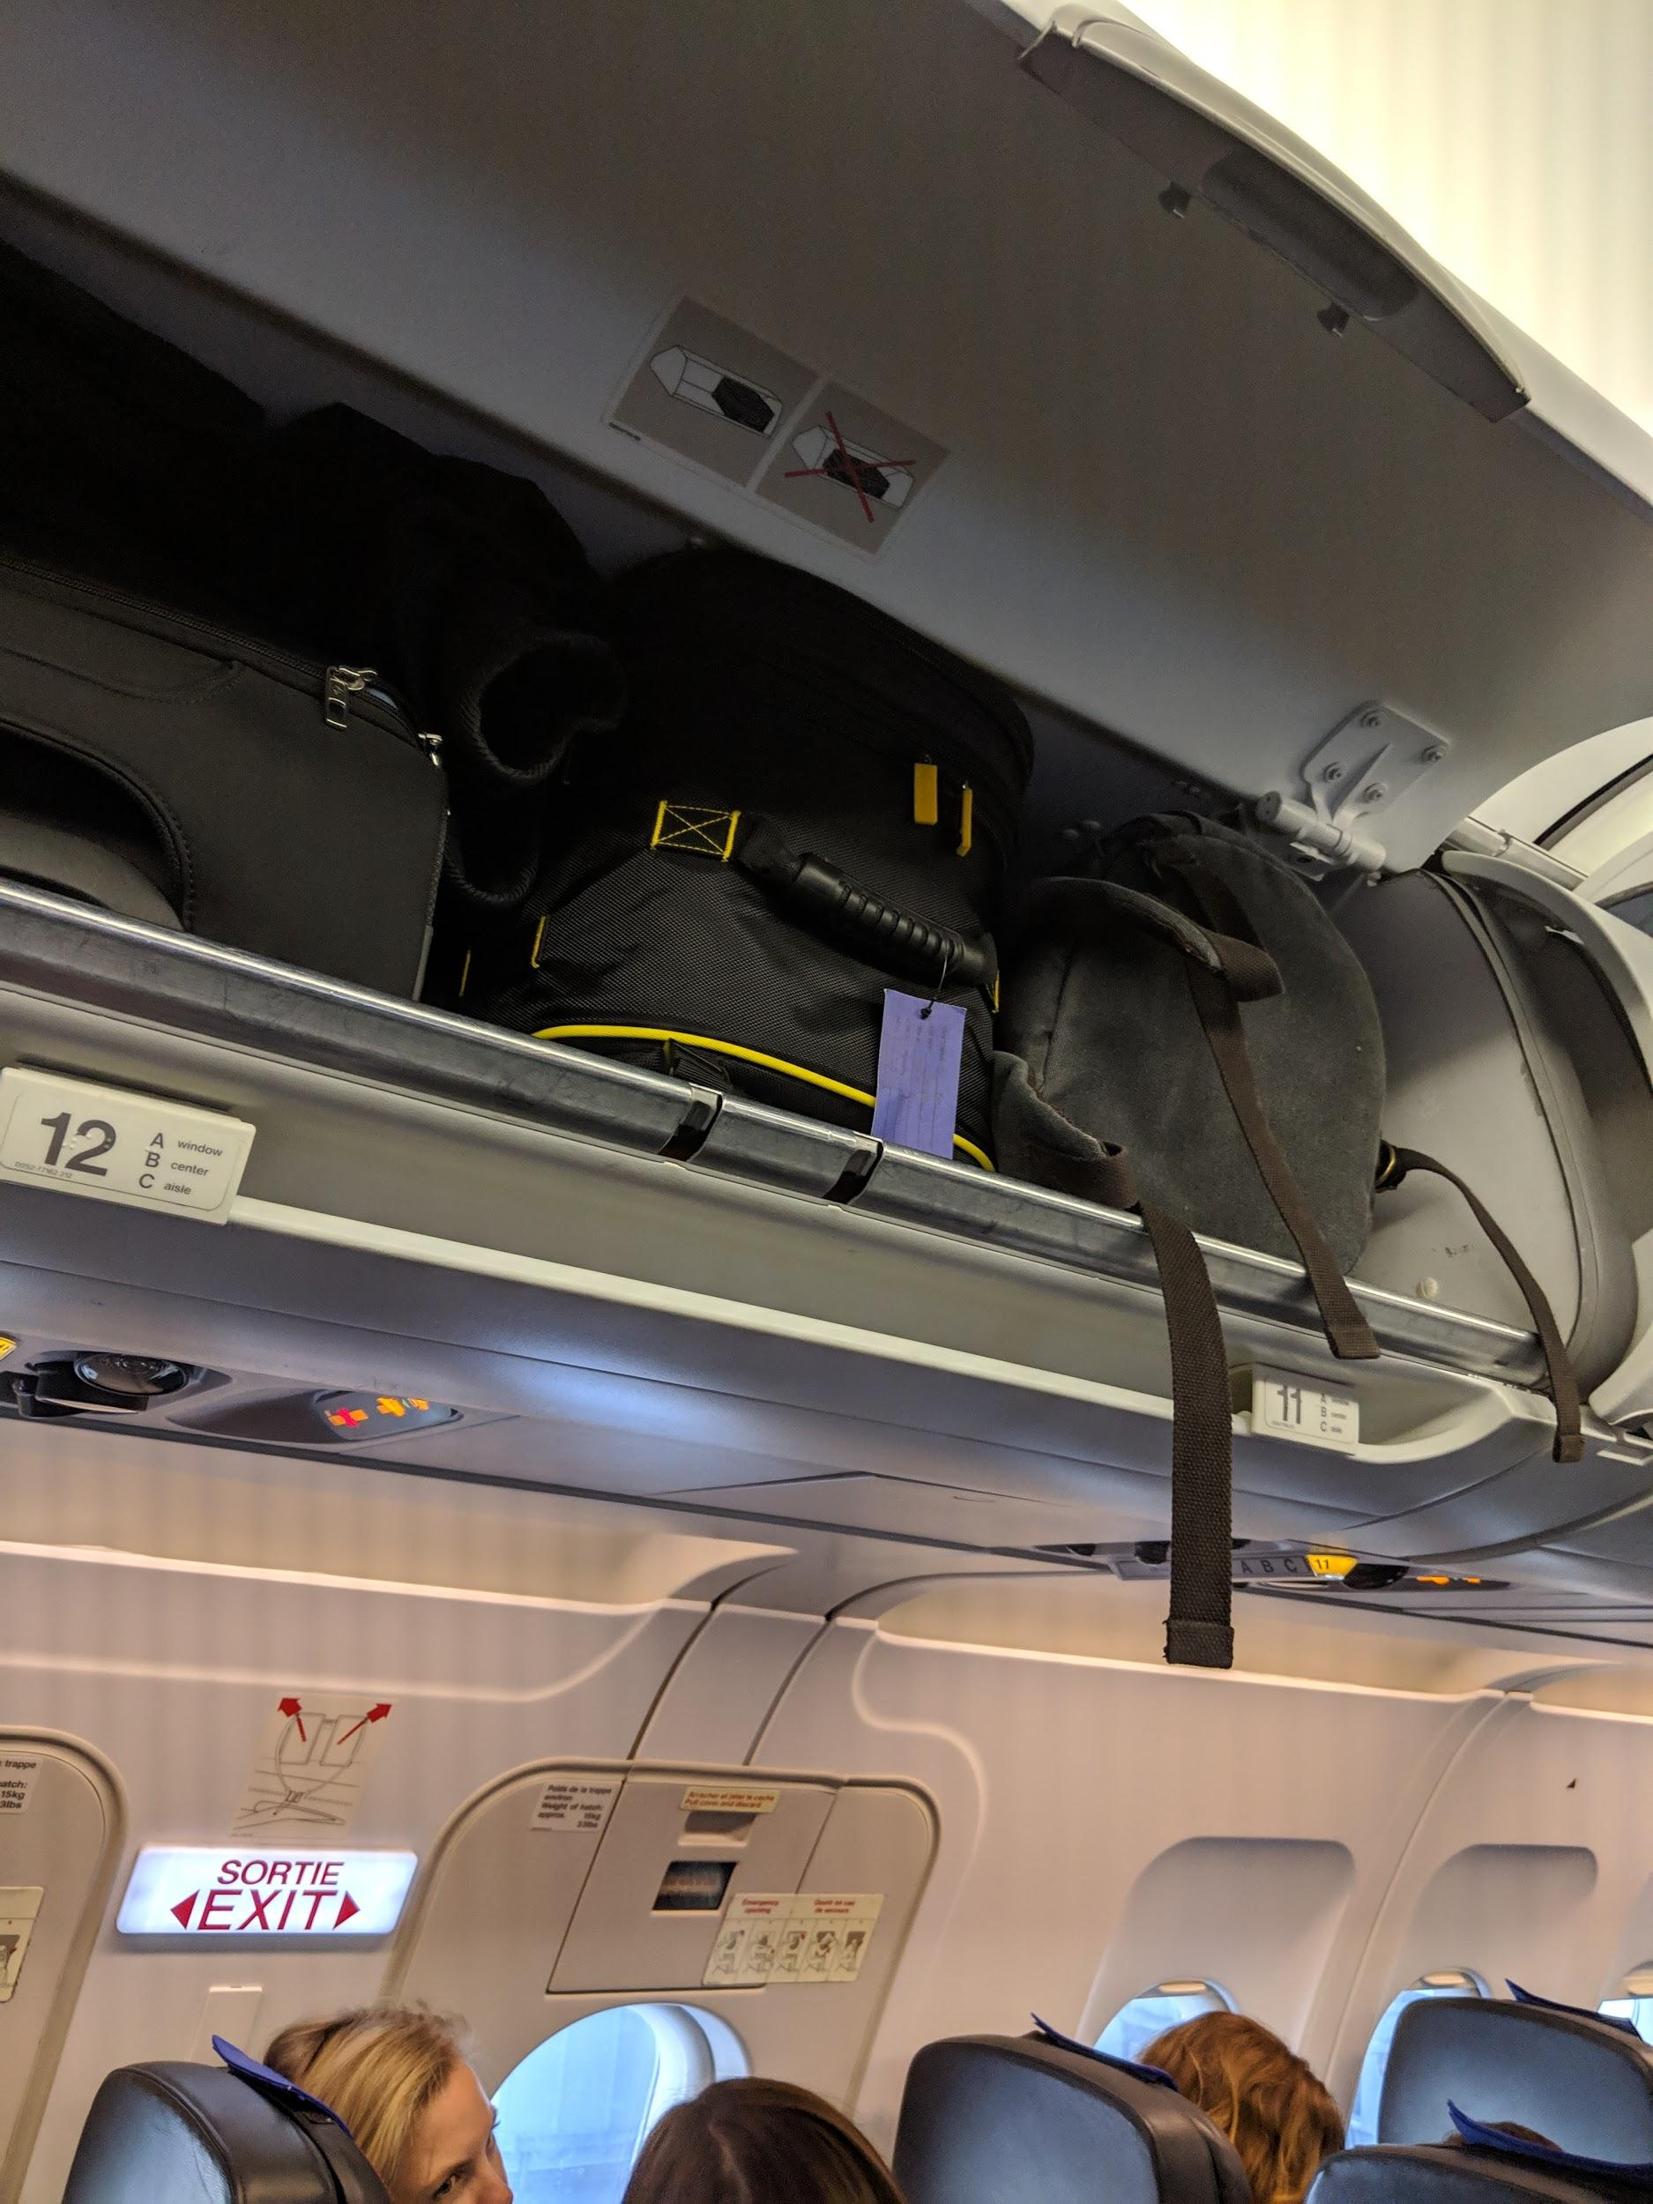
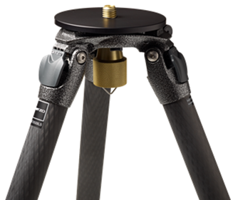
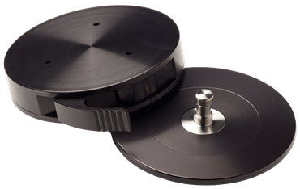
Simple - Compact and Portable
Perfect size for stability and transportability
5.8 kg with battery
Scanner Dimensions: 178 mm W x 350 mm H x 170 mm D
Custom backpack
Easy transport at the job site
Carry-on compliant for most airlines
Custom Gitzo Series 3 Tripod
Lightweight and easy transport
Quick release adapter

Slide 22
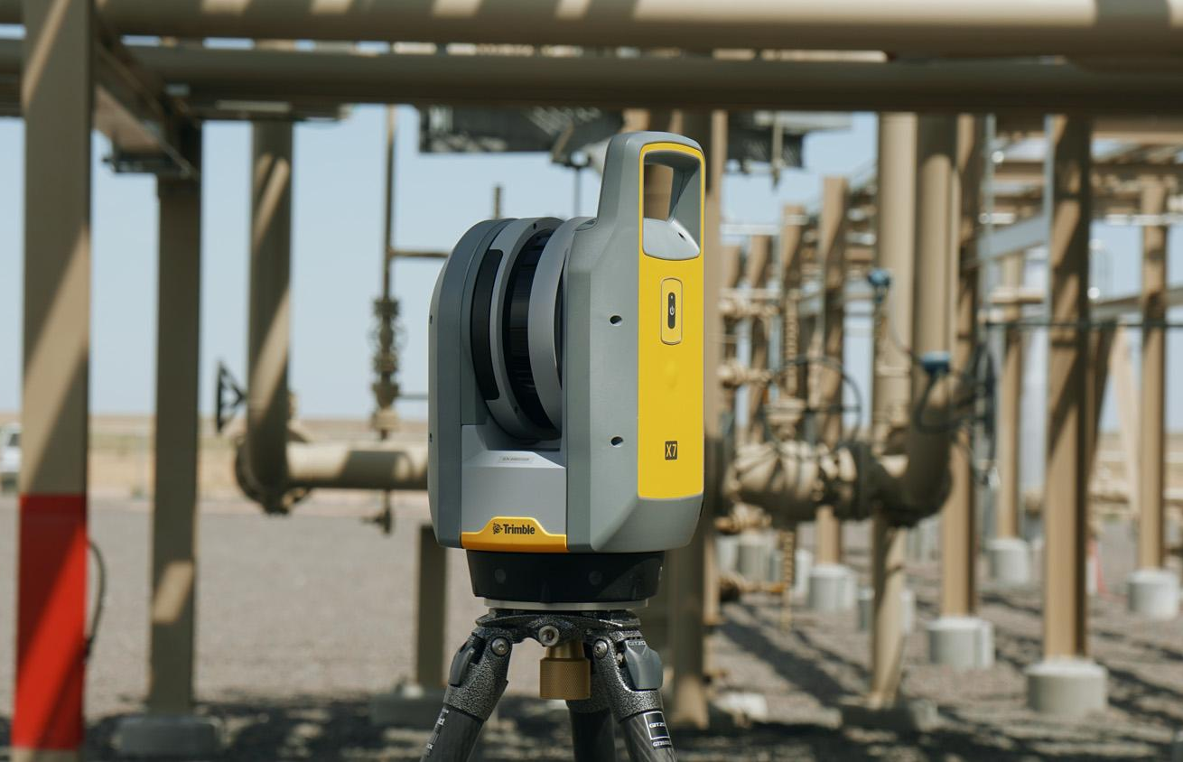
Professional - Scanner Reliability
Instrument built for demanding applications
Operating temperature
–20°C to +50°C (–4°F to 122°F)
Rugged, durable and trusted
IP55 (Ingress Protection for dust and water jet)
Enclosed scanning mirror is safe, clean and robust
Advanced deflection drive technology
Highly reliable, long lifetime
Low friction and power consumption
No noise…you can’t hear it running!
Industry leading, 2-year Trimble Optical Warranty
Made in Jena, Germany

Slide 23
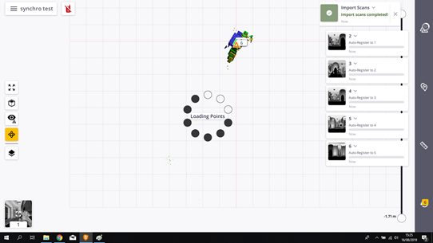
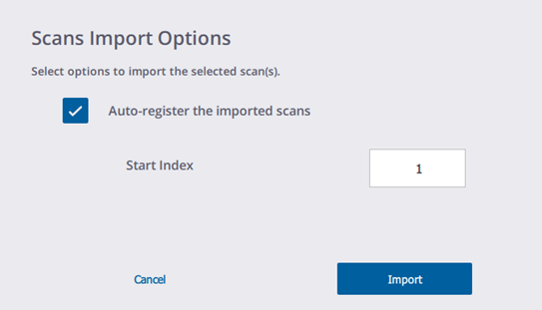
Workflow Flexibility
Workflow options
Tablet - Connected to Perspective
Data syncs back to tablet and is registered in real time
Push Button - Connected
Scanner uses last scan settings
Data syncs back to tablet and is registered in real time
Push Button - Disconnected
Scanner uses last scan settings
Data imported later at user convenience and registered automatically in sequence

Slide 24
Professional - Seamless Data Integration
Or any other software that can import point clouds!

Slide 25
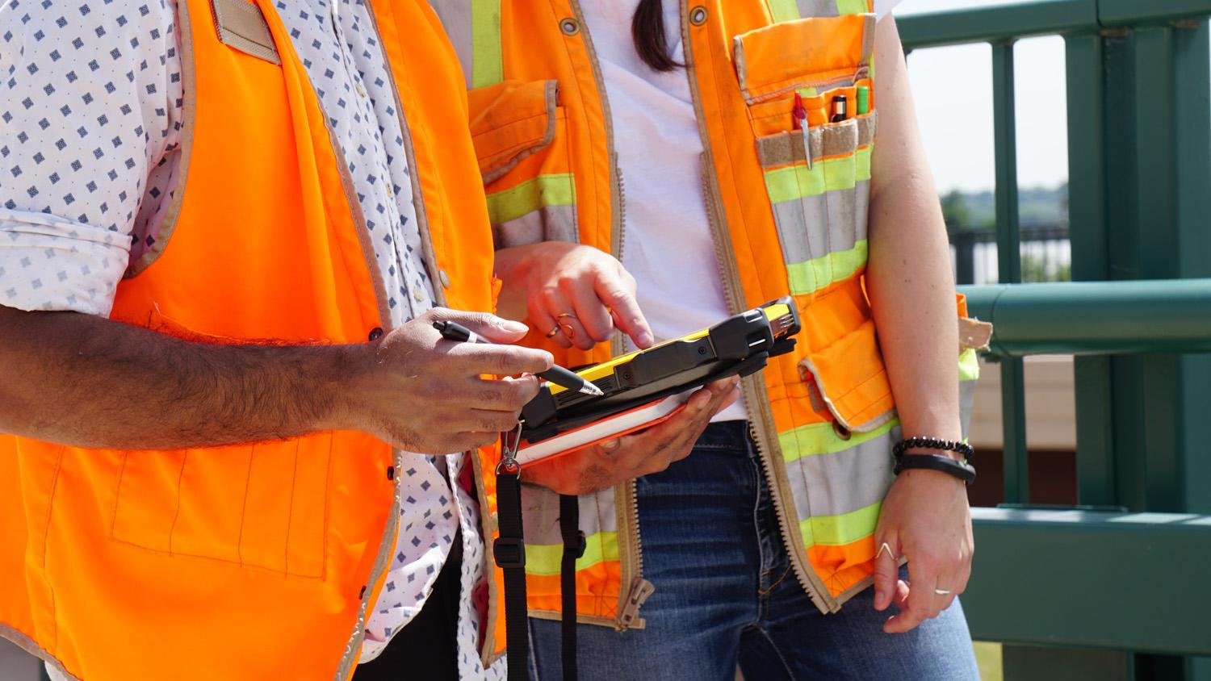
Professional - Data Integration
Point Cloud Exports
E57 / LAS (Industry Standard formats)
RCP (Autodesk, including ReCap, Revit, Civil3D, Navisworks)
POD (Bentley format)
PTX (Leica)
Trimble Office Software (TZF / TDX)
Trimble RealWorks
Trimble Business Center
Other Trimble solutions - Trimble RealWorks Forensics, Tekla, SketchUp, Trimble EdgeWise

Slide 26
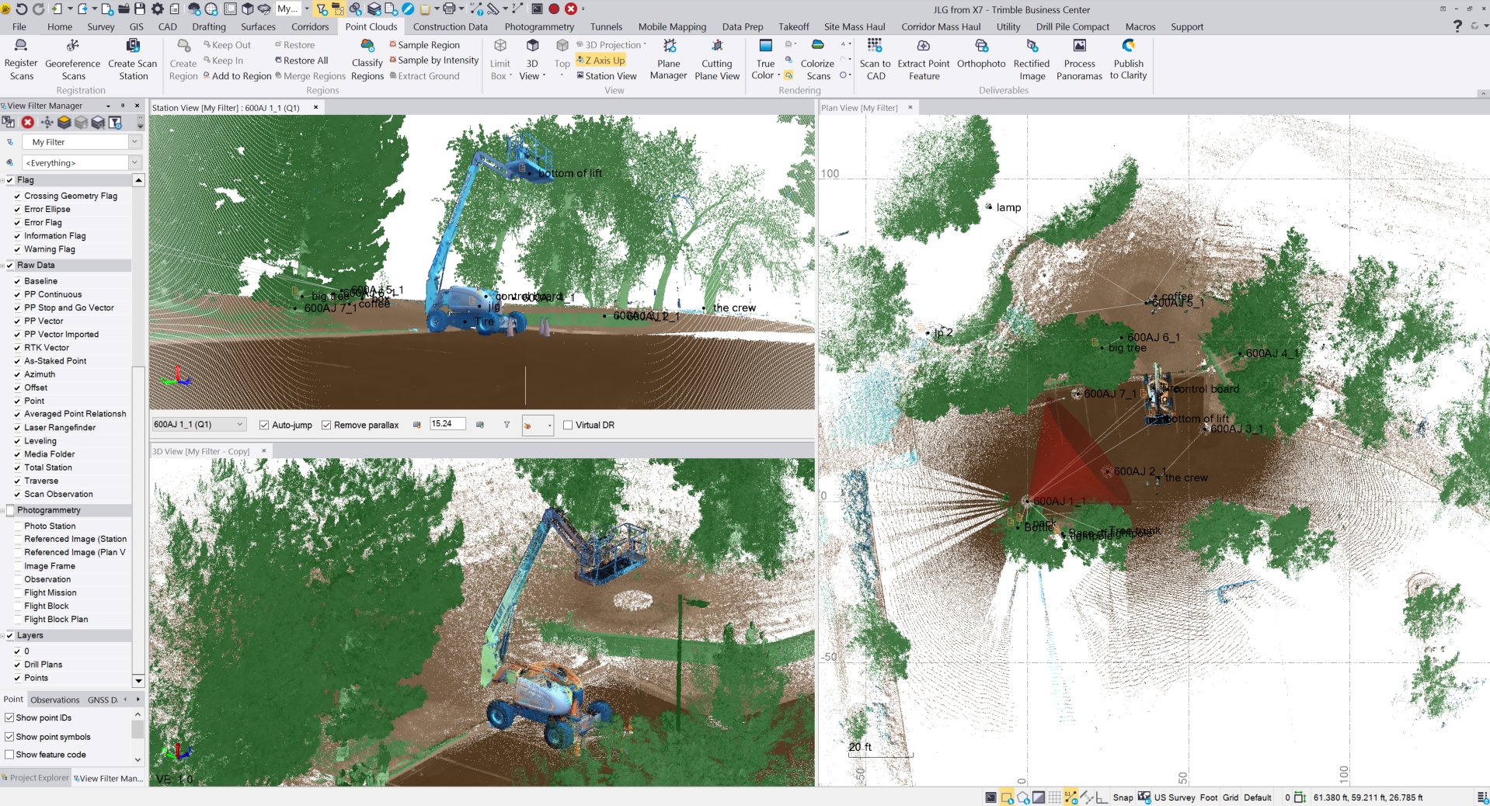
Trimble RealWorks & TBC Integration
Simple drag + drop Trimble Perspective data files from the Trimble X7 scanner
Support for Perspective’s scan labels + field annotations within existing TRW & TBC features to eliminate learning curve
X7 scan data integrates seamlessly with TRW & TBC’s scanning workflows

Slide 27
Customer and Application

Slide 28
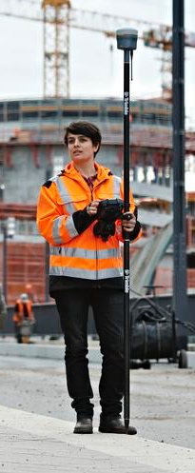
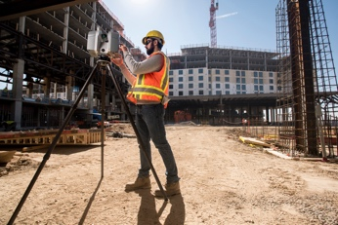
Customer Segmentation Overview
New 3D Scanning User
Needs easy integration into their workflow
Must provide ROI with small budgets
Trimble Fan….Except Scanning
Values Trimble’s Legacy of workflow productivity and professional reliability
Knows the Trimble ecosystem
Existing 3D Scanning User
Understand scanning ROI
Looking to expand business capacity
Established process and data workflows
Simple
Smart
Professional

Slide 29
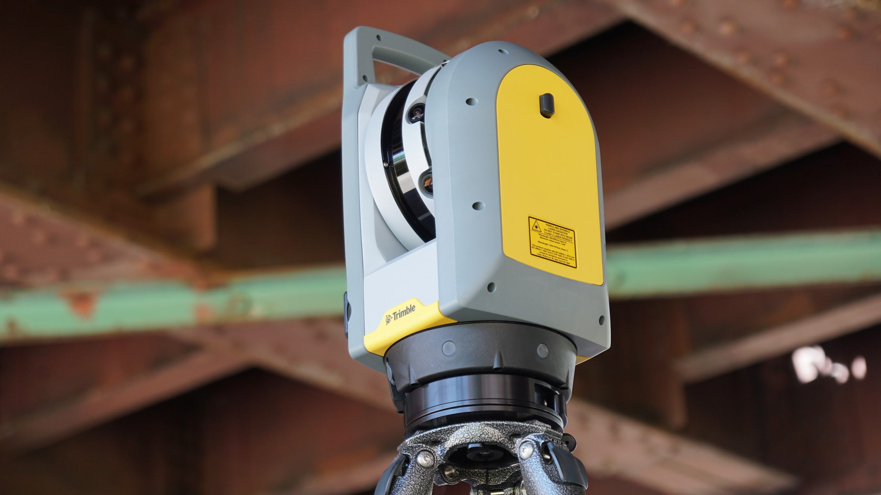
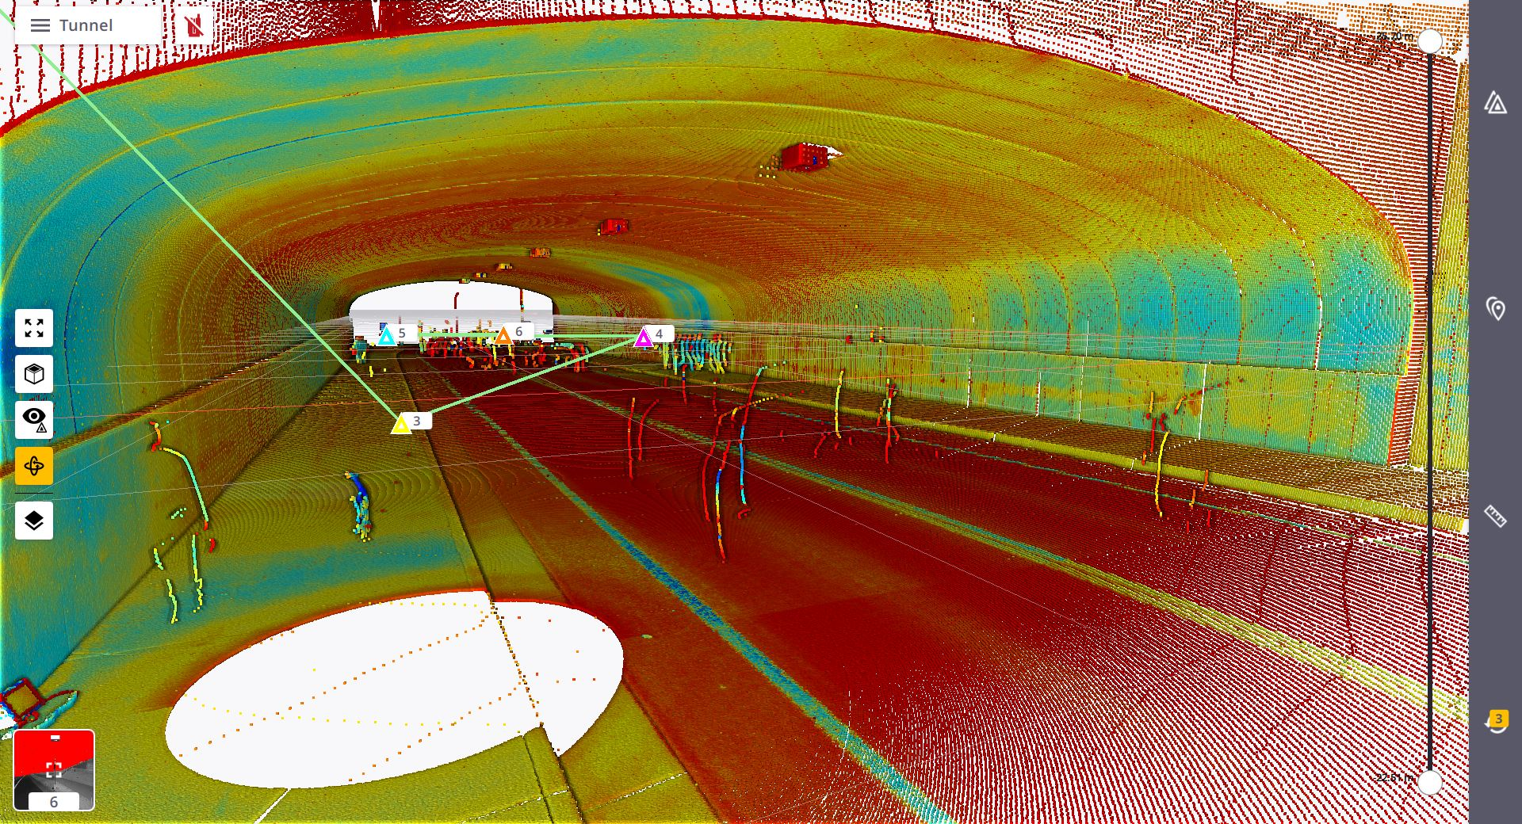
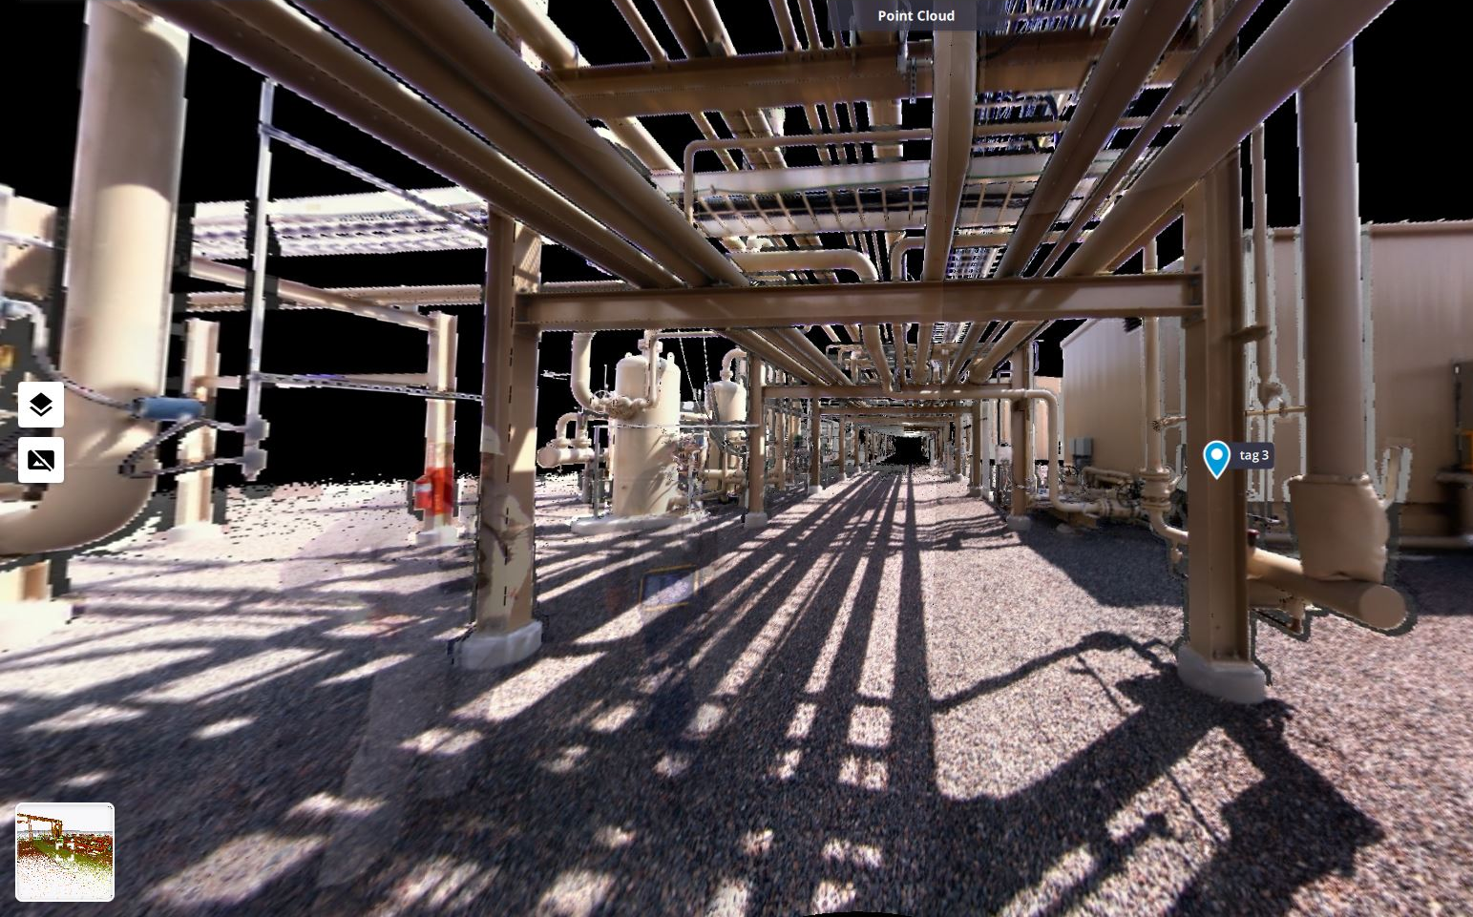
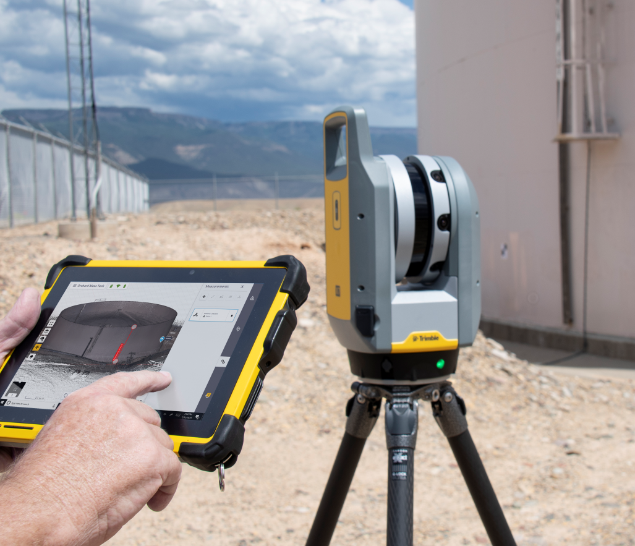
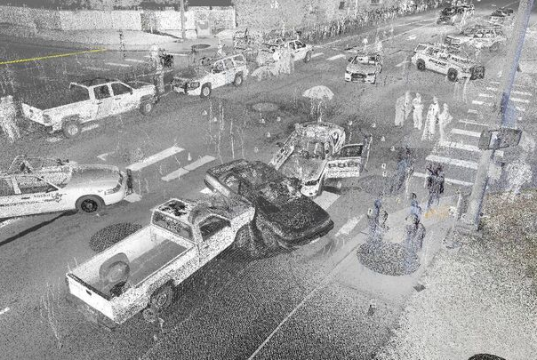
Top Applications
Building Construction/Facility Management
Industrial Surveys
Civil Infrastructure
Topographic/General Surveys
Forensics
Utilities
Marine Construction
Underground Mining
Cultural Heritage
Tank Calibration & Inspection

Slide 30
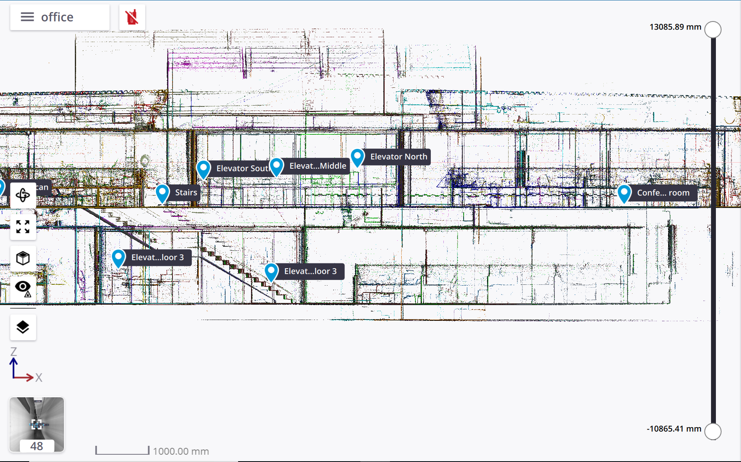
Building Construction / Facility Management
Survey Services for Buildings. Condo maps, facade elevations or large facility management
Labels to help group assets locations by floors
Annotations to call out specific areas of interest in scan data for office personnel
Ensure all areas are captured with in field registration
Survey grade leveling for accurate floor flatness routines without additional control

Slide 31
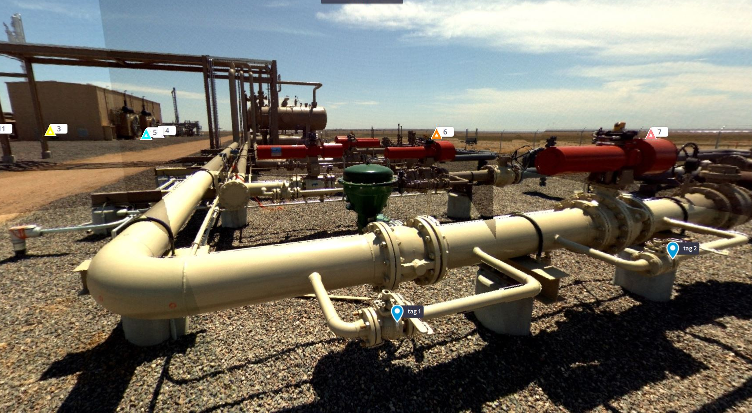
Industrial Surveys
Versatility from small as-builts & retrofits, to large capital projects
Quickly capture complex scenes
Capture difficult objects (dark surfaces, Shiny pipes)
Ensure your data is complete, via registration assist
Increase data processing productivity by annotating (P&ID) labels while in the field

Slide 32
Civil Infrastructure
When safety and speed are a major concern
Comprehensive fast data capture from a safe setup
Reduce traffic control burden
Increase worker safety
Ensure data completeness without site revisits

Slide 33
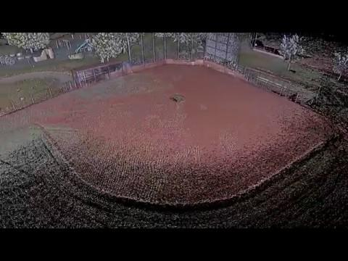
Topographic / General Survey
Improved visibility on all projects
Complete site details
Fast data collection
Survey-grade leveling for accurate topo on assumed project coordinates without targets or extra control

Slide 34
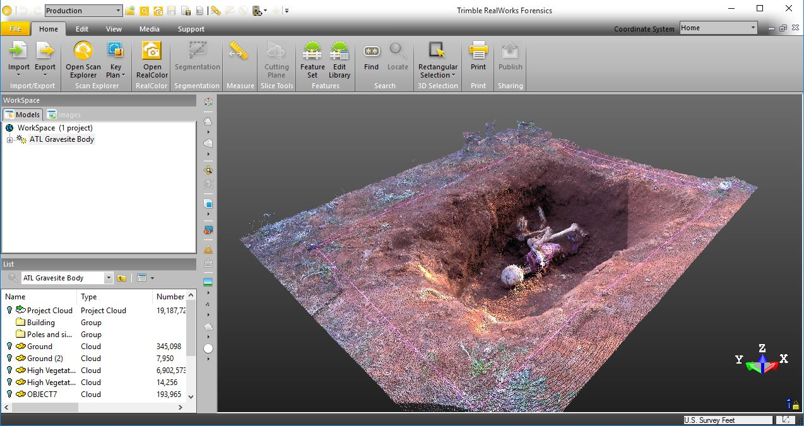
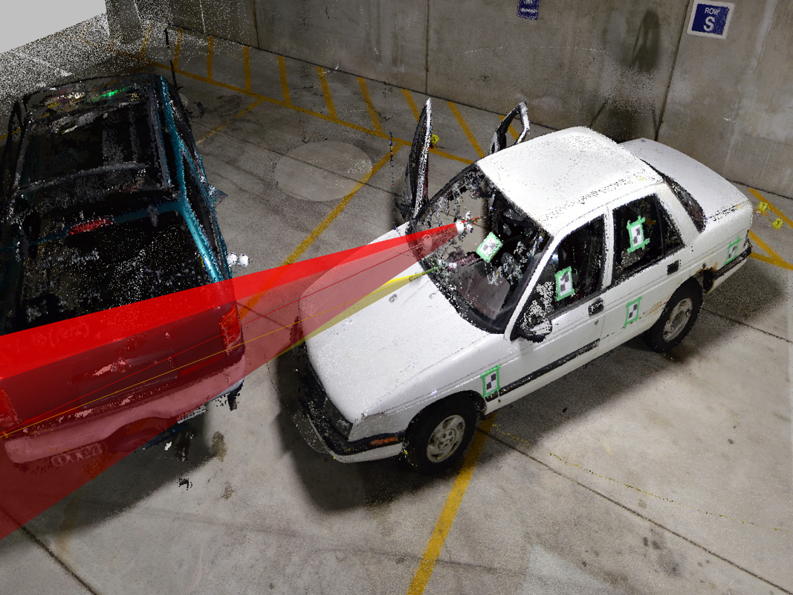
Forensics
Improved visibility on all projects
Complete scene visibility
Evidence annotations for critical markets
Measurements in the field
Fast setup times including image capture to quickly open highways
Fully Registered in the field

Slide 35
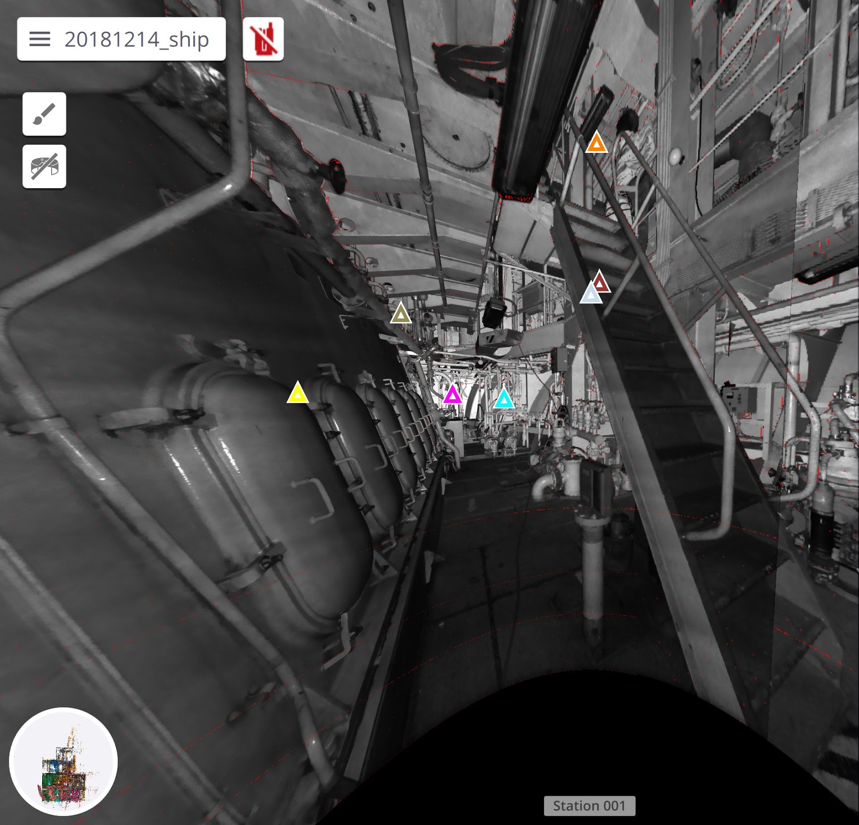
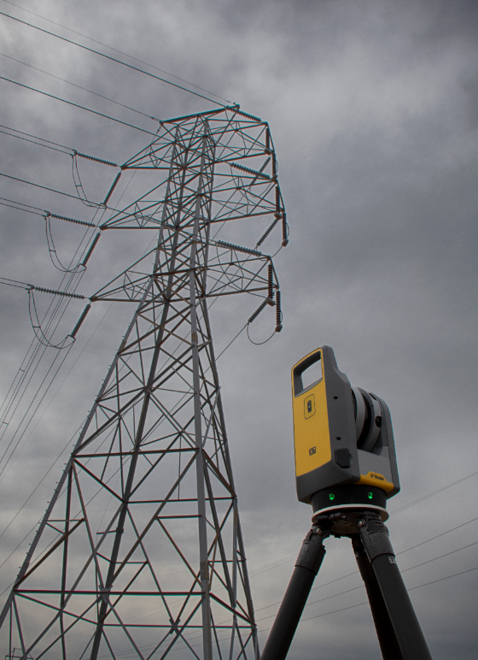
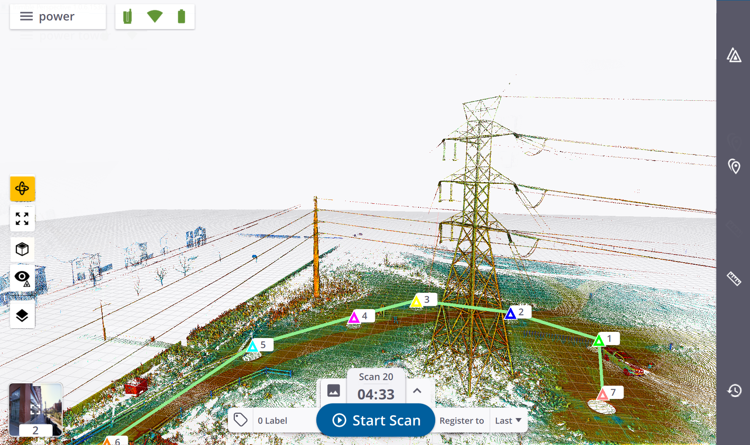
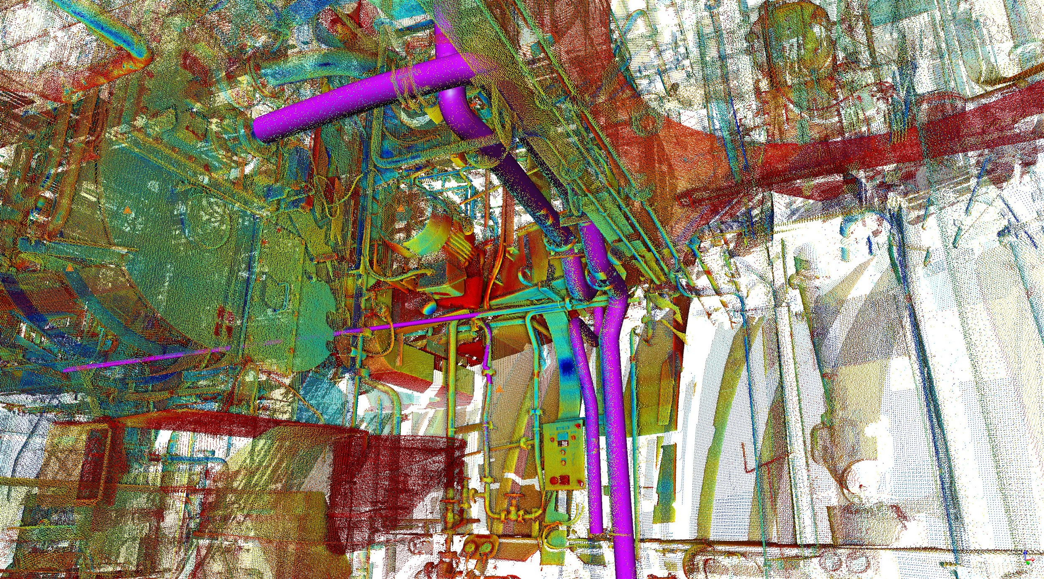
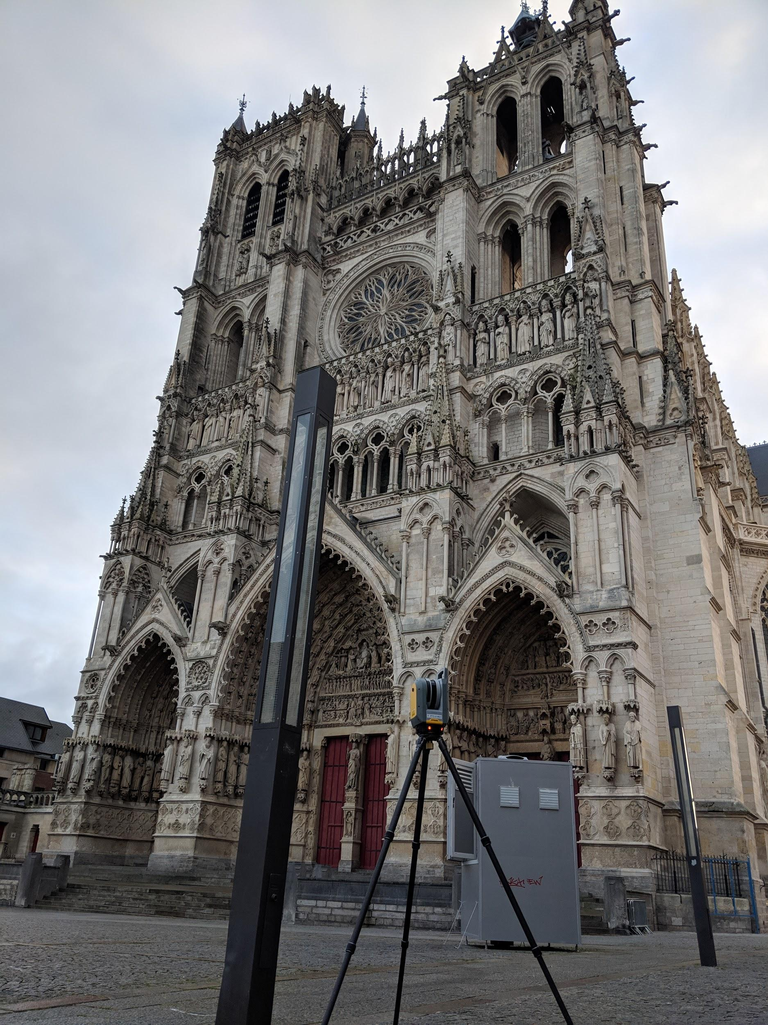
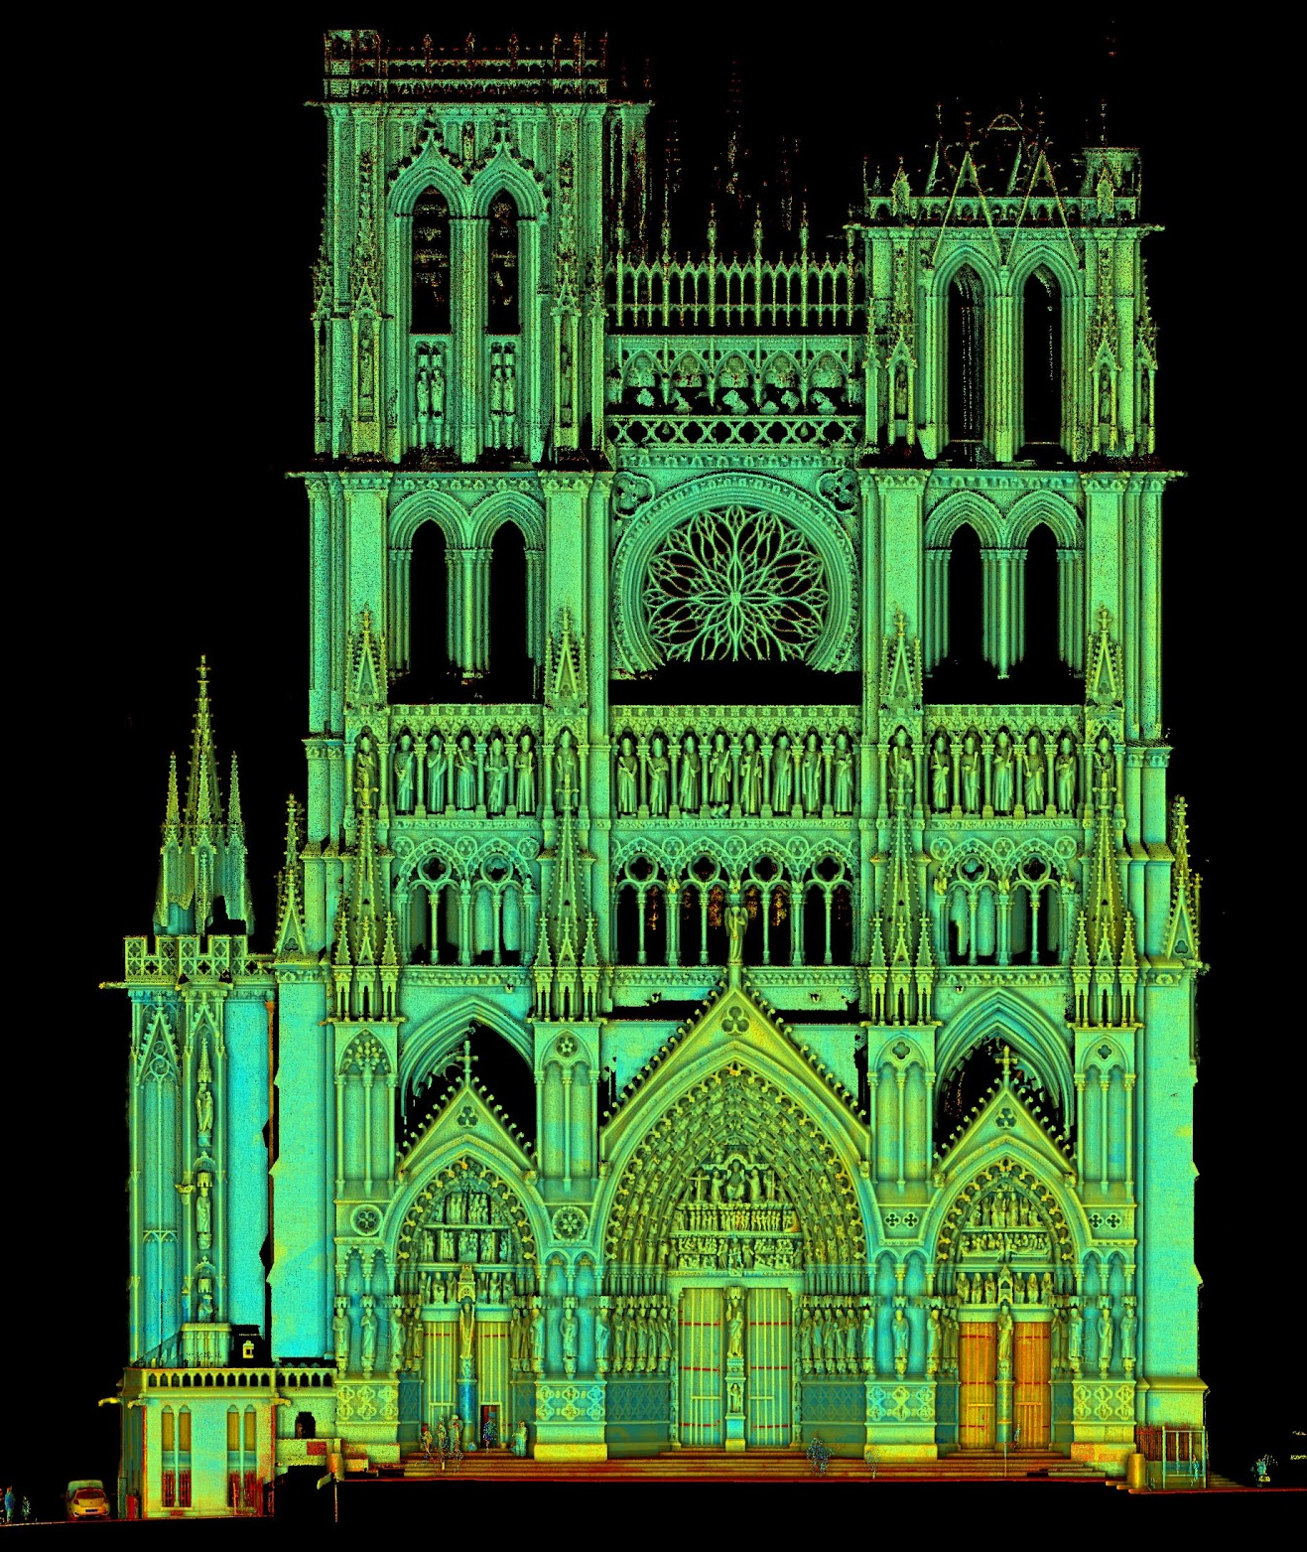
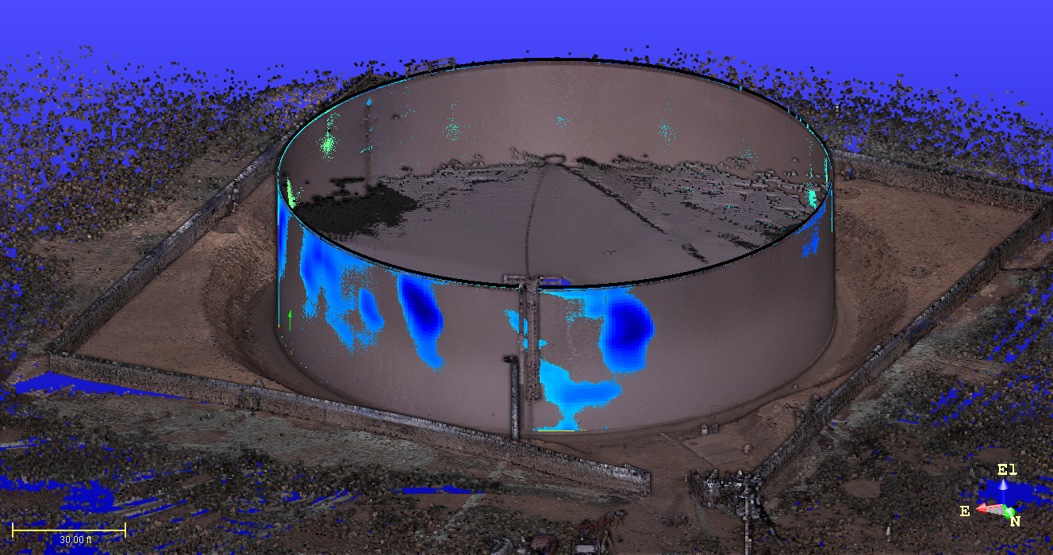
Additional Application Examples
Marine Construction
Utilities
Cultural Heritage

Slide 36
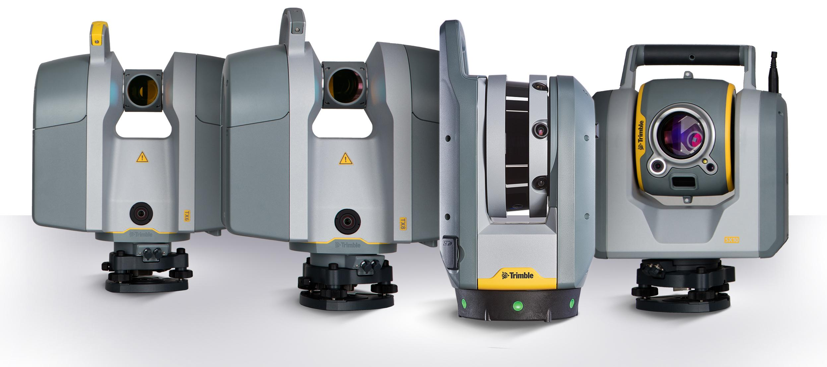
Trimble Scanning Portfolio

Slide 37
Trimble X7 Positioning Statement
High-speed 3D laser scanning system with new innovations to simplify adoption, increase efficiency and provide confidence in the field.
Trimble Registration Assist for Simple and fast in-field scan registration
Trimble X-Drive for SMART on the fly calibration to help ensure data Quality on every scan
Professional instrument quality you can trust with IP55 and Industry leading 2 year warranty

Slide 38
Trimble TX8 Positioning Statement
Ultra-high-speed 3D laser scanner with no compromise on range & accuracy to deliver unsurpassed performance and versatility
Trimble Lightning technology for ultra-high speed & high precision over full scan range
Best value for high end performance
Standard and extended range models
Flexibility to address a wider range of projects

Slide 39
Trimble TX6 Positioning Statement
High-speed 3D laser scanner with best value-for-money on the market to deliver essential performance and scan quality
Trimble Lightning technology for high speed & precision over full scan range
Essential performance for small to medium size projects
Notes:
The TX6 provides the best value for the money to deliver essential performance and scan quality.
You get high speed and precision over the full scan range with the necessary performance for small to mid-size projects.

Slide 40
Trimble SX10 Positioning Statement
The most INNOVATIVE surveying solution we’ve ever engineered. The SX10 truly merges high speed 3D scanning, high accuracy surveying measurements and enhanced imaging capability into one seamless solution. This solution will Transform the way surveyors work without requiring them to change the way they work.
Trimble Lightning 3DM technology for high speed and high precision for all your measurement styles (DR, prism and scanning)
Best Range - 600m +
Survey workflow or scanning workflow
Flexibility to address a wider range of projects

Slide 41
The Right Solution for the Right Application

Slide 42
Compare | X7 | TX6 | TX8 | SX10 | RTC360 | BLK360 | FOCUS S
Range | 80m | 120m | 340m | 600m | 130m | 60m | 70m, 150m, 350m
3D Point Acc (at 20m) | 3.5mm | 3mm | 3mm | 2mm | 2.9mm | 8mm | 3.5mm
Leveling Accuracy | 3” | 1” | 1” | 0.5” | 3’ = 180” | ND (180”) | 19”
Typical Scan Duration | 4mns | 3mns | 2mns | 6mns | 1mn | 2mns | 6mns
Imaging | 3x10MP, 1mn | 10MP, 1mn | 10MP, 1mn | 3x5MP, 3mns | 3x13MP, 1mn | 3x5MP, 2mns | 8MP, 3mns
Weight (incl. battery) | 5.8kg | 11.2kg | 11.2kg | 7.8kg | 6.03kg | 1kg | 4.2kg
Calibration | Automatic calibration | Annual Service | Annual Service | Manual field calibration Biannual Service | Annual Service | Annual Service | Annual Service
Typical Workflow | Full in-field registration | Target-based or cloud-based registration | Target-based or cloud-based registration | Survey | In-field Pre-registration | Target-based or cloud-based registration | On-site Registration with laptop
Field Software | Trimble Perspective | Onboard Remote Control | Onboard Remote Control | Trimble Access | Onboard FIELD360 | FIELD360 | Onboard
Standard Warranty | 2 Year | 1 Year | 1 Year | 2 Year | 1 Year | 1 Year | 1 Year
Scan Angular Accuracy | 21” | 17” | 17” | 5” | 18” | ND (66”) | 19” *
Range Accuracy | 2mm | <2mm | <2mm | 2mm+1.5ppm | 1mm+10ppm | 7mm | 1mm
Range Noise | <3mm@40m | <2mm@120m | <1mm@80m | <1.5mm@200m | 0.5mm@20m | Not Disclosed | 0.3mm *
Scan Speed | Up to 500kHz | 500kHz | 1MHz | 26.6kHz | 2MHz | 360kHz | 976kHz
IP Rating | IP55 | IP54 | IP54 | IP55 | IP54 | No | IP54
Temp Range | -20;+50 | 0:40 | 0;40 | -20;+50 | -5;+40 | 5;40 | 5;40

Slide 43
Sales Information

Slide 44
Trimble X7 Instrument Pack - PN X7-100-00
Shipped in transportation case
Trimble X7 Scanner
3 x Standard Trimble Optical Batteries
Quick Start Guide, RID, CoC, Warranty Cards
SD Card Reader
Standard SD Card (32GB SDHC)
Cleaning Cloths
USB Cable
Regional battery chargers ordered separately
Dual Slot Battery Charger
Power Supply for Charger
Power Supply Cable for Charger
Notes:
Read from slide
Call out the product bulletin as a place to find more information

Slide 45
Key Trimble X7 Accessories
Trimble X7 Backpack
Part Number X7-BP-01
Custom foam insert
Trimble X7, 3 batteries and charger
Front pocket
T10 Tablet, shoulder strap, extra batteries
Side pockets for power supplies and cables
Side straps to hold tripod
Airline carry-on compatible for most aircraft

Slide 46
Key Trimble X7 Accessories
Gitzo Series 3 Tripod with Bell Connector
Part Number 90573-TR
Quick Release Adapter
Part Number 90573-QR
Optional accessory for 90573-TR
Quick Release attaches to X7 base
Custom head attaches to Gitzo Series 3
Notes:
Read from slide
Call out the product bulletin as a place to find more information

Slide 47
Trimble Installation Manager
Both Instrument Firmware and Software Installation
Instrument FW
Perspective SW

Slide 48
Thank You

