Slide 1
A Company Driven by Purpose:
Transforming the Way the World Works
Notes:
Technology moves fast. Yesterday’s breakthrough is often gone tomorrow. At Trimble, we believe in doing more than keeping pace. We’re intent on leading the way by embracing innovation in all its forms – from applying existing technology in surprising new ways to opening untapped frontiers.
The result: We are transforming the way the world works.

Slide 2
Our technology-forward solutions deliver digital insights that solve physical world problems.
Notes:
How?
Our passion for innovation, combined with 40+ years of digital insights, make Trimble uniquely qualified to solve our customers’ most complex physical world problems.

Slide 3
We enable real-time data integration throughout project
lifecycles to create seamless system workflows.
Notes:
How do we do it?
Key to our approach is the delivery of purpose-built solutions that integrate complex, real-time data throughout full project lifecycles, providing a seamless system workflow where innovation meets action, software meets hardware, office meets field.
The result: we are helping customers around the globe to optimize operations across a wide range of industry end-markets.

Slide 4
Partnering with our customers, we are optimizing task productivity to transform the way the world works.
Notes:
But we do more than just serve our customers… we forge strong relationships with them to identify, assess and overcome the ongoing challenges of doing business in this rapidly changing world.
The benefits extend far beyond our customers’ improved productivity and increased profits. Our solutions open new opportunities to create a positive impact on global economies, the environment and society as a whole.
We are transforming the way the world works, making it a better place for everyone.

Slide 5
Our Story
The world’s first commercial GPS company
Notes:
Let’s take a look at how we got here – our story.
In 1978, certain that positioning and navigation technology would become a fundamental part of our everyday lives, Charlie Trimble formed what would become the world’s first commercial GPS company. Based in a small office in Silicon Valley, Trimble was the cornerstone of what would become an entire new industry.

Slide 6
Driven by Innovation & Experience
GPS Technology
Precise Positioning
Productivity Optimization
Connected Workflow
Strategic & Managerial Continuity
Charlie Trimble
1978–1998
Steve Berglund
1999–2019
Rob Painter
2020–
Notes:
During our history, Trimble leadership has remained remarkably consistent.
The first 20 years, under the leadership of Charlie Trimble, was built around technology. The point of differentiation was pure innovation. Trimble was an exceptionally innovative company during that time, and strategically expanded the application of position-centric information across multiple industries and diverse markets.
In 1999, with the arrival of Steve Berglund, Trimble began to transition our point of differential from pure innovation to overlaying an industry workflow focus that significantly enhanced our technology. By seamlessly connecting the network of operations throughout project lifecycles, the common value provided by our technology solutions became productivity gain.
Last year, leadership was transferred to Rob Painter. While respecting and building on Trimble’s 40+ years of success, Rob is driven to further increase connectivity across project lifecycles in the industries we serve to give our customers the best opportunity for success in an ever-evolving world.
Driven by innovation, we continue to find new ways to connect our physical and digital worlds, as we have done since day one.

Slide 7
Positioned to Optimize Operations
Deep Domain Knowledge | Accomplished Innovation | Full Workflow Solutions
With average tenure at more than a decade, Trimble has domain knowledge that greatly benefits our customers. | Trimble has been the ﬁrst on many technology fronts, and continues to innovate based on customer insights. | Trimble optimizes workflows across project lifecycles, with purpose-built solutions for every phase along the way.
Notes:
While continuing to evolve, Trimble remains uniquely positioned to help the industries we serve capitalize on technology-driven transformation, with a broad scope of knowledge, technology and purpose-built solutions to meet challenges of any scale.
Key to this is our people. With an average employee tenure of more than a decade, we have deep domain knowledge and an unparalleled understanding of our customers’ perspectives. This allows us to provide innovative functionality in a context specific to customer needs – beyond just how to work, to why that work should (or should not) be done.
Our insights help eliminate rework and optimize operations, with hardware and software solutions that drive success across every phase of project workflows.

Slide 8
Improved Productivity Yields Rewards
Economic Breakthroughs | Quality, Safety, and Compliance | Environmental Stewardship
Enhanced ROI | Higher Quality of Data | Reduced Fossil Fuel Use
Higher Yields | Enhanced Worker Safety | Reduced Chemical and Water Use
Better Asset Utilization | Greater Regulatory Compliance | Less Waste
Notes:
The impact of optimizing network operations amplifies the opportunities to deliver improved system productivity.
Increasing returns and higher yields drive economic breakthroughs.
Connectivity and real-time data analysis increase quality of work and worker safety.
And through a more efficient use of all assets, the impact on the environment is reduced.
Simply put: our solutions enable big boosts in our customers’ efficiency, effectiveness and productivity, which translates directly to increased profitability.

Slide 9
Our Success = Customer Success
Financial Strength | Global Vision | Technology Leader
$3.152B in non-GAAP Revenue | 11,000+ employees | R&D centers in 15 countries
≈$1.3B ARR (+9% growth) | Facilities in 40+ countries | $400M+/year invested in R&D
NASDAQ TRMB | Customers in 150+ countries | 2,000+ active patents
Notes:
Our success is directly linked to our customers’ success.
Global demand for Trimble technologies delivered $3.152 billion in non-GAAP revenue in 2020, including approximately $1.3B in annualized recurring revenue (+9% growth).
With more than 11,000 employees in 40+ countries, and a global network of dealers and distribution partners, we’ve formed relationships with customers in 150+ countries.
And our success feeds our ability to support our customers. We operate R&D centers in 15 countries, and invested more than $400 million into exploring new technologies in 2019. With 2000+ active patents, Trimble is among the most innovative companies in the world.

Slide 10
Collaboration & Interoperability
MODELING
POSITIONING AND SENSING
Software for design, scheduling, visualization, cost, maintenance and operations
ANALYTICS AND OPTIMIZATION
Sensing and measuring in a geospatial context
Decision support, predictive indicators
HOW
WHAT
WHY
Notes:
We are truly transforming the way the world works by optimizing task productivity at the convergence of the physical and digital worlds.
We achieve this by leveraging deep roots in positioning and sensing, modeling and analytics – providing the right combination of collaboration and interoperability to help users worldwide make intelligent decisions, solve complex problems and improve operating results and safety.

Slide 11
Core Industries We Serve
Agriculture
Construction
Geospatial
Transportation
Emerging Global Markets
Field Services
Forestry
Railway
Utilities
Notes:
It’s worth repeating: our success is directly linked to our customers’ success. We are passionate about innovation and delivering solutions that drive success across the core industries we serve.
IN AGRICULTURE – revolutionizing the way we farm around the world, enabling the production of more food per acre at lower cost, with lower environmental impact.
IN CONSTRUCTION – our innovative software and services optimize the design, construction and maintenance of next-generation buildings – helping to serve real estate demands in growing population centers. We keep our prosperous world moving with critical infrastructure by providing our customers with a forward-thinking continuum of solutions and services.
IN GEOSPATIAL – we deliver a high-quality, productive workflow and data exchange, resulting in accurate data and measurement that can be transformed into the intelligence required to make informed decisions.
IN TRANSPORTATION – we make it possible to move the goods of commerce more quickly, intelligently and safely. In doing so, we’re helping makes the roads safer for everyone, and reducing carbon footprints.
And within a growing number of emerging global markets, Trimble innovation enables productivity and economic breakthroughs—while enhancing safety, boosting compliance, and reducing environmental impact.

Slide 12
Business Snapshot

Slide 13
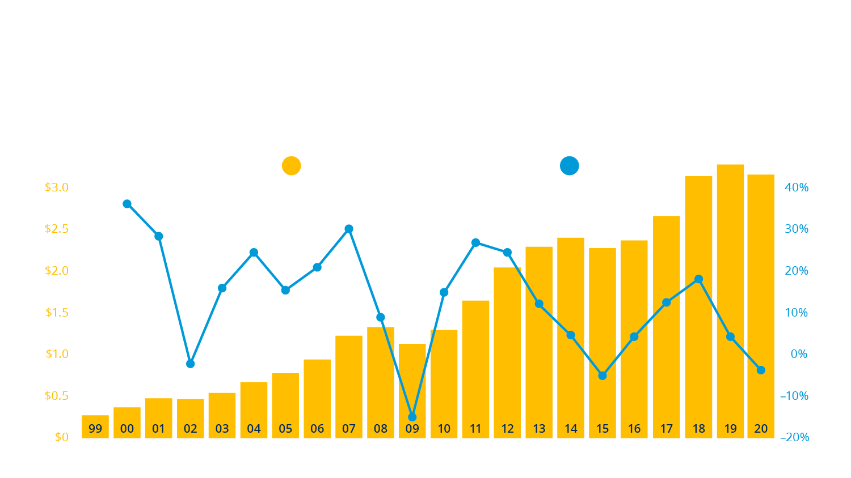
Revenue Growth ($ Billions)

Slide 14
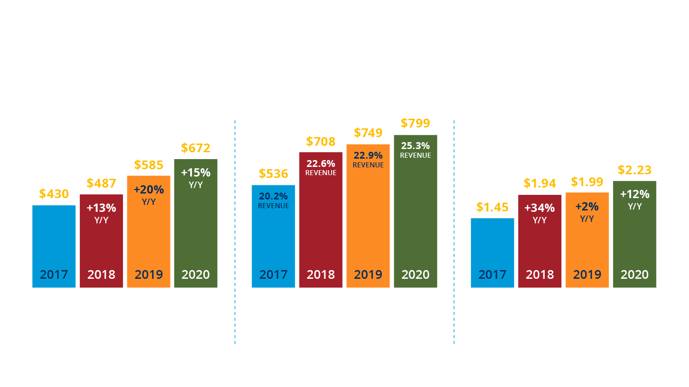
A Record of Success
Adjusted EBITDA refers to non-GAAP operating income plus depreciation plus income from equity method investments, net.

Slide 15
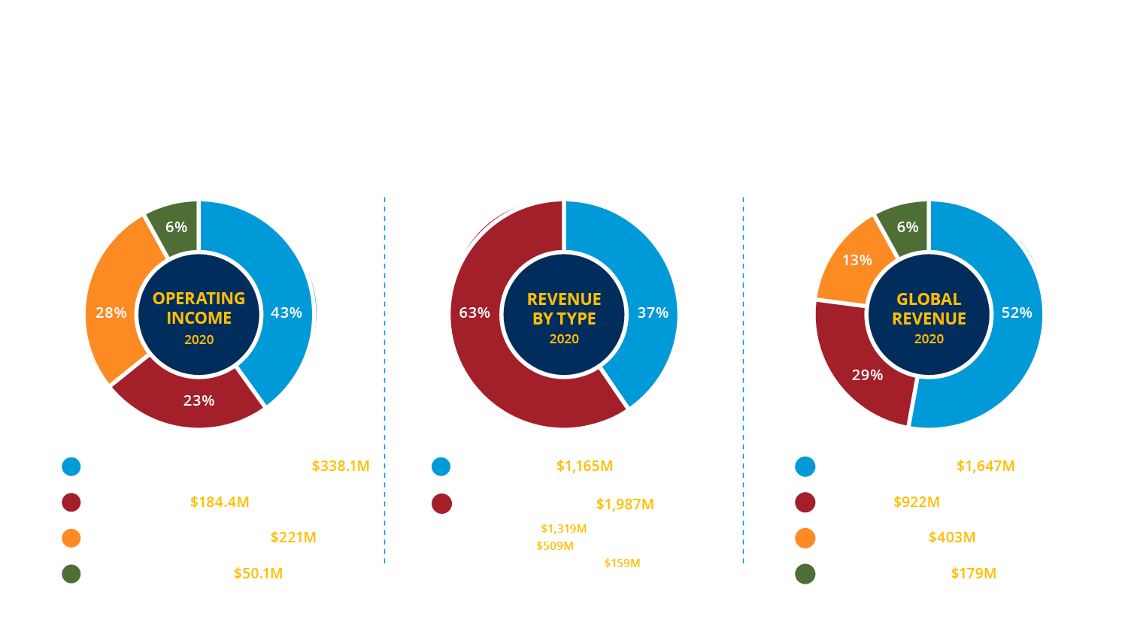
Diversified and Balanced

Slide 16
Forward-looking Statement
Certain statements made in this presentation and any subsequent Q&A period are forward-looking statements, within the meaning of Section 21E of the Securities Exchange Act of 1934, as amended, and are made pursuant to the safe harbor provisions of the Securities Litigation Reform Act of 1995. These statements include expectations for future financial market and economic conditions, the impact of acquisitions, the ability to deliver revenue, earnings per share and other financial projections. These forward-looking statements are subject to change, and actual results may materially differ from those set forth in this presentation due to certain risks and uncertainties. The Company’s results may be adversely affected if the Company is unable to market, manufacture and ship new products, obtain new customers, or integrate new acquisitions. The Company’s results would also be negatively impacted by weakening in the macro economic environment, or foreign exchange fluctuations or the imposition of barriers to international trade. Any failure to achieve predicted results could negatively impact the Company’s revenues, cash flow from operations, and other financial results. The Company’s financial results will also depend on a number of other factors and risks detailed from time to time in reports filed with the SEC, including its quarterly reports on Form 10-Q and its annual report on Form 10-K, such as changes in economic conditions, further worsening in the geospatial market, critical part supply chain shortages, possible write-offs of goodwill, and regulatory proceedings affecting GPS. Undue reliance should not be placed on any forward-looking statement contained herein, especially in light of greater uncertainty than normal in the economy in general. These statements reflect the Company’s position as of the date of this presentation. The Company expressly disclaims any undertaking to release publicly any updates or revisions to any statements to reflect any change in the Company’s expectations or any change of events, conditions, or circumstances on which any such statement is based.

