Slide 1
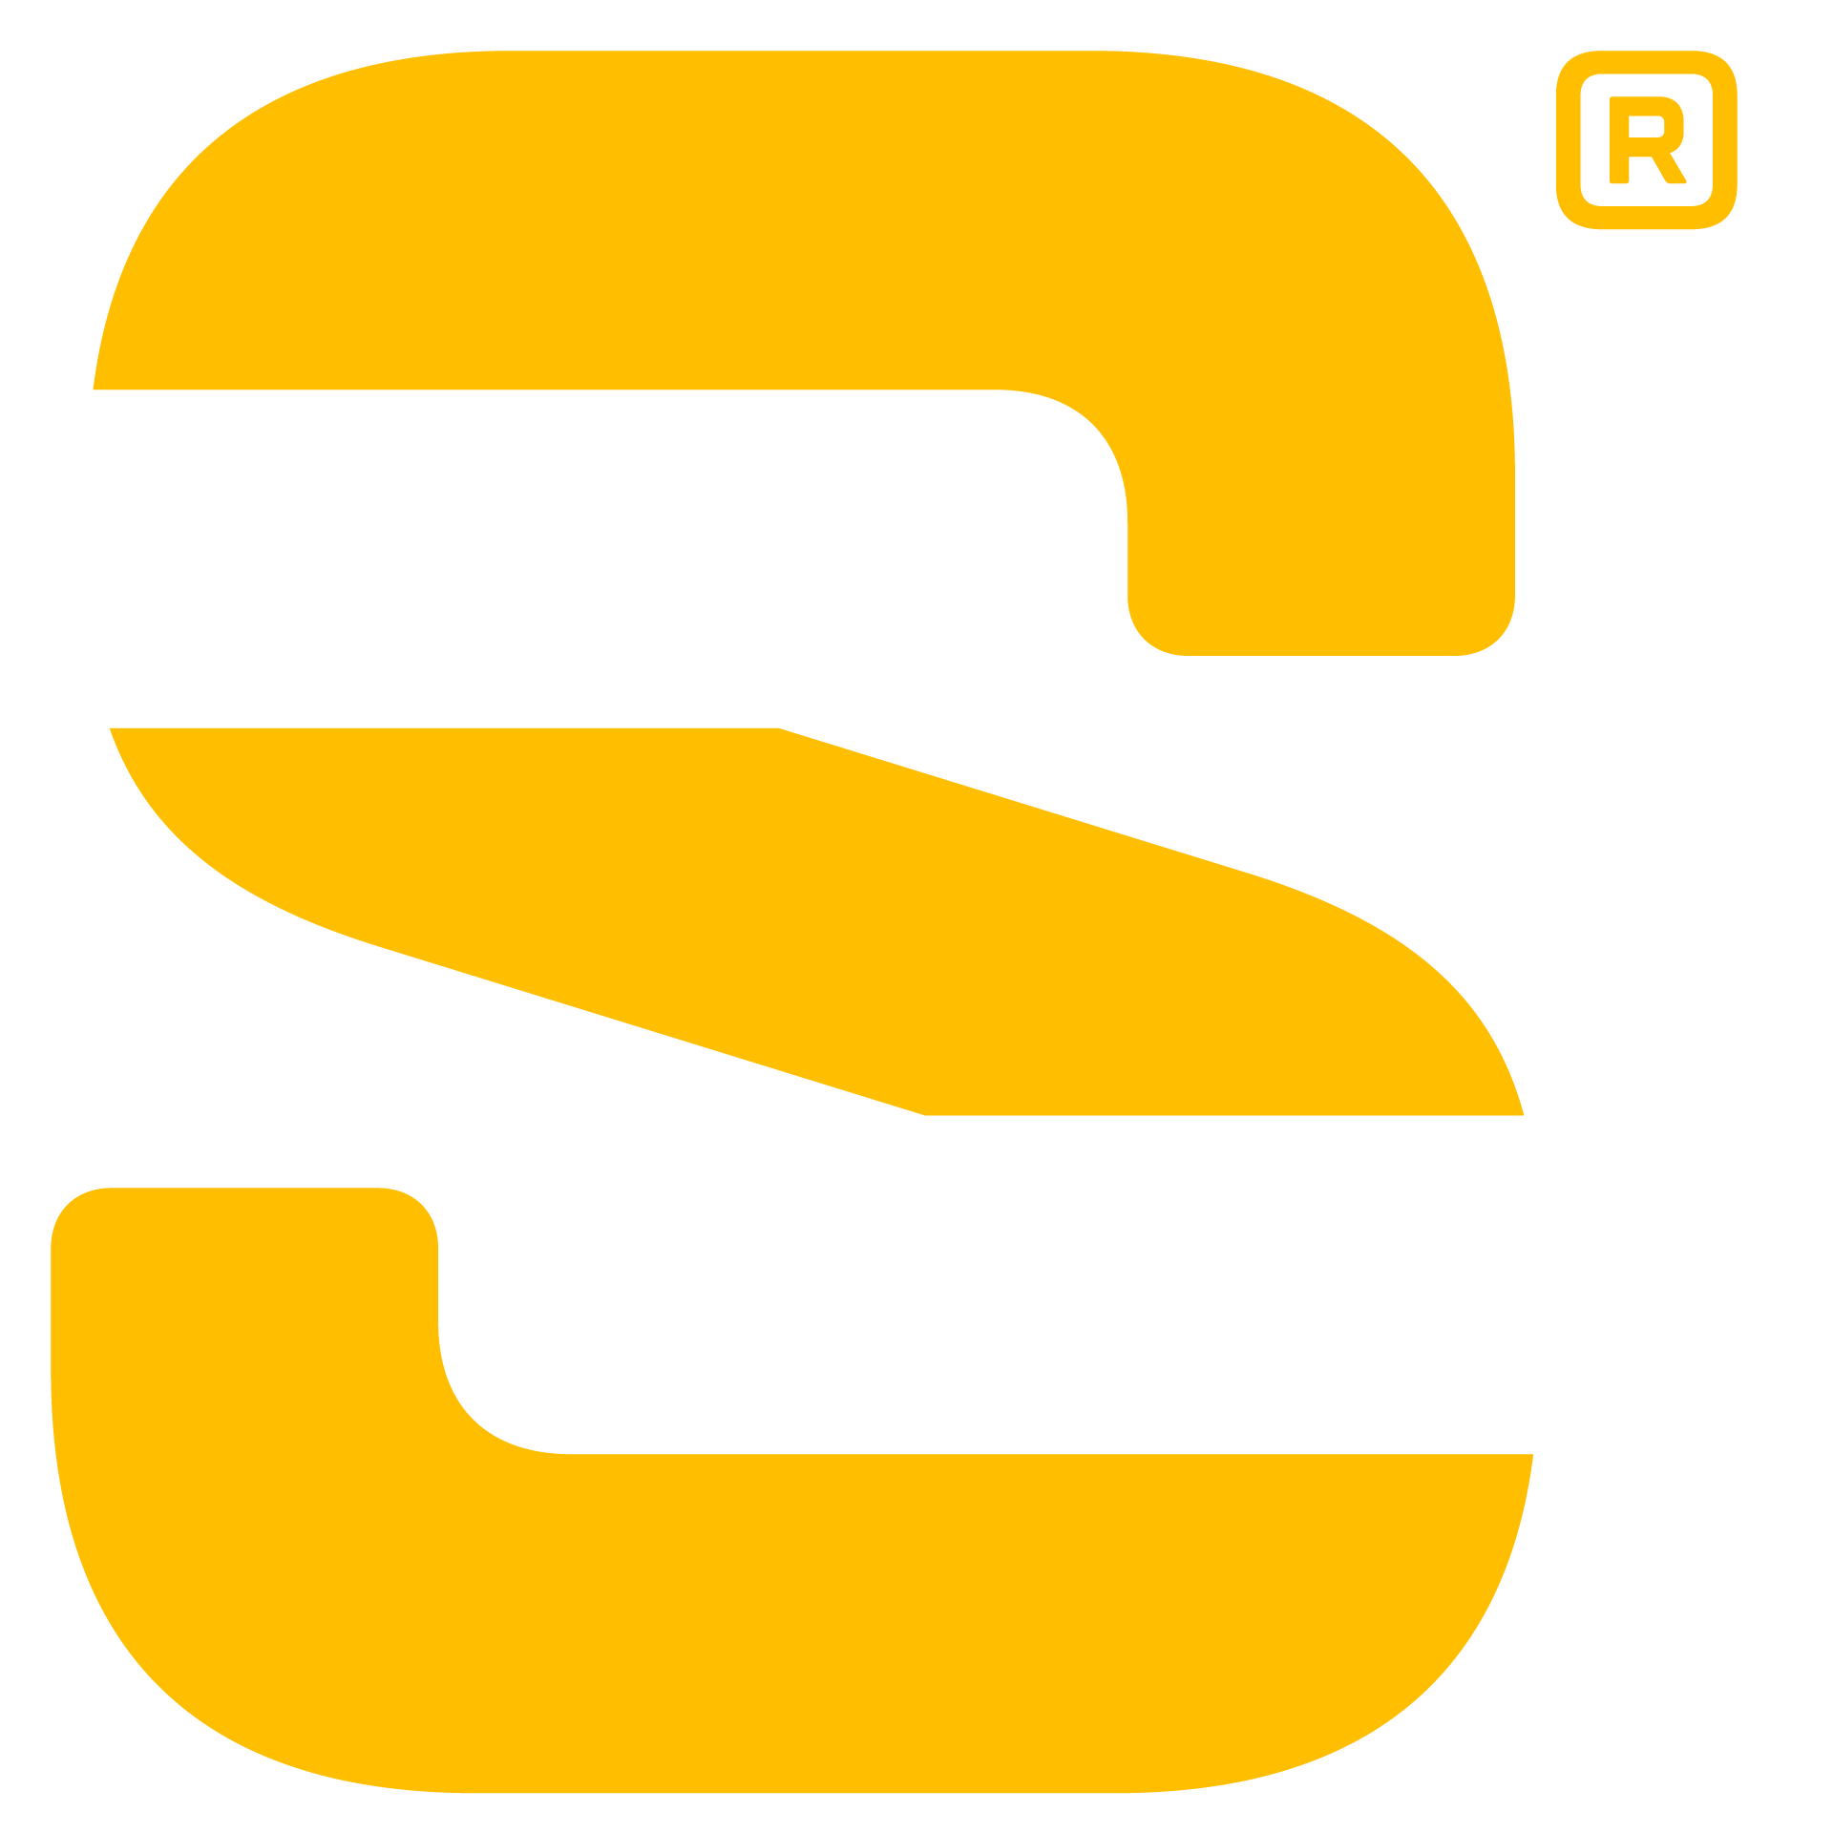
Introducing the FOCUS 50
Total Station
Scott Lyttle, Product Manager
Chantal Jorawsky, Product Marketing Manager
Rag Patel, Product Management Intern
November, 2021

Slide 3
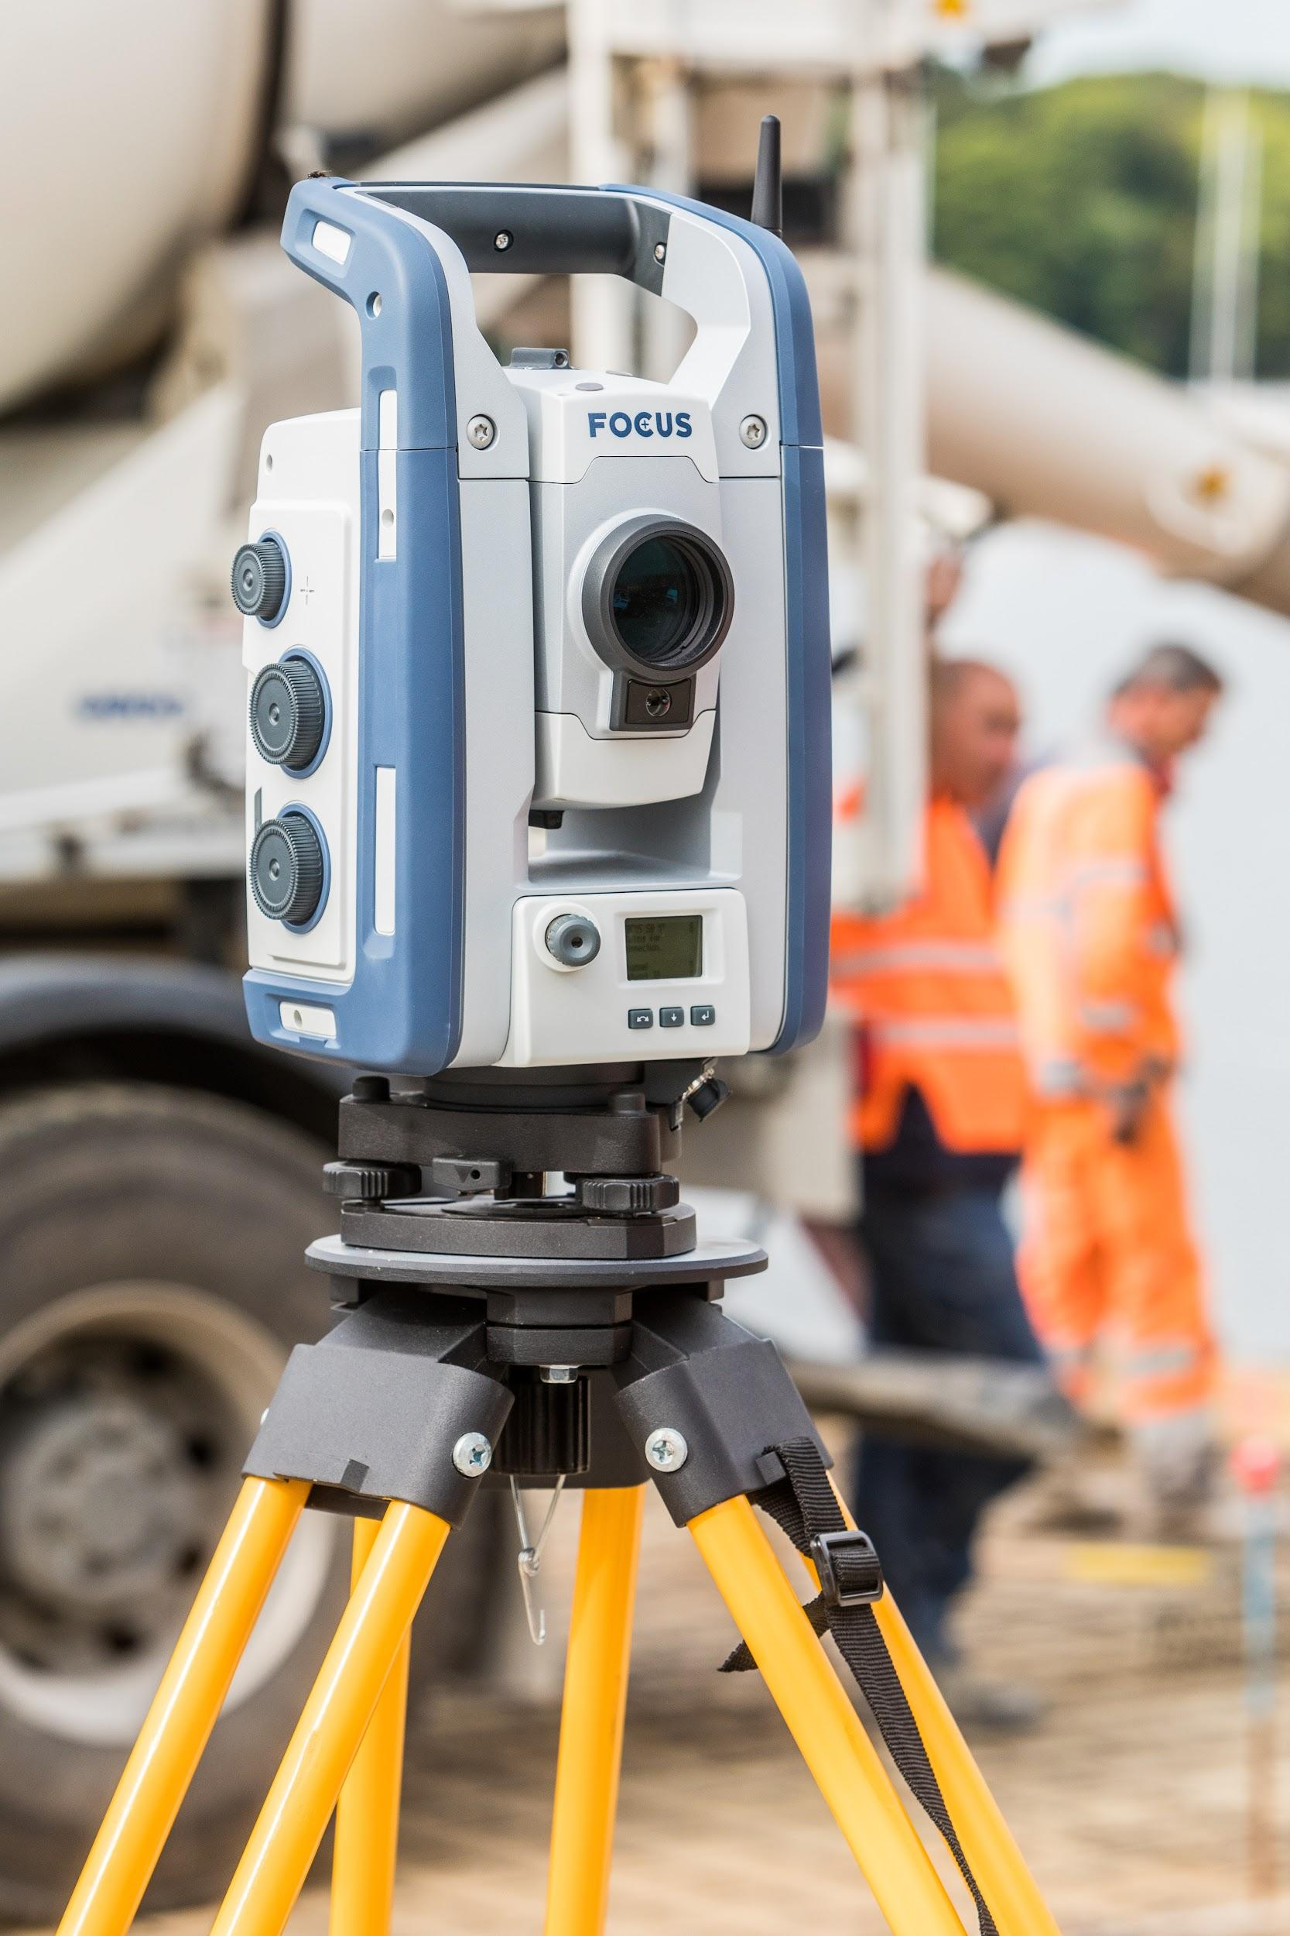
FOCUS 50 Total Station
Three New Models:
FOCUS 50 Autolock
FOCUS 50 Short Range Robotic
FOCUS 50 Long Range Robotic
Configurable angular accuracy

Slide 4
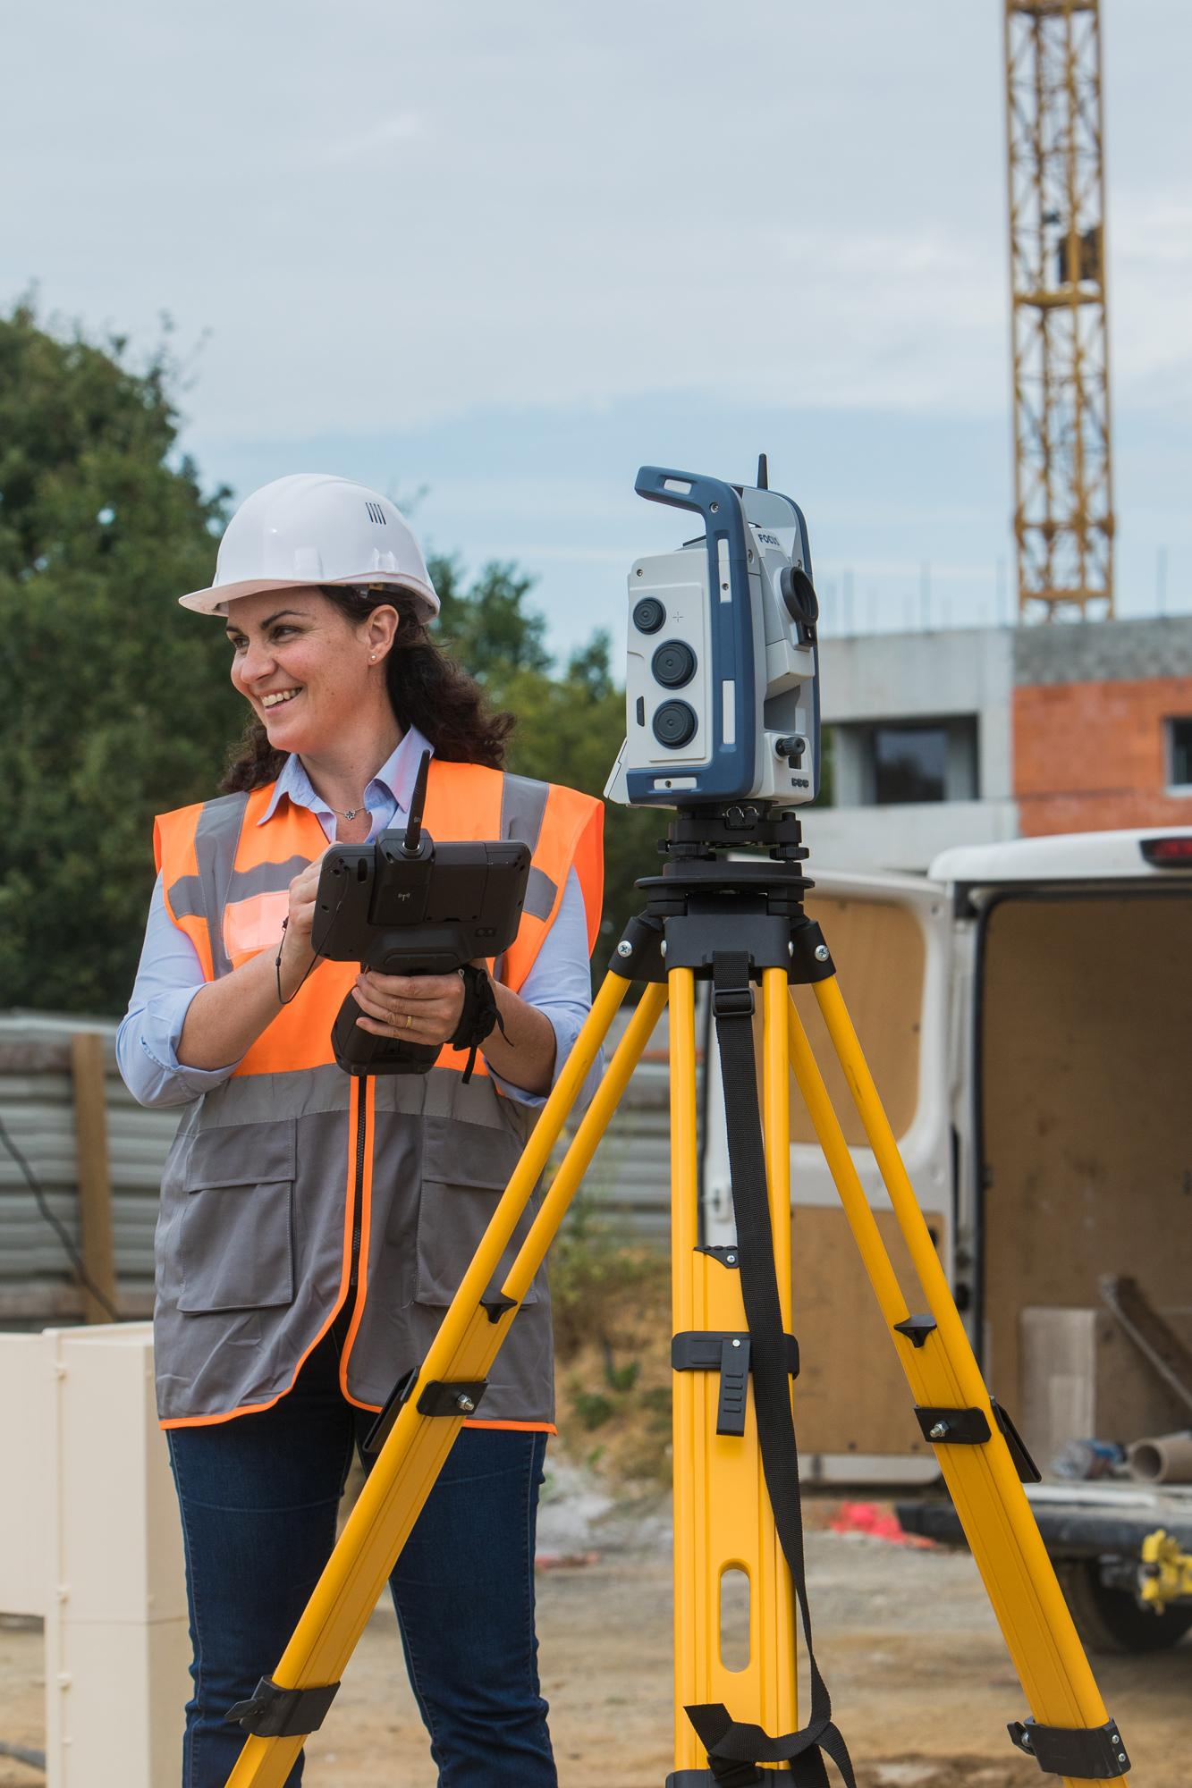
Agenda
Specs & Performance
3 Models of FOCUS 50
Specifications
System Compatibility: comms, controllers & software
Working with Bluetooth
Key Technologies
MagDrive ™
SurePoint ™
Autolock ™
Angular Accuracy, Certificates, and Firmware Updates
FOCUS 50 & Origin Field Software
Questions

Slide 5
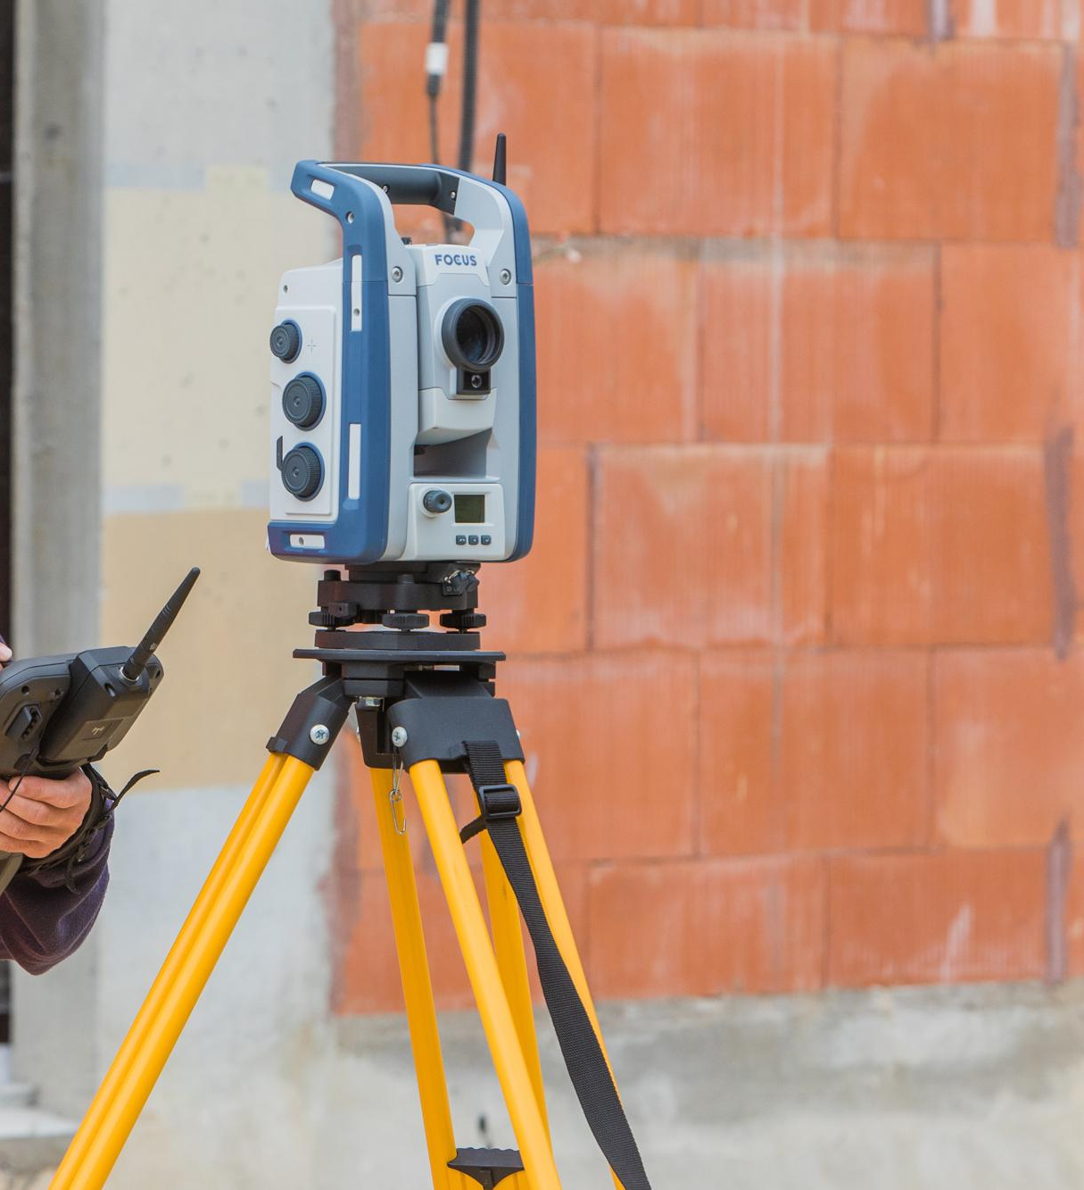
Specs &
Performance

Slide 6
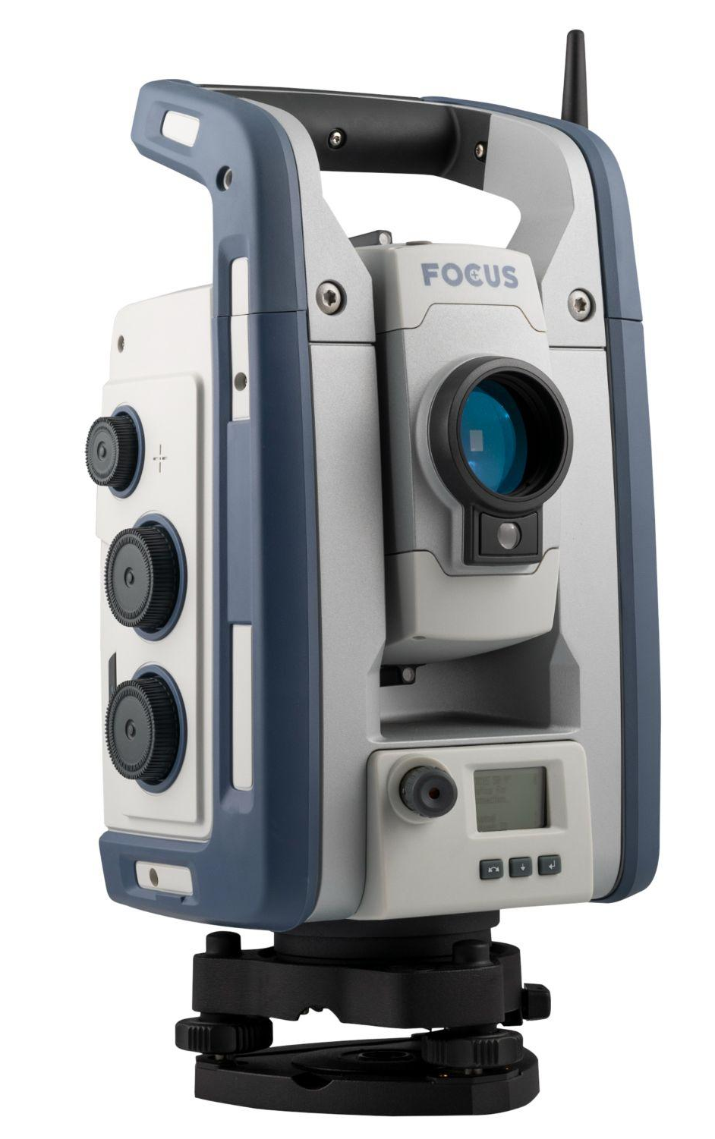
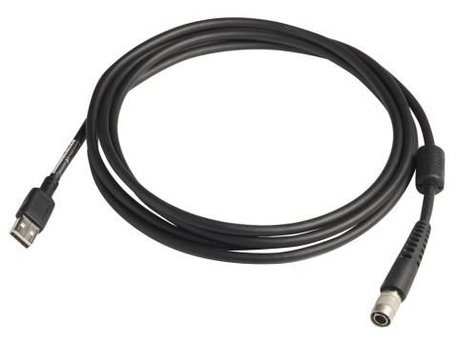
3 Models of FOCUS 50
Specs & Performance
 | Autolock | Short Range Robotic | Long Range Robotic
Communication Method | Cabled Connection | Bluetooth (long range) | Bluetooth (short range) & 2.4 GHz Radio
Do you…? | ...prefer to work with someone always behind the instrument? e.g. always doing DR shots, or on a 2-person crew | ...want to work robotically, but at shorter range? -and/or- ... want to use 3rd party controllers’ integrated Bluetooth? | ...want to work robotically at maximum range/reliability?

Slide 7
Specifications: EDM
Specs & Performance
Speed Standard Mode | Prism: 1.2 s DR: 1 - 5 s
Accuracy Standard Mode | Prism: 1+2 ppm DR: 2+2 ppm
Range | Prism: 5500 m DR: 1300 m

Slide 8
Specifications: General
Specs & Performance
Display | Yes, Face 2 LE-Display
Battery | 6.5 h 20 h with multi-battery adapter (external)
Environmental | IP65
Weight | 5.9 kg (including battery & tribrach)
Tracklight | Standard on all models
Laser Pointer | Standard on all models
Warranty | 2 year factory warranty Extended warranties also available
Service | 2 year recommended preventative maintenance

Slide 9
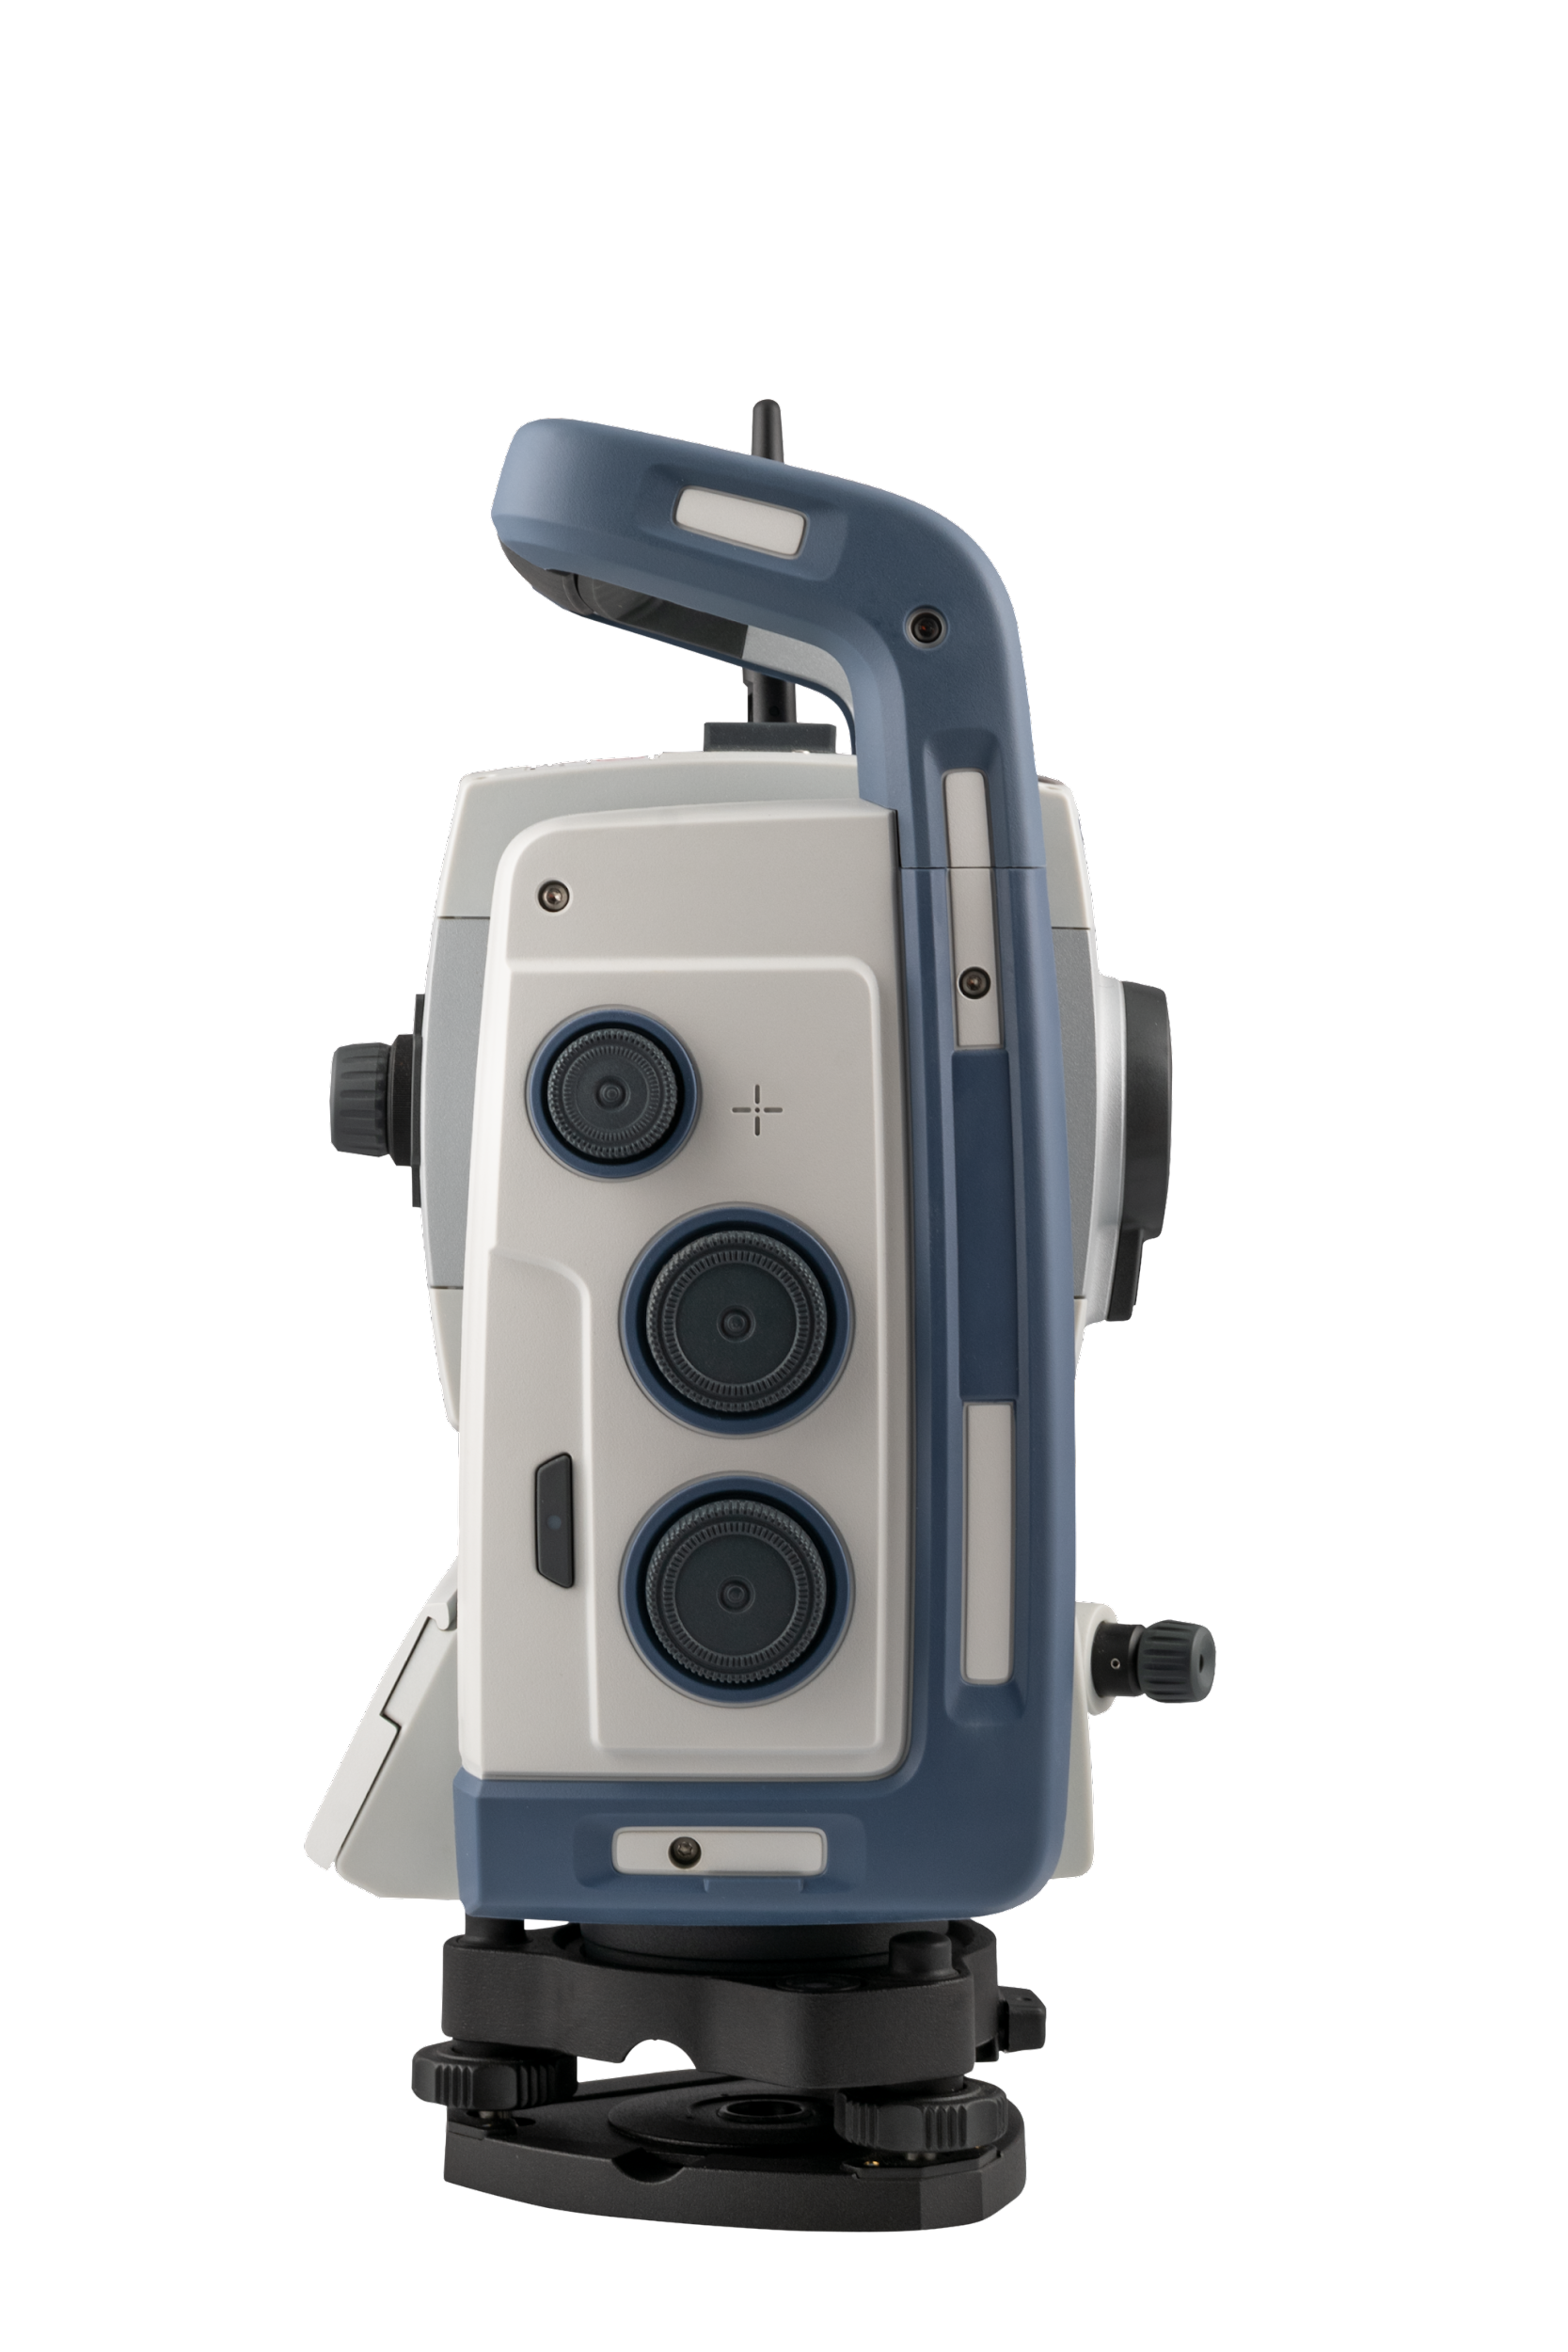
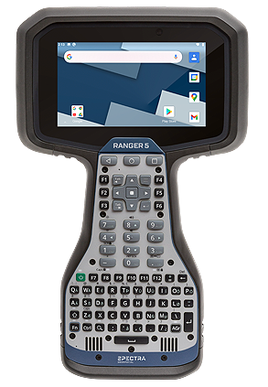
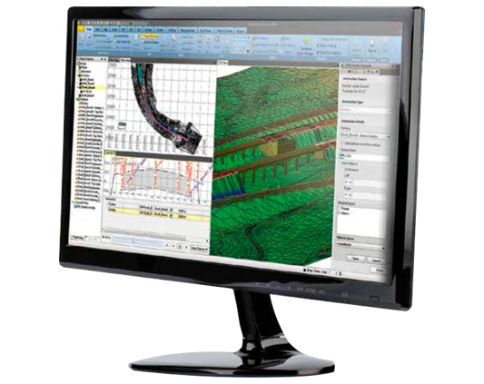
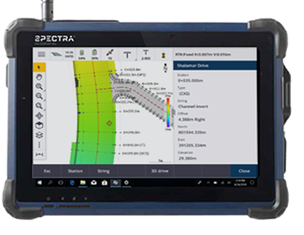
System Compatibility
Specs & Performance
Data Collectors
Field Software
Origin
Survey Pro
Layout Pro
TPSDK
Trimble Access
Survey Office Software
Also works with TBC
Notes:
Controllers
Ranger 5
Ranger 7
ST10
Also works with the Ranger 3
Also works with 3rd party controllers

Slide 10
Connections Comparison by Model
Specs & Performance
 | Autolock | Short Range Robotic | Long Range Robotic
Cabled Connection
Ranger 5 * Ranger 7 ST10 | ✔️ | ✔️ | ✔️
Wireless Connection
Ranger 5 Ranger 7 | ❌ | ✔️ Controller Bluetooth | ✔️ EM120 module on controller
ST10 | ❌ | ✔️ Controller Bluetooth | ✔️ ST10 (Radio model)
3rd party | ❌ | ✔️ Controller Bluetooth | ✔️ SPDL radio paired with controller
*Requires USB A-to-C Adapter

Slide 11
Short Range Robotic Model
Range Expectations over Bluetooth
Specs & Performance
Range can vary widely depending on:
Radio traffic
Bluetooth, WiFi, radio, cell
Line of Sight
If you are walking away from the total station, your body will block part of the signal and shorten the range
Holding the controller in your hand instead of using a bracket can also cause this effect
Bluetooth module and antenna in both the total station and the controller
This is why range is controller-dependent
Note - as a first step troubleshooting radios, always try a new antenna on both the TS and Controller side
Controller | Approximate Range (m)
Ranger 5 | 150 - 550
Ranger 7 | 100 - 350
ST10 | 50 - 100

Slide 12
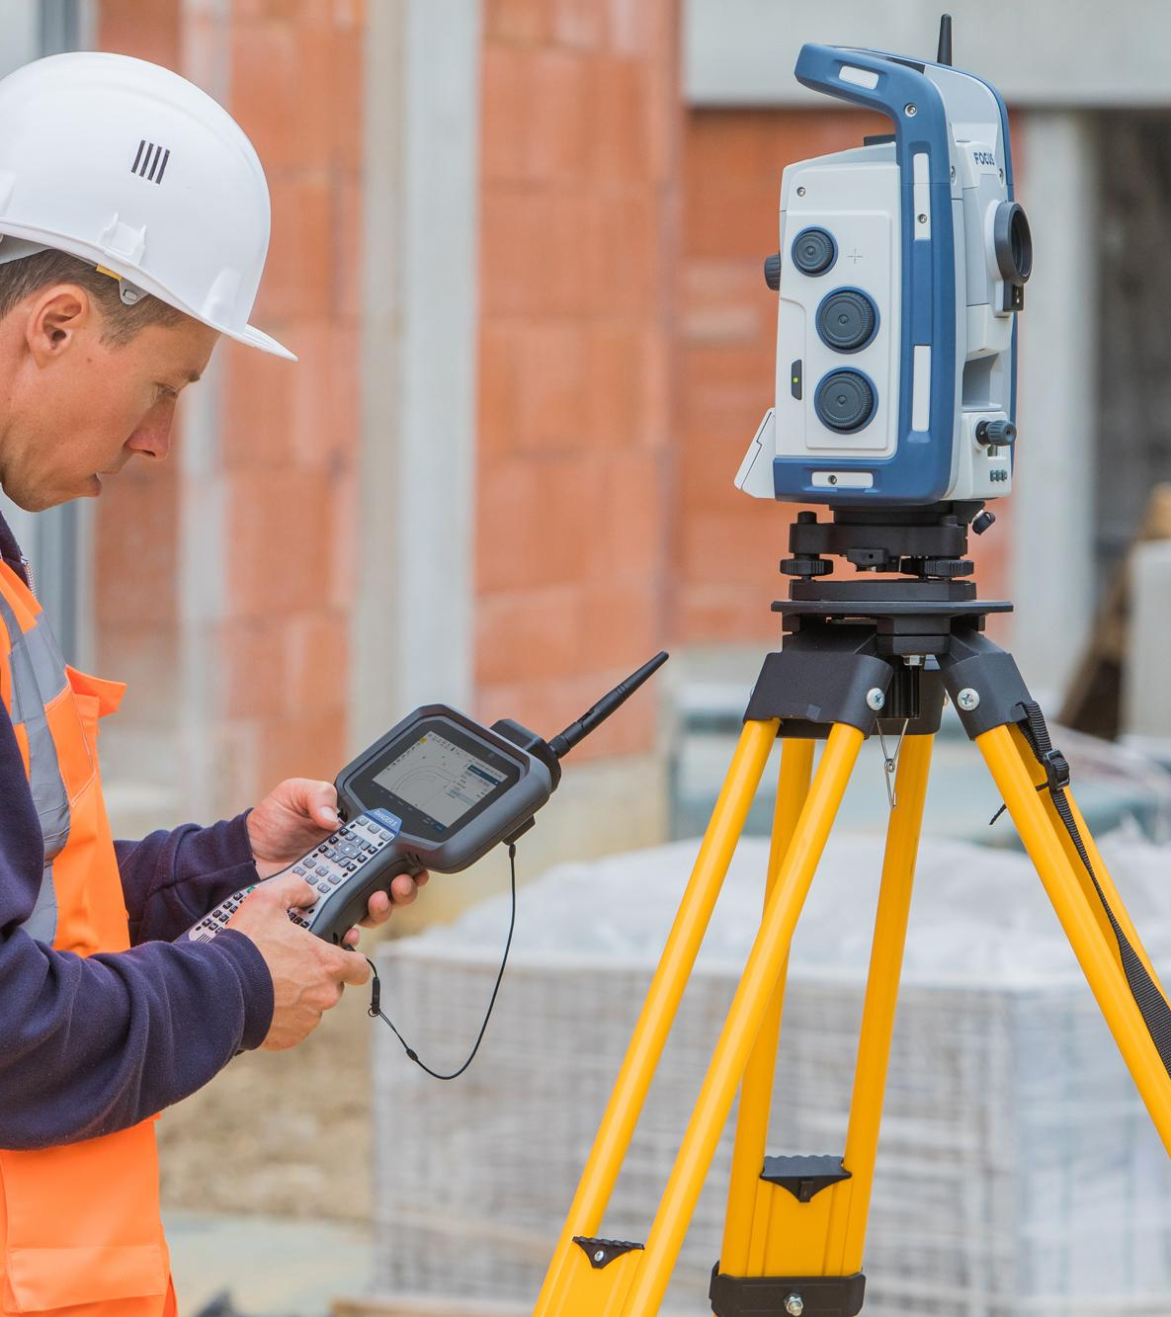
Key Technologies
MagDrive ™
SurePoint ™
Autolock ™

Slide 13
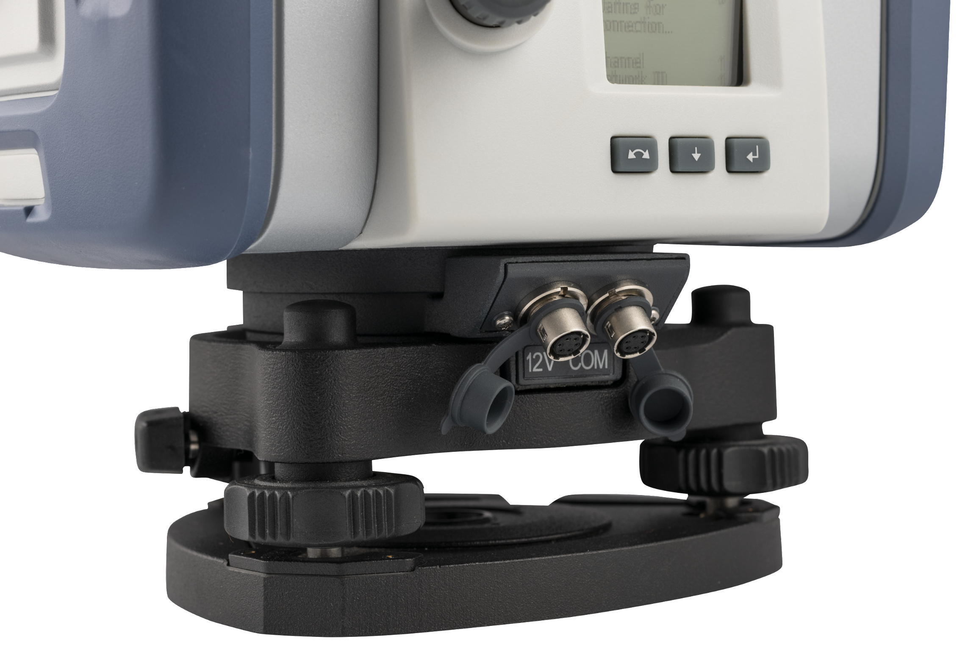
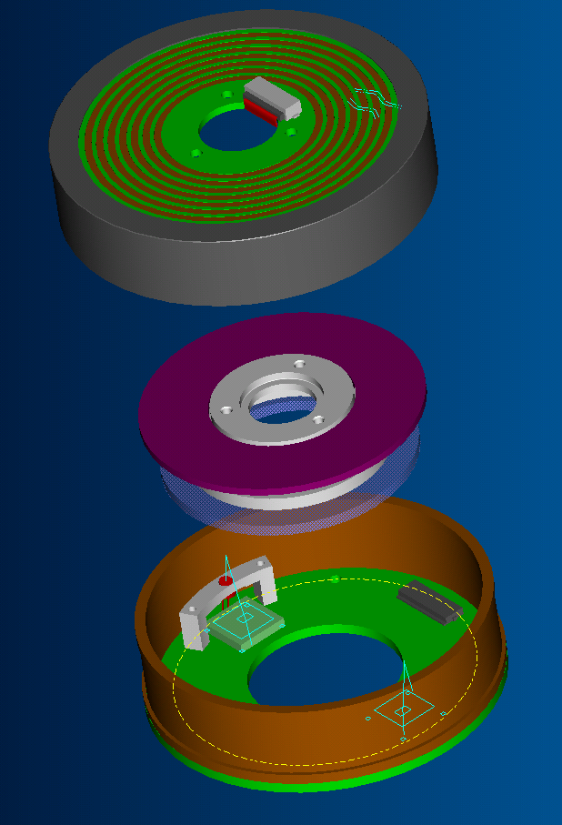
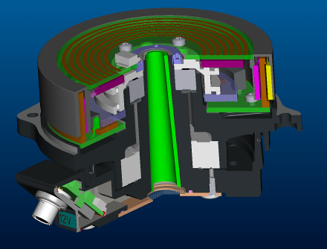
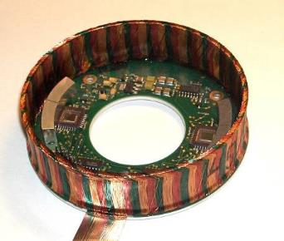
MagDrive™ Technology
Controls the HA/VA movement electromagnetically
Key Technologies
Features
Brushless, frictionless motor
Integrated motor with angle sensors
No gear, no clutch
Accurate positioning
Low power consumption
→ Drives are smooth, silent, and accurate!

Slide 14
MagDrive™ Technology
Controls the HA/VA movement electromagnetically
Key Technologies
Intuitive Aiming
Endless fine adjustment
Multi Speed Tangents with Automatic Gear Changes
→ The slower/faster you turn the knob, the total station movement matches
→ The fine adjustment is really fine, one full turn at lowest speed takes more than a month!

Slide 15
SurePoint™
Compensator information is used to automatically correct the pointing of the telescope for all mislevelment and trunnion axis errors in real time during operation
Key Technologies
Not a problem if instrument is disturbed slightly it will aim itself back at target
Buttons pushed on instrument
Contact with instrument when looking through telescope
Wind
Tilt of Tripod
How it works
Control loop is active all the time
Always turns instrument to the current reference angle
Reference angle only changed when
Knobs are turned
Position commands are given
Instrument is turned firmly so that it enters friction mode

Slide 16
Key Technologies
Collimation error the old way
What happens when you aim at a plumb line and turn the vertical knob?
A old system will only turn the vertical motor
The aim will not follow the plumb line but the horizontal angle will be compensated for this drift
HA: 143.4004
HA: 143.4532
HA: 143.4478
HA: 143.4431
HA: 143.4363
HA: 143.4301
HA: 143.4268
HA: 143.4216
HA: 143.4141
HA: 143.4097
HA: 143.4051
VA: 95.0000
VA: 90.0000
VA: 85.0000
VA: 80.0000
VA: 75.0000
VA: 70.0000
VA: 65.0000
VA: 60.0000
VA: 55.0000
VA: 100.0000
VA: 50.0000

Slide 17
Key Technologies
Collimation error with SurePoint ™
SurePoint feeds the corrections back into the control loop when the vertical knob is turned
SurePoint uses both motors and make the instrument follow the plumb line!
HA: 143.4532
VA: 95.0000
VA: 90.0000
VA: 85.0000
VA: 80.0000
VA: 75.0000
VA: 70.0000
VA: 65.0000
VA: 60.0000
VA: 55.0000
VA: 100.0000
VA: 50.0000

Slide 18
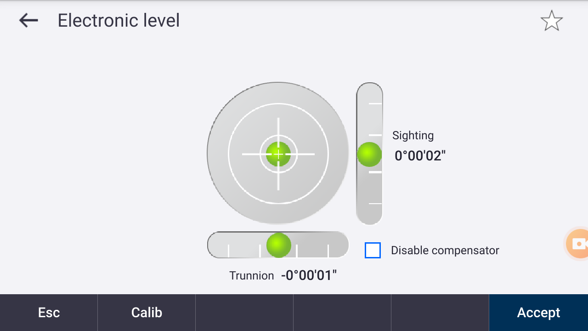
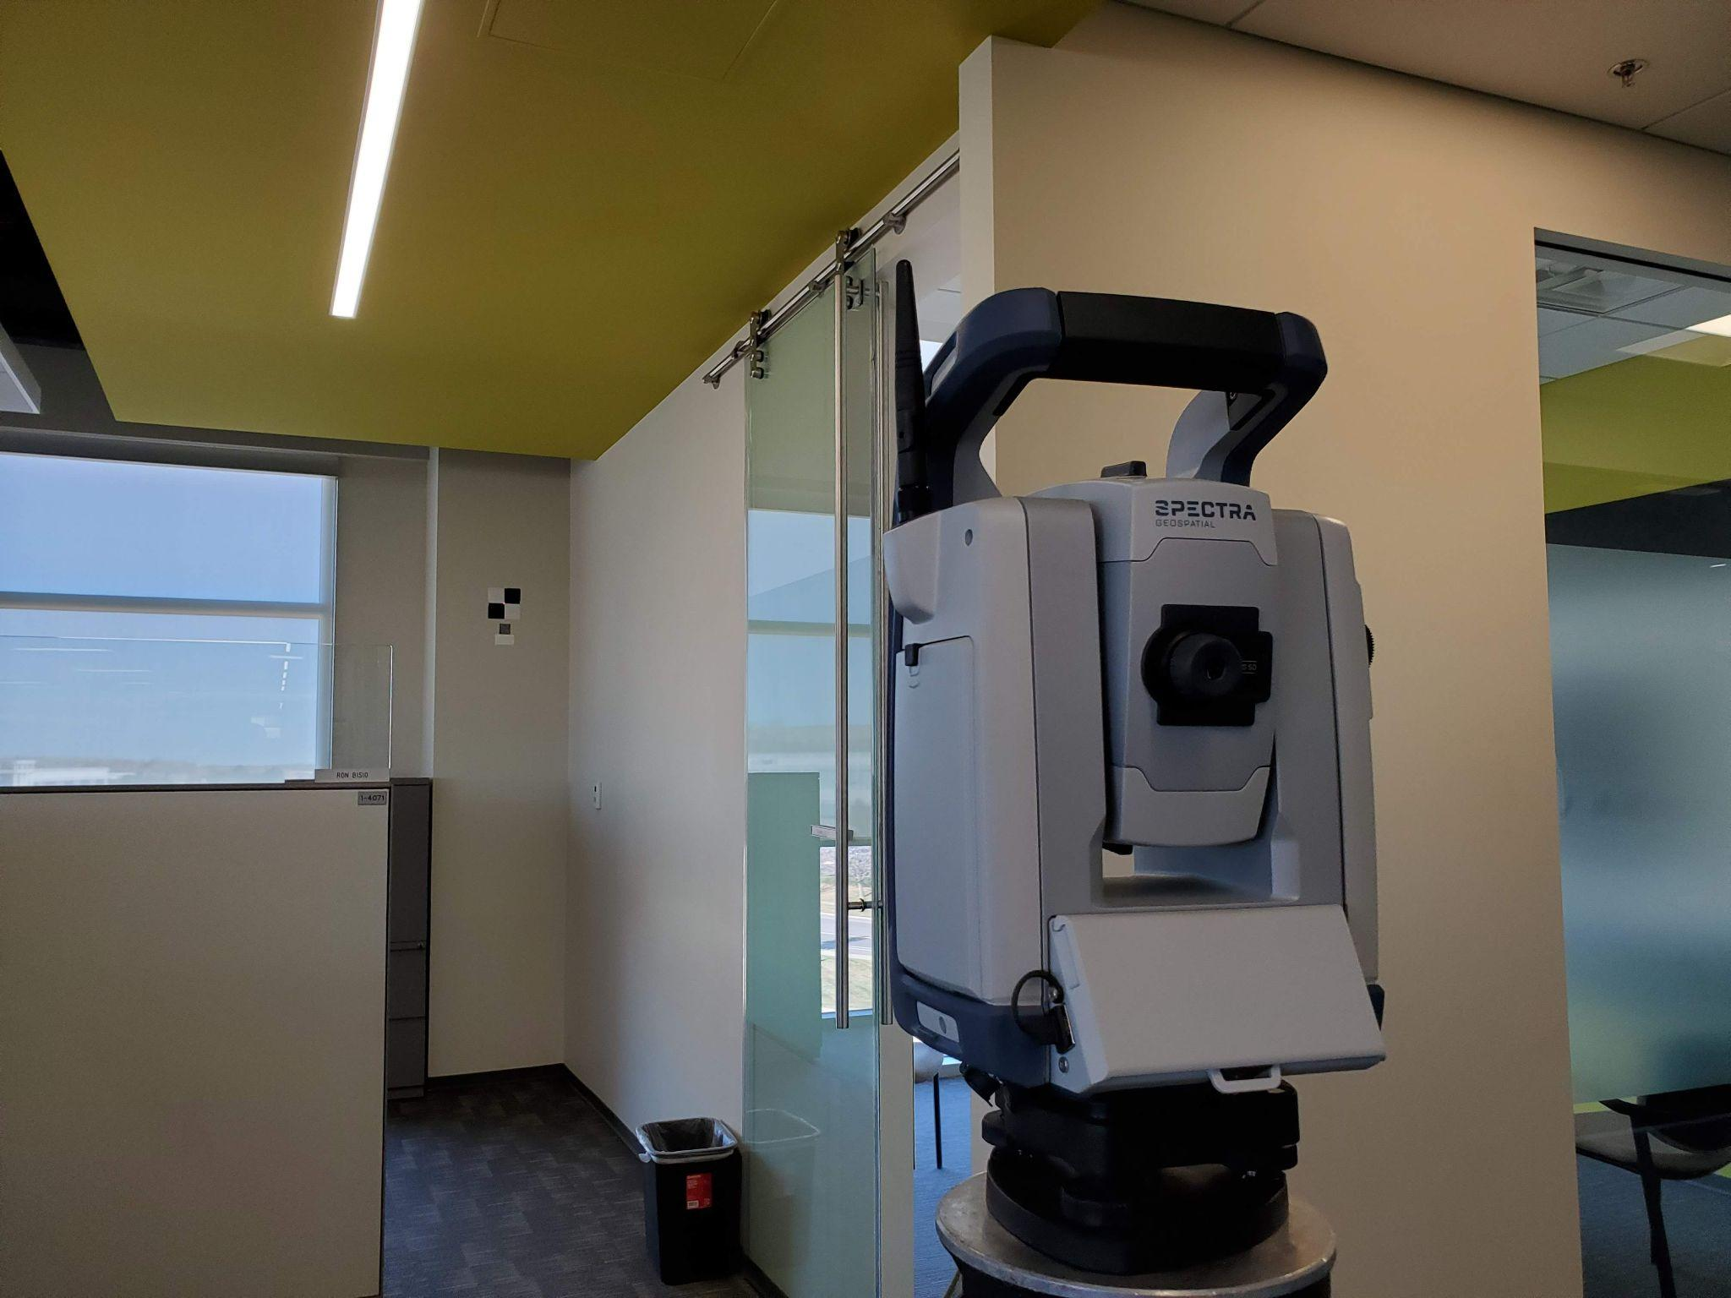
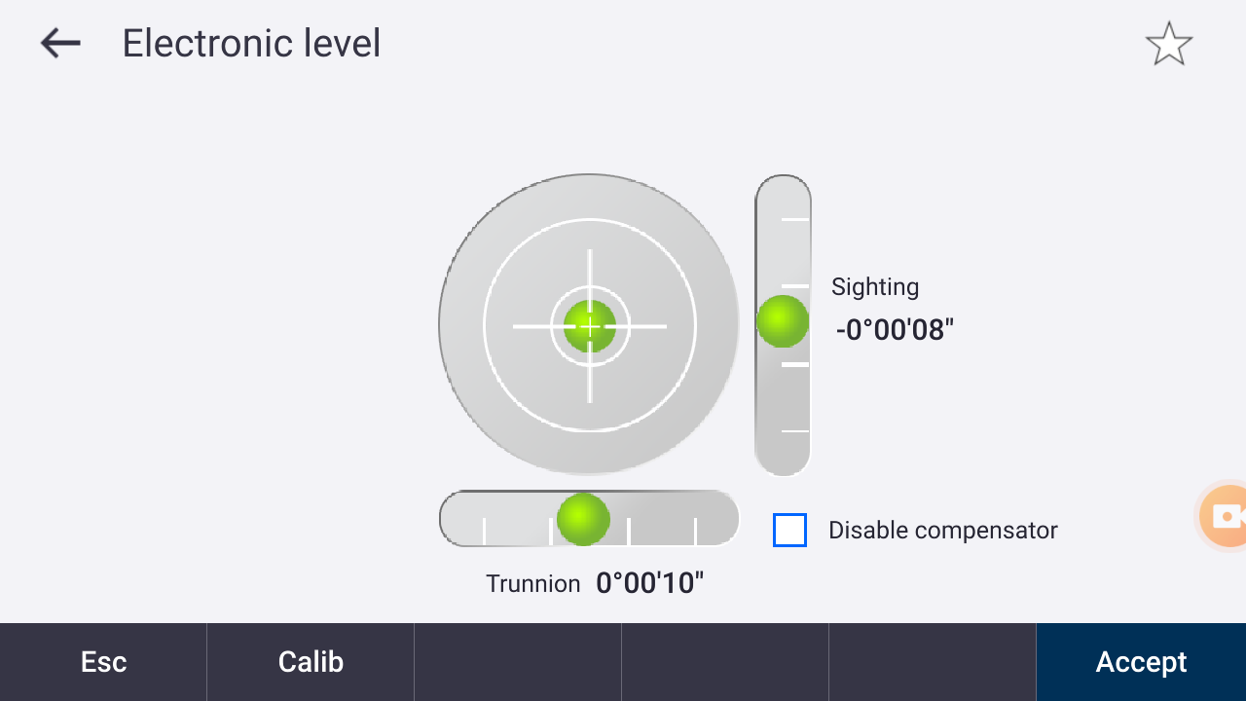
SurePoint™ In Action
Key Technologies
The Setup
Total Station is levelled and aimed at the B/W target with the laser pointer turned on
Next Slide
Move tribrach screw / total station out of level (but still in compensator range) → laser pointer moves off of the target center
→ SurePoint automatically moves the laser pointer back to the center

Slide 20
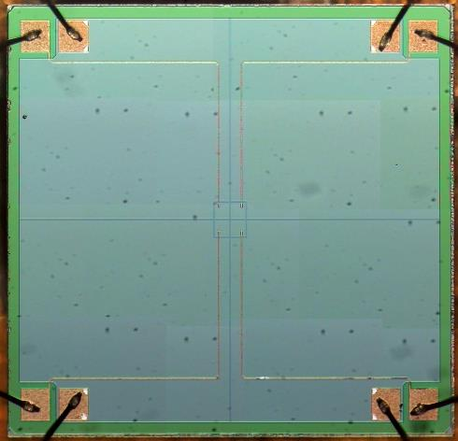
Autolock™
Key Technologies
Autolock is the name for the tracking technology
The base model of FOCUS 50 is named Autolock after this technology
How it works
FOCUS 50 sends out a signal (the prism is passive)
The signal reflects off the prism and goes back to the FOCUS 50
FOCUS 50 Tracker Sensor looks for the return signal
Tracker sensor has 4 quadrants
Once the total station detects a prism is within the tracker window, the servos will adjust the aiming until the signal is equally strong in all 4 quadrants
Tracker Sensor

Slide 21
Angular Accuracy,
Certificates,
and Firmware Updates

Slide 22
Choose the accuracy you need, now or later
Angular Accuracy, Certificates, and Firmware Updates
All Models of FOCUS 50 are available in 1”, 2”, 3”, or 5” angular accuracy
Change your mind? Upgrade at any time
How it works:
In the factory, all instruments go through extensive testing and calibrations to ensure they achieve 1” angular accuracy
Before delivering to you, a Spectra Geospatial Distribution partner applies an electronic configuration (firmware) to set the instrument performance

Slide 23
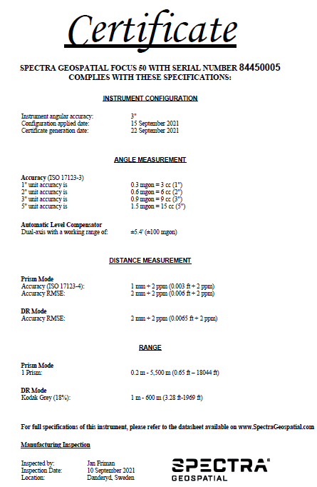
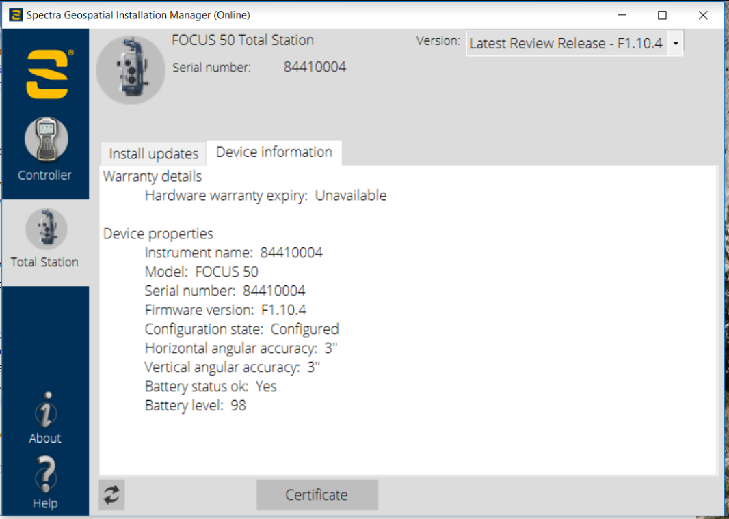
Certificate Delivery through SGIM
Angular Accuracy, Certificates, and Firmware Updates
Instrument Certificates are delivered electronically, on demand, through SGIM

Slide 24
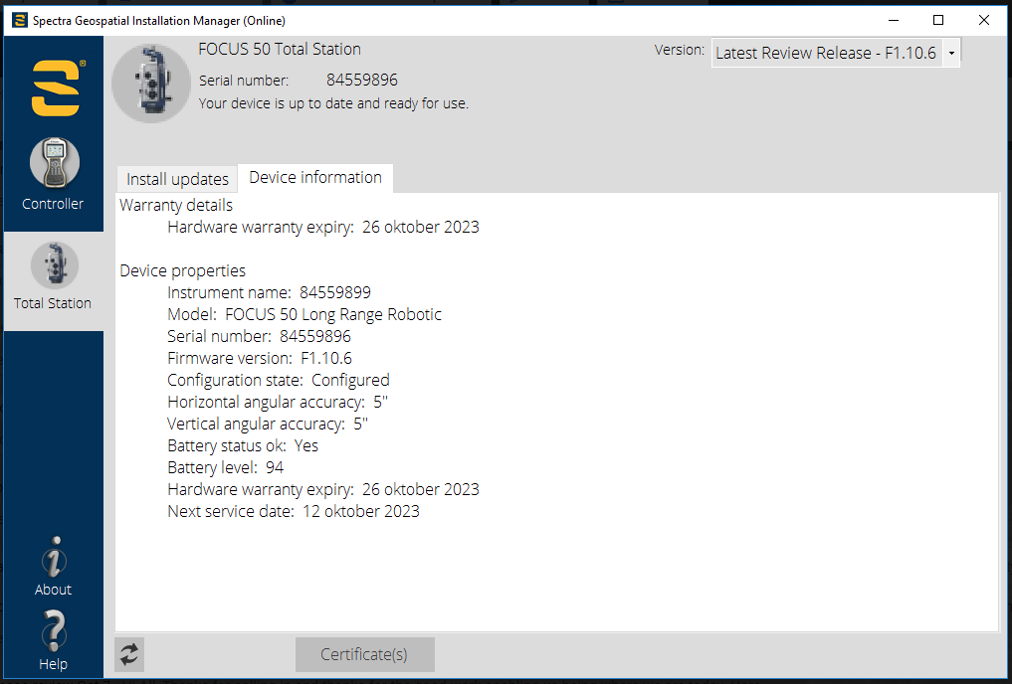
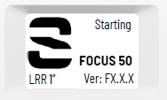
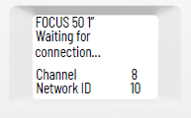
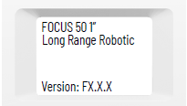
Where to find an instrument’s configuration
Angular Accuracy, Certificates, and Firmware Updates
Plug into SGIM > Device Information
Within Origin > Instrument Settings
In the Face 2 display
Splash Screen
Waiting for connection page
Firmware Page

Slide 25
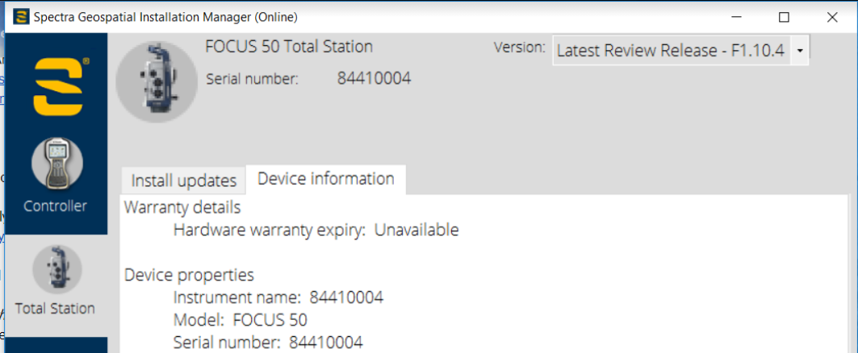
Firmware Updates through SGIM
Angular Accuracy, Certificates, and Firmware Updates
Firmware updates for the FOCUS 50 are built into SGIM → Easily update the instrument firmware

Slide 26
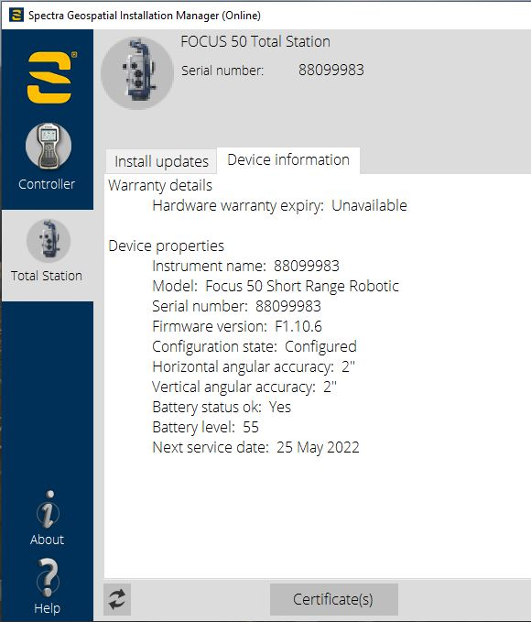
Service Certificates & Next Service Date
Angular Accuracy, Certificates, and Firmware Updates
Service certificates also delivered through SGIM
Certificate(s) button will download both:
Factory Certificate
Preventative Maintenance certificate (if available)
Next Service Date can be found:
In SGIM
Onboard the instrument under “Service Info”

Slide 27
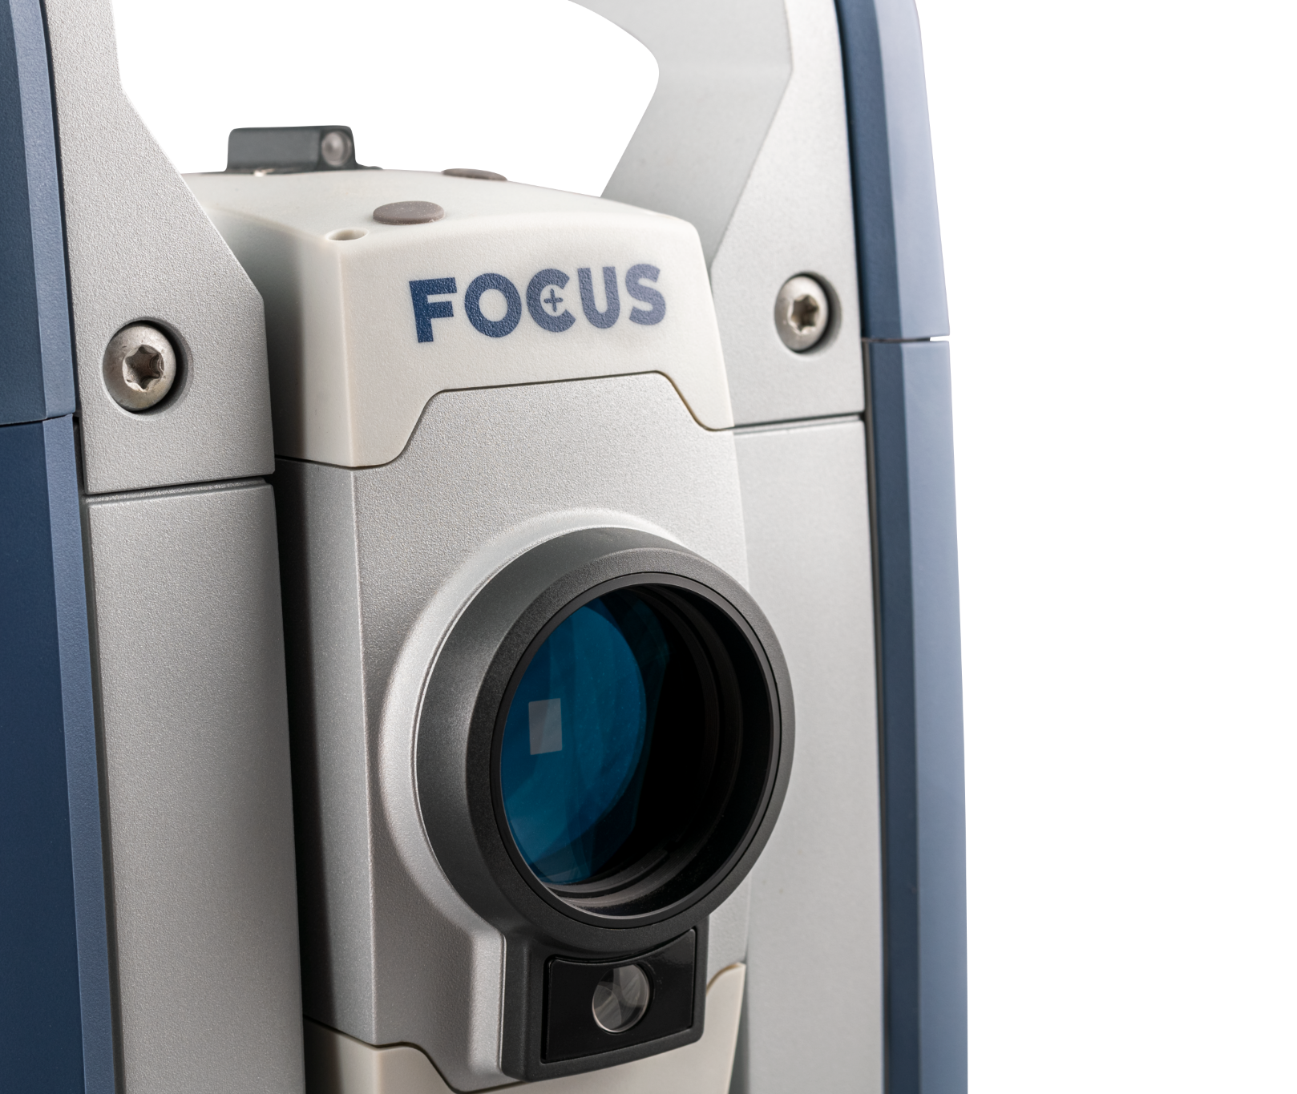
Configuration How-To
FOCUS 50 &
Origin Field Software

Slide 28
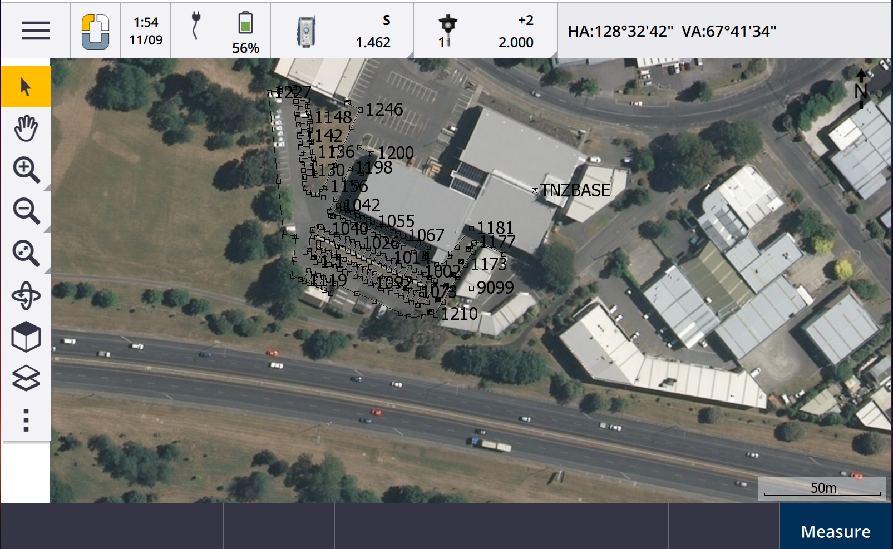
Modern Workflow
FOCUS 50 & Origin Field Software
Origin increases productivity by:
Map centric workflows
Modern UI reducing clicks required to access features and carry out a job
Auto connect to instruments to get the job started fast
Simple point selection and navigation, including multi-touch (pinch-to-zoom)
You can also add satellite imagery

Slide 29
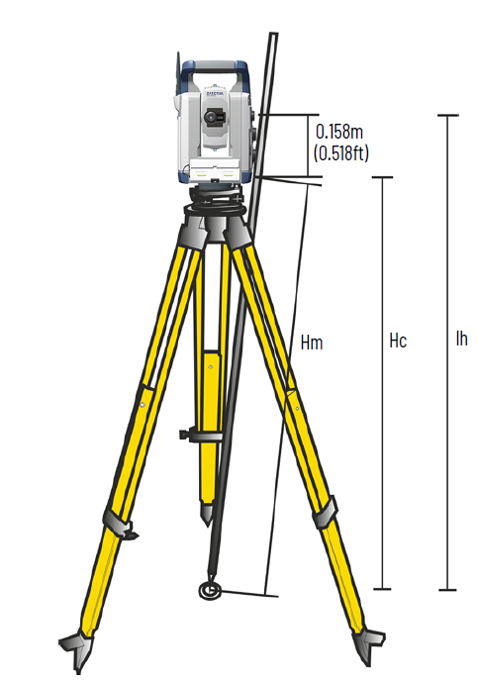
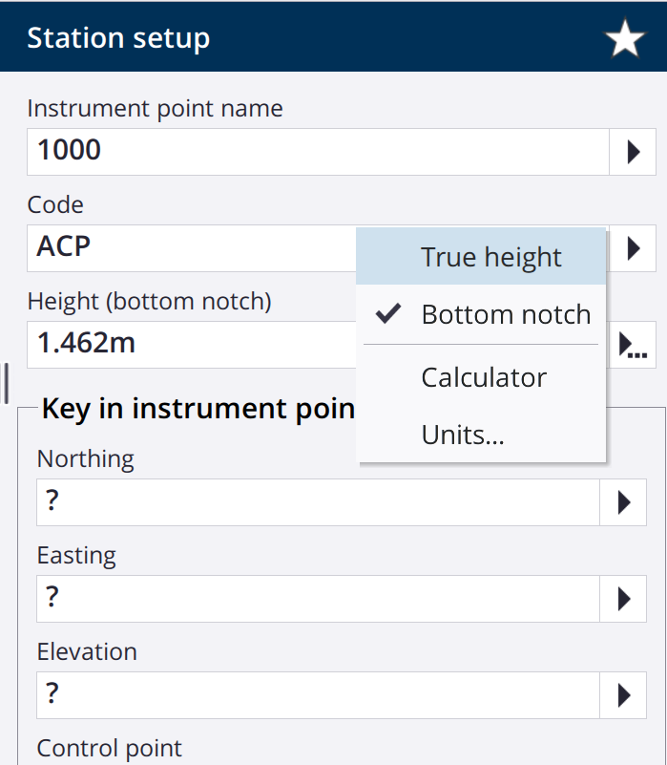
Simplified Instrument Height
FOCUS 50 & Origin Field Software
Sometimes measuring instrument true height is a little hard, especially on rough ground
Use the “bottom notch” for an easier and more accurate height measurement!
Measure the Hm (slope to bottom notch)
→ Origin software will automatically calculate the True Height
(You can always still measure/input Ih directly if you prefer)

Slide 30
Status Bar
FOCUS 50 & Origin Field Software
Data controller & Instrument Battery level (in this case, a controller is plugged in)
What instrument you are connected to
FOCUS 50
Solid straight line means you’re locked on a prism
EDM in Standard mode
Instrument height 1.434 m
Prism you’re using
Target 1
Instrument is locked on (autolock)
K value = +2mm
Target height = 2m
Current HA/VA (and SD if your EDM is in tracking mode)

Slide 31
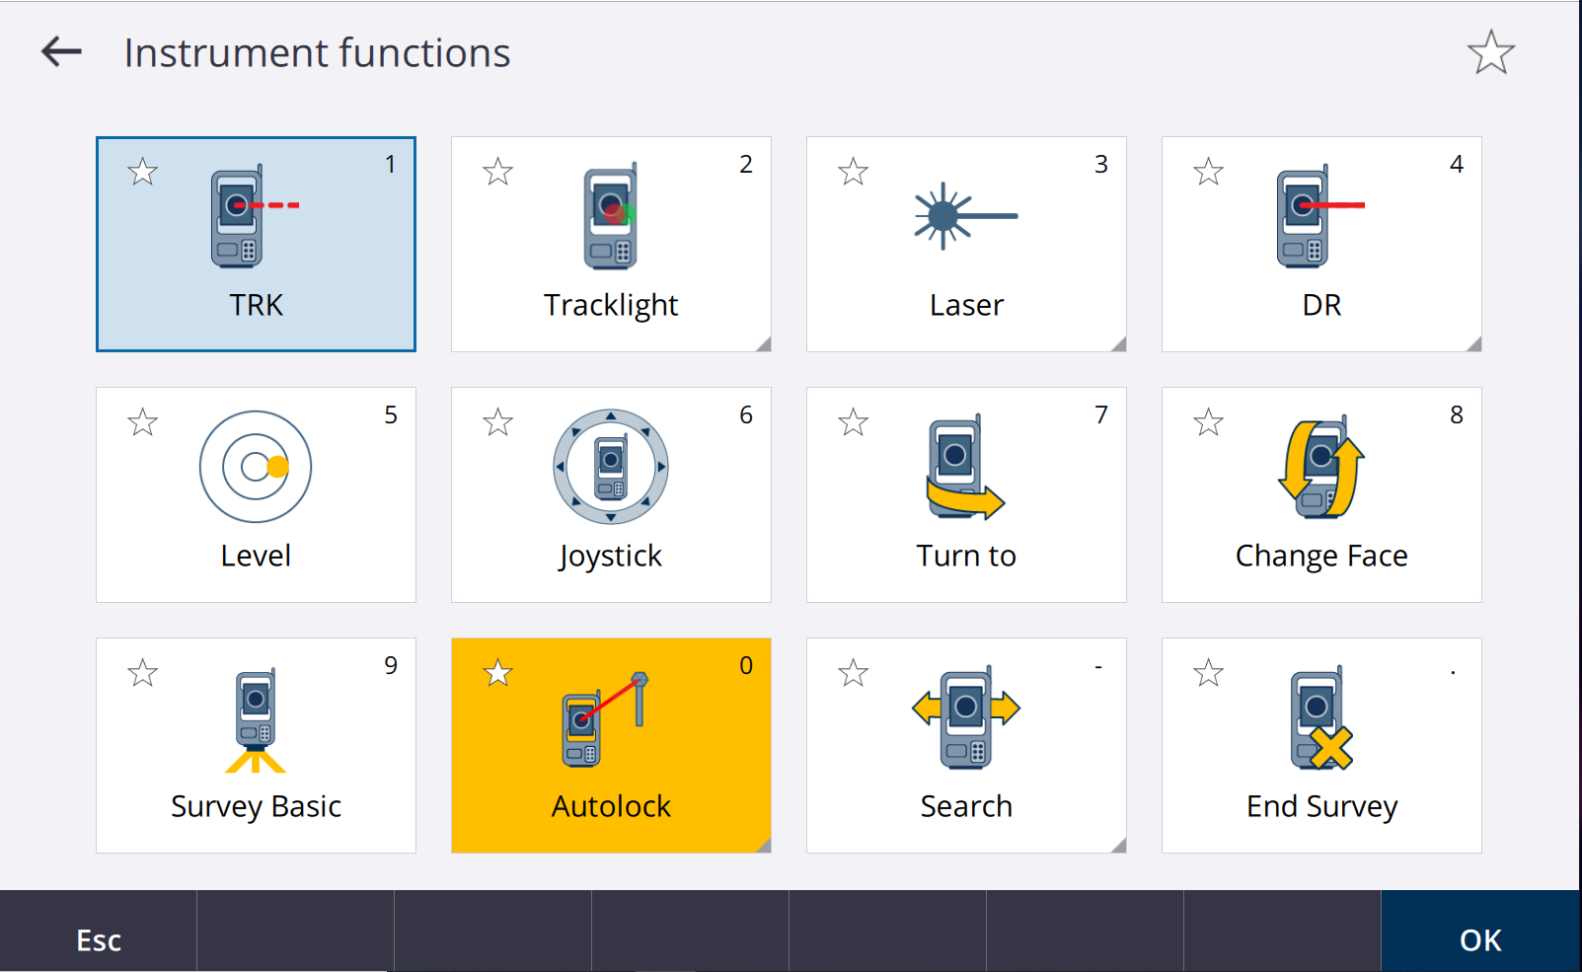
Instrument functions
Easily toggle on/off
FOCUS 50 & Origin Field Software
Click the FOCUS 50 icon at anytime to see all the instrument functions
Toggle them on/off as needed

Slide 32
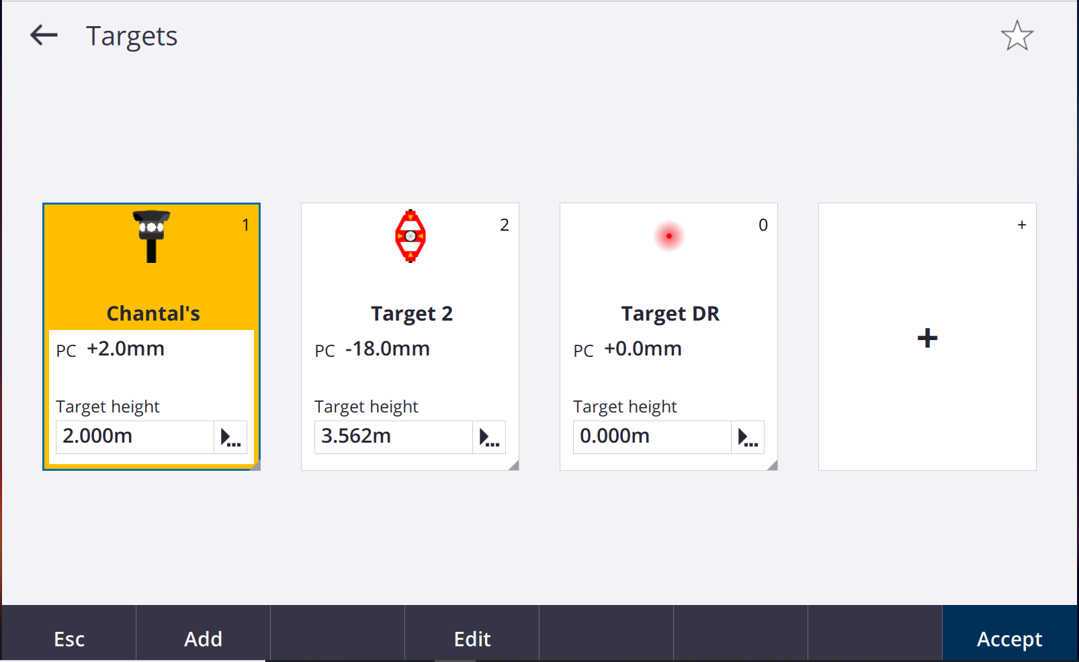
Targets
FOCUS 50 & Origin Field Software
Click on the prism icon at the top to jump into your Targets
Default named Target 1, 2, ...
Can also add nicknames, I named mine “Chantal’s”

Slide 33
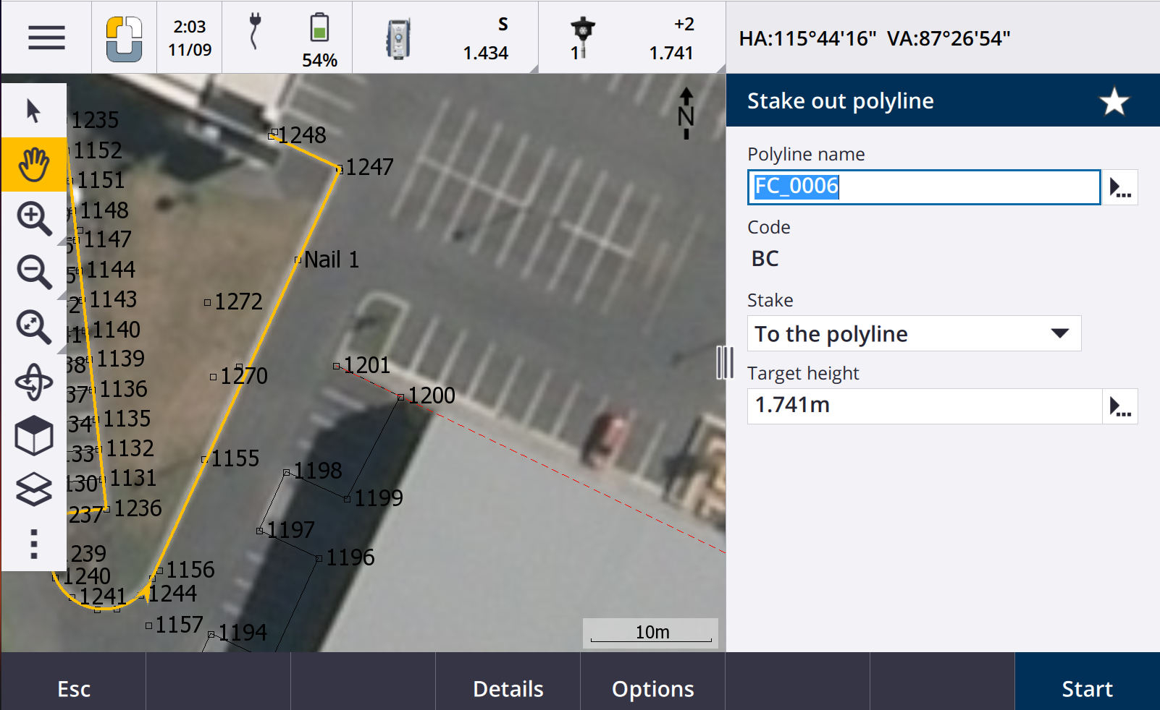
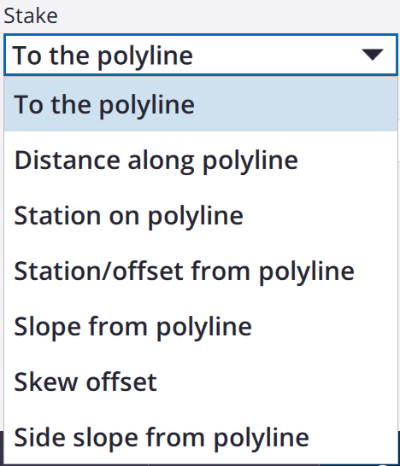
Stakeout (1/2)
FOCUS 50 & Origin Field Software
Easily select points, lines, or even polylines to stake out
Click polyline FC_0006
Click “Stakeout”
Side menu opens (shown)
Click “Start”
Other Stake Options:

Slide 34
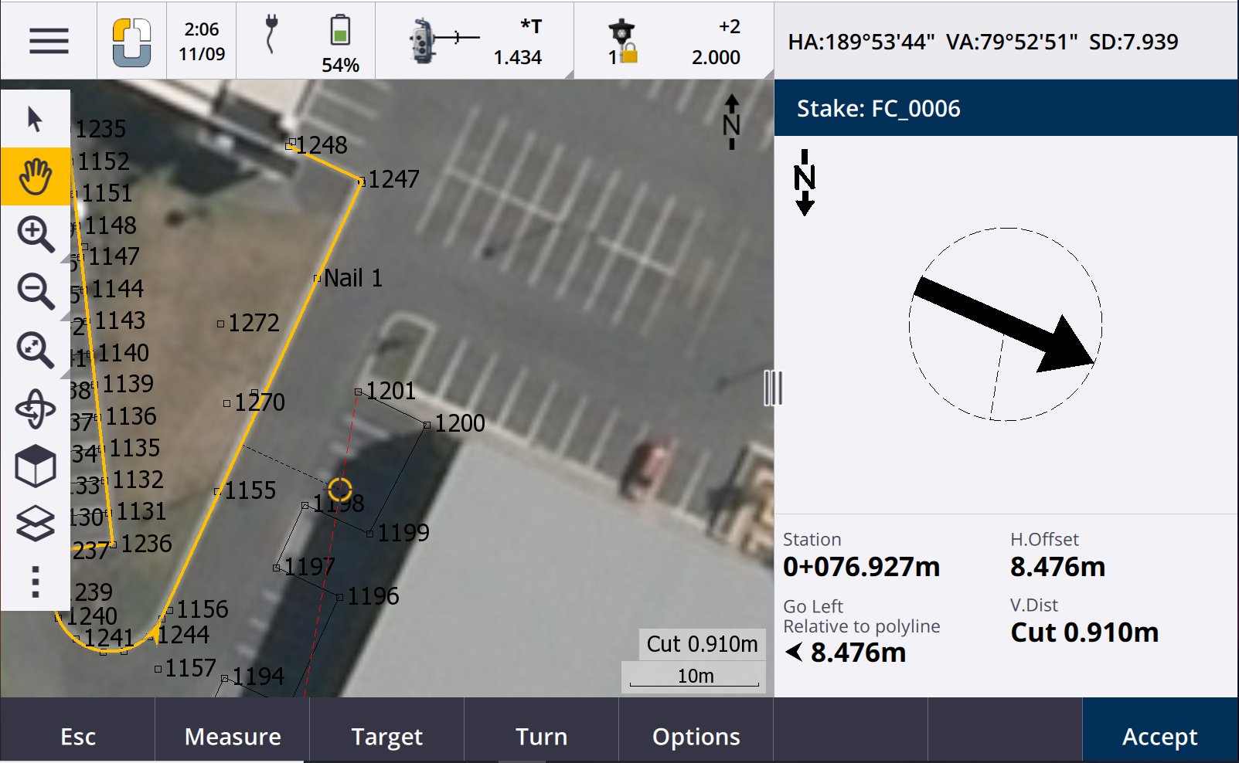
Stakeout (2/2)
FOCUS 50 & Origin Field Software
Simply follow the arrow!
Note-the top status bar changed
The total station automatically entered tracking mode (EDM constantly streaming a distance)
The lock symbol next to the prism means we’re tracking the prism using Autolock

Slide 35
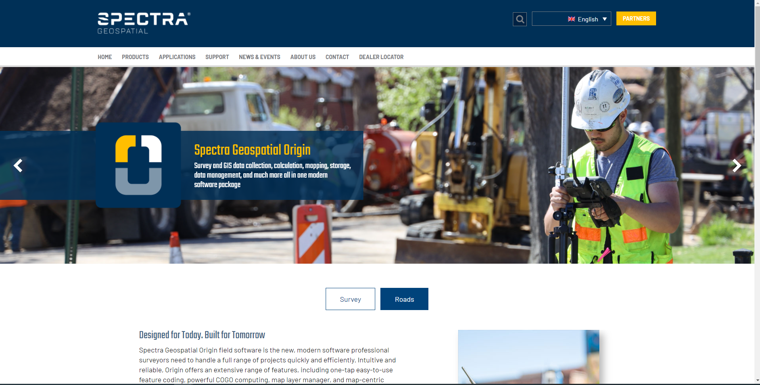
...and lots more!
Roads, feature coding and automated linework, integrated surveying with GNSS...
FOCUS 50 & Origin Field Software
To learn more about Origin, please visit spectrageospatial.com/origin/
Or reach out to your local Distribution Partner for a demo of Origin and the FOCUS 50 together
Origin incentive for Survey Pro, Survey Mobile users:
All Survey Pro and Survey Mobile users can try one year of Origin subscription for free. This includes:
Origin Max, GNSS, & Total Station
Origin Roads
Origin LT
Incentive to end on December 31st
Need photo

Slide 36
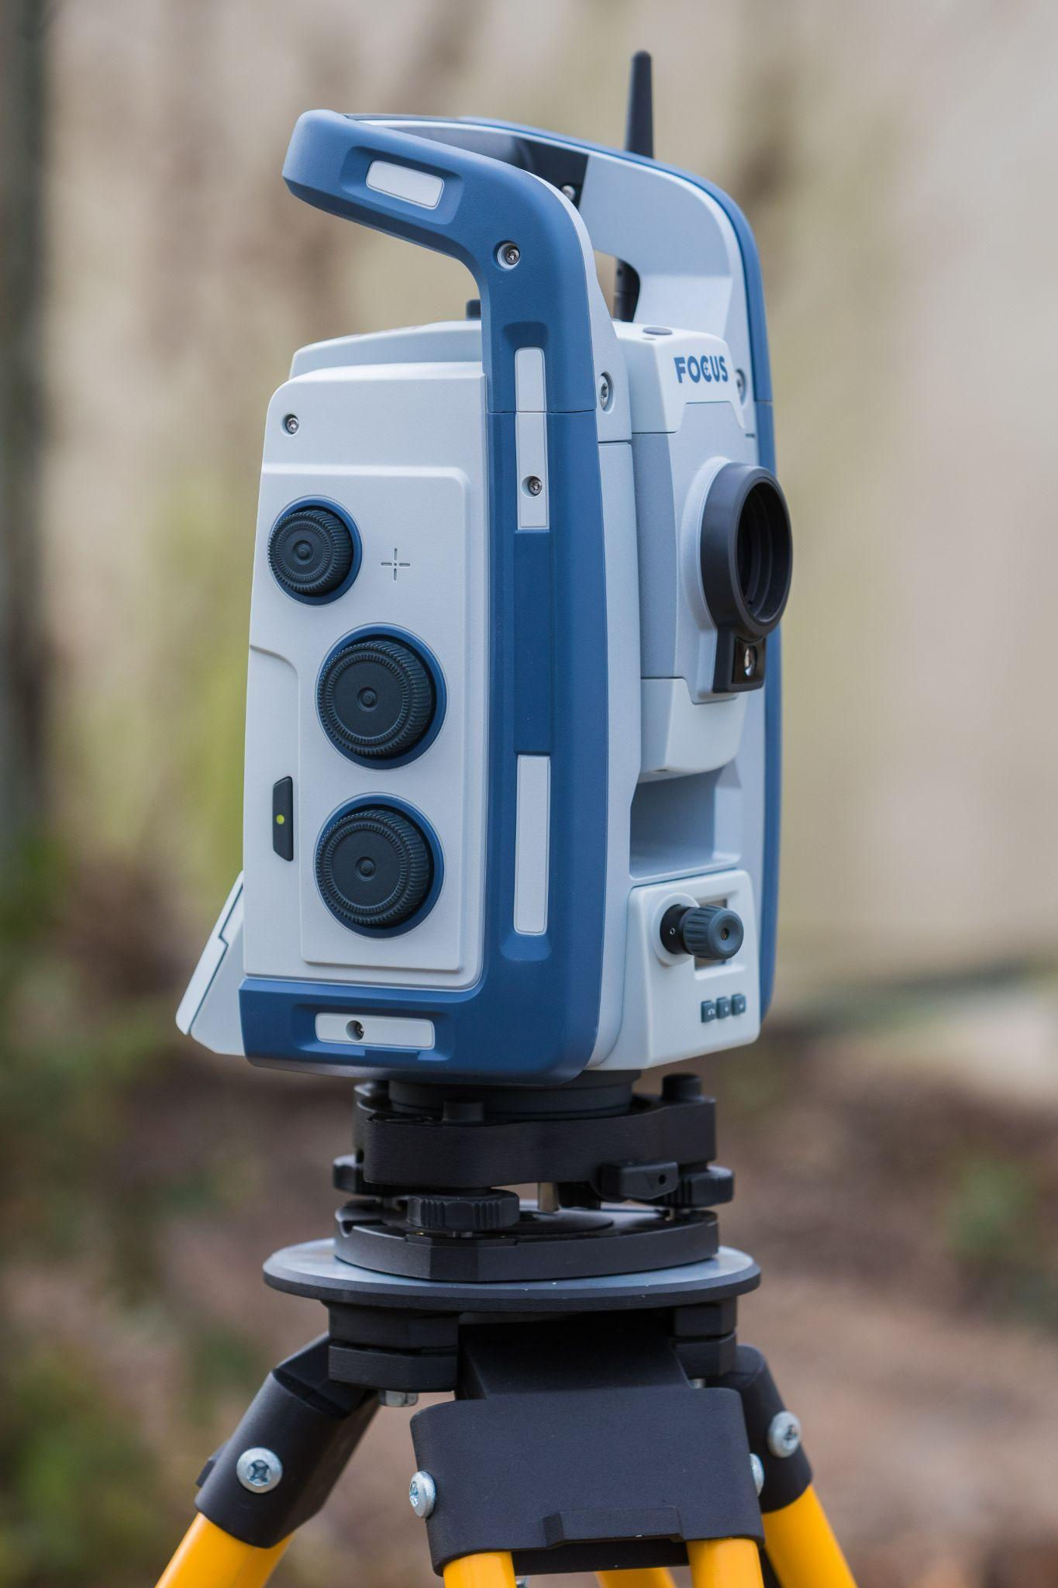
Thank You
Time for Questions

