Slide 1
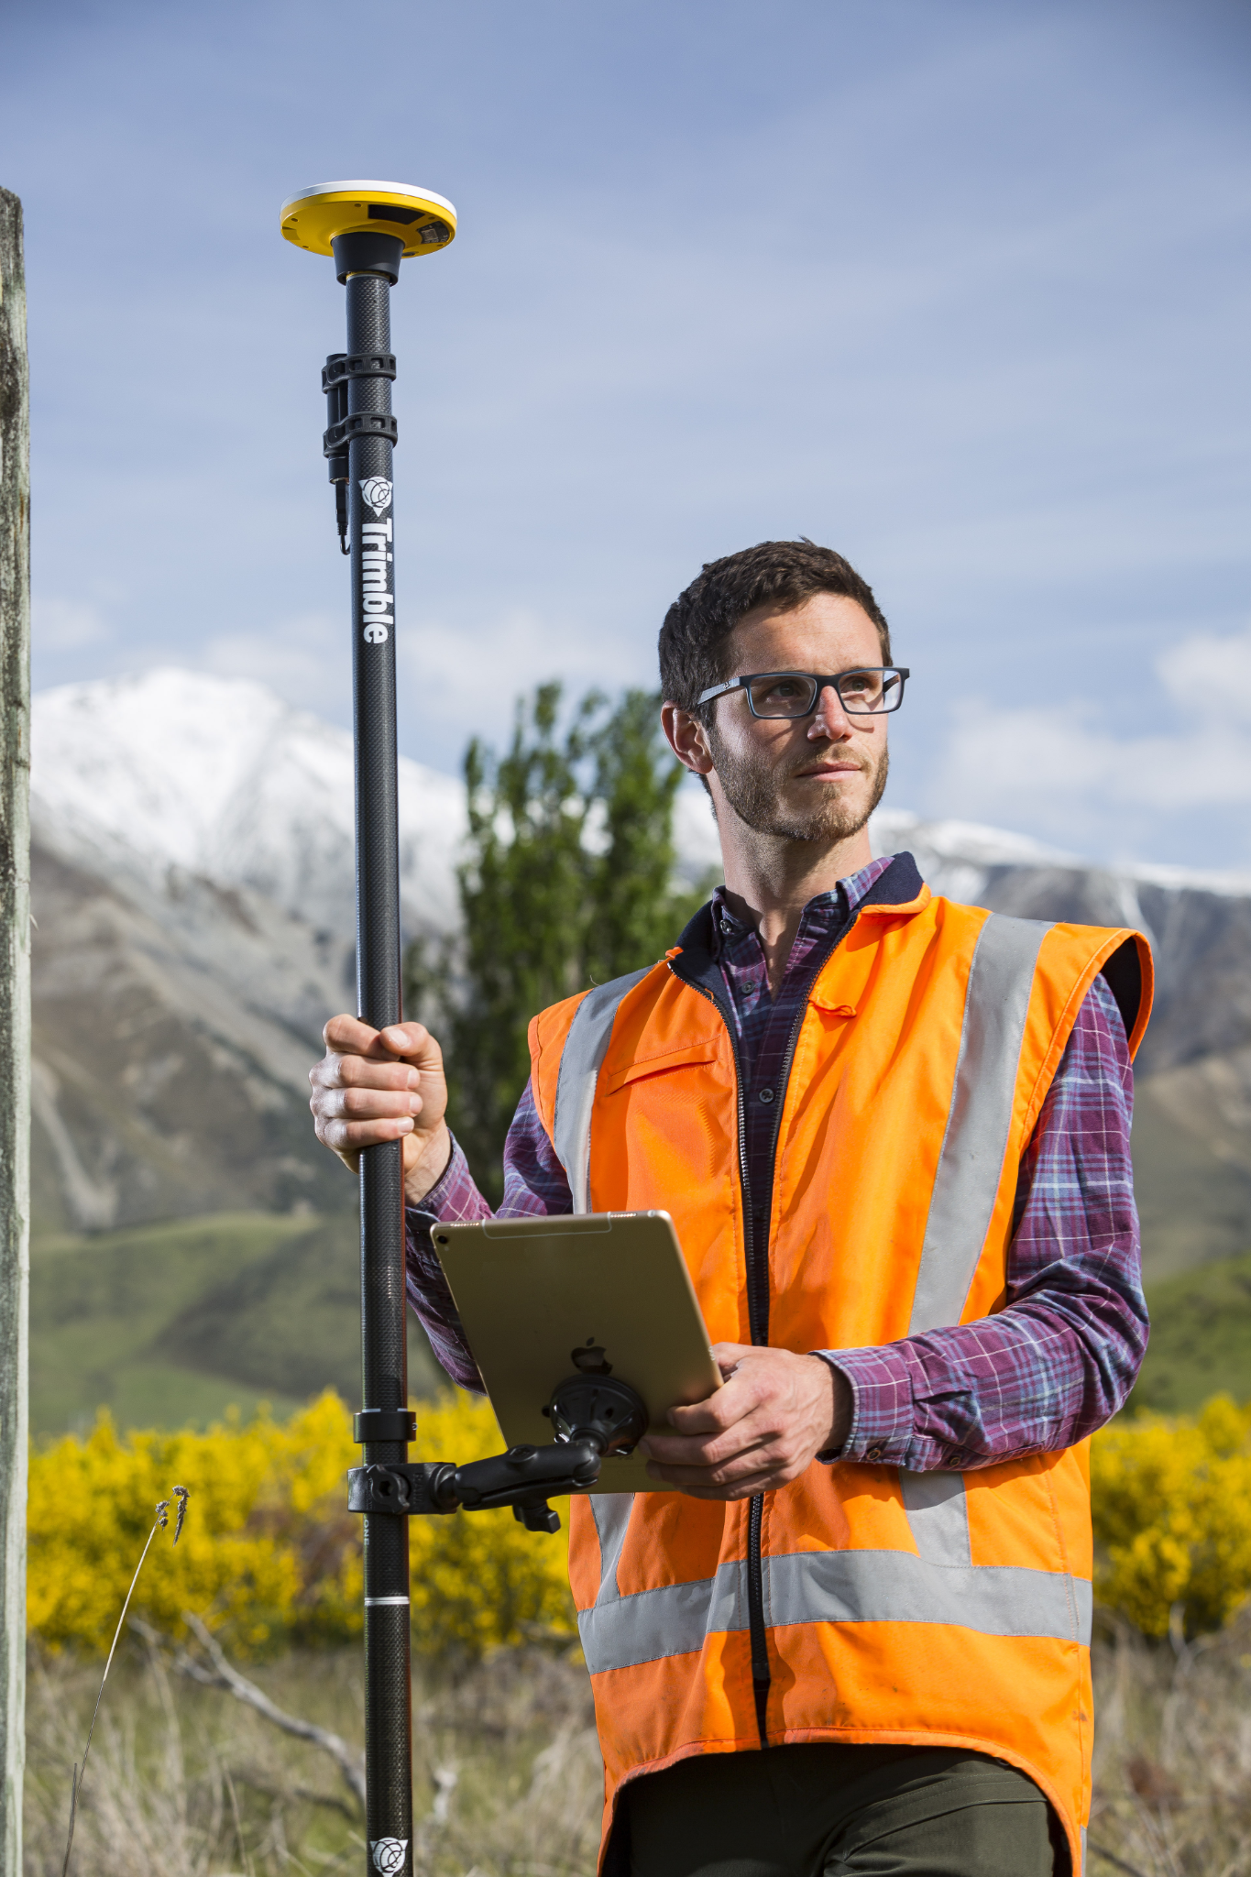
Trimble Catalyst
DA2 GNSS receiver
Introducing a brand new engine at the heart of the Catalyst positioning service

Slide 2
Today’s topics
Catalyst
The Catalyst DA2
Devices, apps, and workflows
Updates to Catalyst subscriptions
Availability

Slide 3
01
Trimble Catalyst

Slide 4
Why Catalyst?
It has never been so easy to get professional grade GNSS positions.

Slide 5
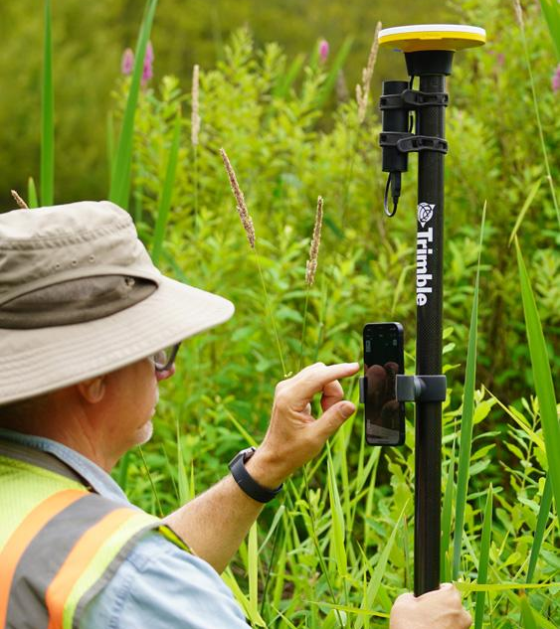
What is Catalyst?
Trimble Catalyst is a revolutionary offering from Trimble that uses a software defined GNSS receiver technology.
The solution enables a customer to subscribe to the Catalyst service in order to enable the GNSS receiver to operate at a level of accuracy related to their subscription level.
Catalyst consists of the DA2 receiver, a power bank of your choice, any Android or iOS device, and your application.
Notes:
The solution enables a customer to subscribe to the Catalyst service in order to enable the GNSS receiver to operate at a level of accuracy related to their subscription level.
Catalyst consists of the DA2 receiver, a power bank of your choice, any Android or iOS device, and your application.

Slide 6
Trimble Catalyst is...
INEXPENSIVE
Minimal upfront hardware cost
Corrections bundled with the subscription
Less of your money tied up in capital assets
SIMPLE
Zero-configuration access to Trimble corrections
Works with nearly any location enabled app
FLEXIBLE
Ready to use on-demand worldwide
Scalable for individuals, small teams, and large crews
Modify as your needs change
POWERFUL
High quality performance
Full survey grade precision

Slide 7
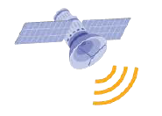
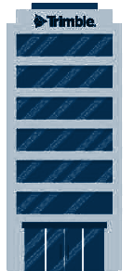
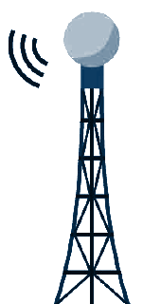
What about “Corrections”?
Satellites for raw positioning
Satellites for positioning corrections
Corrections are applied to raw GNSS data making positions accurate and reliable.
Receiver and handheld
Internet Corrections
Trimble Corrections Hub (TCH)
Notes:
GPS correction provided by
the Trimble Corrections Hub (TCH) are needed to improve raw GPS satellite data
from uncontrolled meters accuracy
to the desired accuracy level.

Slide 8
What about “Corrections”?
It just works!
Catalyst Subscriptions simply include Corrections
Notes:
A traditional receiver requires a separate correction service

Slide 9
02
Trimble DA2
GNSS Receiver
For the Trimble Catalyst Positioning Service
© 2021 Trimble, Inc - All Rights Reserved - Confidential and Proprietary Information

Slide 10
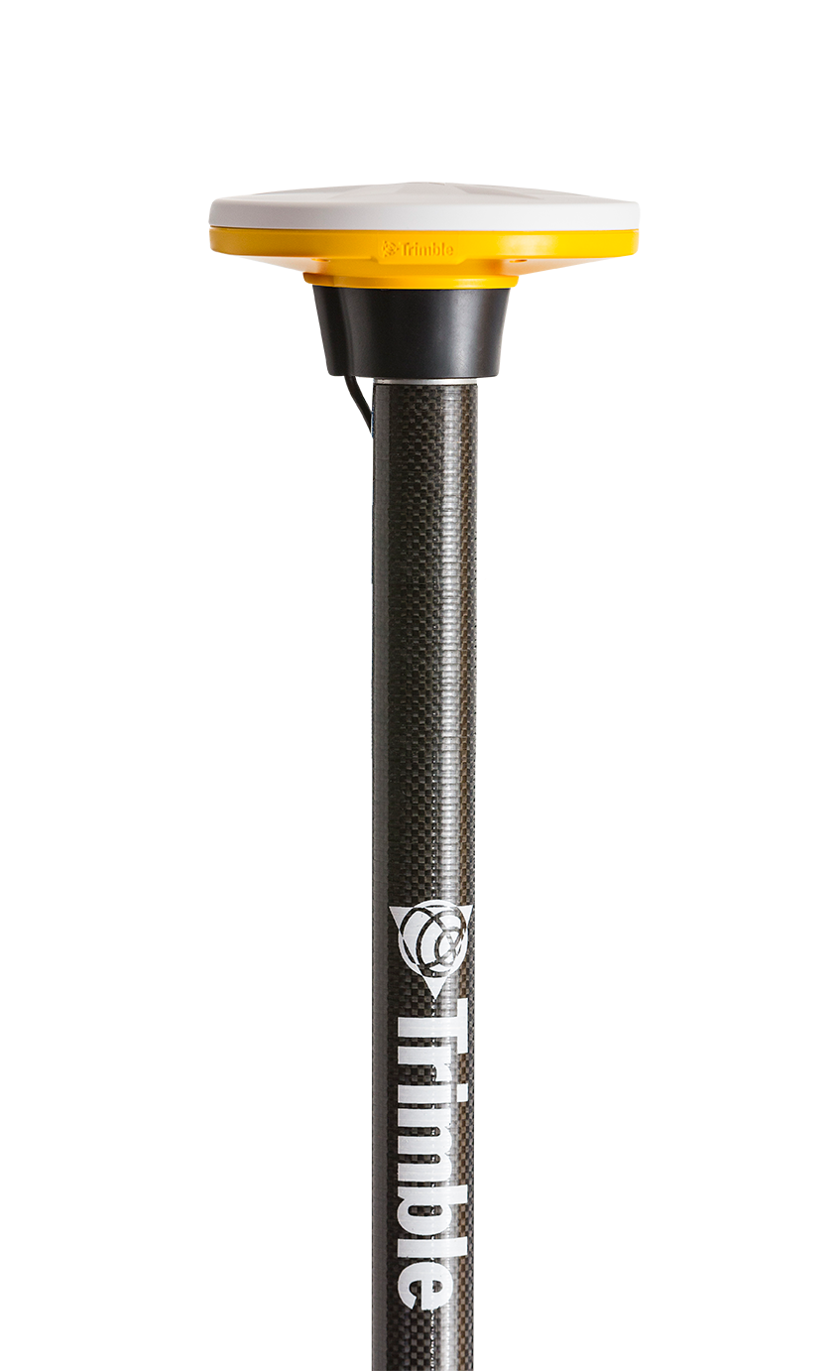
Simply Precise.

Slide 11
Key DA1 Features
Android
Versatile
Lightweight
Catalyst
Positioning

Slide 12
Key DA2 Features
iOS & Android
Bluetooth Delivery
Versatile
Lightweight
ProPoint
Technology
Catalyst
Positioning

Slide 13
Catalyst Technology
Trimble Catalyst is a revolutionary GNSS concept, simplifying the way that precise GNSS positioning is delivered
Notes:
Catalyst receivers process GNSS signals in a software environment instead of a hard wired integrated circuit.
Efficient dynamic channels are controlled in the software.
Updating to the latest receiver functionality is simply a matter of downloading an OTA update.

Slide 14
ProPoint Technology
Improved receiver performance in challenging* GNSS environments, including operating under tree canopy or near buildings & other urban structures.
* Challenging GNSS environments are locations where the receiver has sufficient satellite availability to achieve minimum accuracy requirements, but where the signal may be partly obstructed by and/or reflected off of trees, buildings, and other objects. Actual results may vary based on user's geographic location and atmospheric activity, scintillation levels, GNSS constellation health and availability, and level of multipath and signal occlusion.
Notes:
Advanced tracking and GNSS signal management delivers increased yield.
Advanced signal filtering and error modelling provide better protection against jamming and multipath errors.

Slide 15
GNSS Performance
Network RTK
Horizontal accuracy……………………………………………..….10 mm + 0.5 ppm RMS
Vertical accuracy…………………………...……………………..…20 mm + 0.5 ppm RMS
Positioning rates……………………………………...…………...1 Hz, 5 Hz, 10 Hz
Positioning Engine: Powered by Trimble ProPoint GNSS positioning technology
Satellite Signals Tracked Simultaneously:
GPS: …………………………………………………….………….. L1C/A, L2C, L5
GLONASS: ................................................................L1C/A, L2C/A
SBAS (WAAS, EGNOS, GAGAN, MSAS, SDCM): ..... L1C/A, L2C, L5
Galileo: ……………………………………………………………. E1, E5A
BeiDou: …………………………………………………………... B1, B2A
QZSS: ……………………………………………………………….L1C/A, L2C, L5
NavIC (IRNSS):..........................................................L5
L-Band:..................................................................... Trimble RTX Corrections
Channels: Software-controlled signal management with dynamic (virtual) channel allocation

Slide 16
Mechanical Design
Weight (DA2 only):.................................................330 g (12 oz)
Water & Dust…………………………………………….. IP65 (dust proof, rain proof)
Drop (tipping pole fall onto concrete)........................... Survives 2 m tipping falls
Drop (free fall onto concrete)......................................Survives 1.2 m free falls

Slide 17
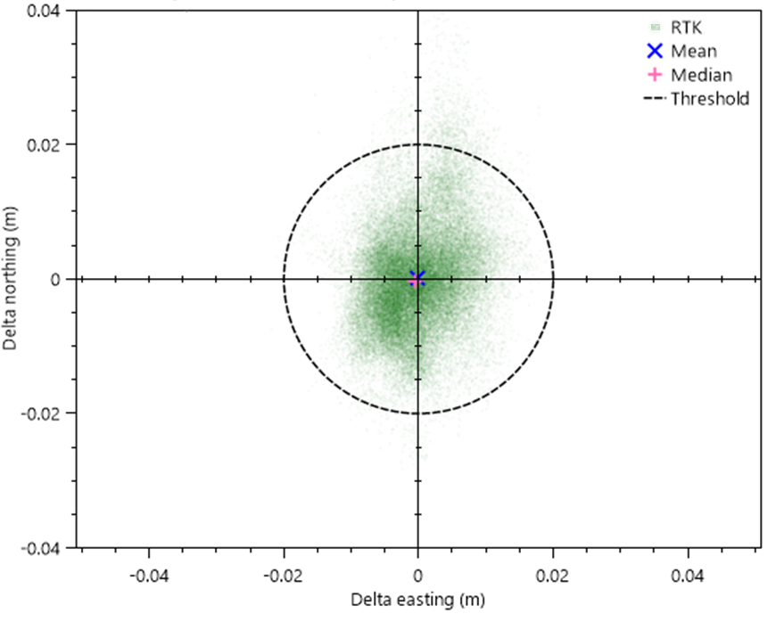
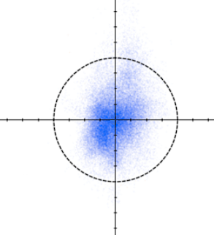
DA2 Performance Testing: Accuracy RTK
20mm
20mm circle
0mm
20mm
Northing
Easting
|20mm
|0mm
|20mm
RTK 27km, CMRx Horizontal Error
Convergence time after RTK reset : < 5 sec (typical)

Slide 18
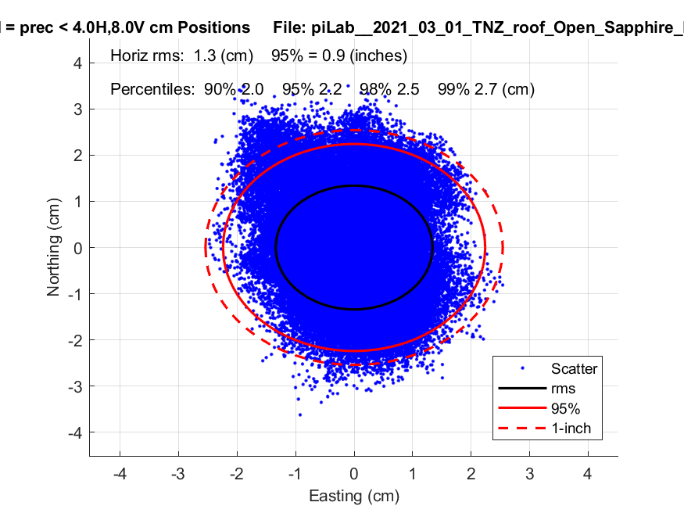
DA2 Performance Testing: Accuracy RTX
RTX accuracy
RTX Fast Convergence: 2 cm in 48 sec (68% percentile)

Slide 19
DA2 Performance Improvements
100%
100%
Positioning yield (RTK)
Positions with fixed RTK position / positioning occupied
DA2
98%
DA1
80%
50%
50%
0%
0%
0
30
60
90
120
DA1
DA2
Time (seconds)
Time to First Fix

Slide 20
Trimble DA2 Corrections Hub Coverage (DA2)
Catalyst subscribers can use Trimble RTX (L-band and IP) with their DA2 using the Trimble Corrections Hub (TCH).
Notes:
With DA2, the availability, precision and convergence speed of TCH's RTX-corrected solutions are significantly improved over DA1 due to improvements in antenna design and the introduction of Trimble ProPoint technology:
<2cm within 1 minute in key regions. otherwise better 2cm in 3 minutes on average worldwide.

Slide 21
What’s In The Box?
DA2 GNSS Receiver (with USB-A power cable)
5/8x11 Pole Cap
Battery pack mount
Documentation (Warranty Card & Quick Start Guide)

Slide 22
Power Solutions
Power DA2 by USB…
...including directly from your tablet or smartphone
Run-time depends on your power source
Notes:
Power DA2 with any* USB-compatible power pack or power source
On the right you see DA2 standard USB power cable and ANKER Powercore Mini+ (12.1 Wh)
Any device supporting Power Delivery over USB functionality can power DA2 (e.g. TDC600, iPad Pro, most Android devices with USB-C). This configuration requires a DA2 to USB-C cable, sold-separately.
Run-time depends on numerous factors, including energy capacity & efficiency of the power source, ambient temperature, and total power being drawn by the system...
With Anker power core batteries between 4.5 and 6 hours or more
* DA2 is equipped with a USB Type-A connector as standard. USB-C cable option required for most Android/iPad Pro devices and Power Banks with USB-C Power Delivery functionality. Power Delivery is not supported on Apple iPhone devices with Lightning connector.

Slide 23
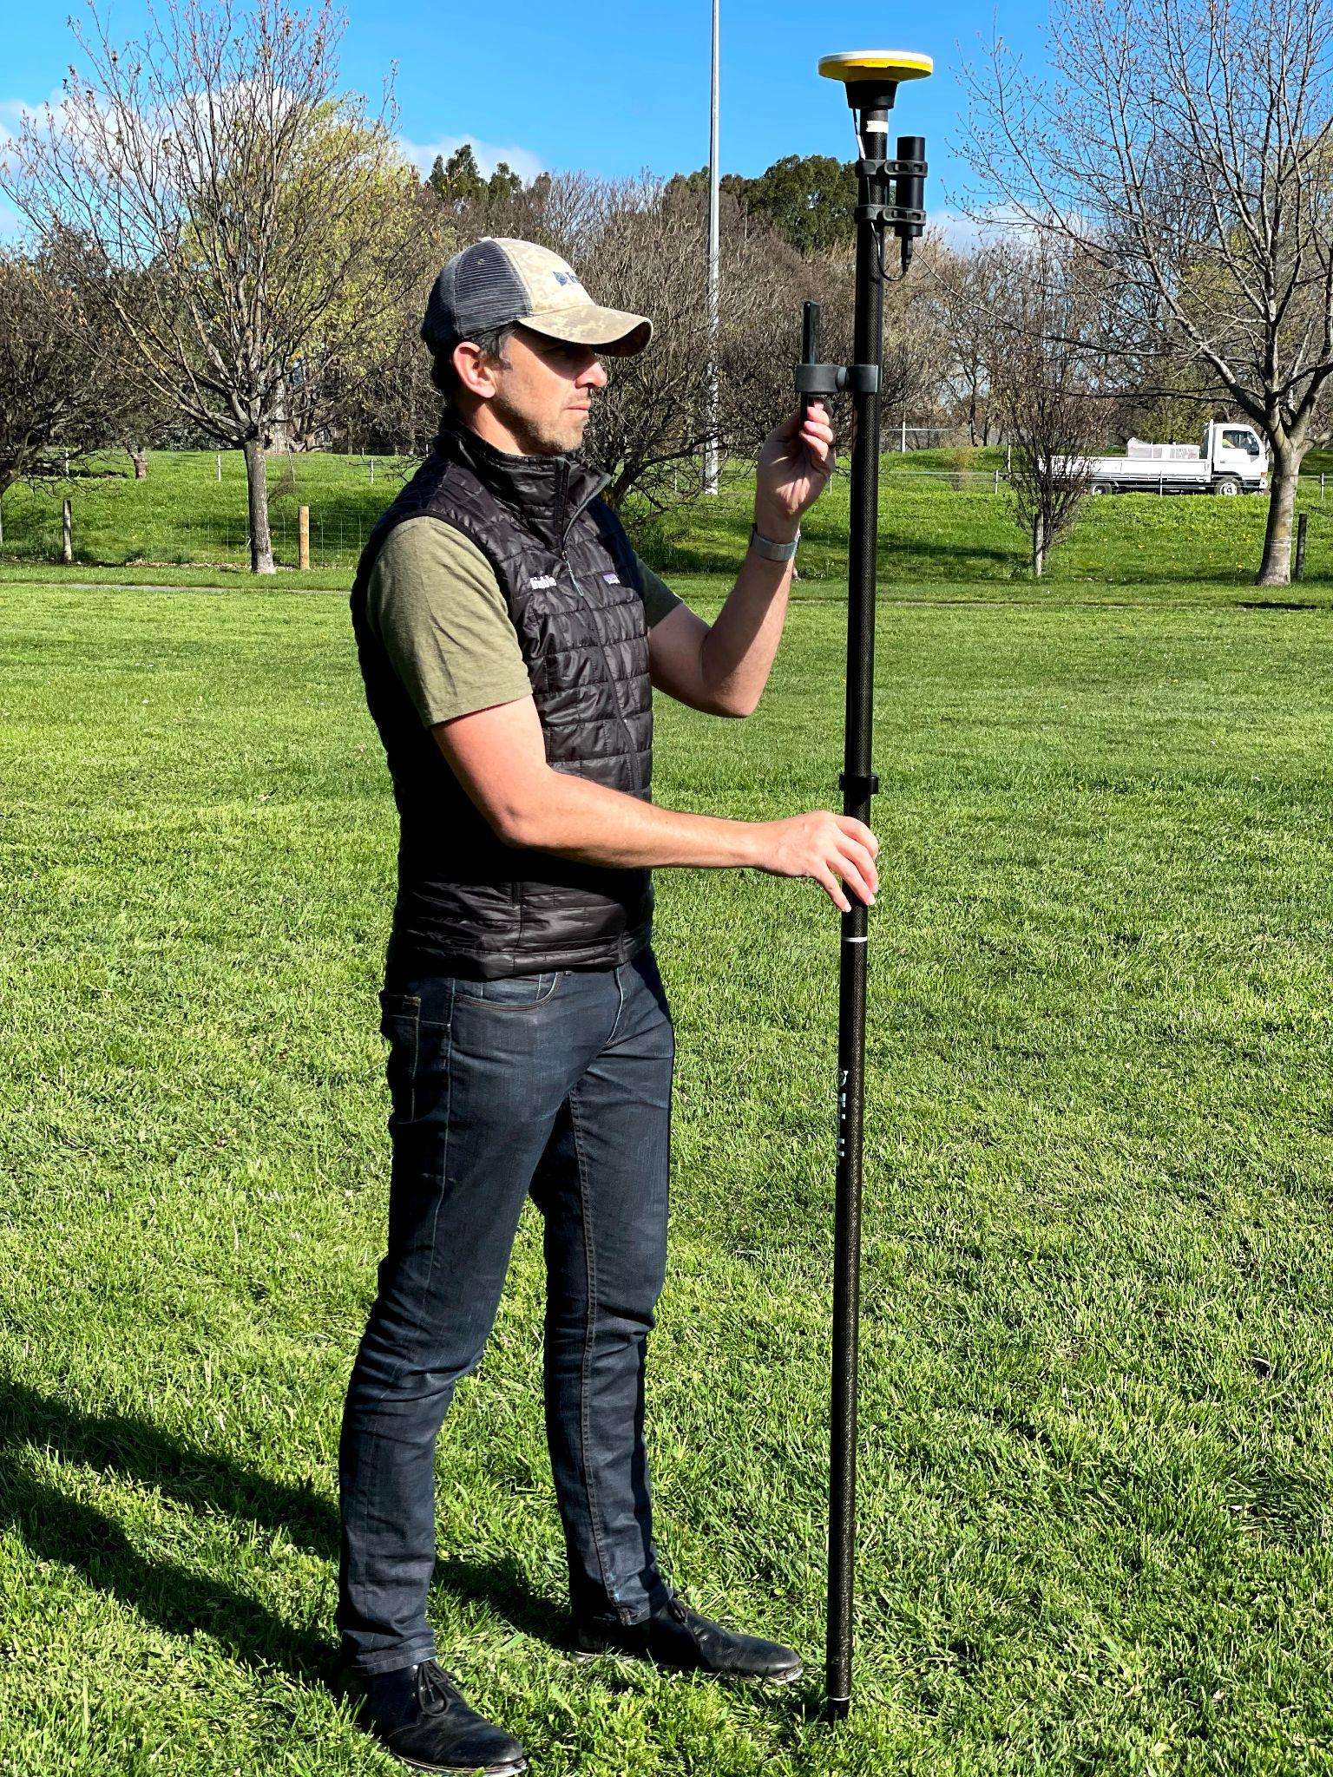
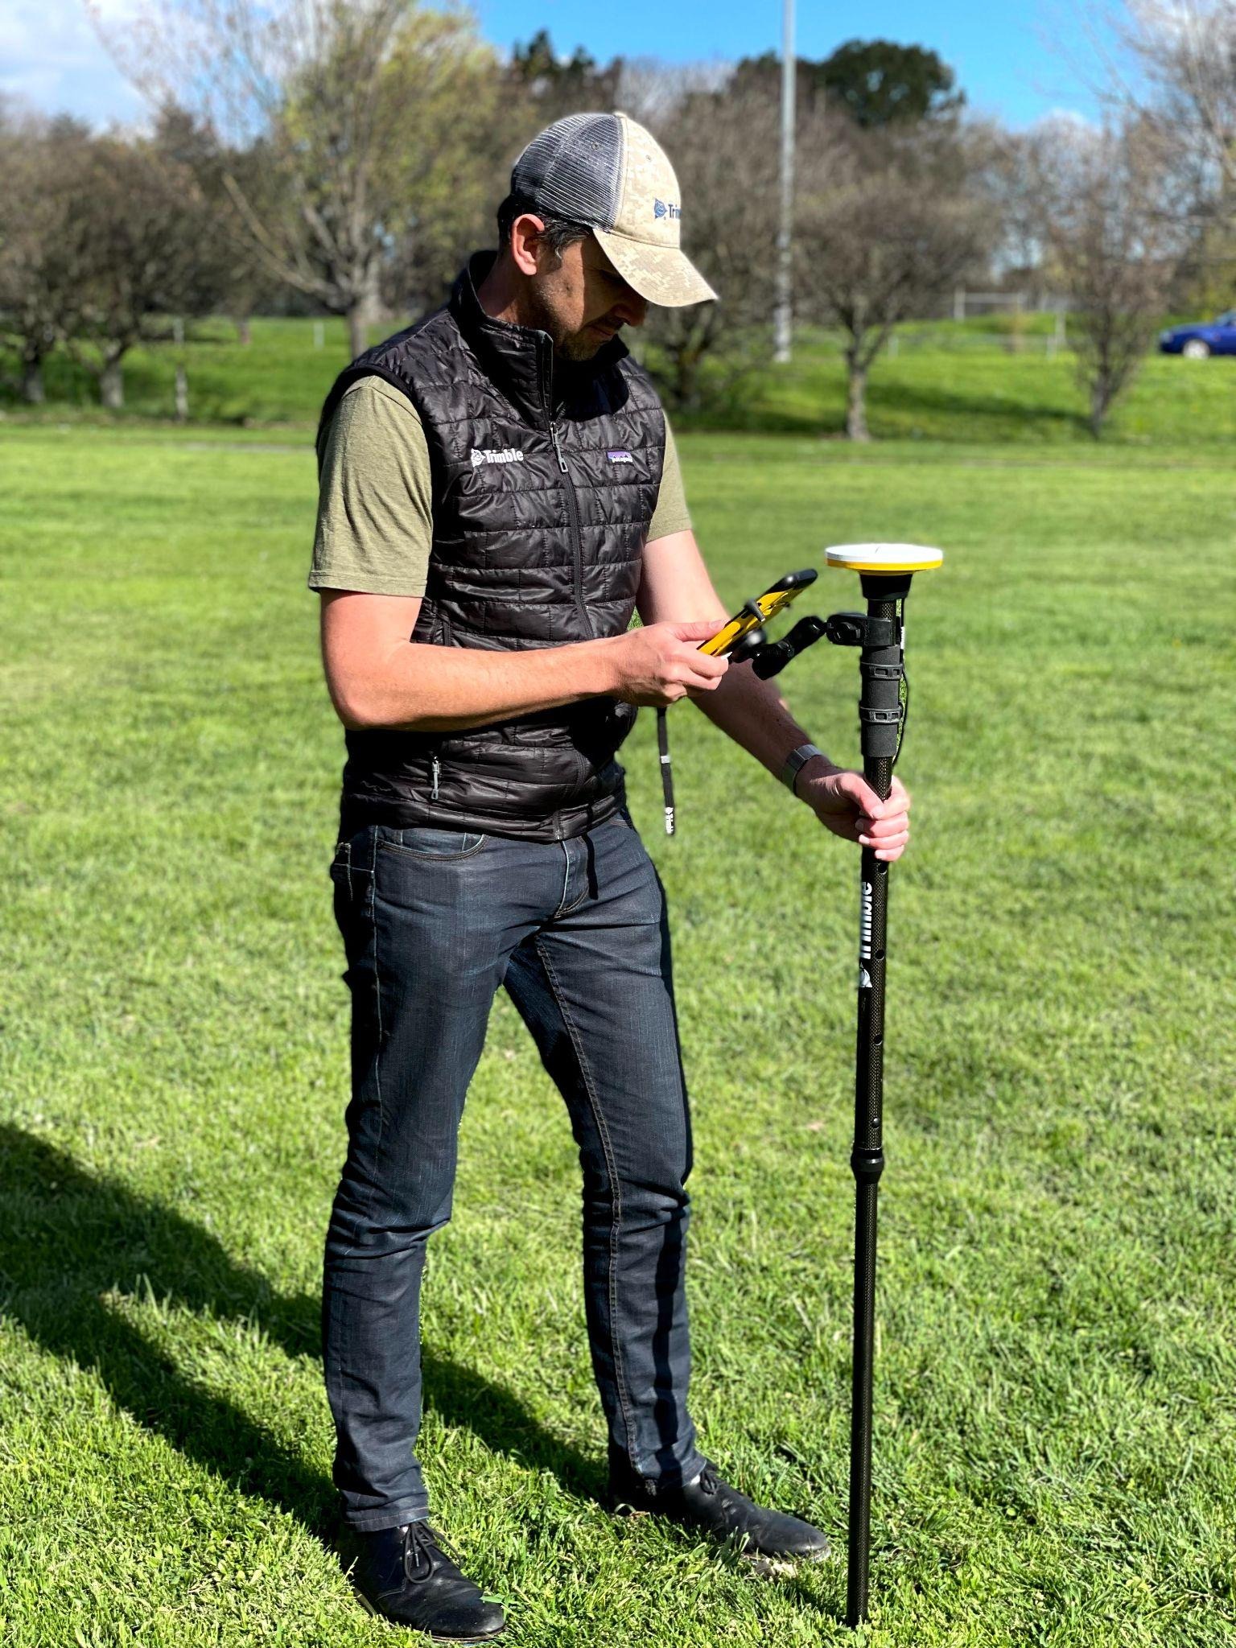
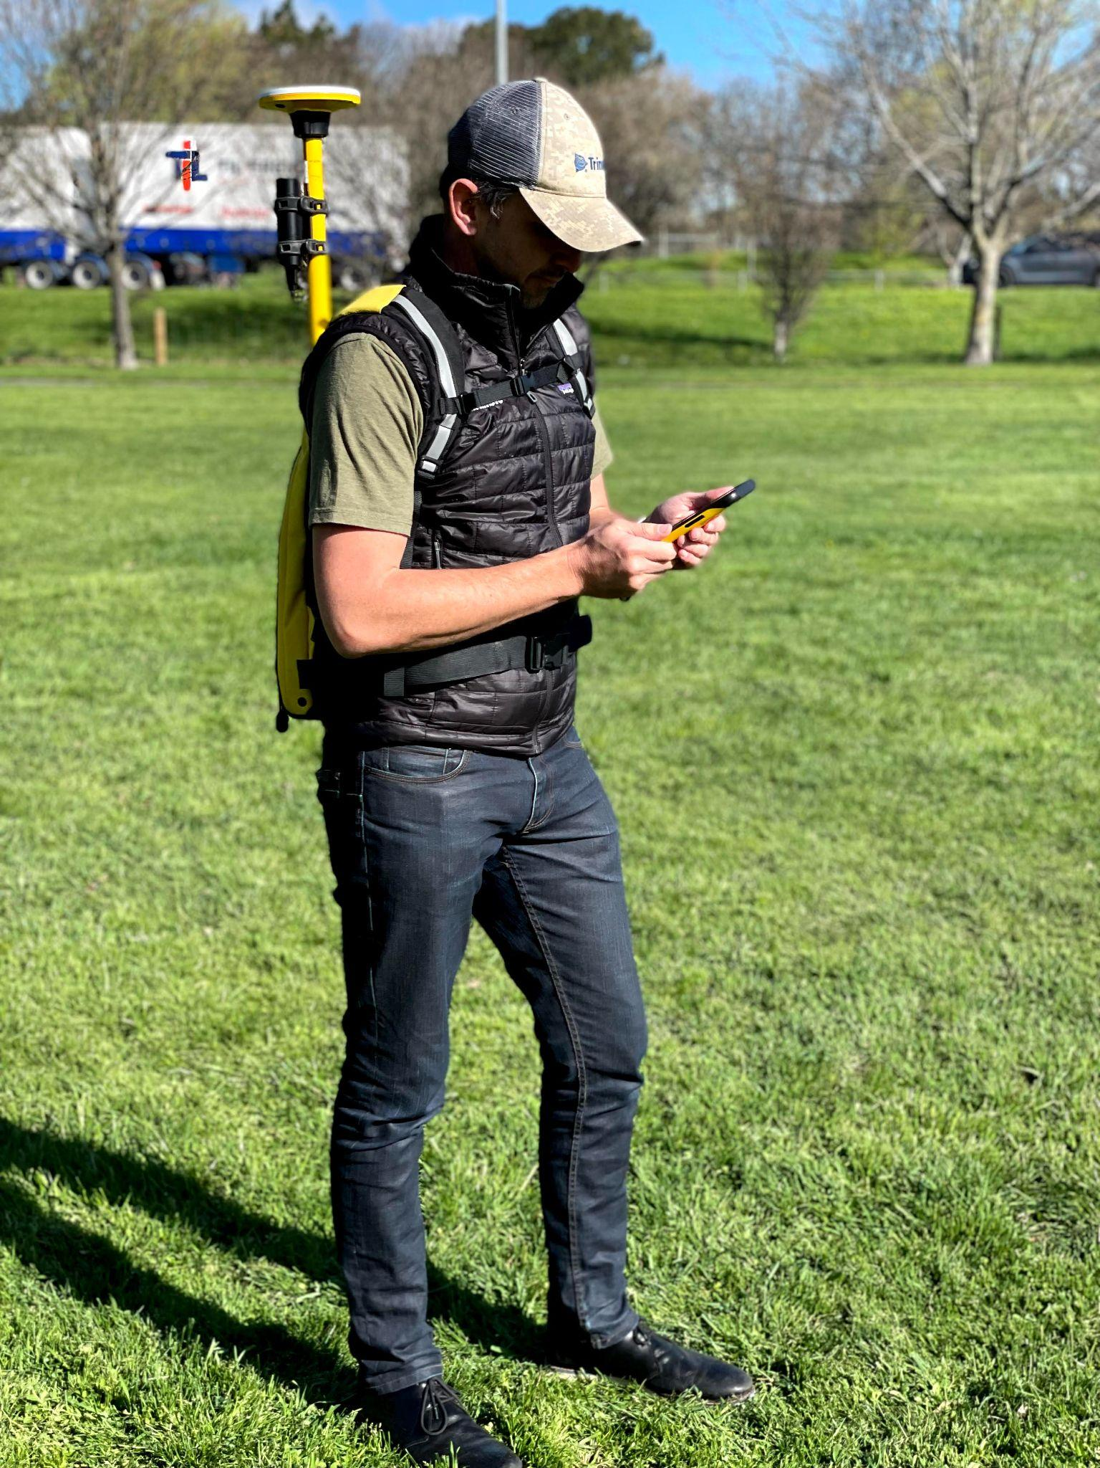
Configurations
2m Pole
Monopole
Backpack
Ways to use the DA2 receiver in field

Slide 24
03
Catalyst Subscriptions
Updates to the Trimble Catalyst Positioning Subscription Offerings

Slide 25
Rebranding Catalyst Subscriptions
Catalyst 1 Meter | 100 cm
Catalyst Sub-Meter | 30 cm
Catalyst Decimeter | 10 cm
Catalyst Precision | 1 cm
Catalyst 60 | 60 cm
Catalyst 30 | 30 cm
Catalyst 10 | 10 cm
Catalyst 1 | 1 cm
Existing customers & stock will automatically transition to the subscriptions
Changes will be implemented at the launch of the DA2. No action required by distributors or customers.
Notes:
Catalyst subscription tiers will be rebranded when DA2 is released
New tiers and naming convey the accuracy “floors” more clearly
All changes will be automatically adopted by existing customers
Works for DA1 and DA2

Slide 26
Introducing Catalyst Annual
Catalyst On Demand
Catalyst Monthly
*NEW* Catalyst Annual
Shared pool, unlimited users, pay per hour
Pay per user, per month, unlimited use
Pay per user, per year
unlimited use

Slide 27
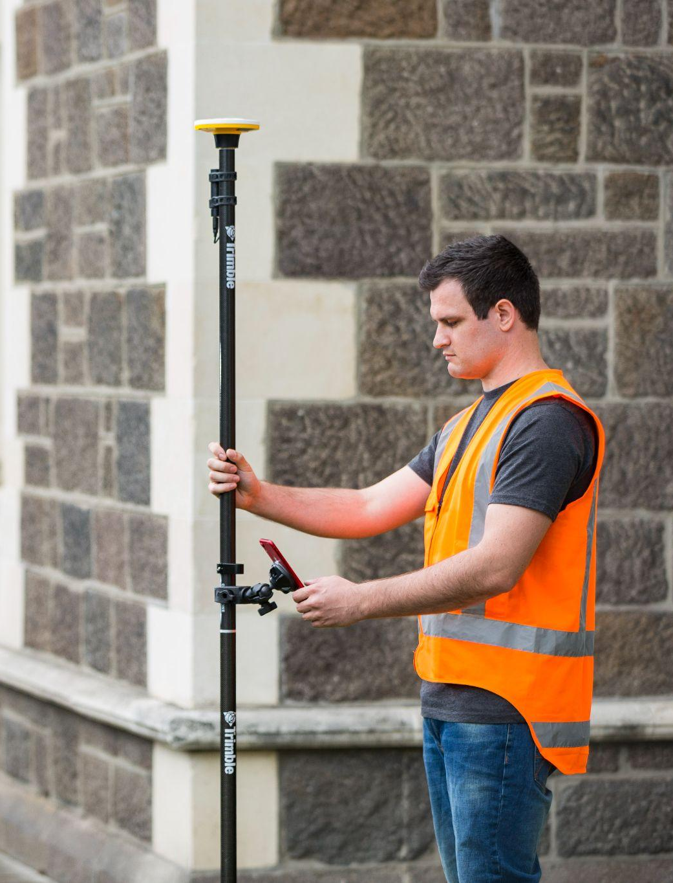
04
Software

Slide 28
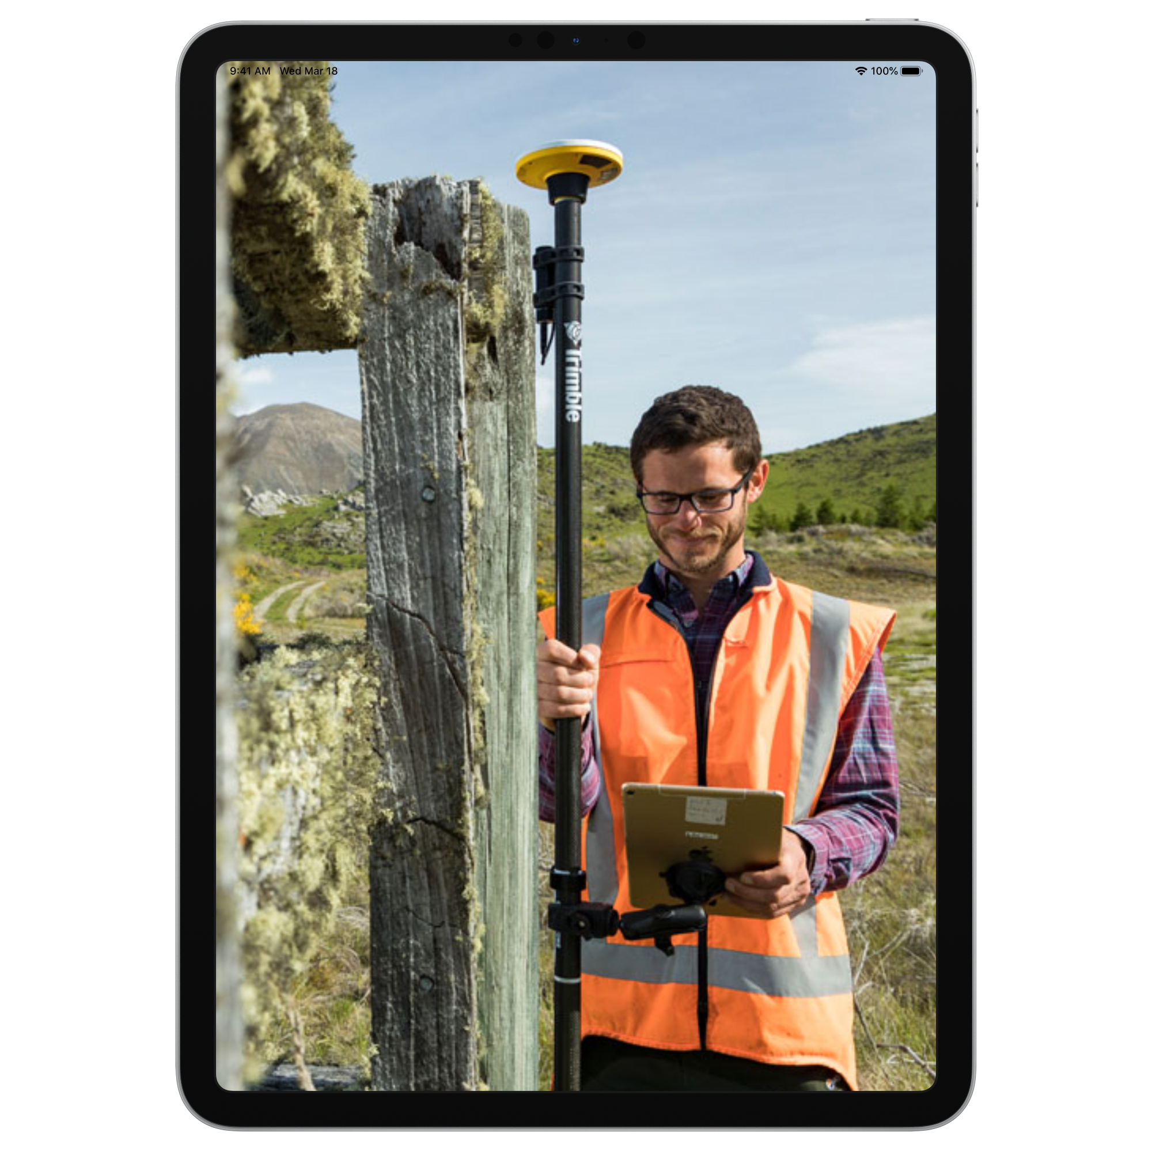
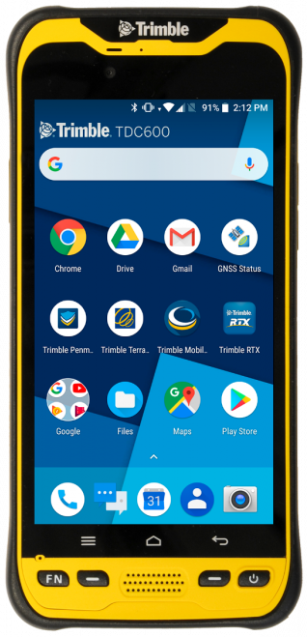
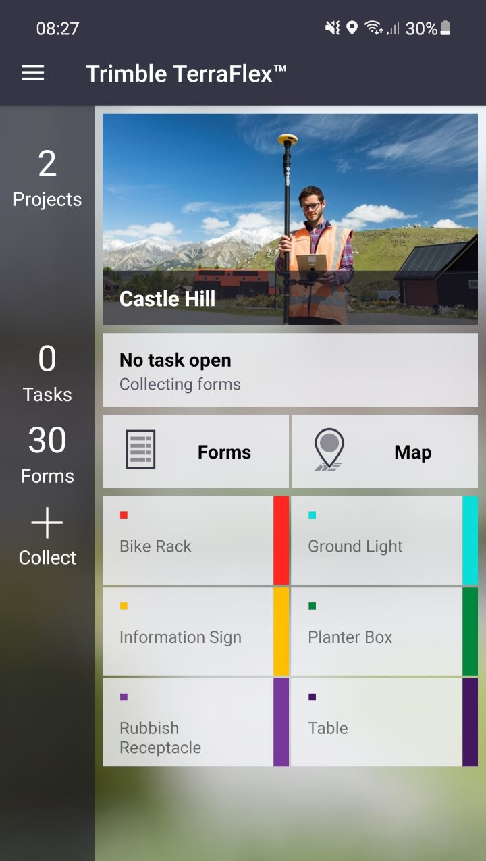
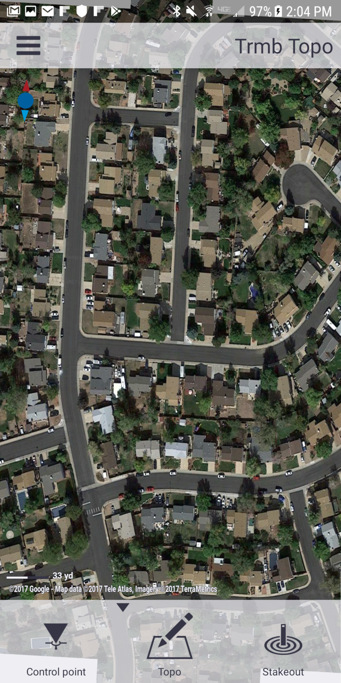
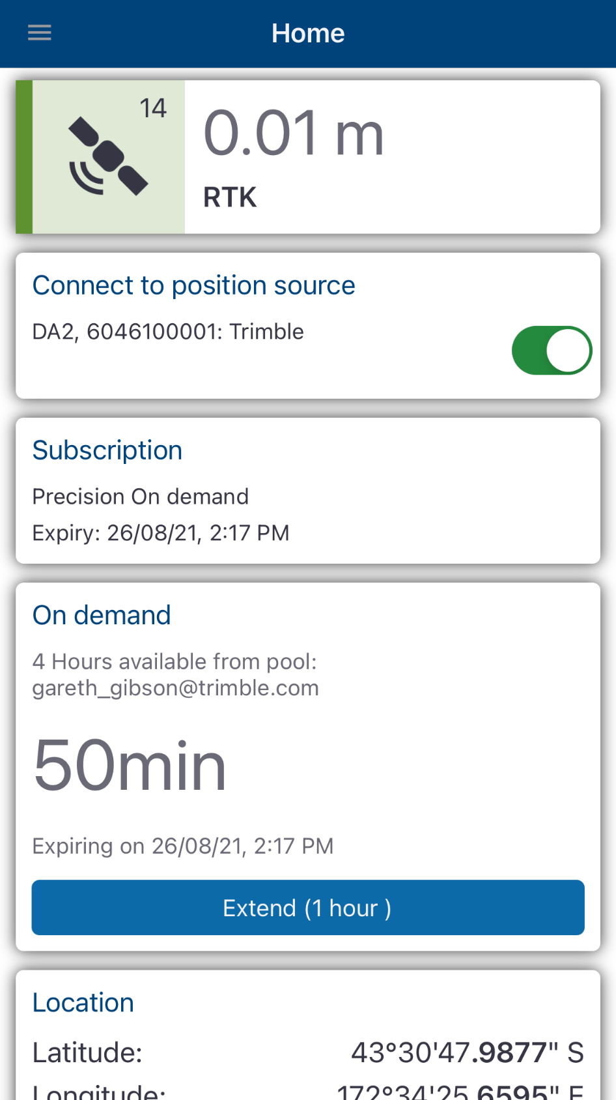
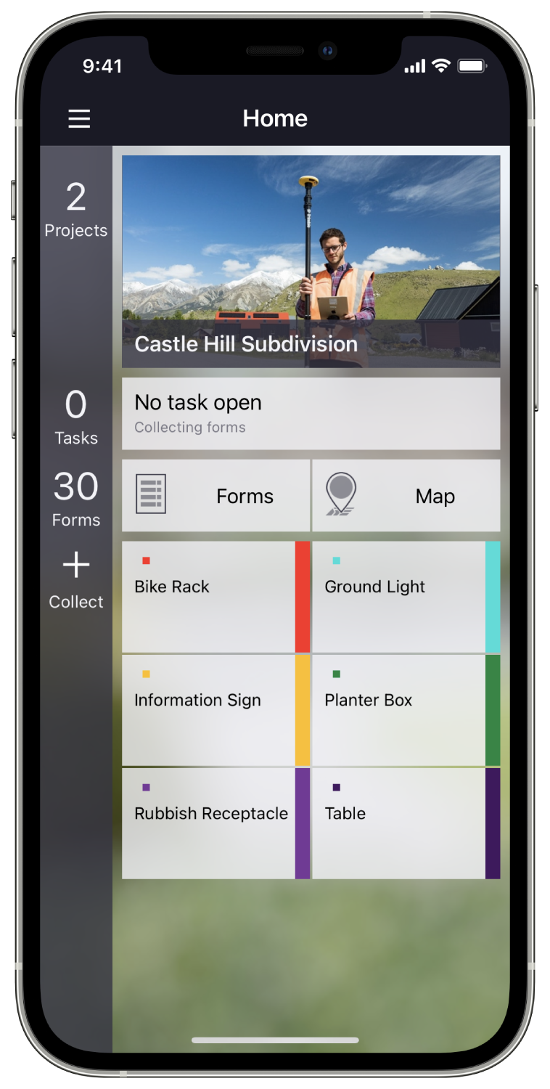
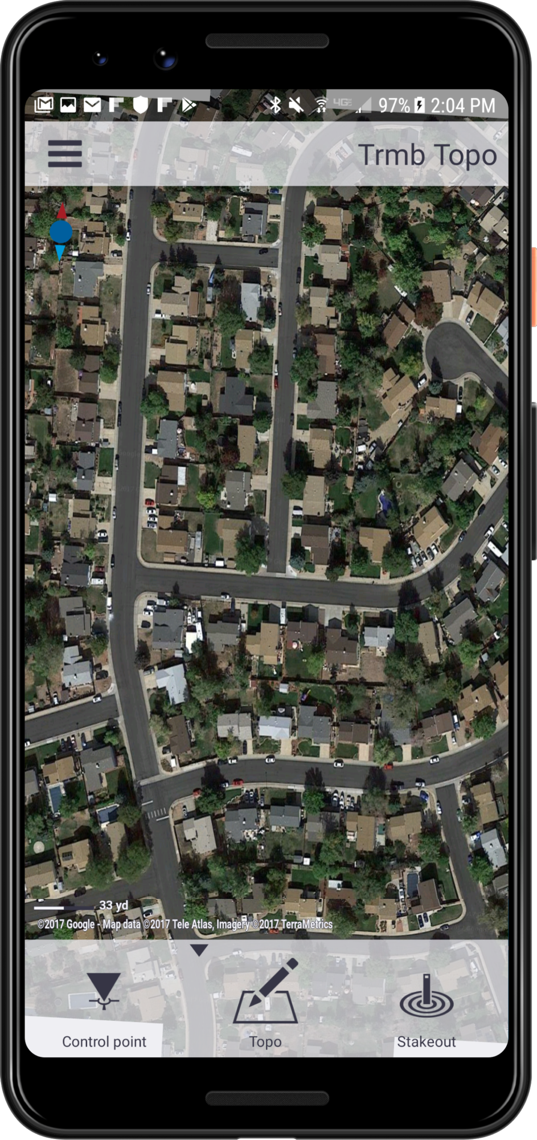
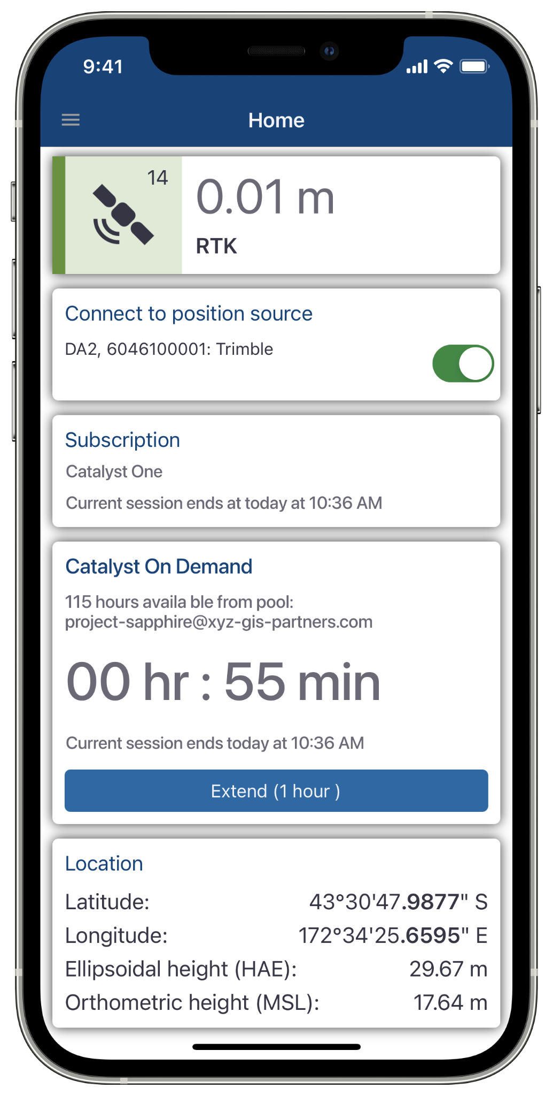
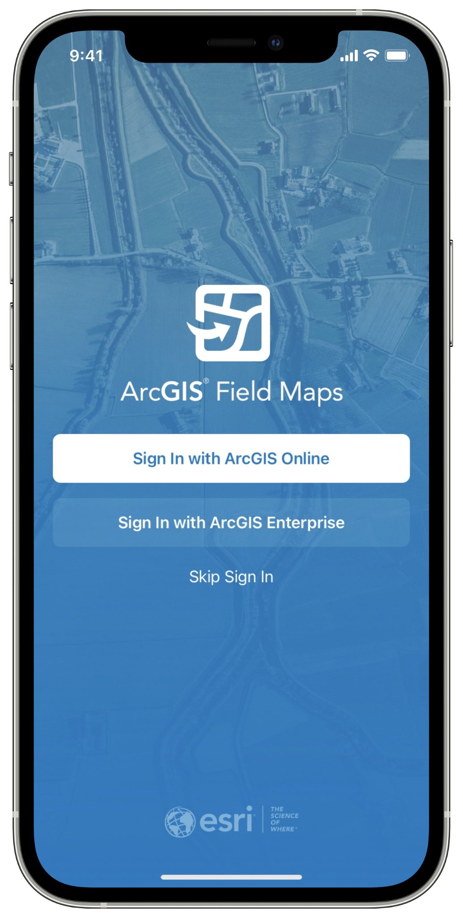
Apps & Workflows
TerraFlex
For iOS & Android
Penmap
For Android
Mobile Manager
For iOS & Android
Partner Apps
For iOS & Android
Notes:
Trimble TerraFlex is a cloud-based solution that provides you with the tools to streamline your data collection workflows and delivers high accuracy positioning when you need it. With TerraFlex, your entire organization becomes more efficient
Penmap is a powerful, yet incredibly straightforward, cloud-connected application for cadastral field surveying and high-accuracy GIS data collection. Whether working on the Windows or Android platform, Penmap is designed to provide both professional surveyors and field workers with a reliable and complete data collection application.
Trimble Mobile Manager (TMM) is a configuration application for Trimble GNSS receivers as well as Trimble and Spectra Precision high accuracy handhelds. It is also a subscription licensing application for Trimble Catalyst GNSS services.
Displays accuracy and quality control related information on the position
Configure and apply real-time custom corrections for your GNSS receiver
Location Extras pass on valuable GNSS metadata to Location Service via Mock Locations Provider
Some Esri applications work out of the box, others require TMM.
Partner applications that have Catalyst integrated will require an update. (check with your app provider)

Slide 29
05
Availability

Slide 30
Availability
Available to order and shipping Q4 2021
https://geospatial.trimble.com/where-to-buy

Slide 31
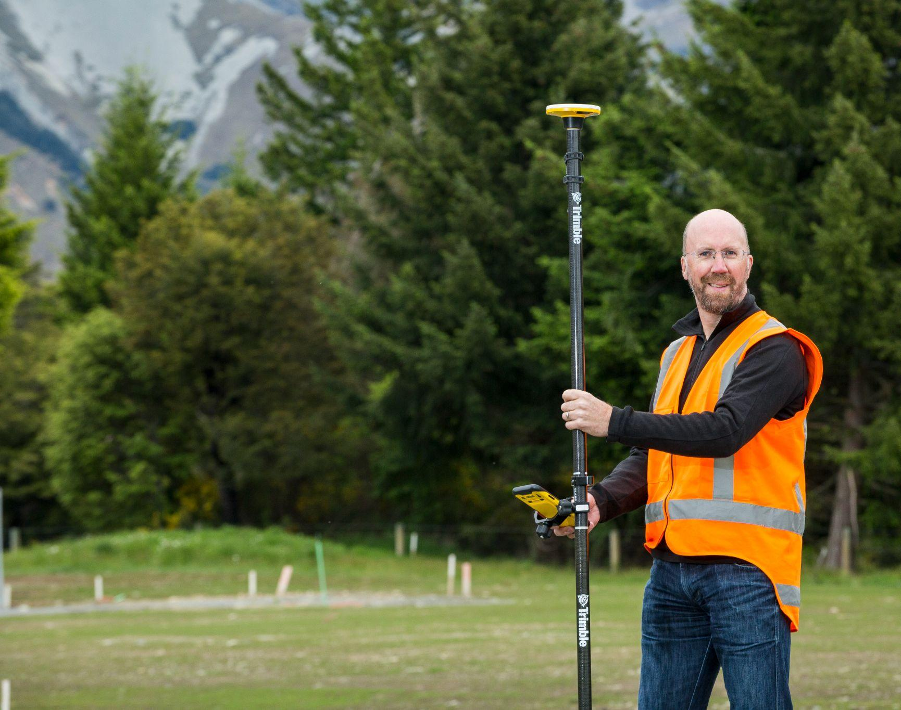
In Summary

Slide 32
What’s new?
The DA2 supports iOS and Android
The DA2 receiver is faster and capable of higher accuracy
GNSS yield is much improved by ProPoint technology
Bluetooth connectivity
Annual subscription added to Catalyst
Notes:
...and with that, imagine,....

Slide 33
How will it feel to press this button?
https://geospatial.trimble.com/where-to-buy
https://geospatial.trimble.com/catalyst

Slide 34
Catalyst Subscriptions include Corrections
A traditional receiver requires a separate correction service

Slide 35
Power Solutions
Power DA2 by USB...
Power DA2 with any* USB-compatible power pack or power source
...including directly from your tablet or smartphone
Any device supporting Power Delivery over USB functionality can power DA2 (e.g. TDC600, iPad Pro, most Android devices with USB-C). This configuration requires a DA2 to USB-C cable, sold-separately.
Run-time
Run-time depends on numerous factors, including energy capacity & efficiency of the power source, ambient temperature, and total power being drawn by the system...
DA2 standard USB power cable and
ANKER Powercore Mini+ (12.1 Wh)
* DA2 is equipped with a USB Type-A connector as standard. USB-C cable option required for most Android/iPad Pro devices and Power Banks with USB-C Power Delivery functionality. Power Delivery is not supported on Apple iPhone devices with Lightning connector.

Slide 36
Who benefits from Catalyst?
MGIS Customers with legacy solutions
MGIS Customers with no high accuracy positioning yet
Existing Catalyst subscribers looking for an upgrade
Catalyst fits a huge variety of customers.
Catalyst brings you further. Easy to step up.
Catalyst is an easy entry to high accuracy positioning.
New subscription options, significantly improved performance.

Slide 37
Catalyst Subscription Modes
Off Subscription:
No Corrections
On Subscription: Bundled access to TCH
On Subscription:
Third party corrections
Use Catalyst off-subscription in Autonomous “Freemium” mode for reliable 2-3m accuracy for basic applications.
Unlimited use. No subscription or internet connection needed.
All correction types are disabled in this mode.
All subscribers to the Catalyst service receive access to Trimble’s global GNSS correction services (RTX & VRS Now).
Hassle-free configuration using Trimble Corrections Hub (TCH).
Alternatively, all subscribers can still also use local services by ‘roaming’ with a third-party corrections if preferred.
Additional service-fees may apply.

Slide 38
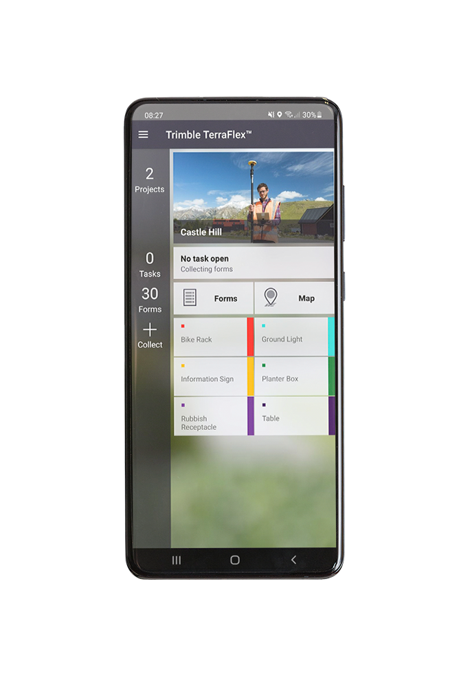
TerraFlex
Trimble TerraFlex is a cloud-based solution that provides you with the tools to streamline your data collection workflows and delivers high accuracy positioning when you need it. With TerraFlex, your entire organization becomes more efficient. Anytime, anywhere.
Fast, efficient, geospatial data collection across a fleet of mixed devices
Import and update existing data for up-to-the-minute information
Streamlined data management to keep your data organized
Direct integration with your Esri environment

Slide 39
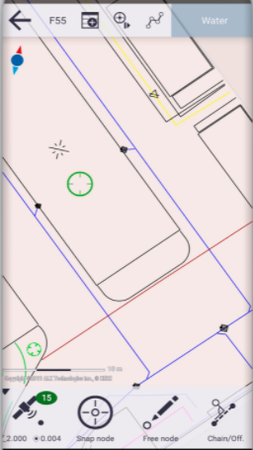
Penmap
Penmap is a powerful, yet incredibly straightforward, cloud-connected application for cadastral field surveying and high-accuracy GIS data collection. Whether working on the Windows or Android platform, Penmap is designed to provide both professional surveyors and field workers with a reliable and complete data collection application.
Offers both GIS and Survey capabilities in one application, to tackle all aspects of your job.
Designed with a visual, intuitive, easy-to-use map-based interface for entering and managing features and attributes.

Slide 40
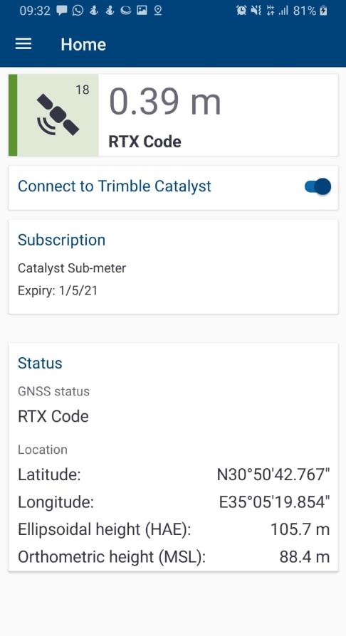
Trimble Mobile Manager (TMM)
Trimble Mobile Manager is a configuration application for Trimble GNSS receivers as well as Trimble and Spectra Precision high accuracy handhelds. It is also a subscription licensing application for Trimble Catalyst GNSS services.
Displays accuracy and quality control related information on the position
Monitor GNSS position status and quality
Configure and apply real-time custom corrections for your GNSS receiver
Detailed satellite tracking and constellation usage information
Location Extras pass on valuable GNSS metadata to Location Service via Mock Locations Provider

Slide 41
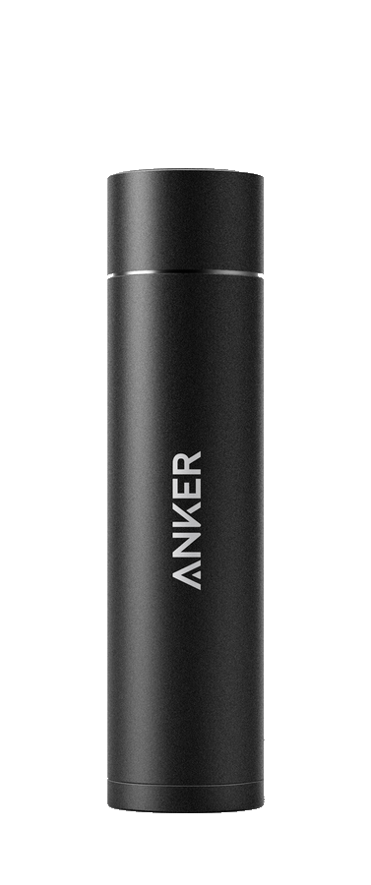
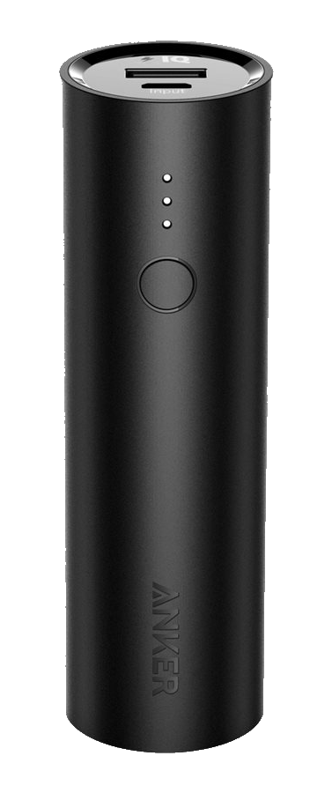
DA2 Run-time Estimates
ANKER PowerCore Mini+ (Model A1104) Available from Trimble
Rated capacity: 3350 mAh / 12.08 Wh
Estimated DA2 run-time: 4.5+ hours
ANKER PowerCore 5000 (Model A1109) Available from Trimble in Q4 2021
Rated capacity: 5000mAh / 18.5 Wh
Estimated DA2 run-time: 6+ hours
Power source rated capacity | Estimated DA2 run-time
10 Wh | 3.0+ hours
15 Wh | 4.5+ hours
20 Wh | 6.0+ hours
25 Wh | 7.5+ hours
30 Wh | 9.0+ hours
35 Wh | 10.5+ hours
40 Wh | 12.0+ hours
45 Wh | 13.5+ hours
50 Wh | 15.0+ hours
55 Wh | 16.5+ hours
60 Wh | 18.0+ hours
Estimating run-time:
Power source efficiency (~0.80 typical)
✕ Rated capacity (Wh)
/ power-draw (W)

Slide 42
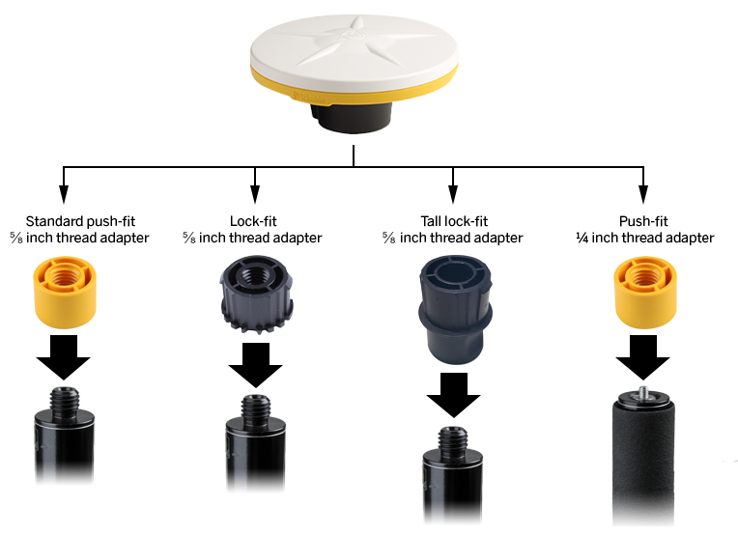
Mounting Accessory Kit
Optional mounting kit
Trimble provides a range of suitable pole mounts including:
2 m carbon-fiber survey rod (⅝”)
2 m carbon-fiber survey rod with bipod (⅝”)
1.5 m telescopic carbon-fiber monopole (⅝”)
2 m flat-topped aluminium survey rod (push-fit)
Trimble backpack with 1’ pole extender (⅝”)

Slide 43
GNSS Performance
Network RTK
Horizontal accuracy……………………………………………..…. 10 mm + 0.5 ppm RMS
Vertical accuracy…………………………...……………………..… 20 mm + 0.5 ppm RMS
RTK start-up time (for specified precisions)......................... < 1 minute (typical)
Single Baseline RTK (<30 km)
Horizontal accuracy………………………………………………... 10 mm + 1 ppm RMS
Vertical accuracy……………………………………………..……… 20 mm + 1 ppm RMS
RTK start-up time (for specified precisions)......................... < 1 minute (typical)
Trimble RTX™
Horizontal accuracy………………………………………..………. 2 cm RMS
Vertical accuracy……………………………………………..……... 5 cm RMS
RTX convergence time (Fast zones).................................. < 1 minute (typical)
SBAS
Horizontal accuracy…………………………………..……………. 0.6 m RMS
Vertical accuracy………………………………………...…………... 1.2 m RMS
Positioning rates……………………………………...…………... 1 Hz, 5 Hz, 10 Hz

Slide 44
GNSS Signal Tracking
Positioning Engine: Powered by Trimble ProPoint GNSS positioning technology for improved accuracy and productivity in challenging GNSS conditions (near trees, buildings etc.)
Satellite Signals Tracked Simultaneously:
GPS: …………………………………………………….…….. L1C/A, L2C, L5
GLONASS: .......................................................... L1C/A, L2C/A
SBAS (WAAS, EGNOS, GAGAN, MSAS, SDCM): ............. L1C/A, L2C, L5
Galileo: ………………………………………………………. E1, E5A
BeiDou: ……………………………………………………… B1, B2A
QZSS: …………………………………………………………. L1C/A, L2C, L5
NavIC (IRNSS):.................................................... L5
L-Band:................................................................ Trimble RTX™ Corrections
Channels: Software-controlled signal management with dynamic (virtual) channel allocation

Slide 45
Mechanical Design
Dimensions (Diameter x Height):............................. 128 x 55 mm
Weight (DA2 only):.................................................330 g (12 oz)
Weight (DA2 with Carbon fiber Rod, Anker power pack).... 1.275 kg (2 lb 13 oz)
Water & Dust…………………………………………….. IP65 (dust proof, rain proof)
Drop (tipping pole fall onto concrete)........................... Survives 2 m tipping falls
Drop (free fall onto concrete)......................................Survives 1.2 m free falls
Operating Ambient Temperature............... −20° C to +60° C (−4° F to +140° F)

Slide 46
Power & Communications
Bluetooth:......................................................... v 4.2
USB:.................................................................... Power input only
Device compatibility:..................................... Android, iOS
Corrections data protocols:.………..………….. NTRIP, VRS, RTCM 3.x, CMRx , DCOL
Position output protocols:............................ NMEA (LLH), DCOL (TPSDK)
Position output platform:............................. Android Location Service (location sharing)
Android Location Extras
iOS Location Service
Android/iOS: TPSDK integrated apps
External power input:……………………………… 5V / 1A (via USB-A)
Power consumption:...................................... 0.5–2.5 W (typical)

