Slide 1
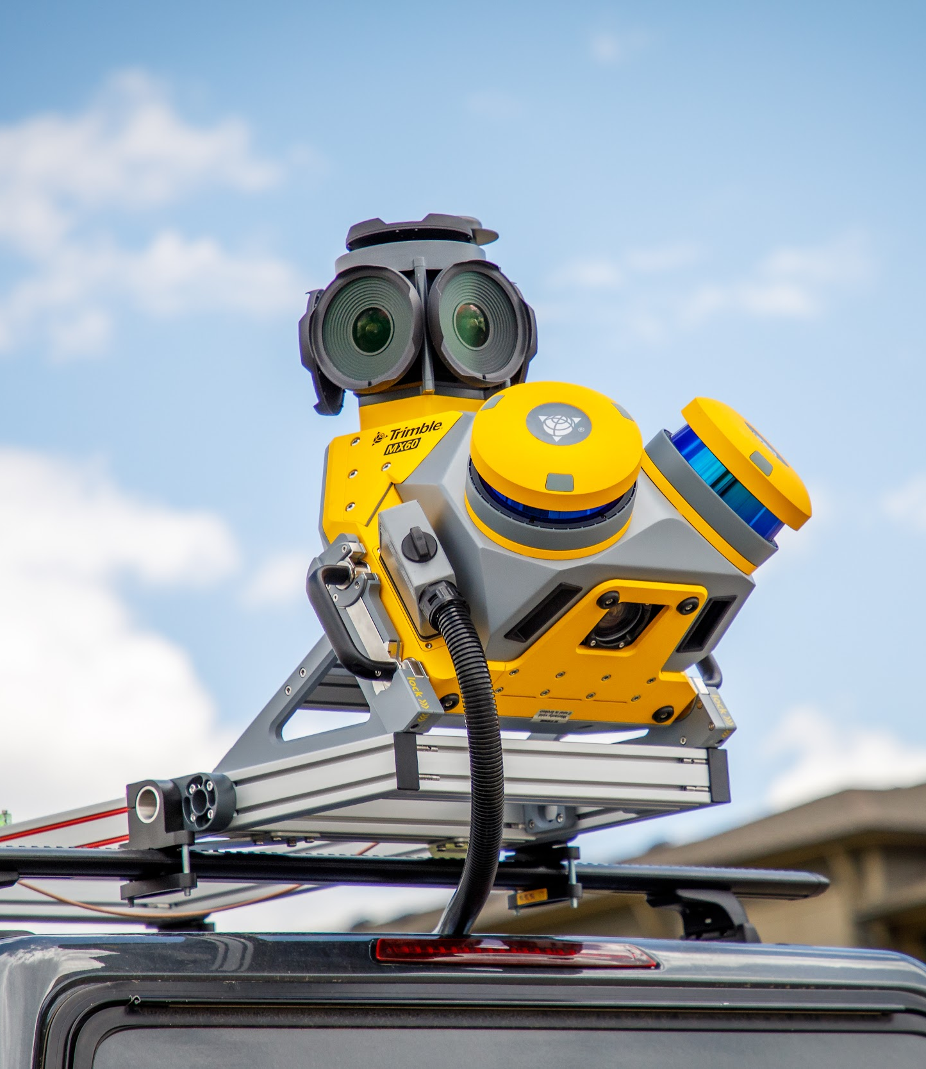
Introducing the
Trimble MX60

Slide 2
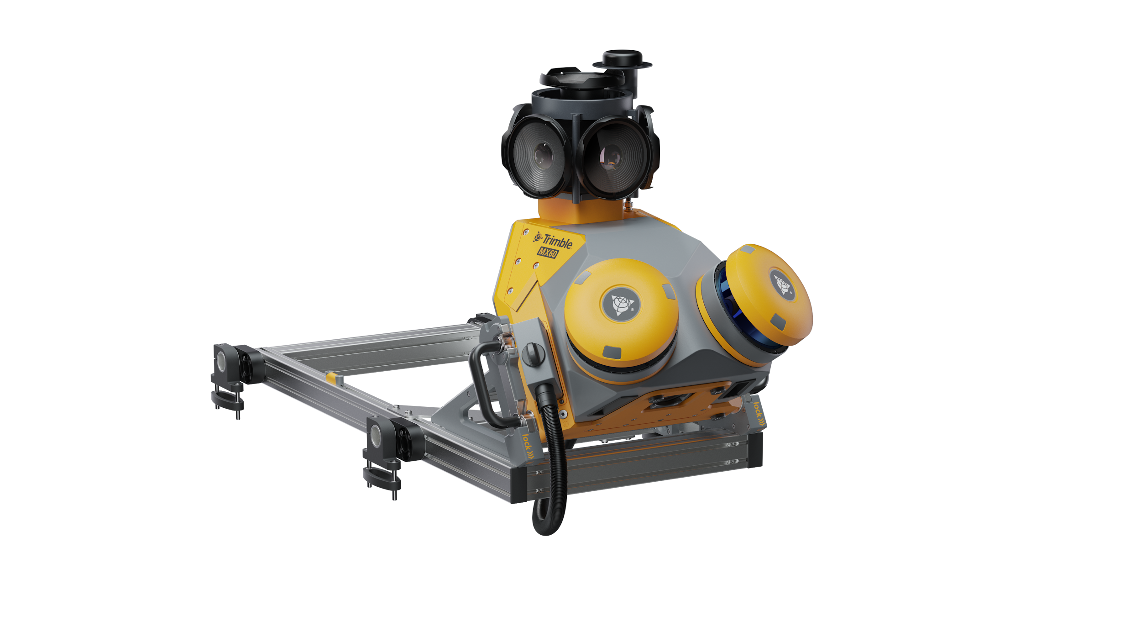
Trimble MX60 Mobile Mapping System
Each project is a journey. Enjoy the ride

Slide 3
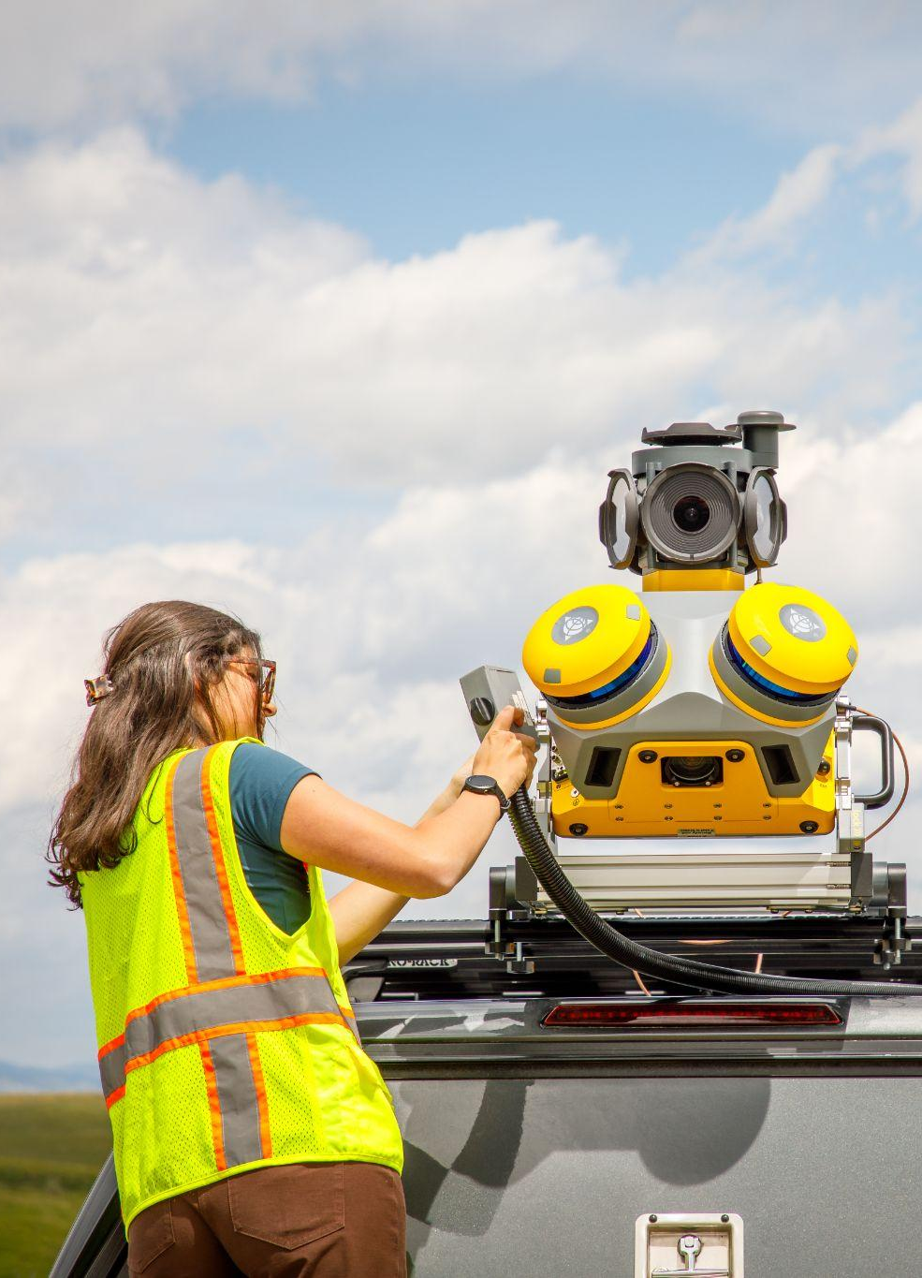

Trimble MX60 Core, Pro and Premium
Updated Hardware Components
New Trimble LiDAR system
New 360 and backward camera
Improved positioning system
New Configuration Options
Core, Pro and Premium configurations
Different performance needs and price points
Competitive lineup
Advanced Software Solutions
New POSPac, TBC and TMX releases
New LiDAR QC point cloud alignment tools

Slide 4
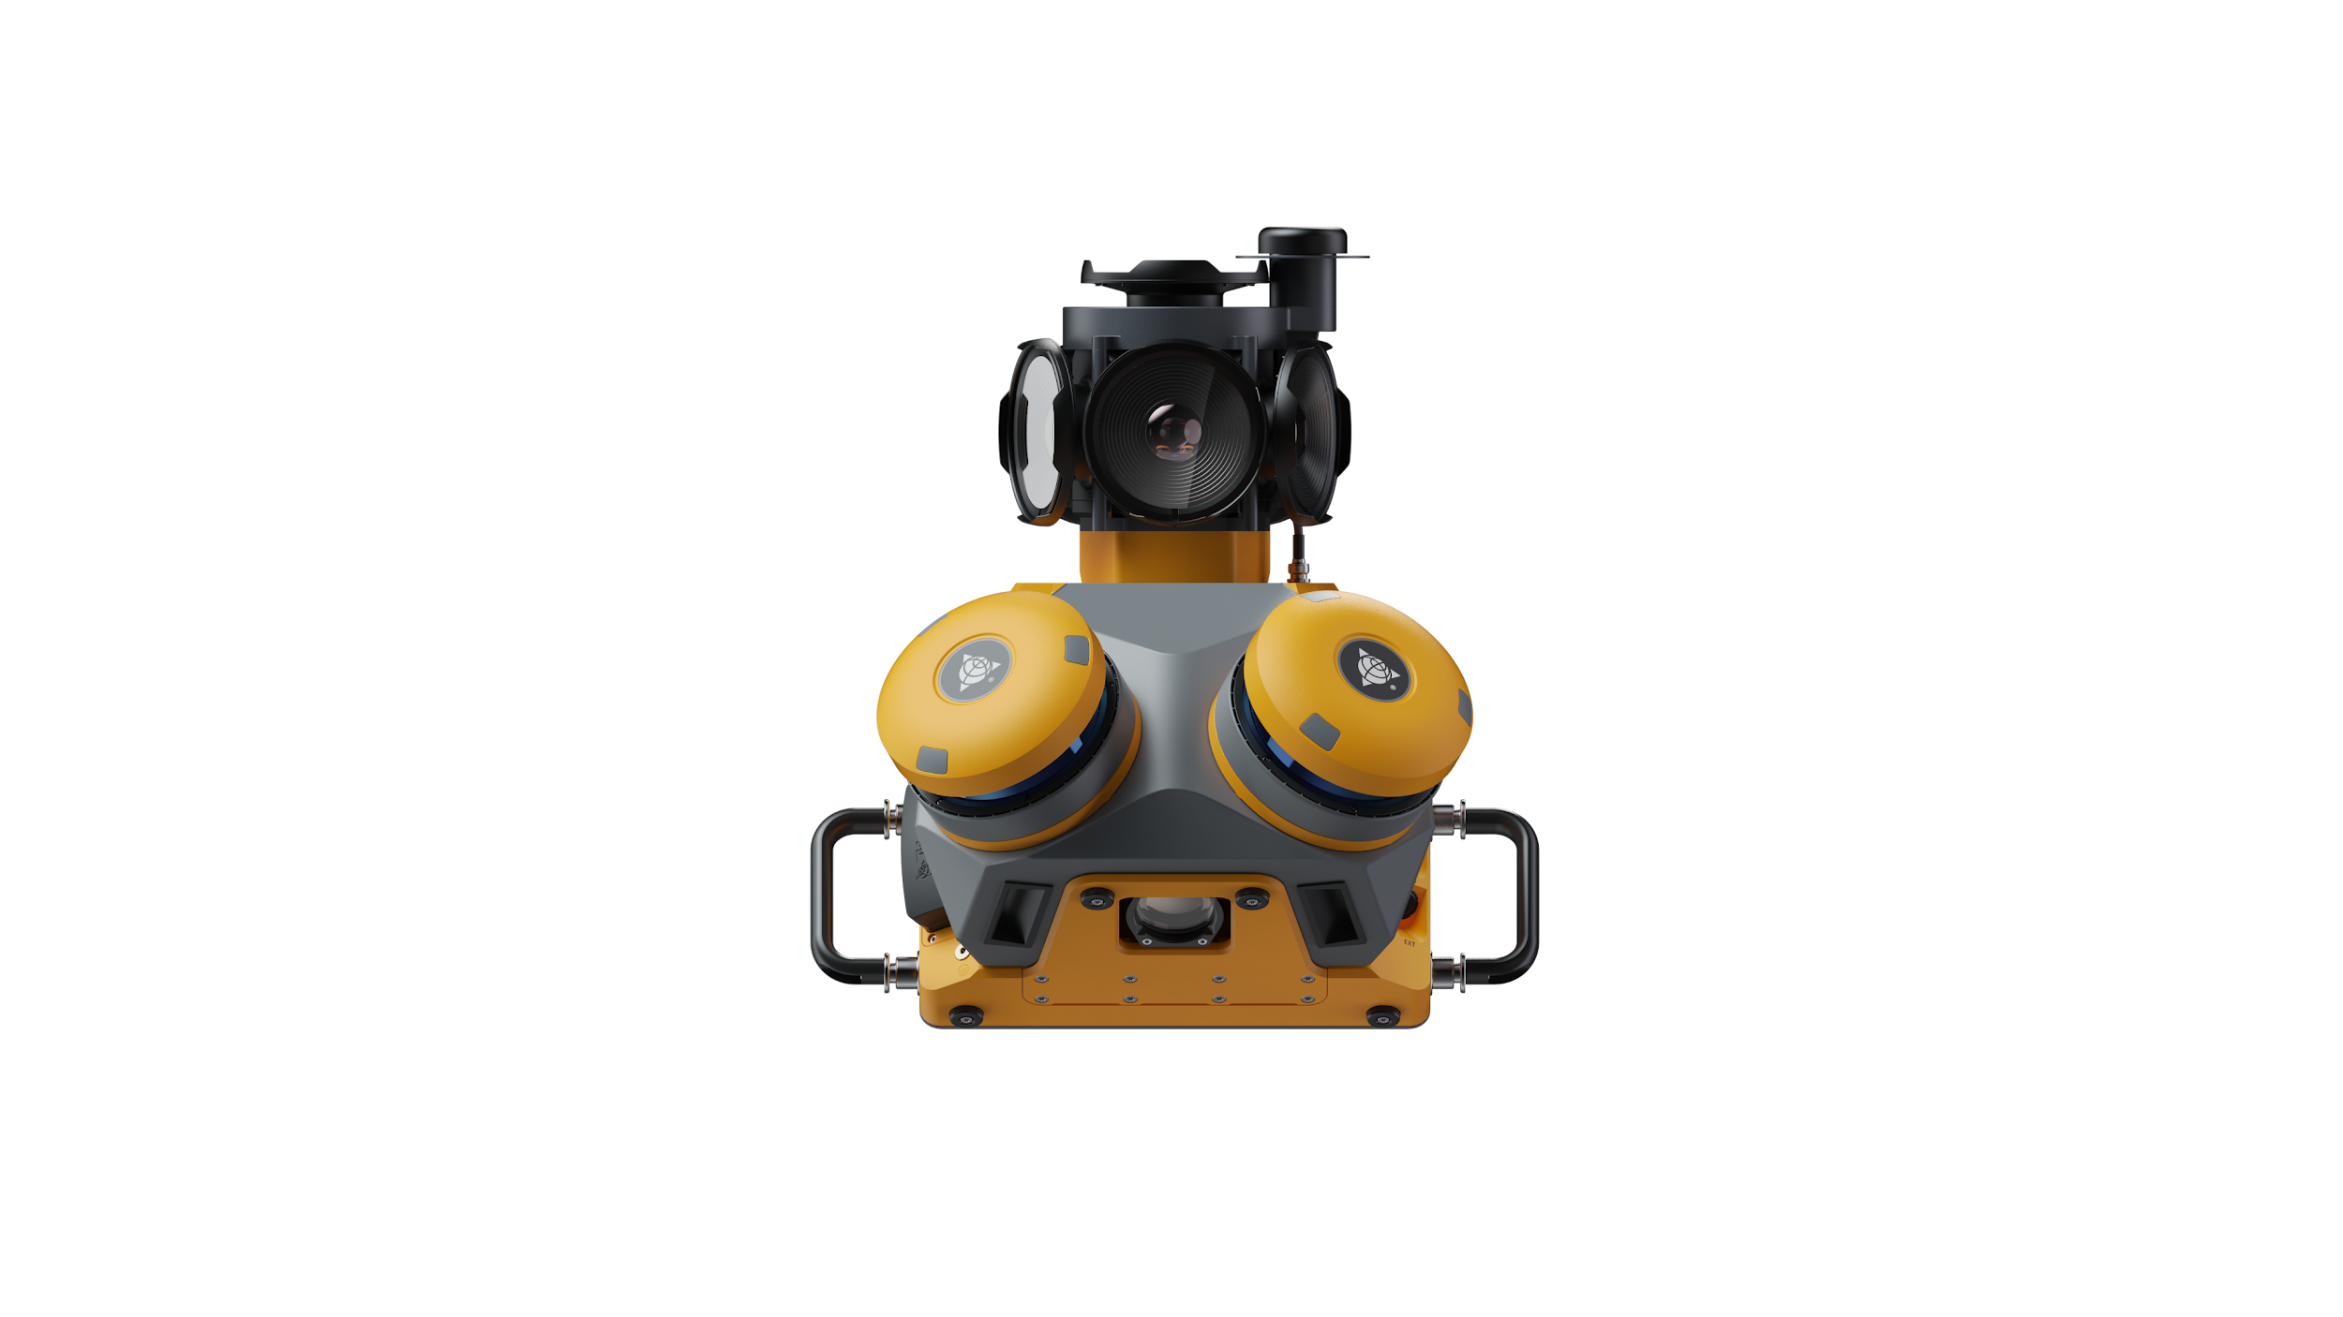
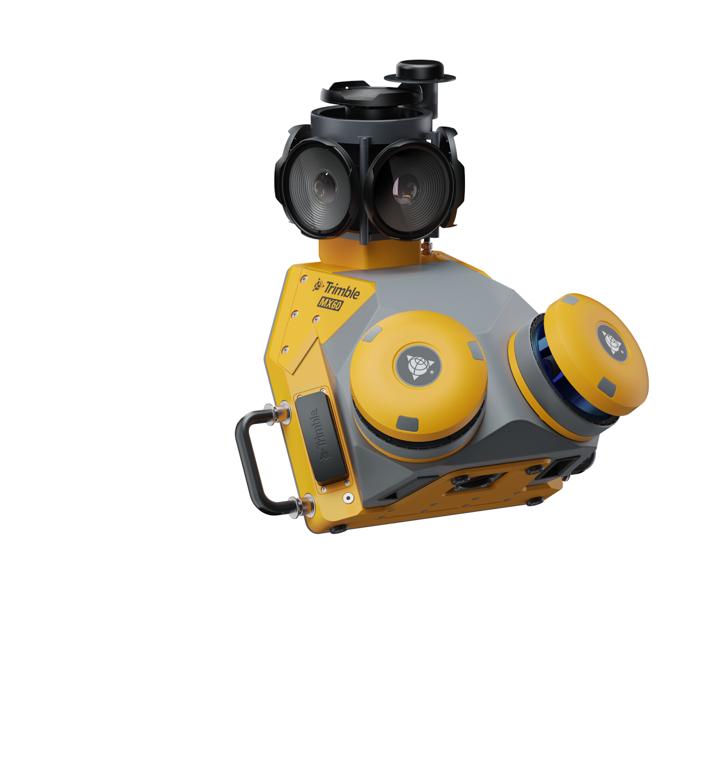
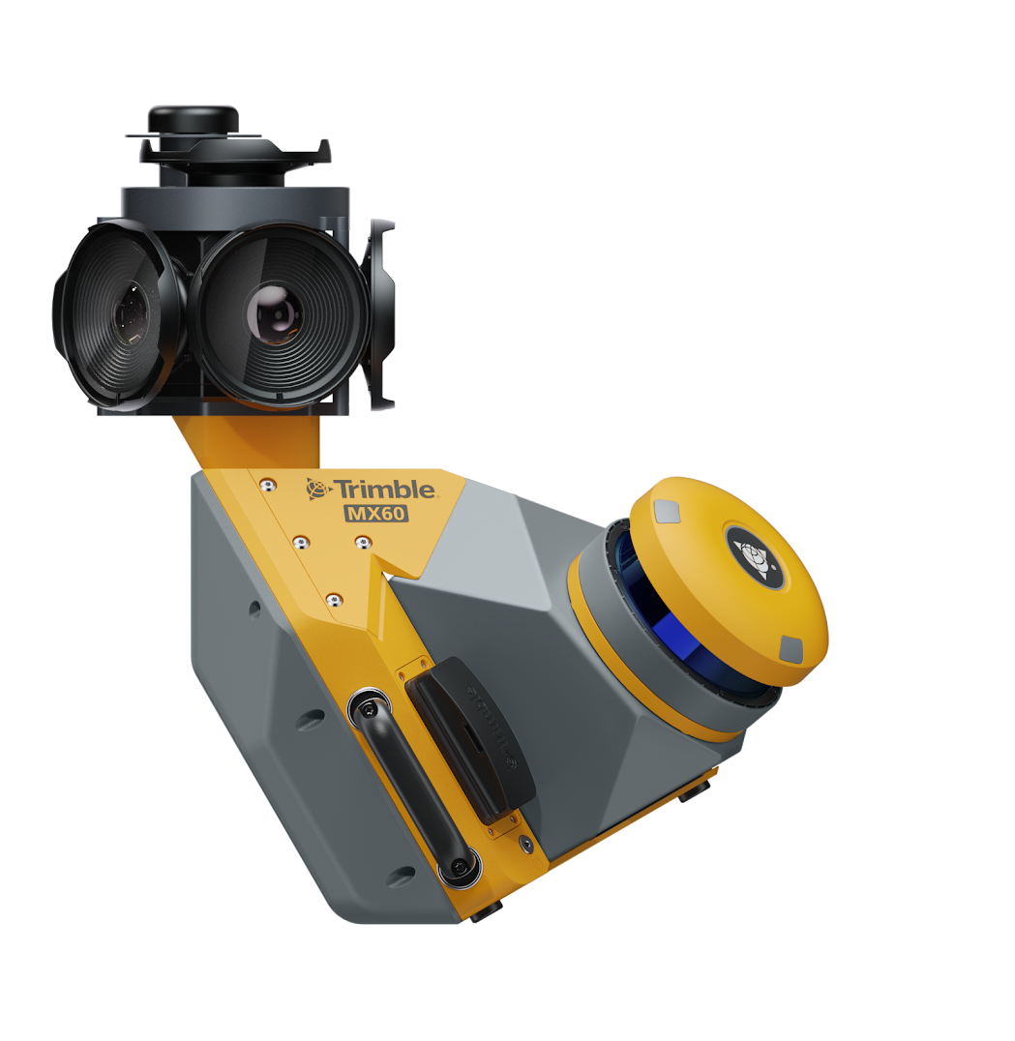
Trimble MX60
Intuitive
Highly productive, yet simple to use. Easy to install and user-friendly, the MX60 offers an effective mobile mapping solution that is readily accessible within your organization.
Powerful mobile scanning and imaging for asset management
Efficient
Enhance productivity through efficient workflows that enable the capture of more data at a higher speed.
Powerful
Whether mapping dense urban centers, tagging assets across vast corridors, or spotting the smallest of cracks in the road, the MX60 does it all.

Slide 5

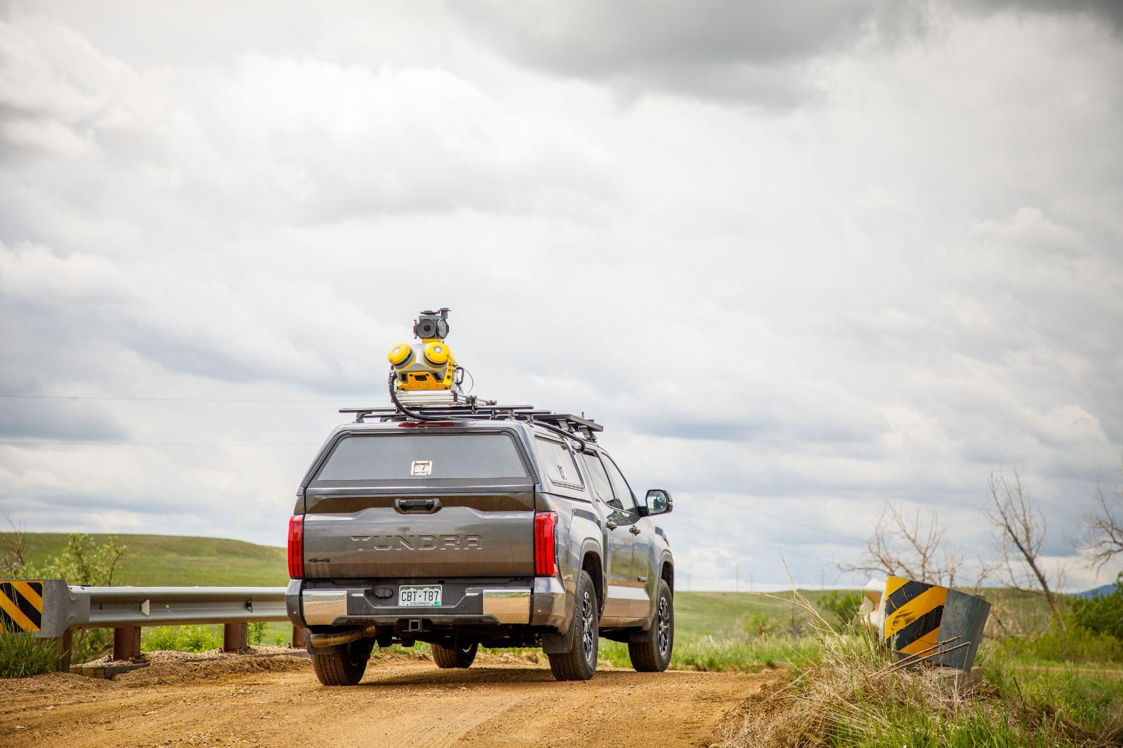
Intuitive
Trimble MX60 Key Messages
Easy installation of trusted and field-proven Trimble hardware
Handles mobile data collection through user-friendly field software, guaranteeing efficient and well-structured field operations
Powerful Trimble office software facilitates exporting and seamless integration into various applications or cloud-based solutions, simplifying data sharing
Provides precise point clouds combined with immersive imagery for scalable asset management, mapping, and maintenance, from the field to the finish

Slide 6


Efficient
Trimble MX60 Key Messages
Enhance productivity through efficient workflows that enable the capture of more data at a higher speed
Effortlessly capture, process, extract and share data and maximize its value to your organization
Streamline data collection and deliver high quality results with a safer alternative that outpaces traditional survey methods

Slide 7
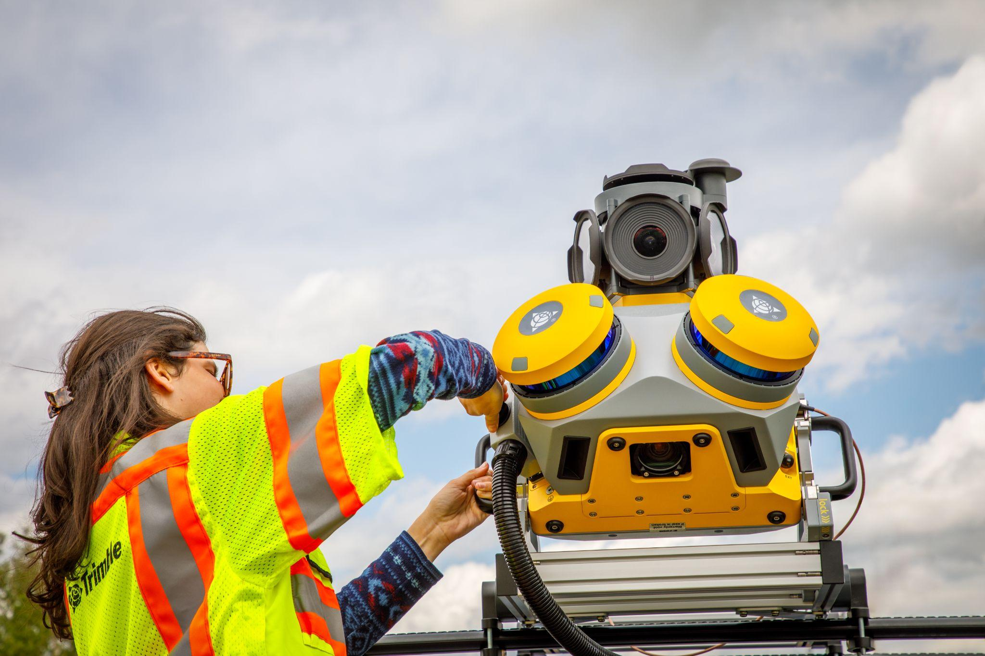
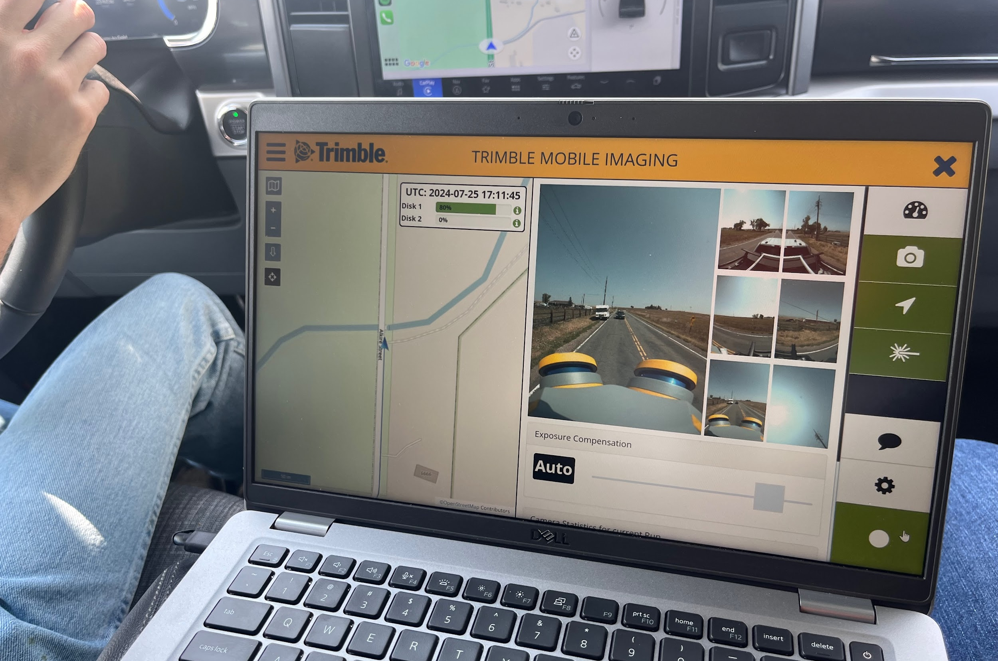
Powerful
Trimble MX60 Key Messages
Leverage the power of industry-leading Trimble LiDAR technology to capture every detail of your drive
Capture high quality 360 panoramic imagery without hitting the brakes to drive your inspection workflows
Featuring a new precise laser system, a 360 degree panoramic camera and back down camera handle data flows seamlessly, at top speed with high accuracy

Slide 8

Product Offering
Trimble MX60

Slide 9

Product Family
MX60 Core
MX60 Pro
MX60 Premium
A robust solution capable of handling demanding tasks at an affordable cost
Experience a step up in power with the MX60 Pro, designed to tackle more detail oriented projects
A high-performance system, ready for today’s needs and tomorrow’s challenges, as your business grows

Slide 10
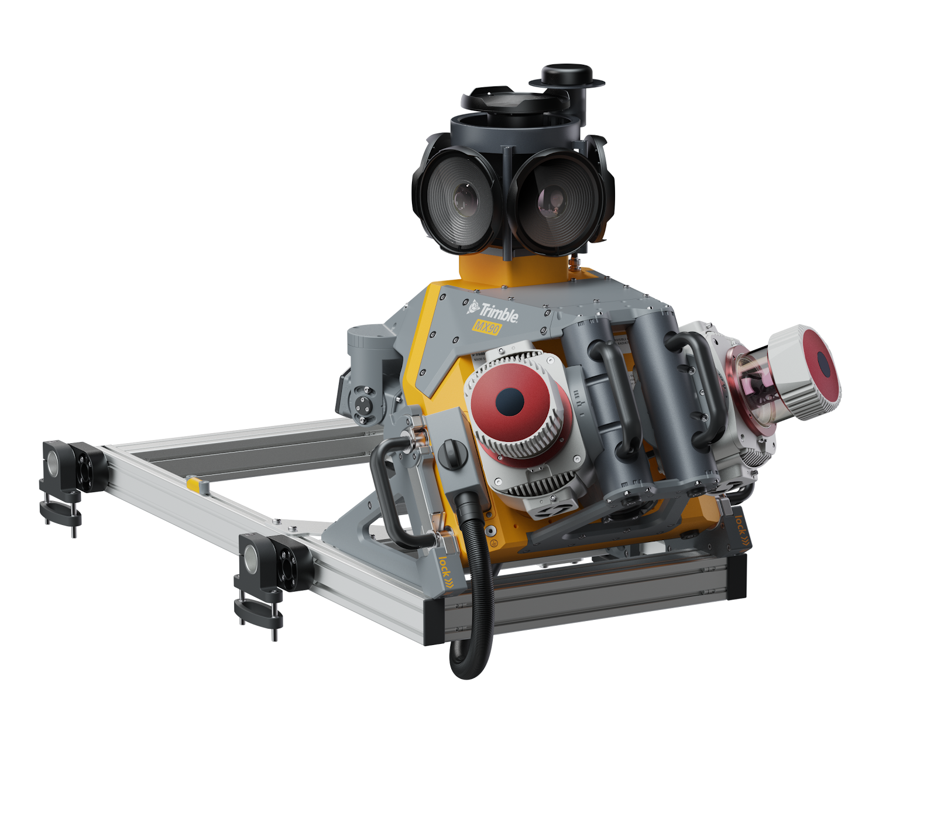


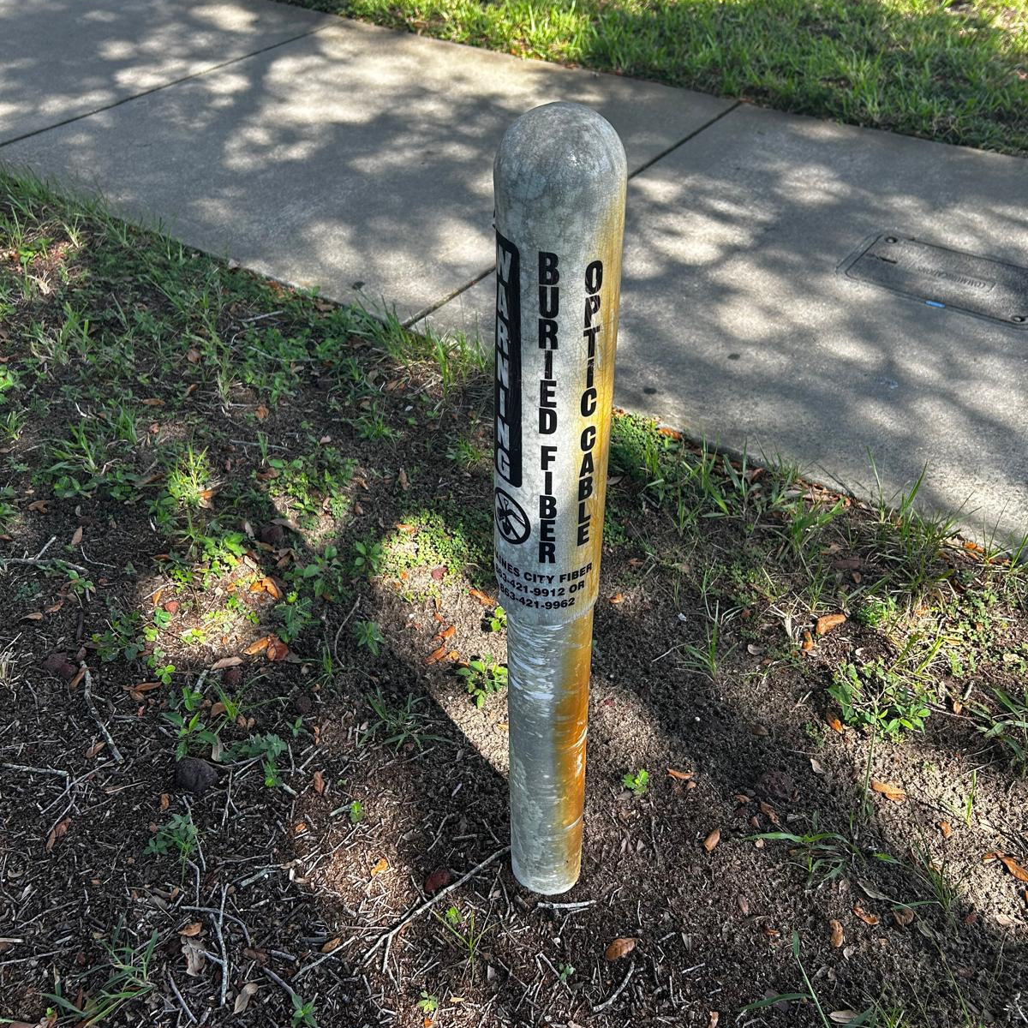
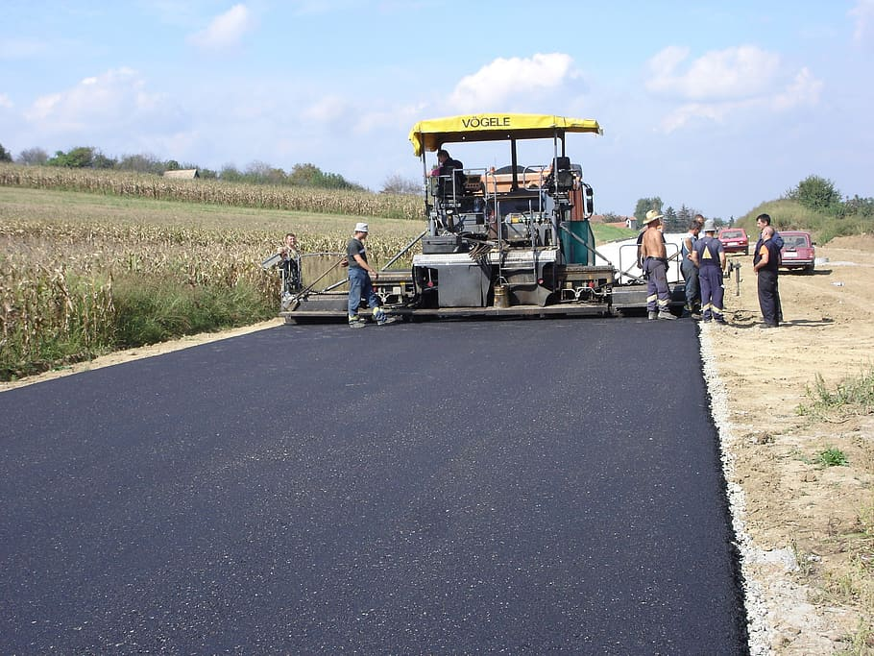
How they measure up
We’ve got you covered!
MX90
Premium
Rail
Pro
Road Condition
Utilities
Core
Paving

Slide 11
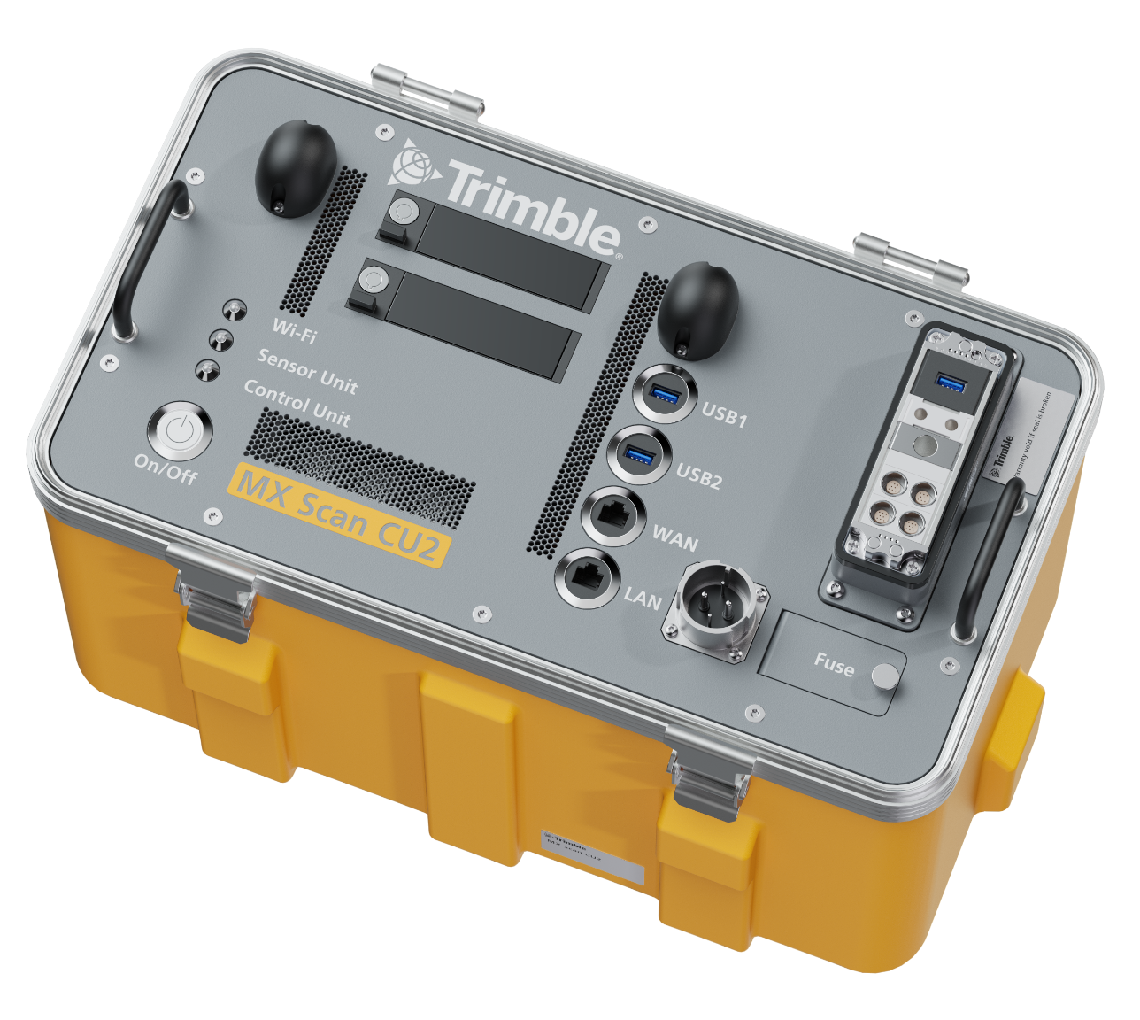
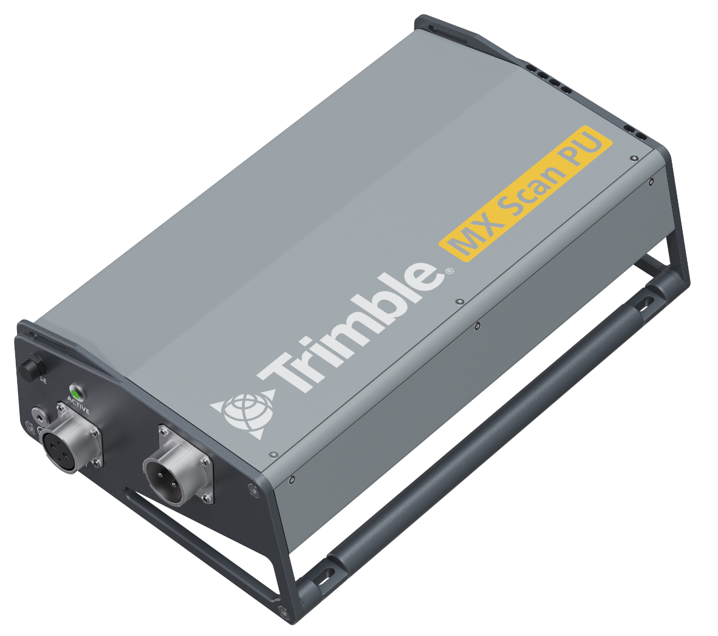
Trimble MX60
Trimble MX60 System
Trimble MX60 Sensor Unit & Case
MX Control Unit 2
MX Power Unit
MX Roof Rack
2 x 4TB Data Carrier
SSD Data Transfer Dock
ODU & Power Cables
System Overview
Field Software
Trimble Mobile Imaging (TMI)
Office Software
Additional Software Options
Trimble Business Center Mobile Mapping
Trimble MX Assets Manager
Trimble MX Publisher

Slide 12
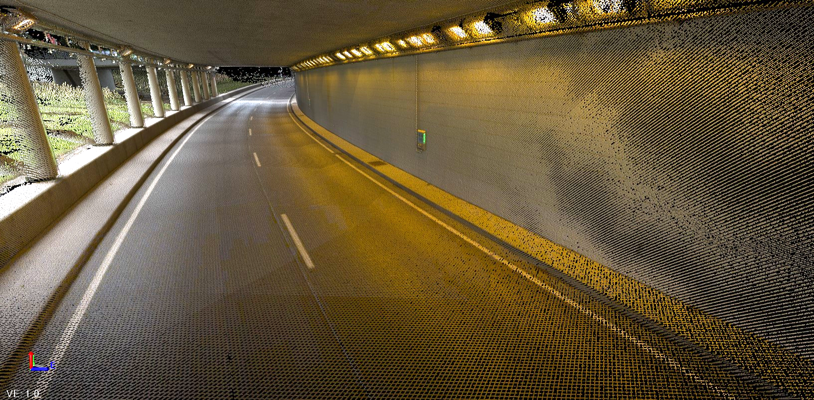
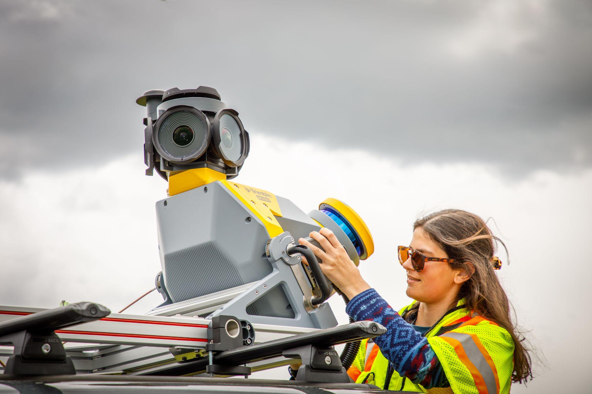
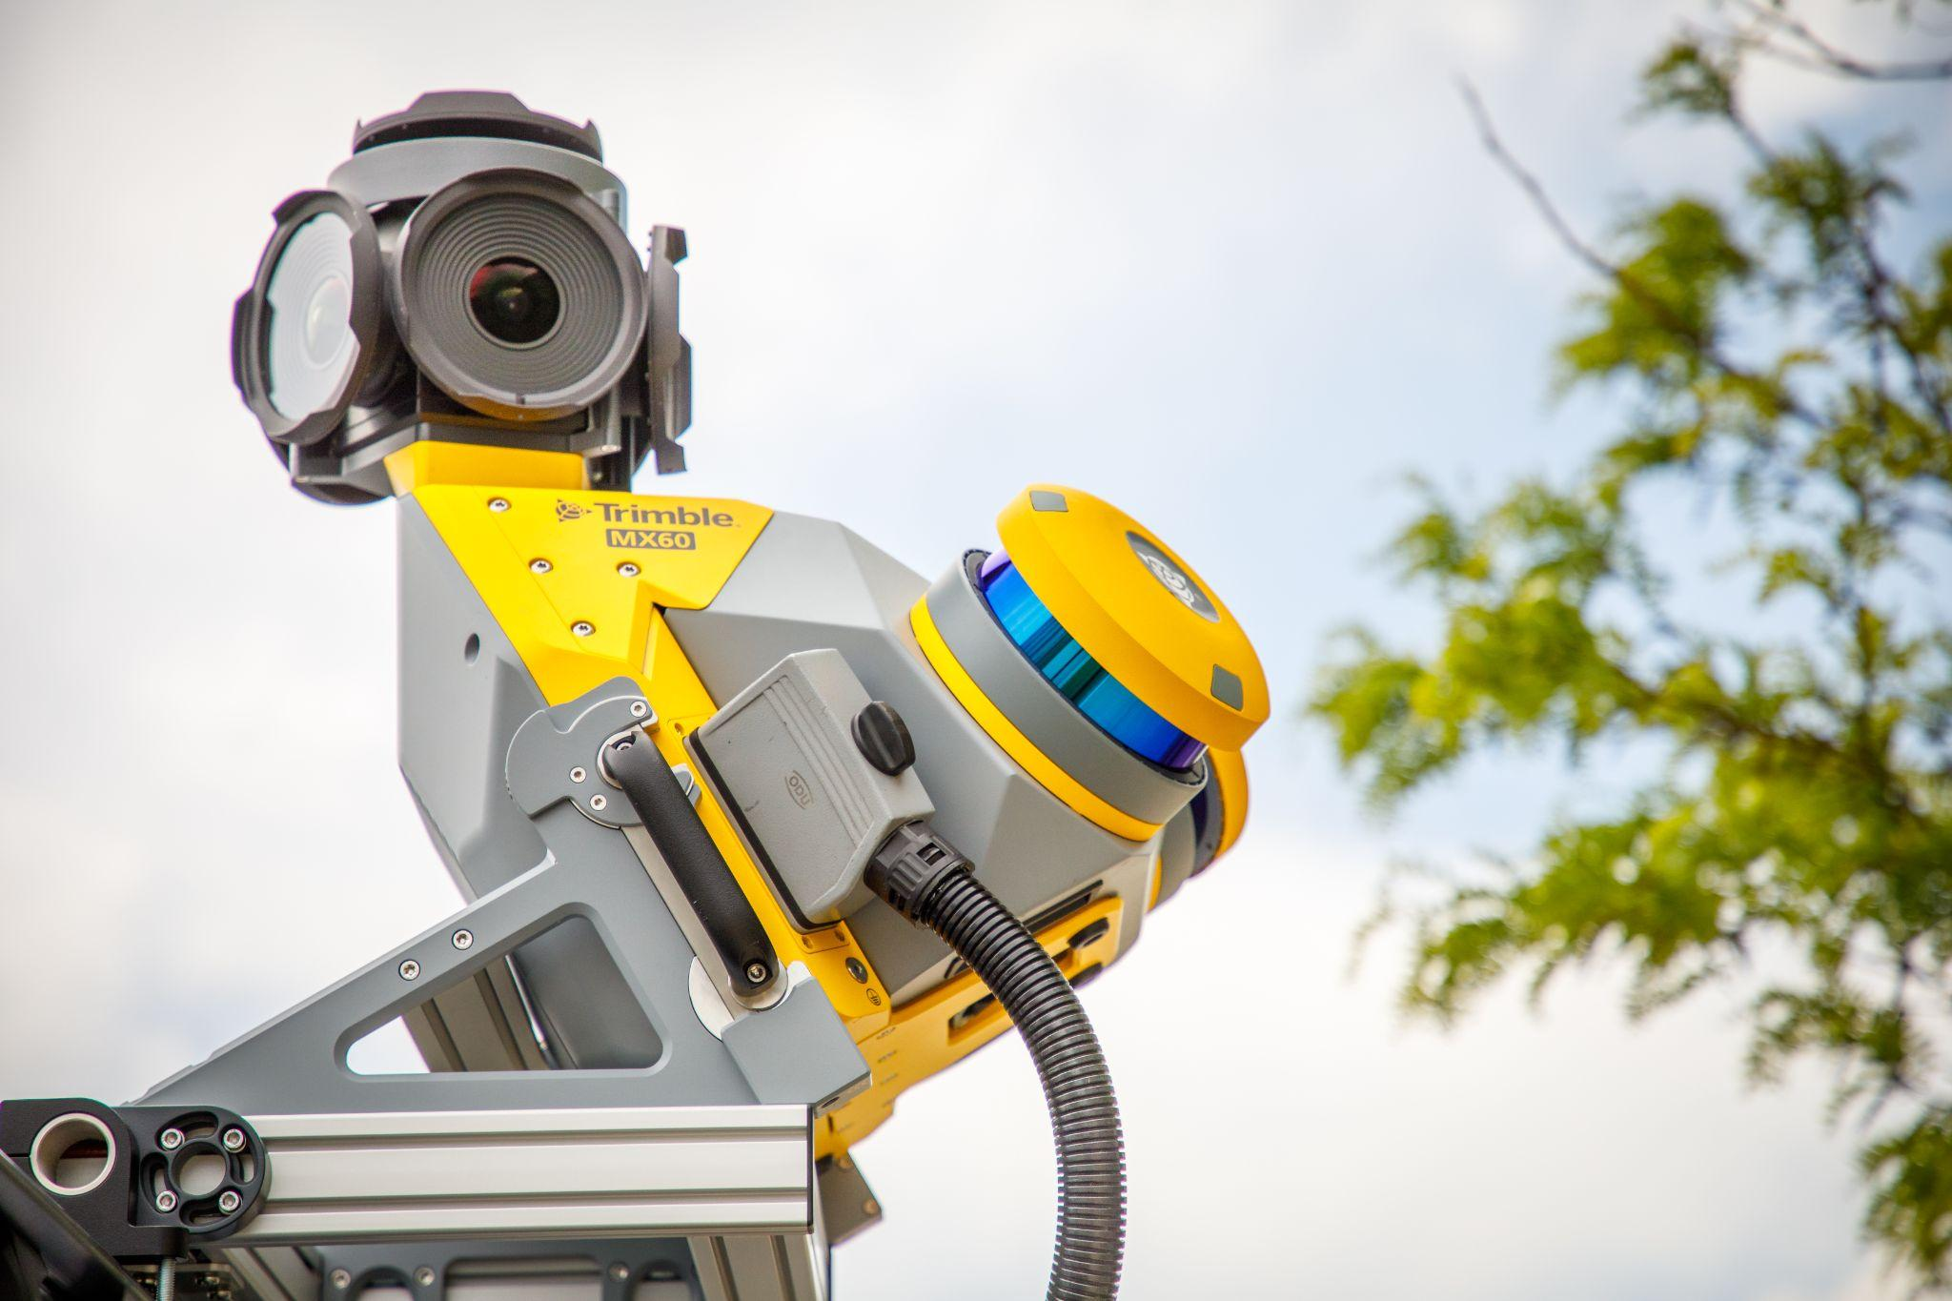
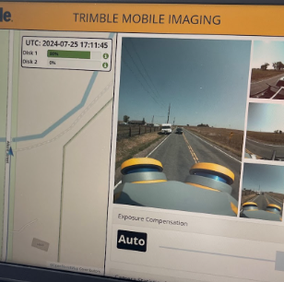
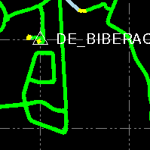

Key MX60 Specifications
Scanning
Up to 2 million points per second
Environmental IP64 certified
Features
2x4TB SSDs
Improved Control Unit
Imagery
Up to 72 MP spherical
12 MP downward
Positioning XY: <0.01m, Z: 0.01m

Slide 13
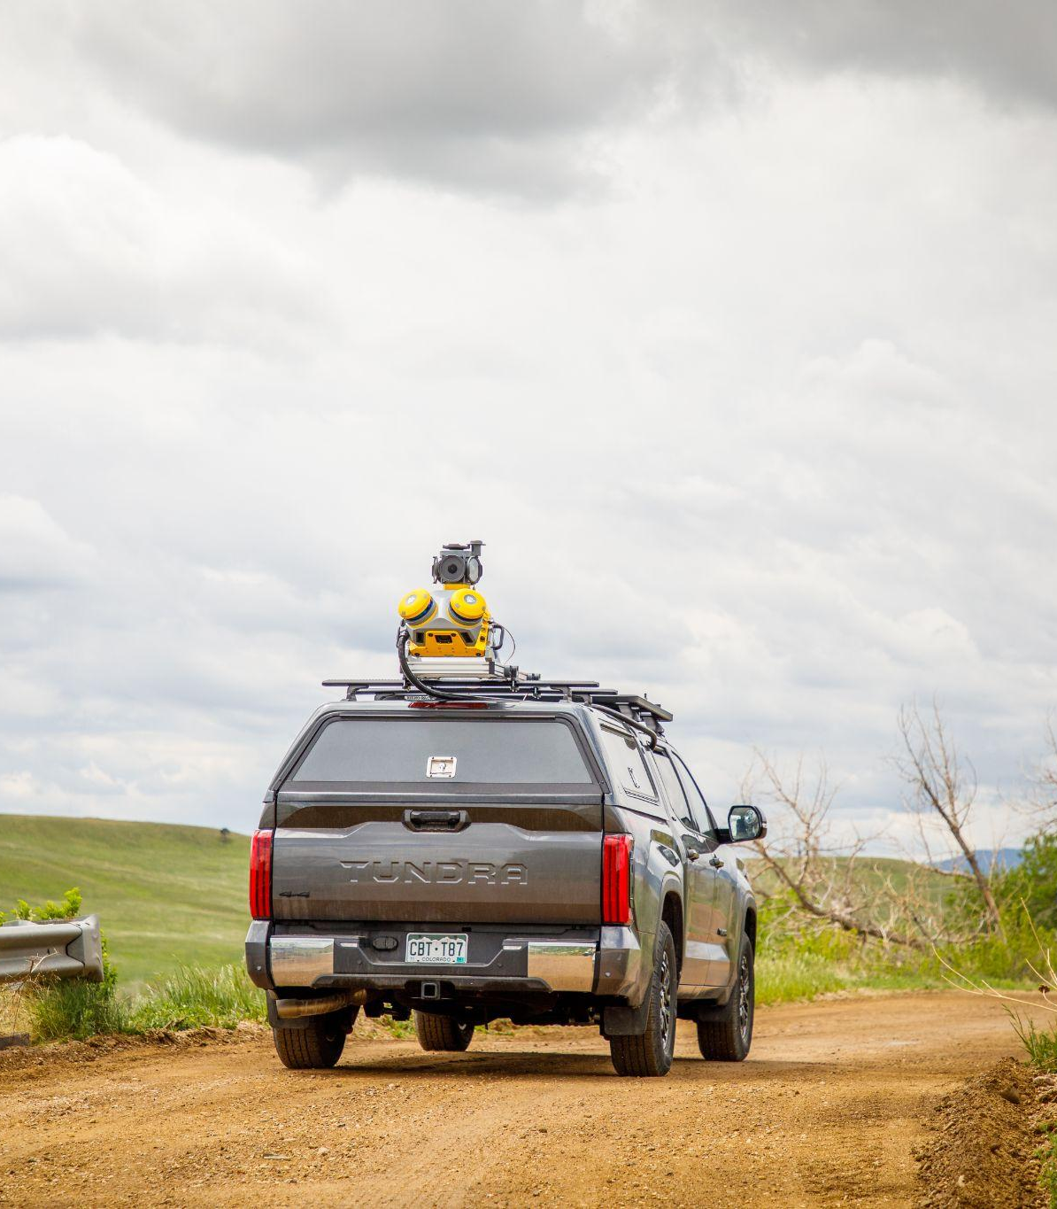
Key Features
Trimble MX60

Slide 14
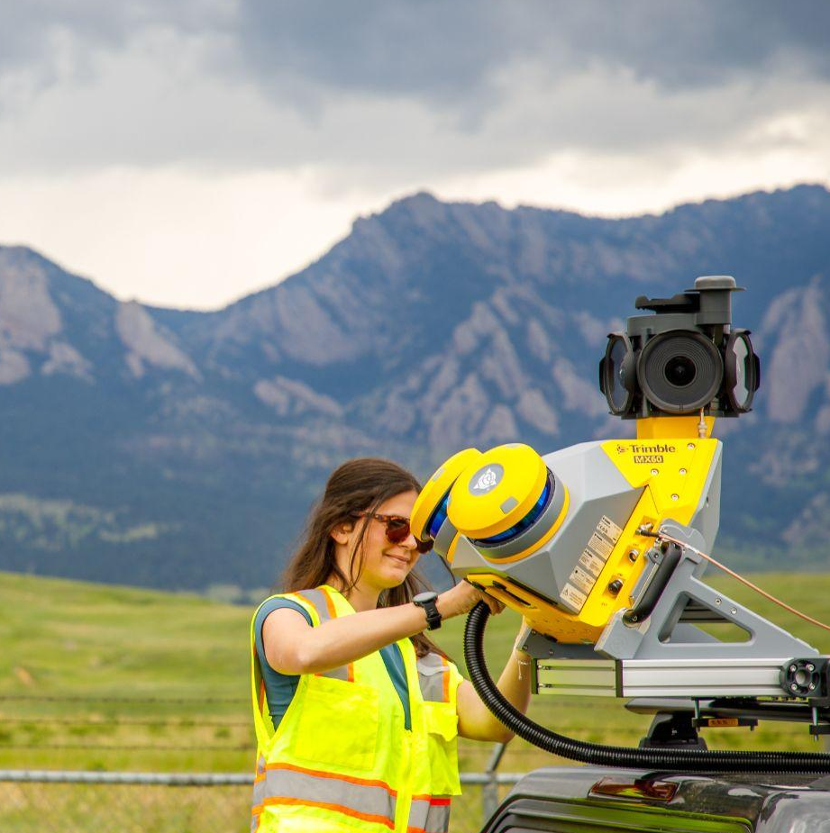
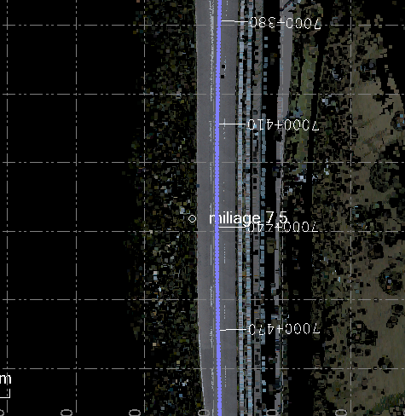
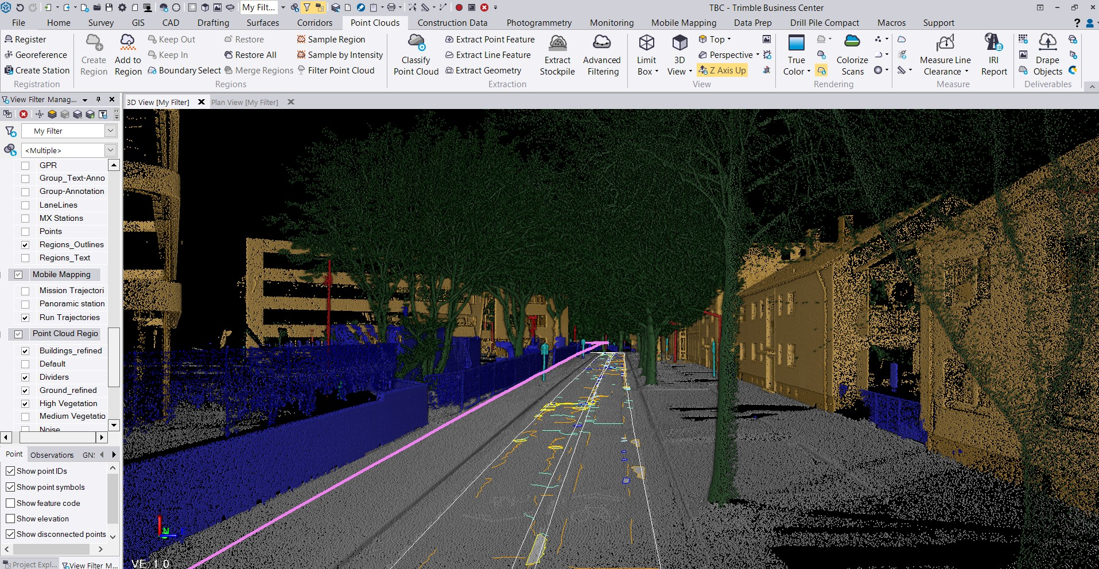
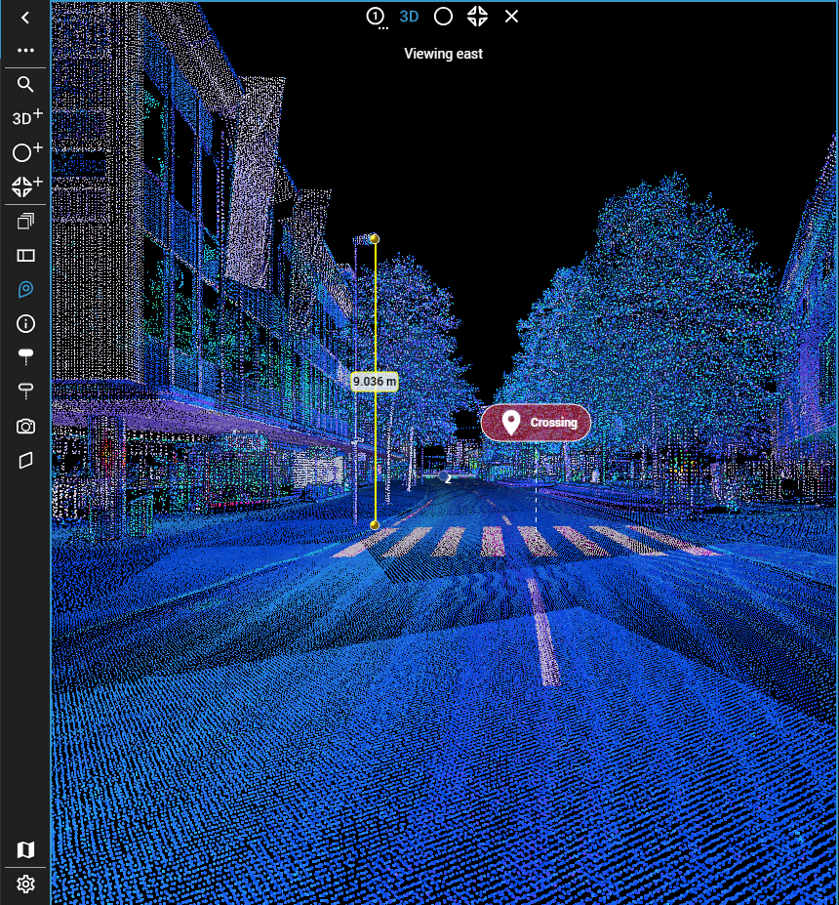
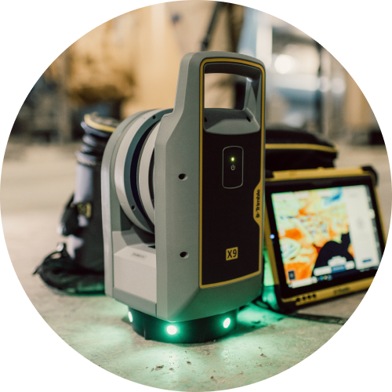
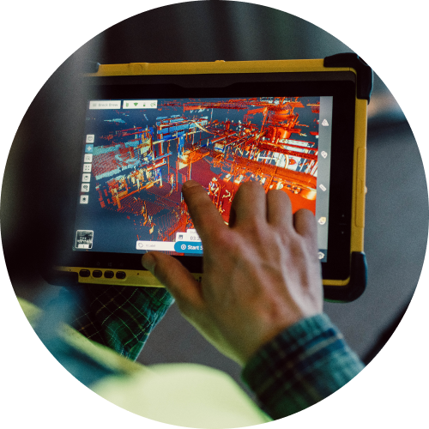
Workflow
Step 1 | Capture
Use TMI control and capture using your MX60, from virtually any device
Step 2 | Process
With tightly coupled GNSS and inertial processing engines inside TBC
Step 3 | Extract
Create, inspect and analyze high quality survey and engineering CAD and GIS deliverables
Step 4 | Share
Avoid site revisits by sharing point clouds and images with overlaid existing asset data

Slide 15
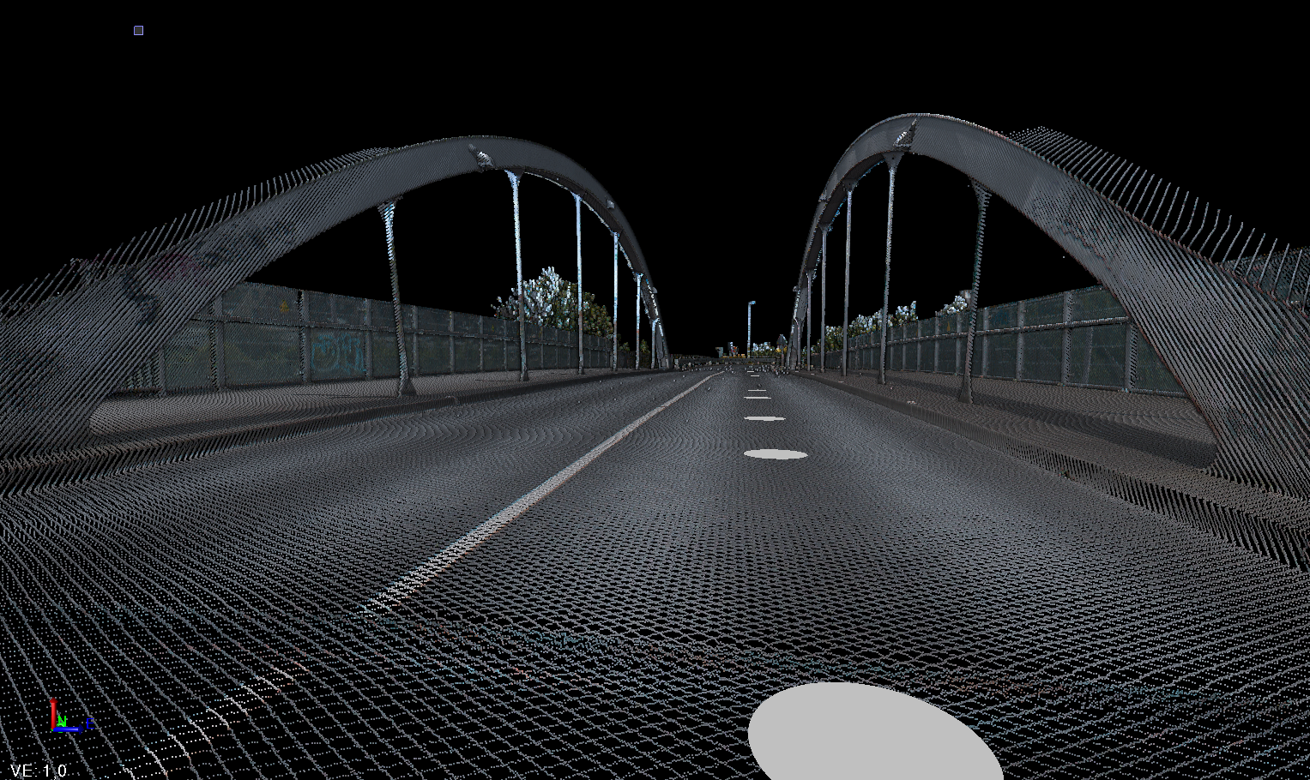
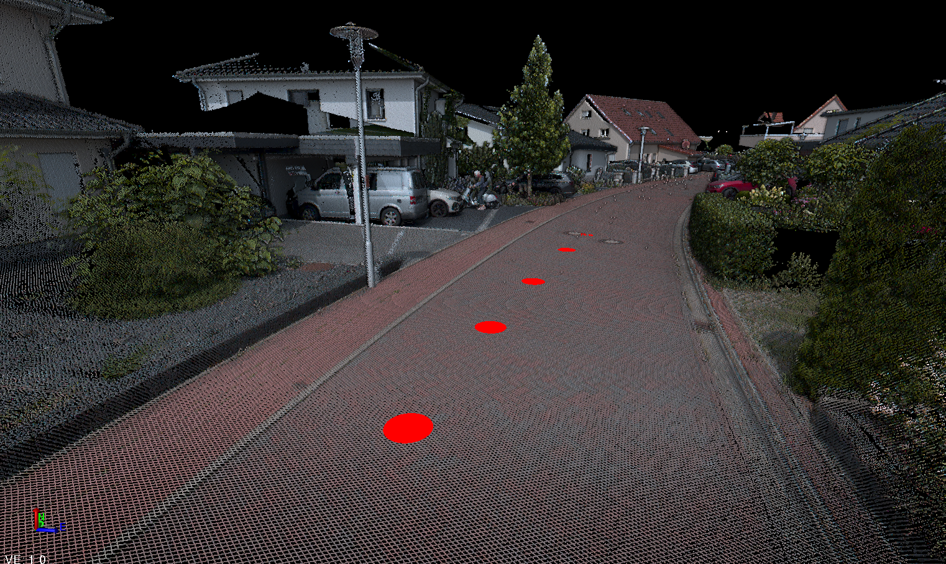
Scanning System
System Summary
The MX60 Scanners are a performance advancement on their MX50 Counterpart
Maximum range has increased to 150m - an increase of 70m in comparison to the MX50
Effective Measurement rate has increased to 1000 kHz or 2000 kHz - up from 340 kHz or 1920 kHz respectively
Scan speed has increased to 400 Hz from 240 Hz
All whilst maintaining the high accuracy and precision of 2 mm / 2.5 mm seen in the MX50
Resulting in a much cleaner and more detailed point cloud

Slide 16
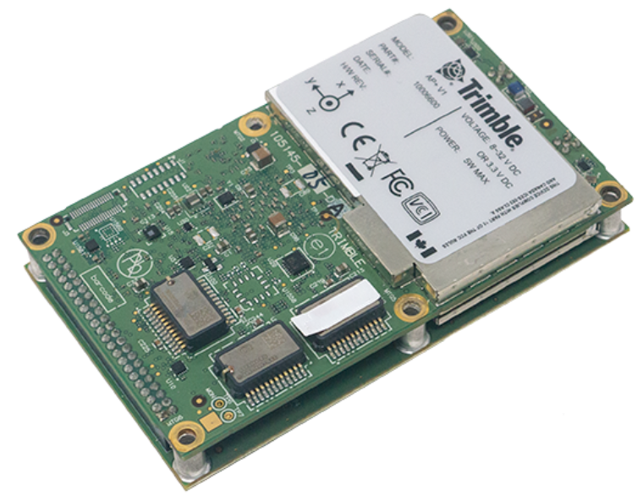
Positioning System
System Summary
The Trimble MX60 system is powered by the next-generation compact, low-power positioning hardware, with dual embedded survey-grade GNSS chipsets
Applanix IN-Fusion+ GNSS-inertial integration firmware featuring Trimble ProPoint GNSS Technology
Onboard IMU with solid-state MEMS inertial sensors and Applanix SmartCal™ compensation technology
Advanced Trimble Maxwell™ Custom GNSS survey technology with 2 x 336 tracking channels

Slide 17
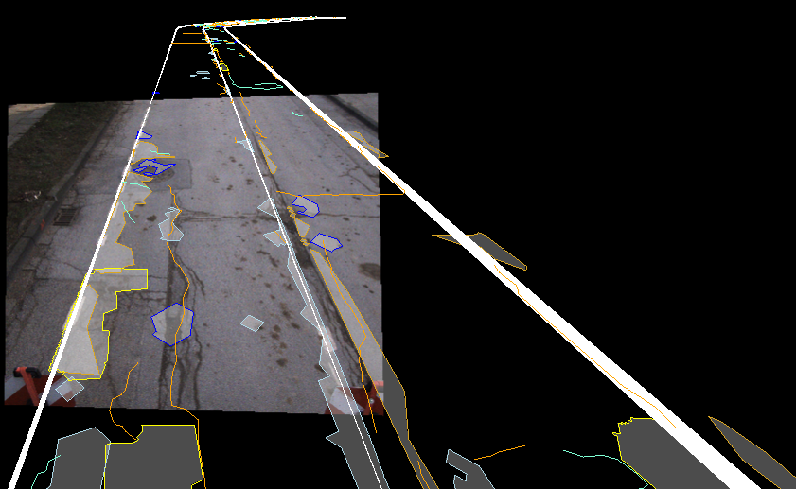
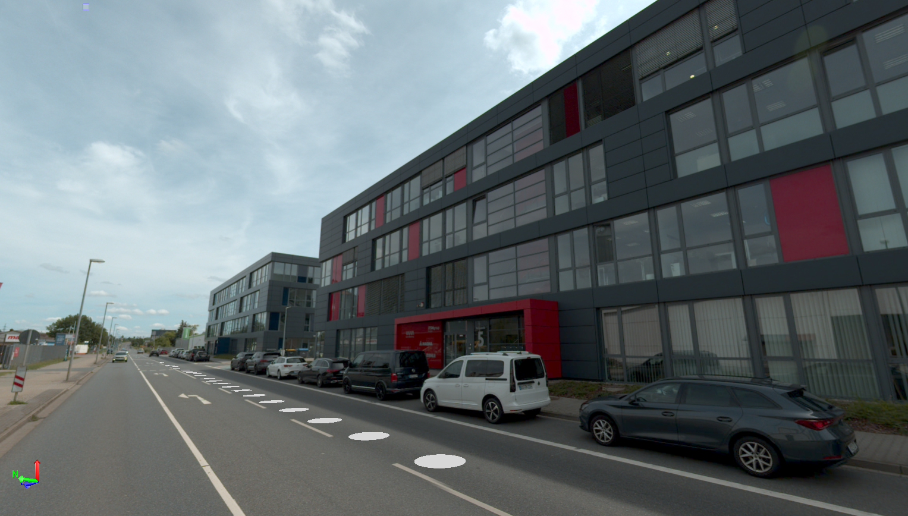
Imagery
Backward and Spherical
The MX60 Portfolio is equipped with a new downward facing camera to capture imagery of the road surface.
The 82° Hz, 66° Vz Field of View and 12 MP resolution complements the detailed point cloud seamlessly
The addition of the new 72 MP Spherical camera to the Pro and Premium models offers users who require it, high quality and detail
For those not requiring such an advancement the existing 30MP Spherical camera is supplied on the Core version

Slide 18
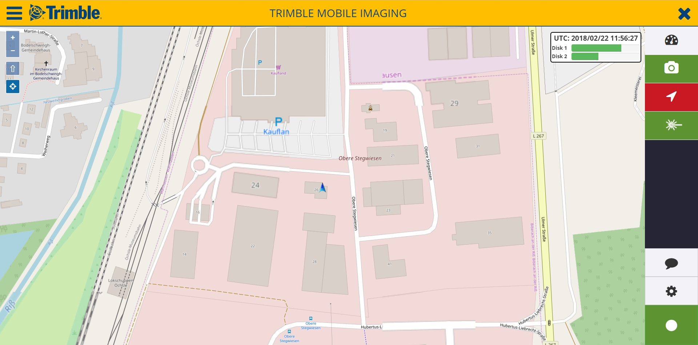

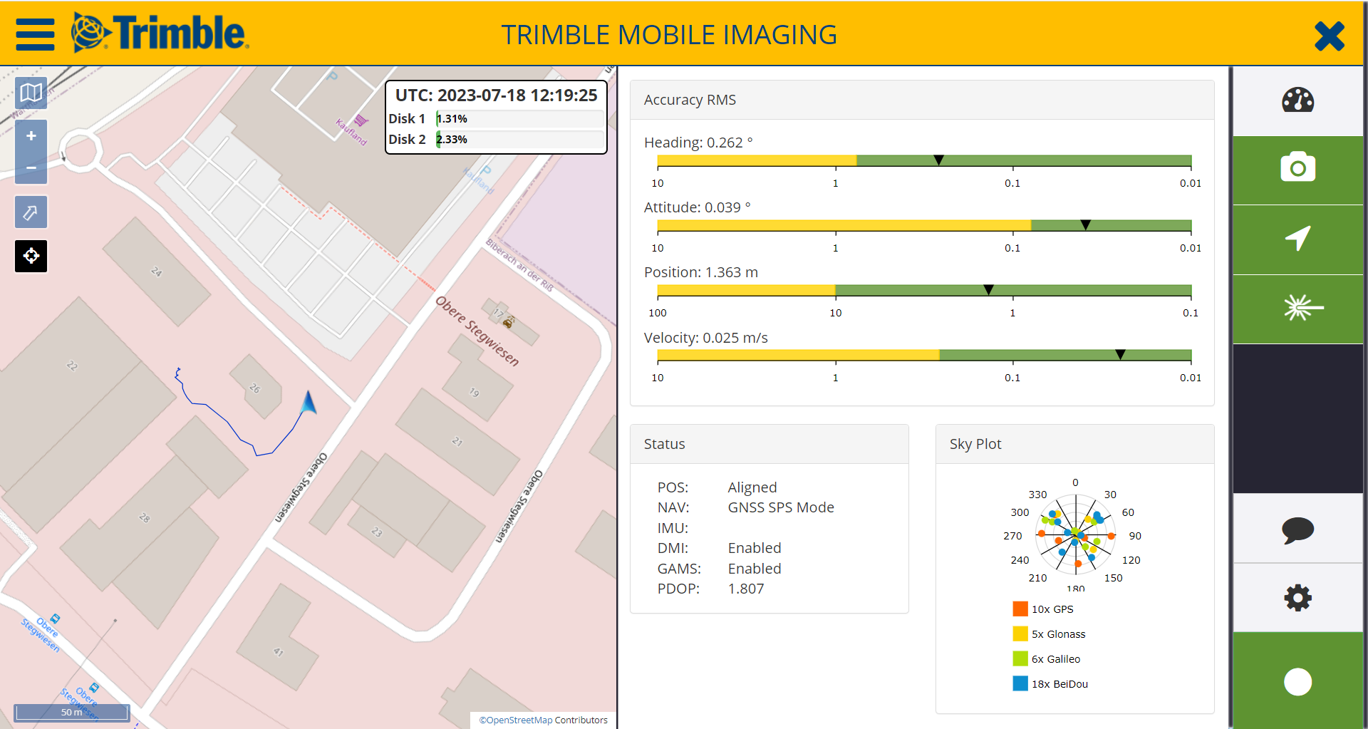
Trimble Mobile Imaging
TMI 5.0.2
Includes full backward compatibility to the MX50, MX9 and MX90.
Improvements to the disk manager
Ensure drives are healthy for collection, improving disk detection and initialization
Bypass data disk warning for critical drives
Bypass the use of the second disk, if it’s not in use.
More improvements and bug fixes for TMI can be found in the release notes.

Slide 19
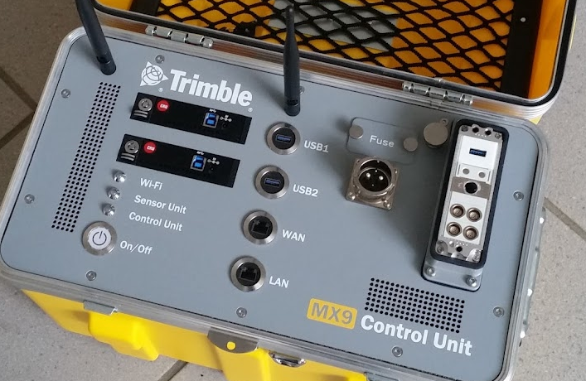
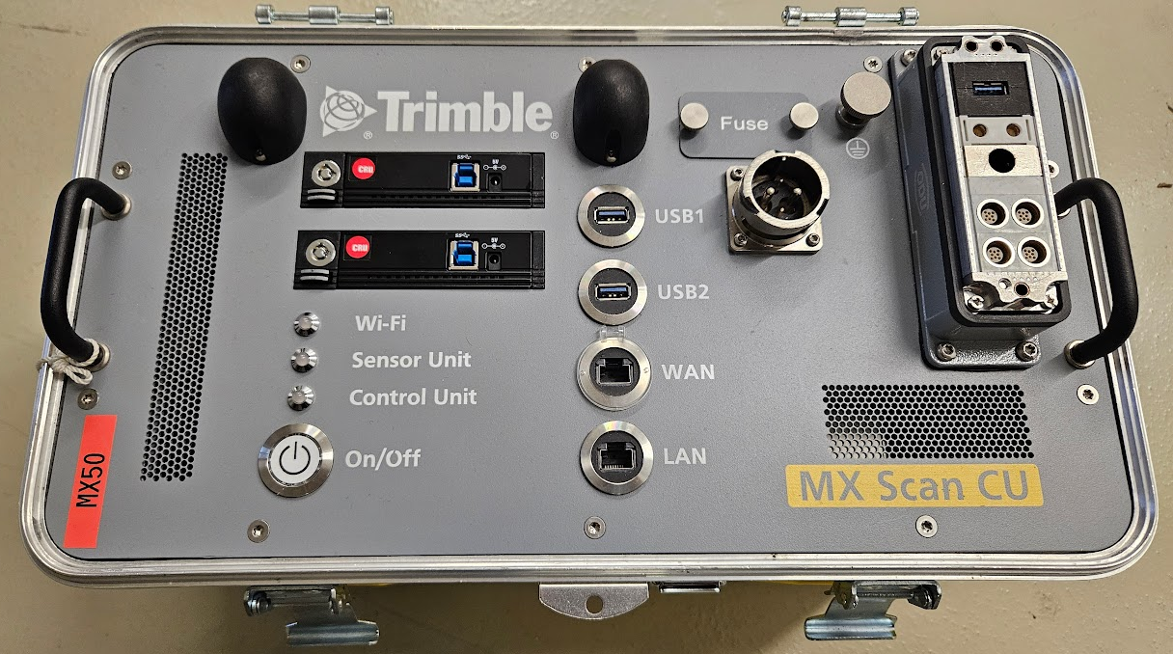
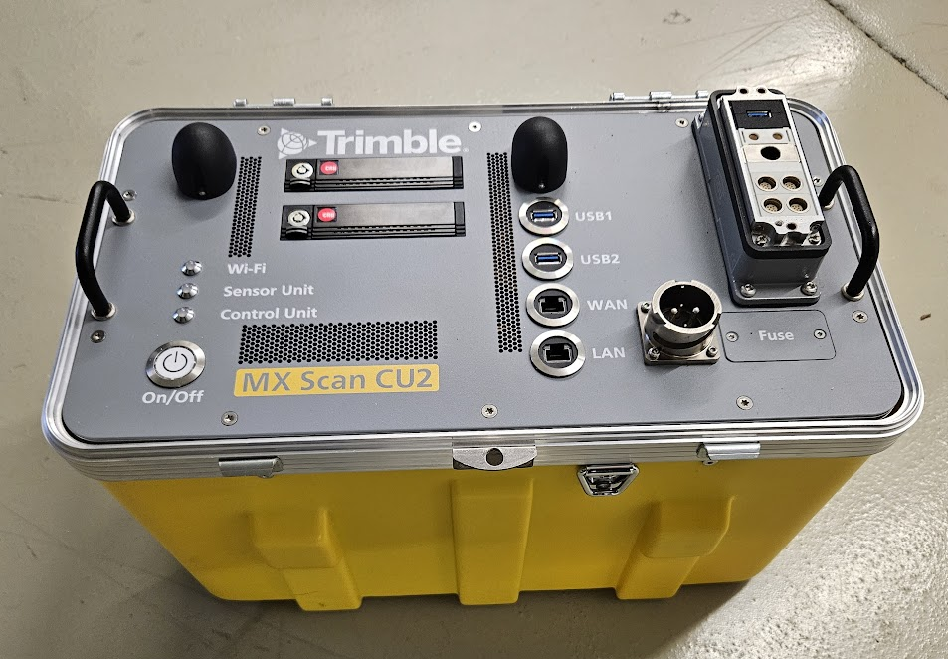
CU & CU2 Compatibility Options
 |  | MX9 | MX50 | MX60 | MX90
 | MX9 CU |  | Not Compatible
 | MX-Scan CU | Compatible |  | Not Compatible
 | CU2 | Compatible*
*TMI 5.0.2 is not compatible with MX7

Slide 20
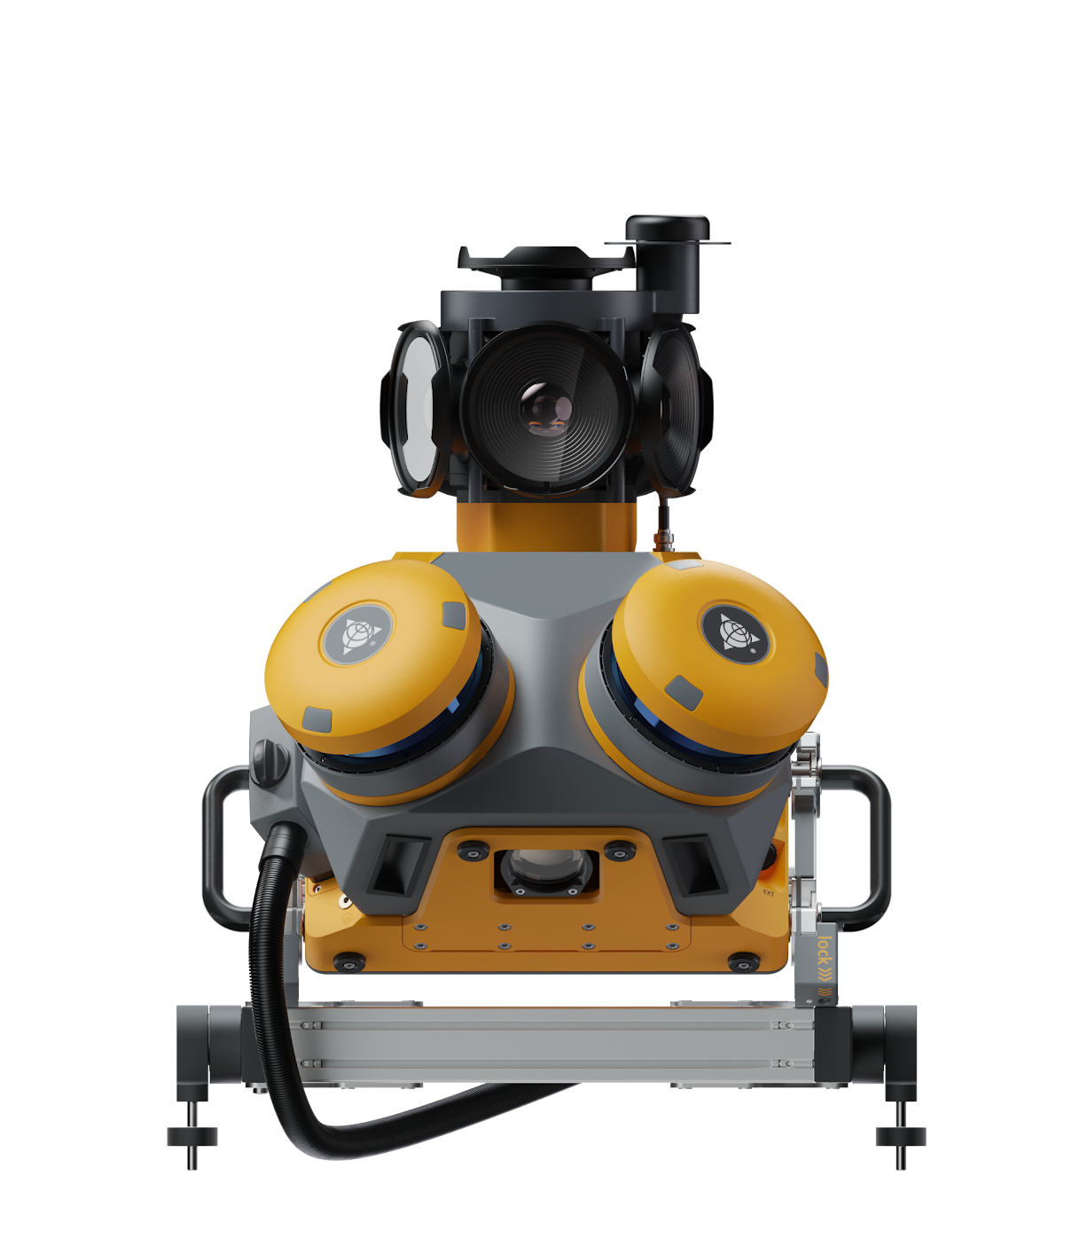
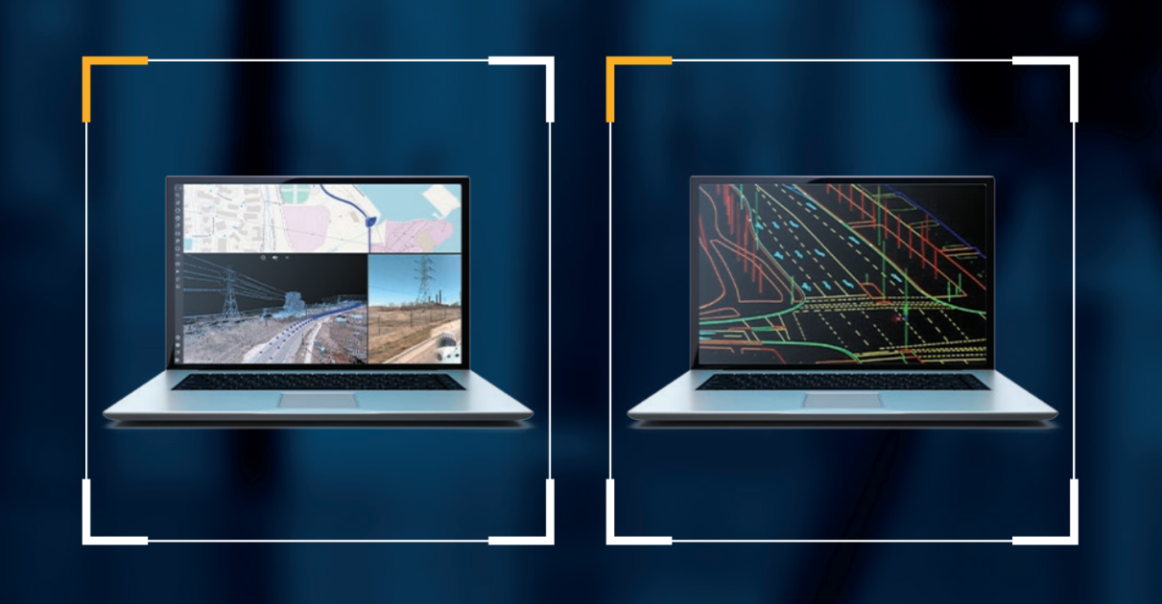
Office Software
What’s new for Trimble MX60

Slide 21



Trimble MM Office Software Solutions
Applanix POSPac 9.2
POSPac 9.2 STD Alone support LiDAR QC functionality for Trimble MX60 systems
POSPac 9.2 CLI support for Trimble MX60 navigation data processing
Trimble Business Center 24.02
Support Trimble MX60 data processing features (IMU, Camera, profilers)
Support Trimble MX60 data navigation and deliverables production
Trimble MX 24.3
Applanix POSPac
Trimble Business Center
Trimble MX
Trimble MX Assets Manager supporting new Trimble MX60 and AI based workflows
Trimble MX Publisher and Import/Upload tool support new Trimble MX60 family

Slide 22
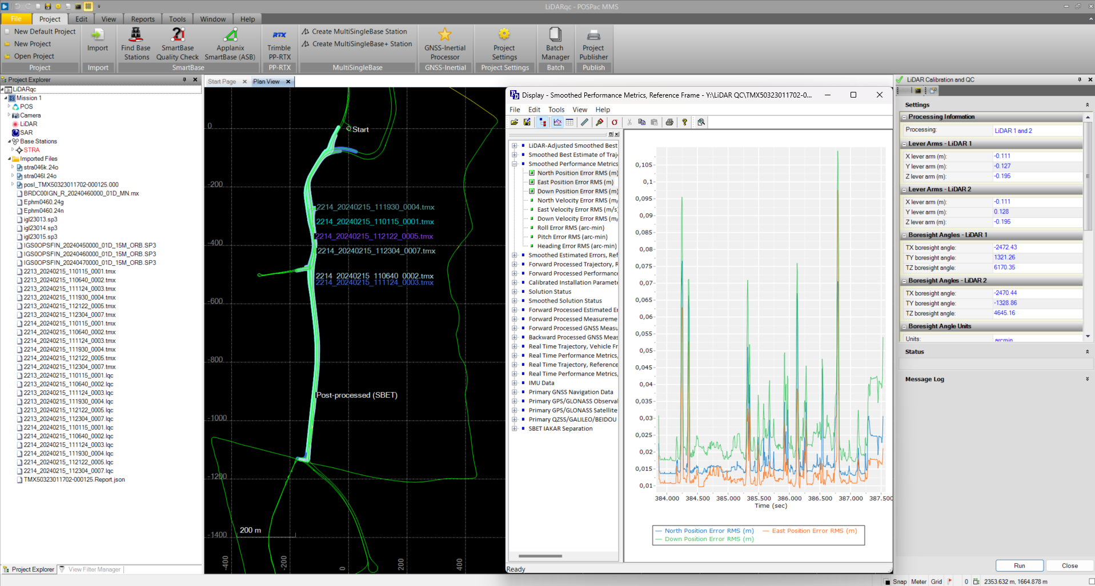

POSPac 9.2
Available as stand alone solution, perpetual and term license
Available as product integration with the TBC Mobile Mapping term license
Process all MX series Mobile Mapping Navigation data
(MX50/MX60/MX9/MX90)
New: LiDAR QC improve trajectory processing performances in complex registration scenarios

Slide 23
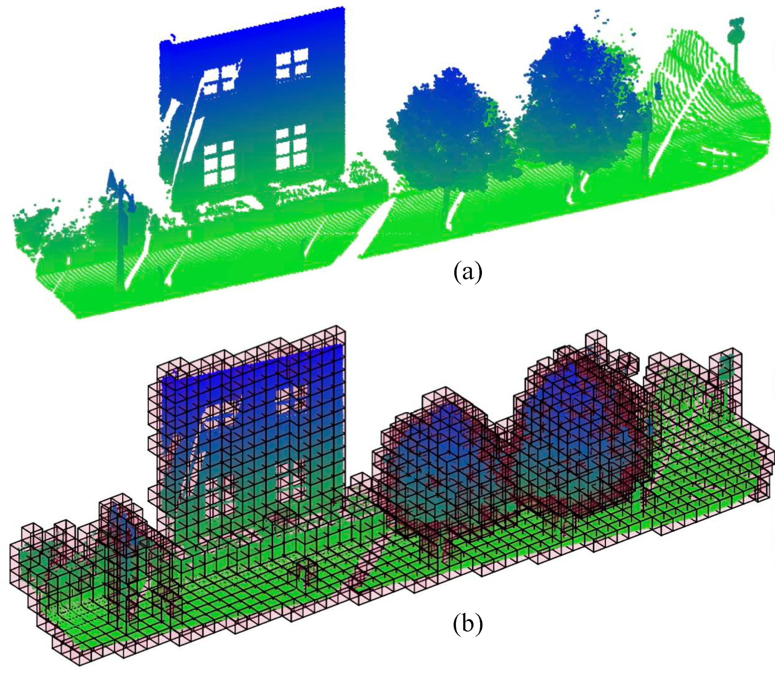
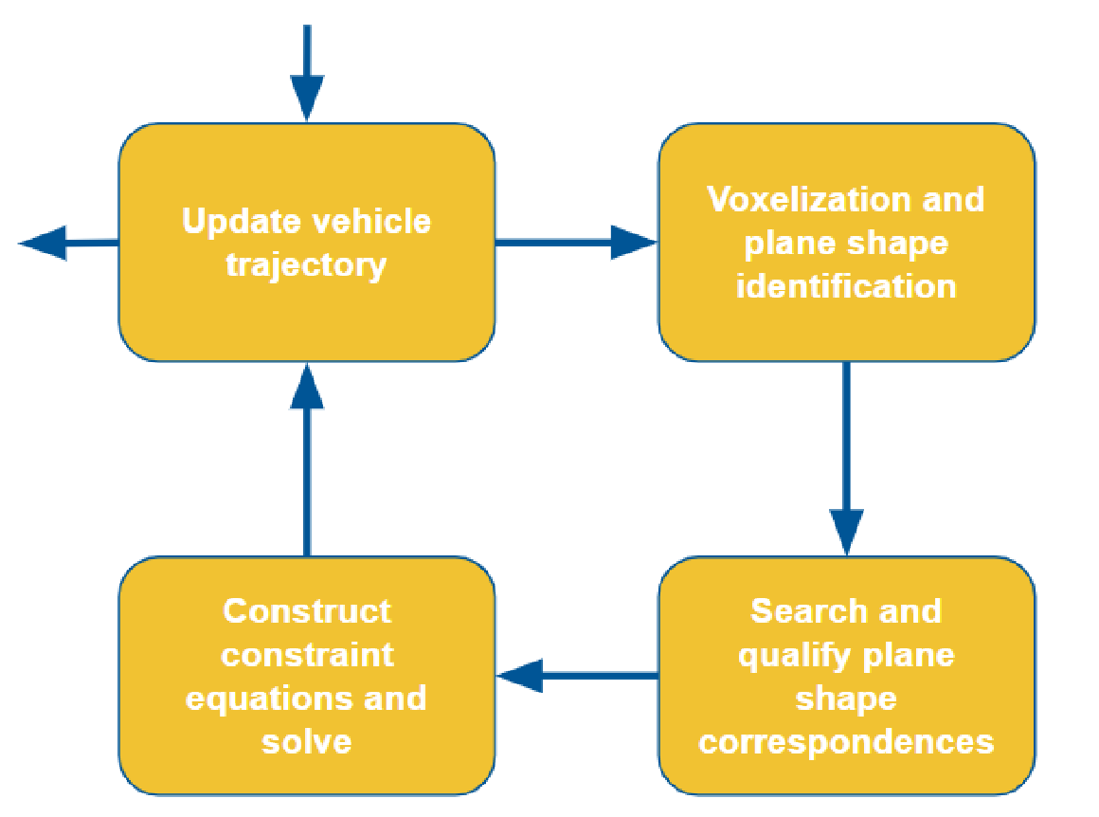
PCDA: Point Cloud Data Adjustment (LiDAR QC)
LiDAR Simultaneous Location and Mapping (SLAM) based on a robust global Voxel iterative least squares adjustment.
Derived from the 3D point cloud data, Voxels are similar to image pixels, but 3-dimensional ones. Voxels are matched in overlap regions.
Iterative least squares adjustment using the matched points is run to solve for the constant IMU boresight angles and makes corrections to the trajectory (position and orientation). LiDAR as aiding sensor.

Slide 24
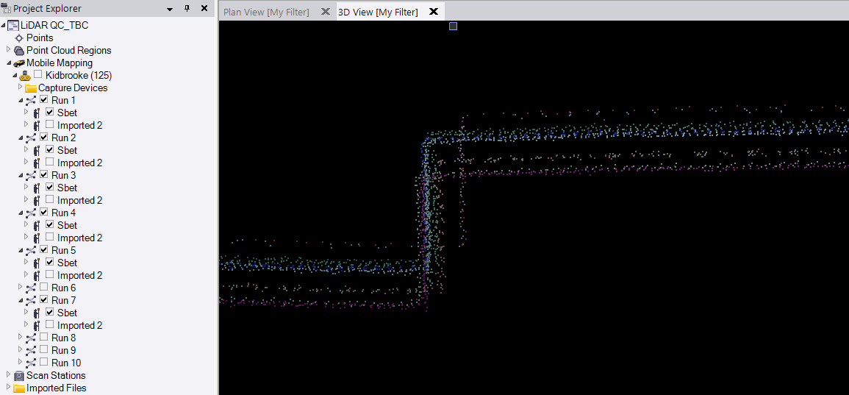

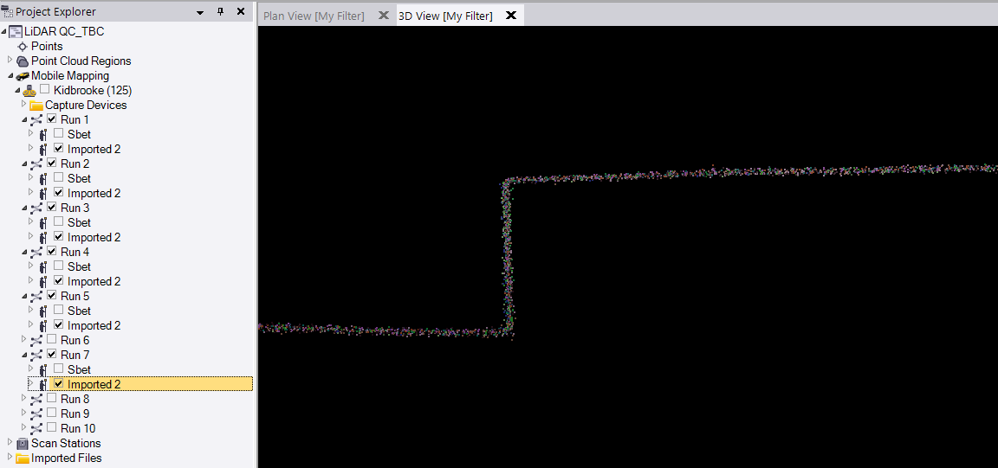
Using LiDAR QC
6 RUNS
17 cm
Import scan data in POSPAC
Run LiDAR QC to generate a new .SBET file (Proc folder of POSPac project,suffix corrected_sbet_mission
Set the corrected_sbet as active trajectory in the Mission Properties, and generate the scans
Example of 6 parallel runs, curbstone 2D and H offsets from the default Sbet, and LiDAR QC results from corrected_Sbet
6 RUNS

Slide 25
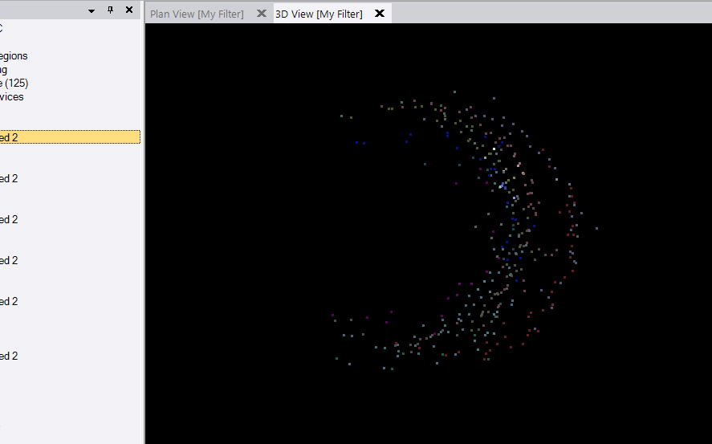

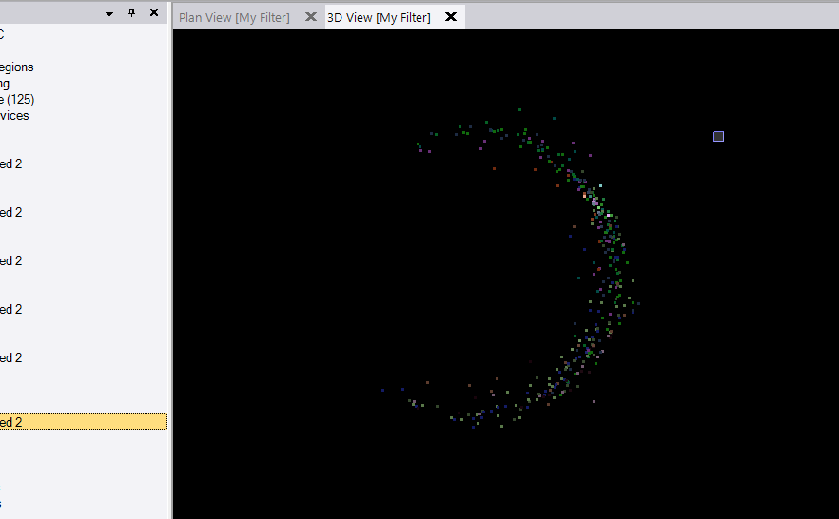
Using LiDAR QC
6 RUNS
6 RUNS
6 cm
Import scan data in POSPAC
Run LiDAR QC to generate a new .SBET file (Proc folder of POSPac project,suffix corrected_sbet_mission
Set the corrected_sbet as active trajectory in the Mission Properties, and generate the scans
Example of 6 parallel runs, curbstone 2D and H offsets from the default Sbet, and LiDAR QC results from corrected_Sbet
6 RUNS
6 RUNS

Slide 26
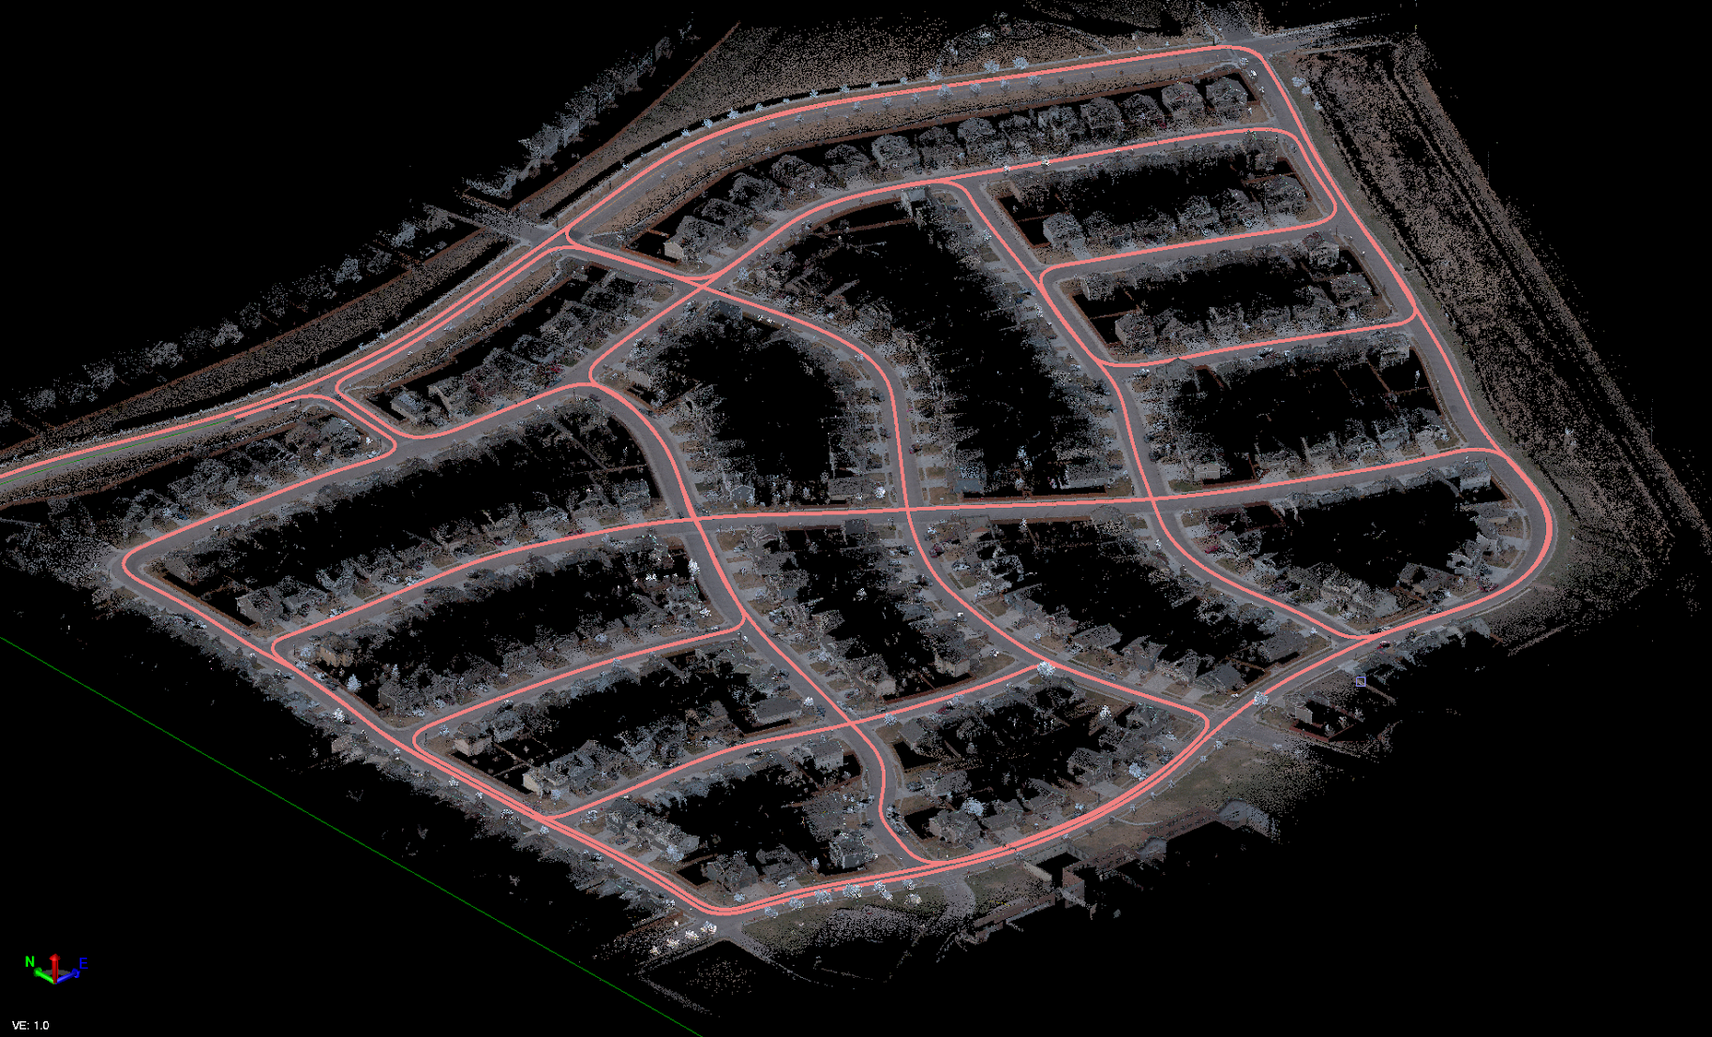
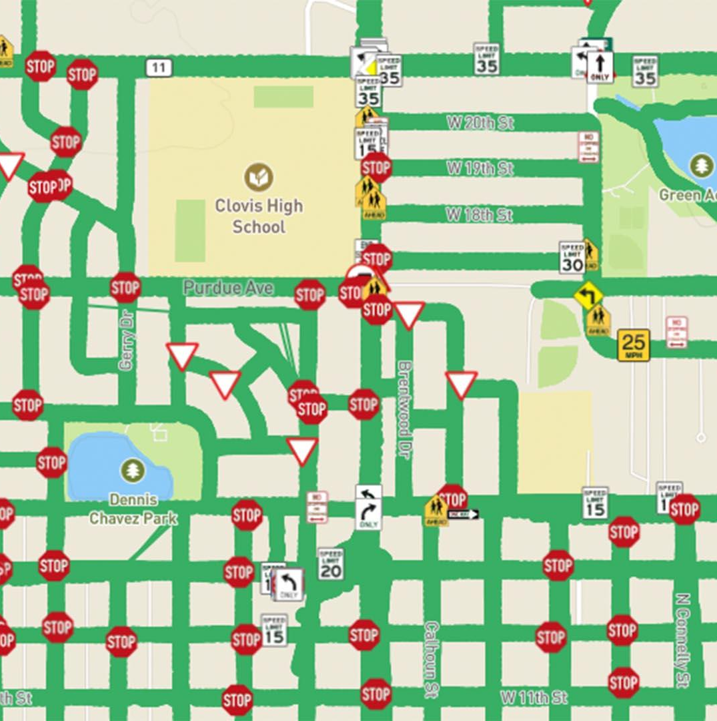
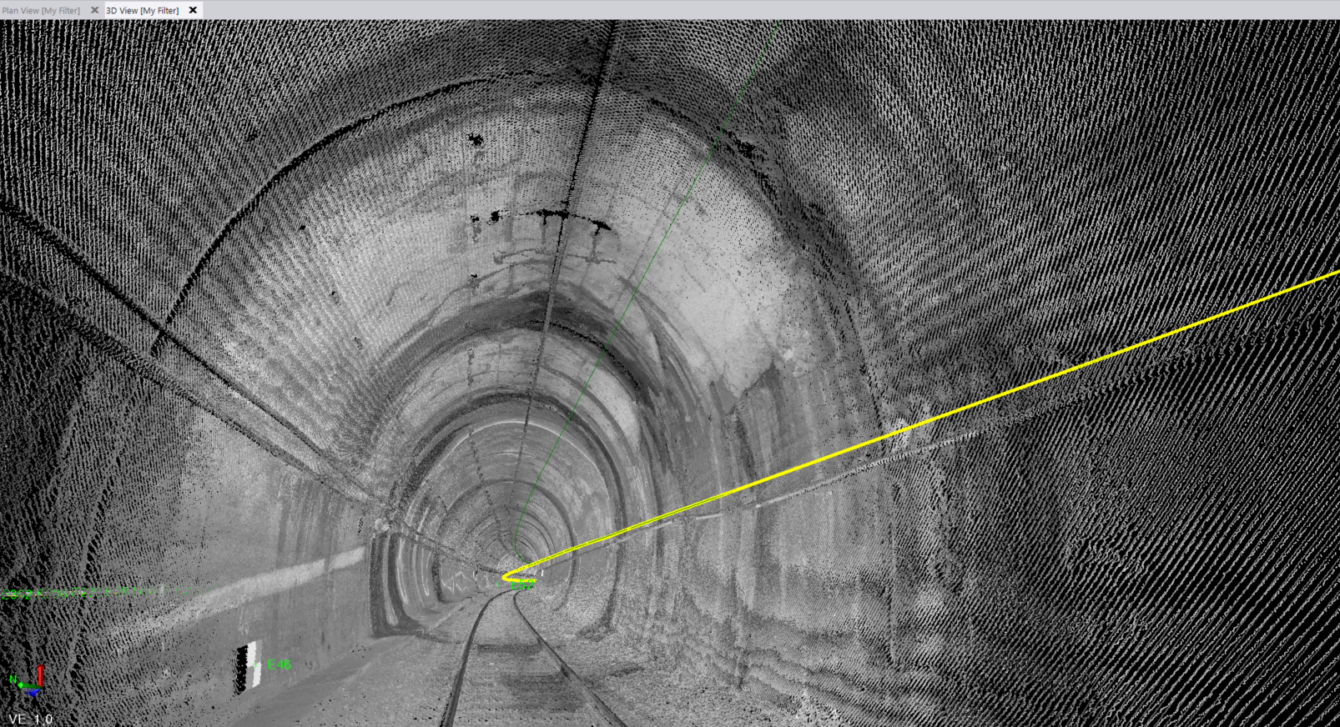
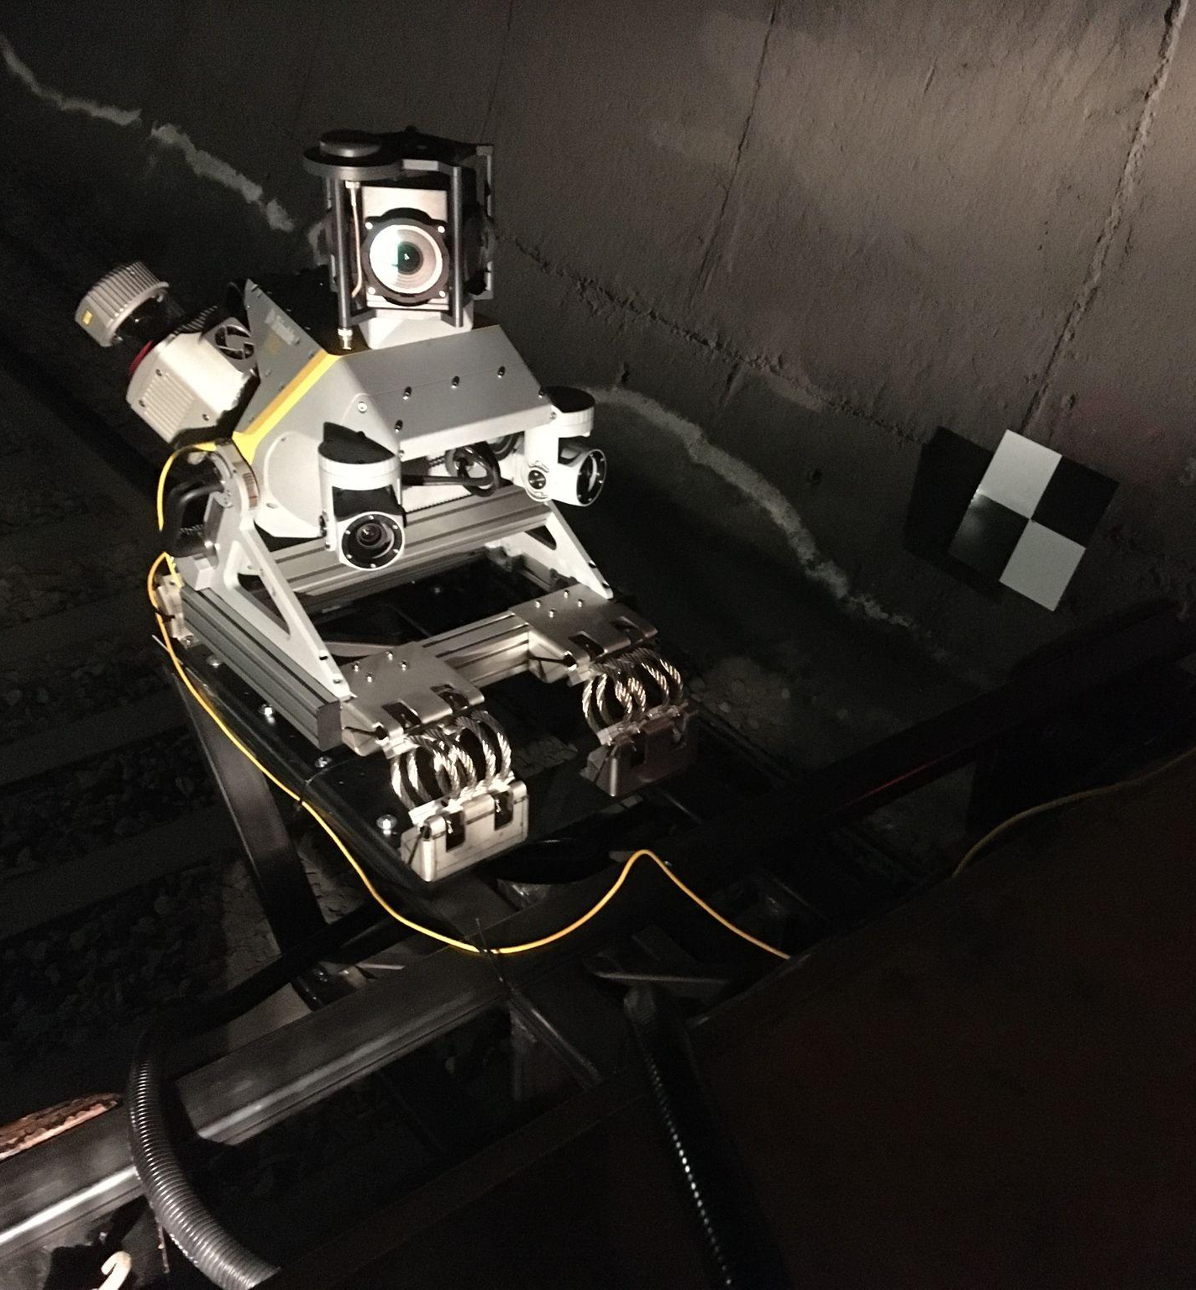
Why LiDAR QC
Helps combine scans from multiple passes into one, allowing scan data from multiple overlapping or intersecting runs to match well
(intersection, bridges, junctions, urban road network, etc.)
Multiple passes in difficult GNSS conditions can deliver results close to GCPs usage
Contributes in solving possible left to right scan misalignment
Produce clean pointcloud data to maximize efficiency with scan data classification tasks

Slide 27
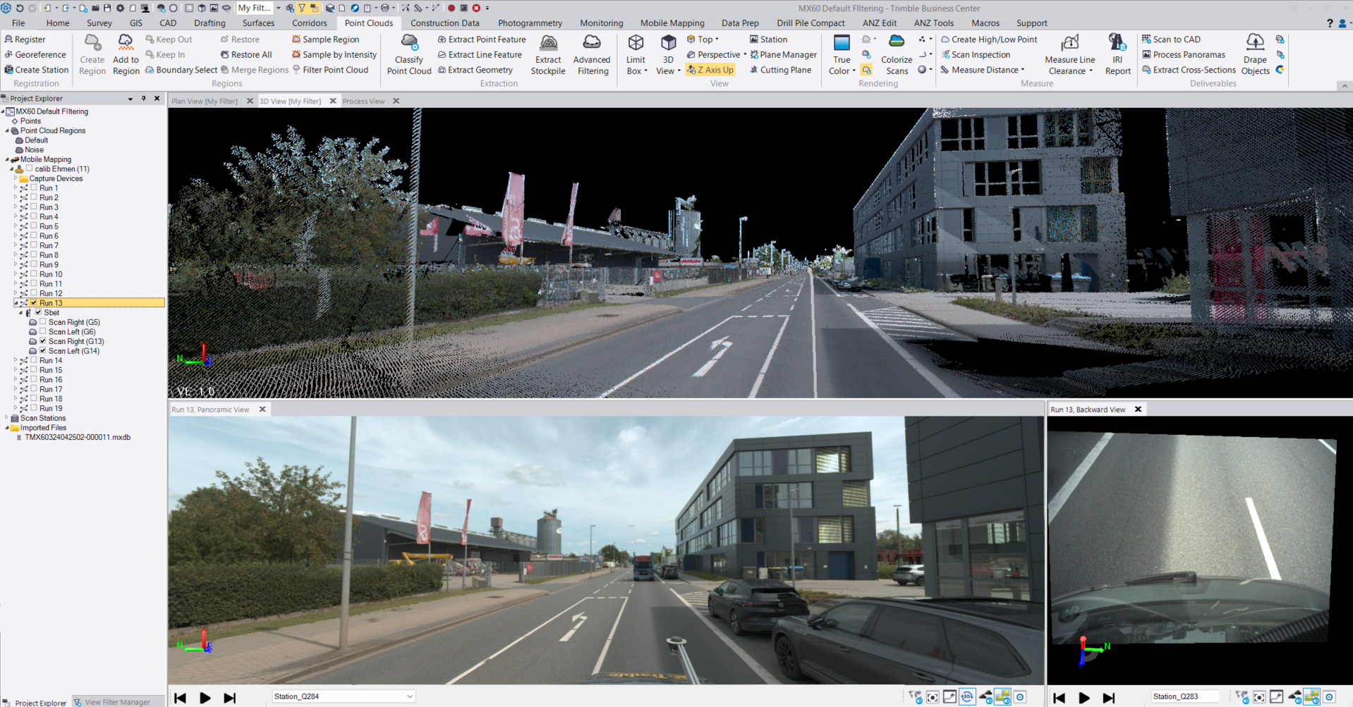
TBC MM 2024.02
Specific release to add Trimble MX60 support to TBC
Enhanced noise and dust reduction filtering capability for cleaner data
POSPac 9.2 CLI package integrated for subscription customers
Support MX60 data for all the processing, production, navigation and export functionalities needed by MM users
Download links:
Online
Offline

Slide 28


Trimble MX 24.3
Trimble MX60 data supported with a system specific template
Trimble MX Assets Manager expanded in AI. Self annotate, create and run your own image or pointcloud detectors
Trimble MX Import and Upload tool and MX Publisher support Trimble MX60 data.
Trimble MX Publisher 24.3 as a data production environment. Store your assets in centralized databases. No strict needs for PlugIns

Slide 29
Top Applications
Trimble MX60

Slide 30

Workflow Applications
Road Infrastructure Management
As cities continue to grow across the world, road construction and inspection is vital to developing and maintaining critical infrastructure for our communities.
Safely and efficiently capture existing conditions at scale, helping to standardize on consistent data capture
Easily inspect road conditions and identify cracks or anomalies that might impact safety and comfort on the road
Identify and manage various key assets along the roadway such as signs, markers, utilities, and more.

Slide 31
Workflow Applications
City & Urban Asset Management
Effective urban planning and management starts with reliable data. With so much ground to cover, Trimble’s Mobile Mapping solutions help you confidently capture data with ease, producing high quality deliverables in a flash.
Improve urban mobility by analyzing traffic patterns and optimizing transportation routes
Optimize routes for emergency vehicles using accurate and up-to-date mapping data
Regularly survey and assess the condition of existing infrastructure and identify areas of repair or maintenance
Aid in the design of new infrastructure projects such as roads, bridges and public transit systems.

Slide 32

Workflow Applications
Rail Infrastructure Management
Mobile mapping helps map and maintain vast rail networks to ensure that existing lines remain safely in operation, and new development doesn’t fall off the tracks.
Inspect rail switches and crossings for wear and tear over time
Monitor track condition, wheel profiles, signals signs and communication systems
Carry out detailed analysis of track side assets without closing down the infrastructure
Ensure precise alignment and geometry of railway tracks, helping to maintain safe and smooth operation
Ensure sufficient clearance around tracks, tunnels, and bridges to prevent collisions and maintain safe operations.

Slide 33
Workflow Applications
Utilities & Fiber to the Home
Growing communities and evolving cities are requiring utility providers to expand their services to match rising demand. Mobile Mapping systems empower rapid data capture, seamless design, and asset management.
Maintain accurate inventories of assets and equipment, facilitating efficient management and maintenance
Conduct regular inspections of infrastructure such as power lines, transformers, and substations to ensure they are in good condition
Support the planning and installation of new utility lines and infrastructure with accurate topographical data and 3D models
Aid in upgrading and expanding existing utility networks by providing precise spatial data for integration and alignment.

Slide 34
Workflow Applications
Mining
Mines are massive, complex operations where every second counts. Mobile Mapping solutions help capture intricate details at scale to help drive mining operations forward in a safe, efficient manner.
Effortlessly capture stockpiles and compute volumes, change over time, and more to drive operations and delivery of unearthed materials
Capture the ever-changing conditions of the mine for critical site-logistics and planning Inspect reality against design to analyze cut and fill requirements for high walls and haul roads
Monitor and detect changes for slopes and preserve safe working conditions.

Slide 35
Workflow Applications
Tunneling
Tunnel infrastructure construction is a rapidly growing industry with demanding requirements for data capture, design, and inspection. With such critical safety needs, mobile mapping solutions help operators spend less time in dangerous environments and drive powerful insights in the office.
Capture and manage utilities within tunnels, such as lighting, ventilation, and communication systems, using precise mapping data
Regularly monitor the structural health of tunnels, identifying cracks, shifts, and other potential issues
Conduct detailed condition assessments to prioritize maintenance activities and ensure safety.

