Slide 1
Optimising Manufacturing with Trimble
Presented By:
Marianna Kopsida, PhD.
Tor-Erik Djupos
Using the Trimble Eco System
Notes:
To change the background image - right mouse click on the image, select “Change background”. Choose the image you want to replace this image with and then click Done.

Slide 2
Speakers
Marianna Kopsida
Tor-Erik Djupos
Advanced Solutions Manager 3D, Trimble Geospatial EMEA
Trimble Rotational Program (Mixed Reality, Tekla, Energy, Geospatial)
PhD in Engineering, University of Cambridge
Visiting scholar, Georgia Institute of Technology
MSc in Engineering Project Management, AUTh
BEng-MSc in Civil Engineering, AUTh
Masters degree in Geomatics Engineering.
Background in Marine, Land and Geodetic Surveying.
Been with Trimble since 1998.
Currently working as an application engineer with the Trimble Geospatial division.

Slide 3
Agenda
01
02
03
04
05
Industry Overview
Requirements/Current Practice
Trimble Workflow and demo
User benefits
User stories
Notes:
To change the background image - right mouse click on the image, select “Change background”. Choose the image you want to replace this image with and then click Done.

Slide 4
Industry Overview
Manufacturers transform raw materials, components, assemblies, and so on, into finished products, often involving processes organised into a production line.
Some applications:
Steel fabrication for infrastructure
Precast
Tunnel components
Ship-building
Off-site fabrication improves the speed of construction. It allows for versatility and sustainability.

Slide 5
Technological Trends
Utilising technology to optimise workflows and increase productivity
How can they better utilise 3D data in the field
How they connect office and the field better
How can they reduce material waste
Notes:
1200*2*60000 = 144mil

Slide 6
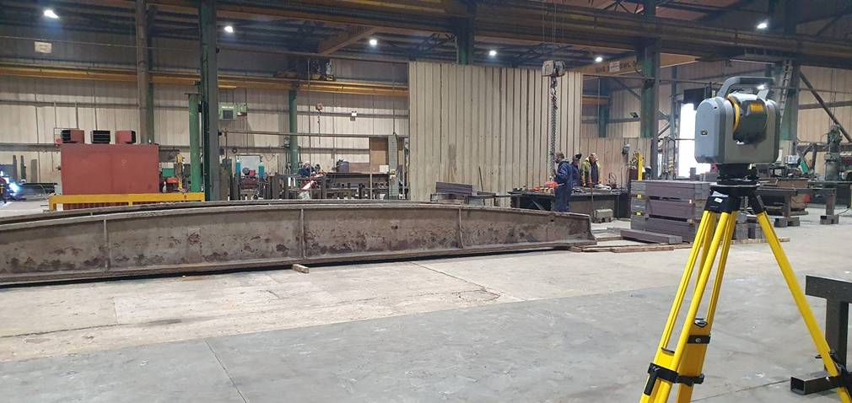
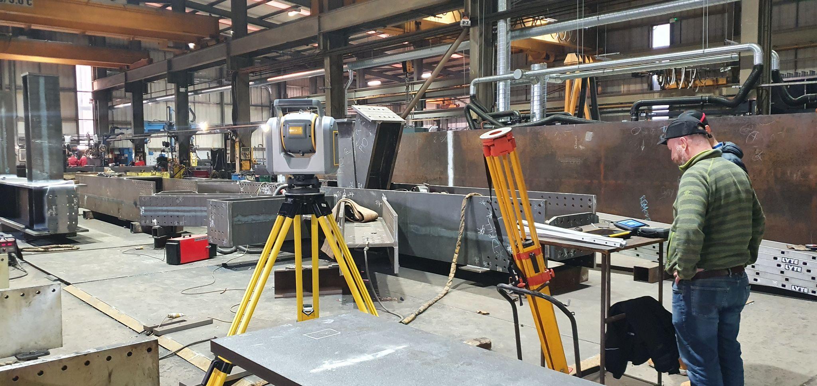
Process we followed
And we would like to share
Voice of Customer (Online Interviews & Customer Visits)
Define industry requirements & current practice (steel, precast, shipbuilding-steel deformation, other)
Map Trimble based workflow (SX12, Trimble Access, Trimble Connect, Tekla S, TBC)
Demo and get feedback from customers (in progress..)
1
2
3
4

Slide 7
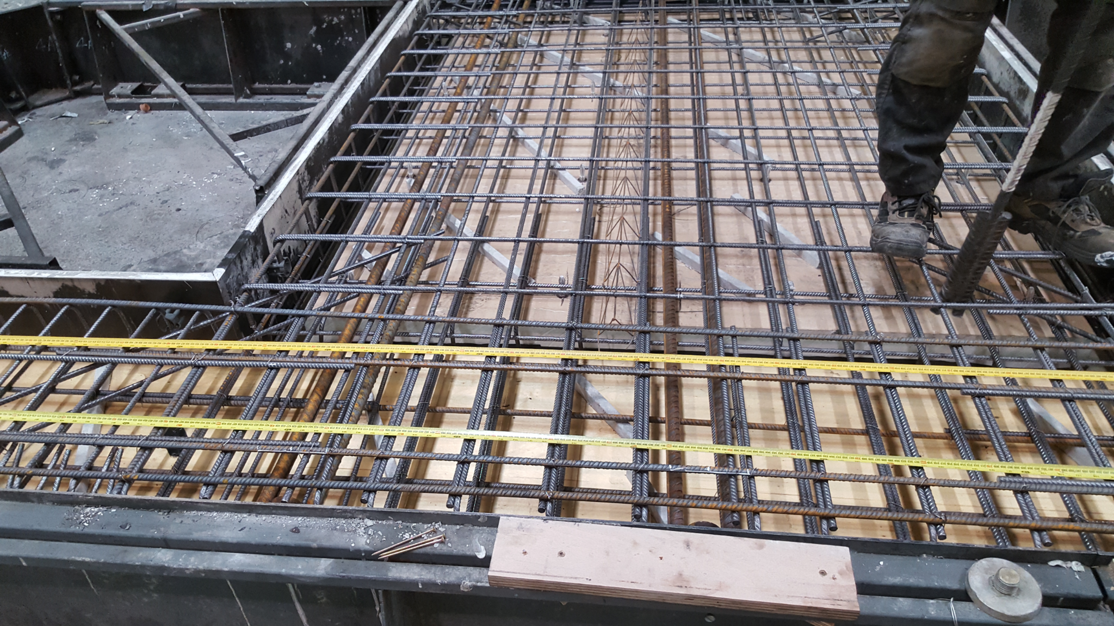
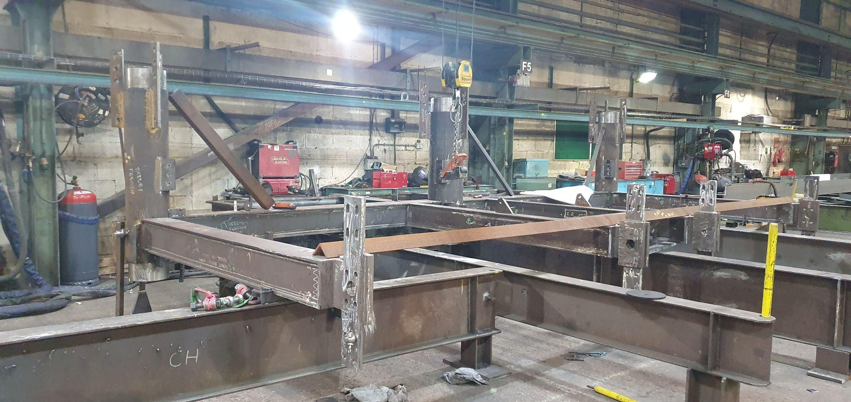
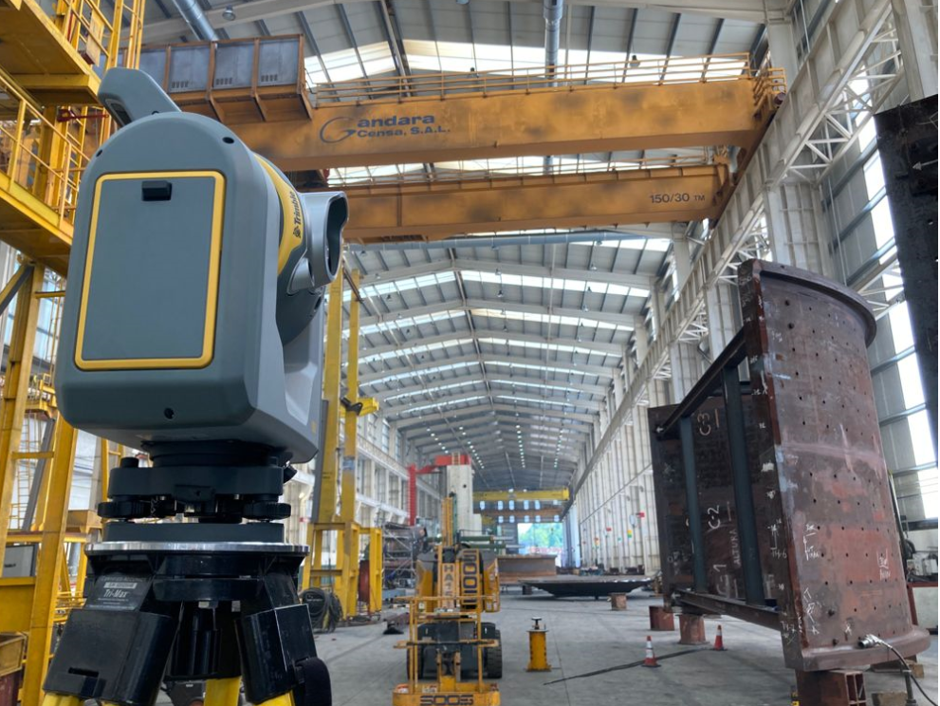
Manufacturing
Sectors explored
Precast
Steel Fabrication (infrastructure & shipbuilding)
Steel deformation inspection

Slide 8
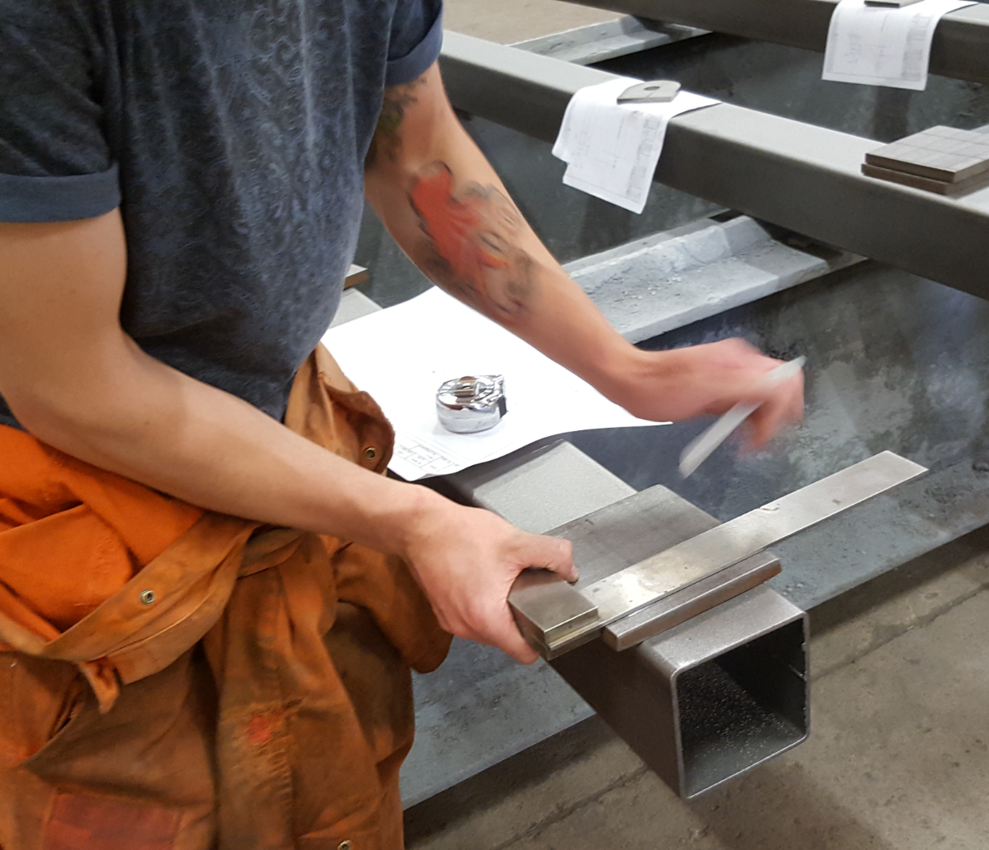
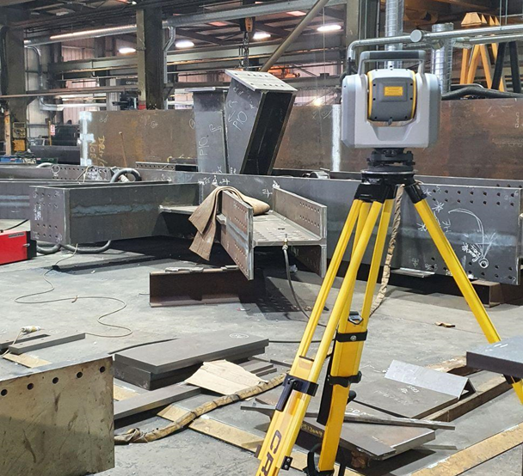
Manufacturing
Inspection methods
Manual
Using Specialised Kit
Robots

Slide 9
Overall Observations
Overview of Process Followed
Design model: often coordinates are different from where the element will be fabricated.
Setting out process to mark locations for assembly process (e.g. location of where plates should be welded for steel, where embeds should be placed for precast, etc.) based on the design model/information.
Inspection process to check if all elements are in place or if anything is missing, dimensions, and deformations.
Report is generated but the way that this is generated can vary. In some cases it can be a heat map or individual points, or in other cases just a document where the inspector needs to fill in some boxes.
1
2
3
4

Slide 10
Overall Observations
Requirements & Current Practice
Common requirement for manufacturing workflows that require the use of an optical total station as part of the building process or the as-built check, is to:
Use an office SW to perform a model transformation (move the model-best fit analysis) so that the model will “sit” correctly onto the physical structure that is manufactured in the shop floor.
Have a network of control points in the factory that the model coordinates are referenced to.
Have the capability to do traditional station setup based on these control points (like in a leveled set-up).
Have the capability to do an object-oriented station set up.
Measure DR points to the structure.
Use of prism balls - when fitted to the design holes, they represent the center of the circle.
Being able to create deviation reports in the office SW as well.

Slide 11
Overall Observations
Challenges of Current Practice
Time consuming process to get the right data in the field (i.e. extract points and transform coordinates)
2D points creates lack of confidence about whether data is right and where it corresponds
AR for visual inspection but does not offer required mm accuracy
Many laser scanners do not offer the required data accuracy and point cloud data needs time for processing
Inspection report (heatmap) is created in the office

Slide 12
Bringing visibility and efficiency to the shop floor
Trimble hardware and software solutions give manufacturers the tools they need to maximize the flow of data between the office and the field, boosting quality, accuracy and efficiency.

Slide 13
Trimble Manufacturing Workflow
Using SX12, Trimble Access & Trimble Connect
Notes:
To change the background image - right mouse click on the image, select “Change background”. Choose the image you want to replace this image with and then click Done.

Slide 14
Trimble
Workflow
Save data to Trimble Connect
7
1
Prepare your data
Verify, QA Inspection
6
Upload to Trimble Connect
2
Cloud platform for collaborating and sharing across project teams
Visualise and interact with your data
5
3
Launch Trimble Access
Load the model
4

Slide 15
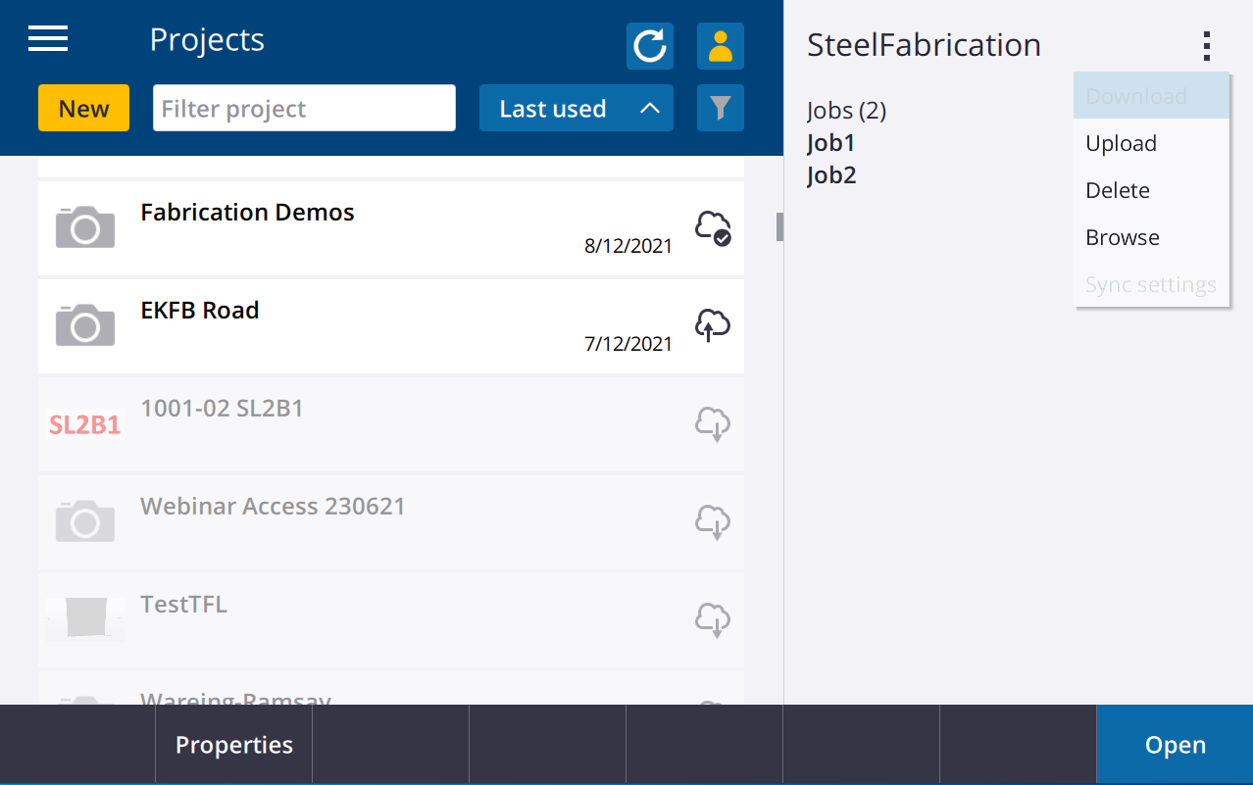
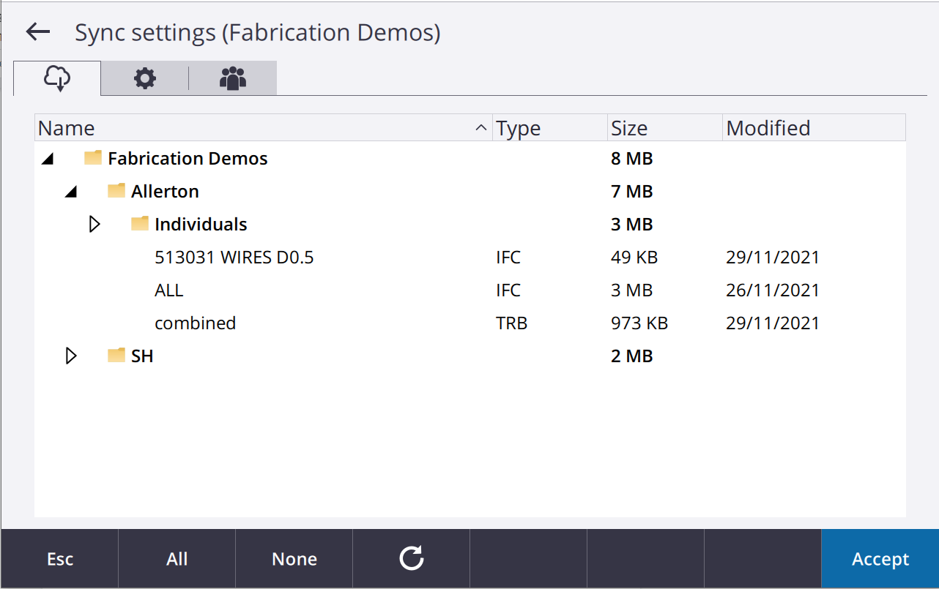
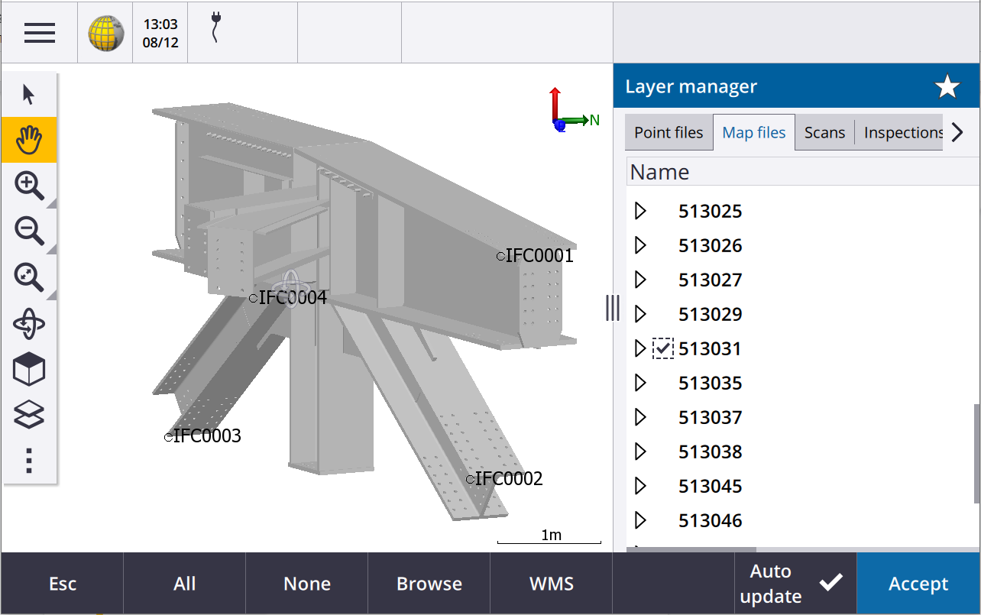
Loading Data
3D model and related files to Trimble Connect
Load data directly on Trimble Access
3D model(s) (with all properties)
Annotations
Set out points

Slide 16
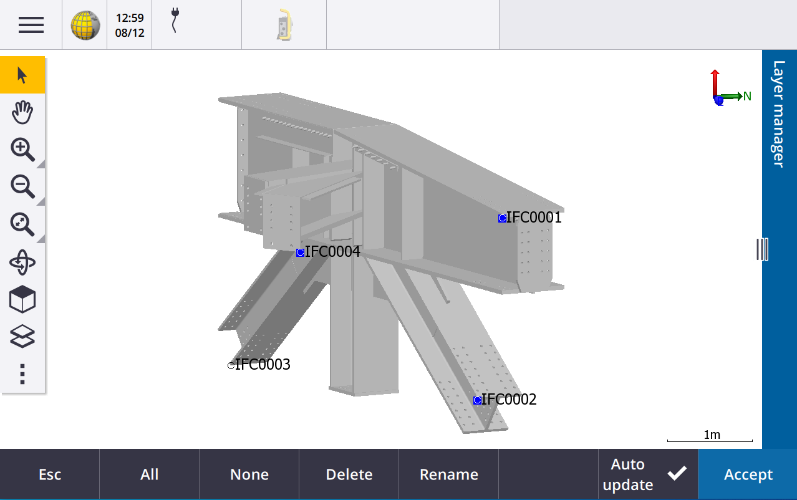
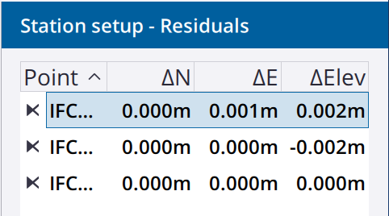
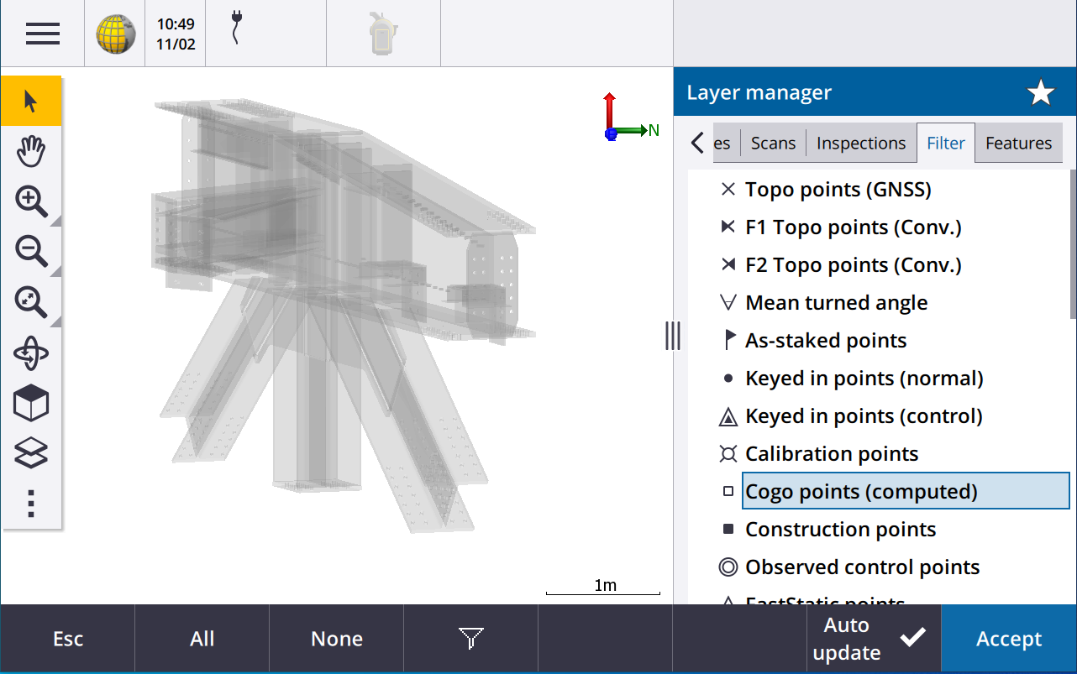
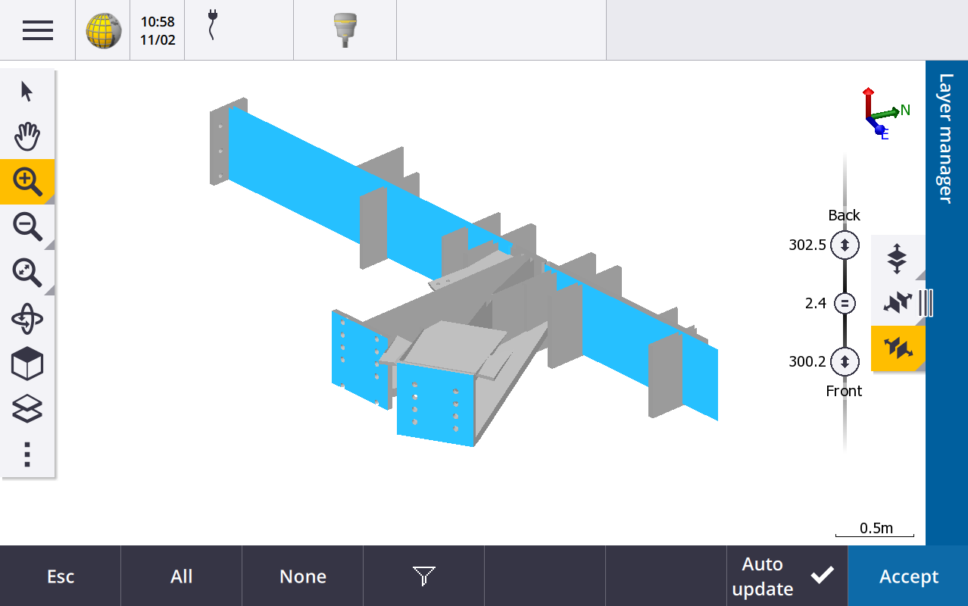
Setting Up
Arbitrary coordinate system in manufacturing environment
Object oriented set-up
(model based registration using 3 points)
Other capabilities
Wireframe
Limit box
Extract points directly from model
Hide/unhide elements

Slide 17
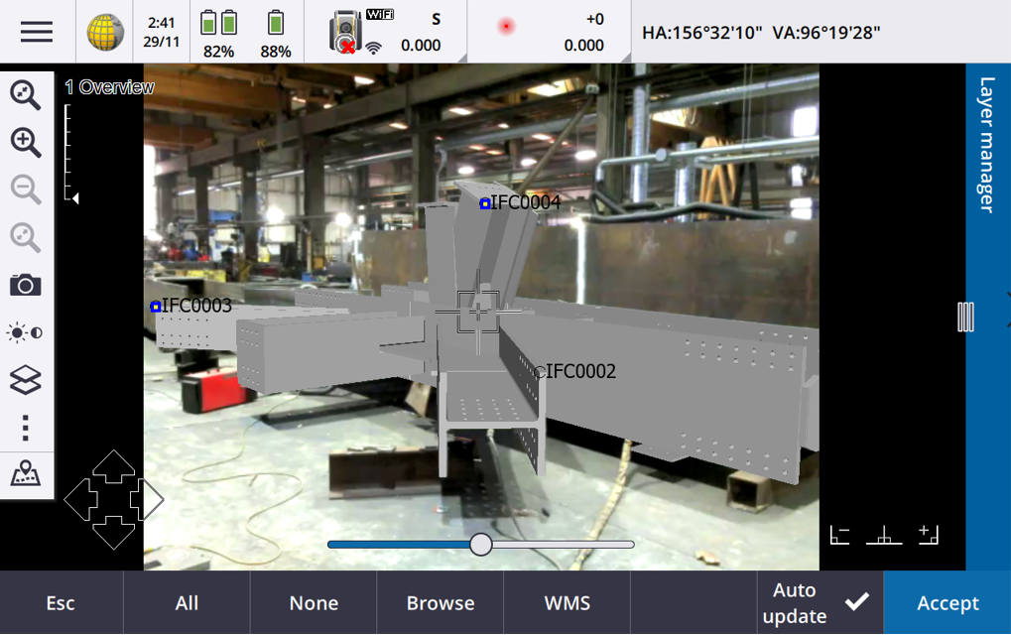
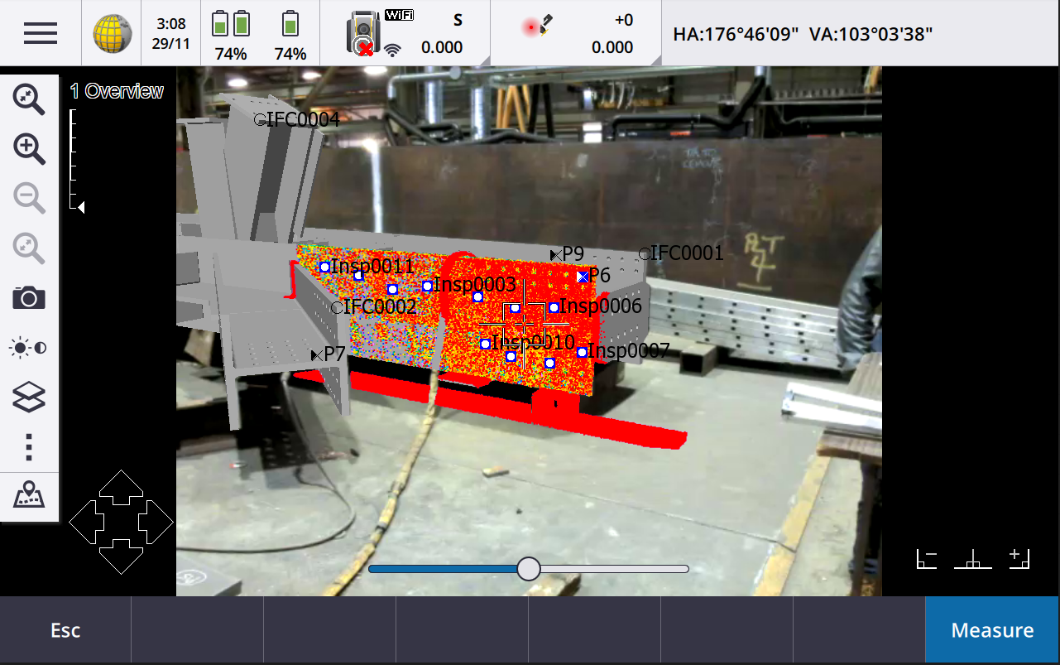
Setting Out and Inspection Process
Model and instrument are aligned with the physical object
Inspection
mm AR capability for visual inspection and better data interpretation
Individual points/scanning and extracted points
Prism offsets
Area scan
In field inspection (scan-to-surface) heat map (in AR too)

Slide 18
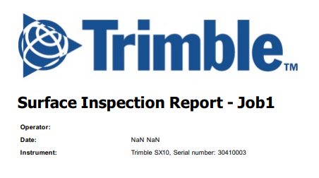
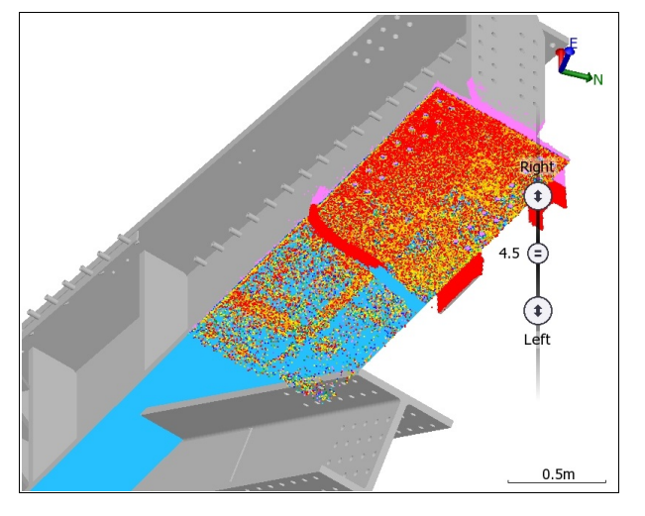
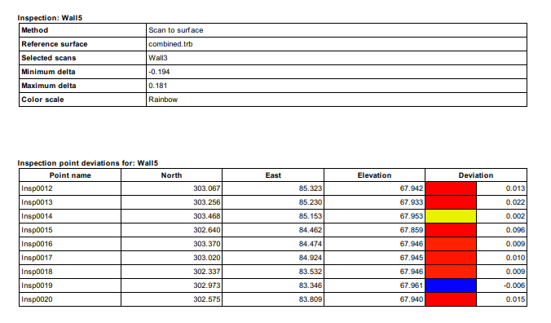
Reporting
In-field inspection report (pdf)
Header
Inspection details
Screenshot of the inspected area
Selected deviation points
Customisable report with XML stylesheet generation

Slide 19
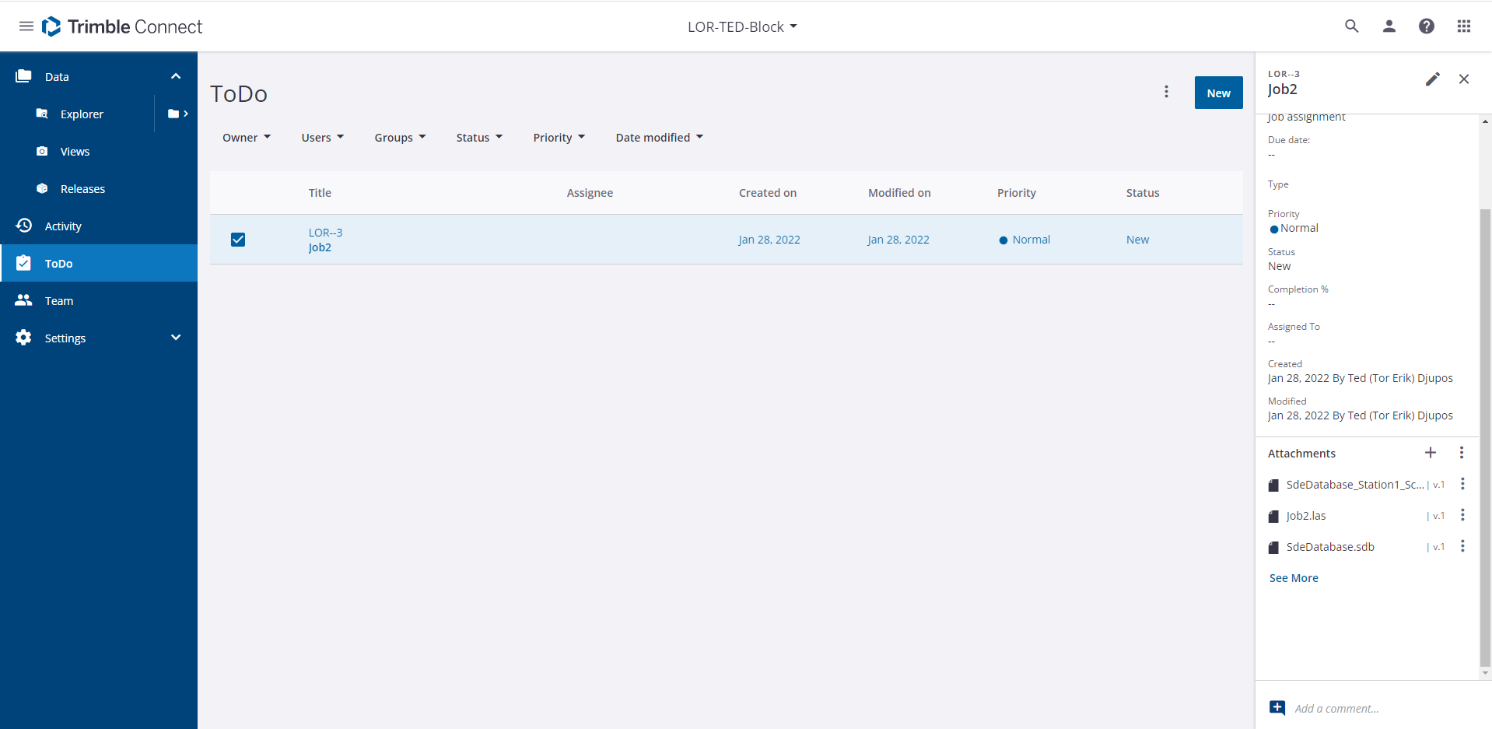
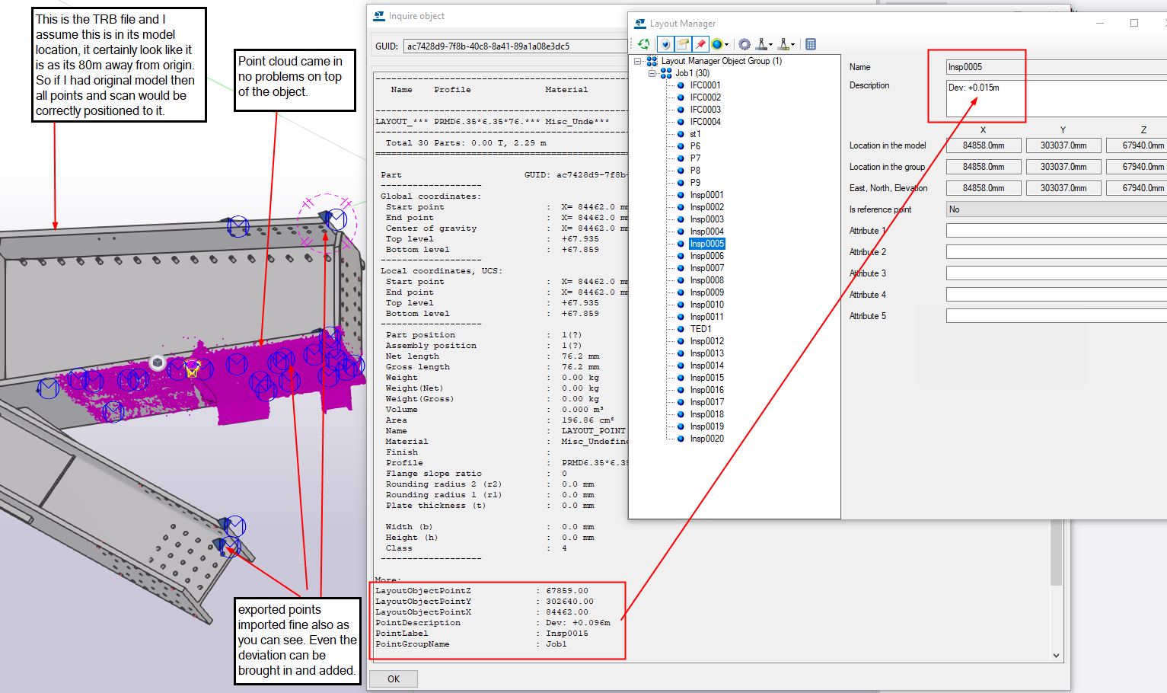
Data upload and office processing
Data upload to Trimble Connect via ToDo directly from Trimble Access
Point cloud
Survey points
Images
Other files (i.e. inspection report)
Office processing (i.e. Tekla S or Trimble Business Center)

Slide 20
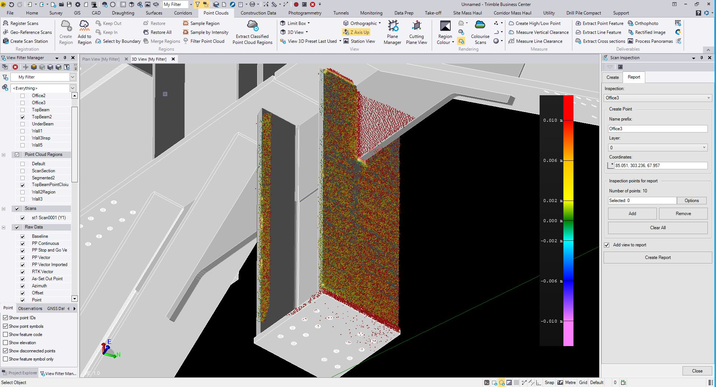
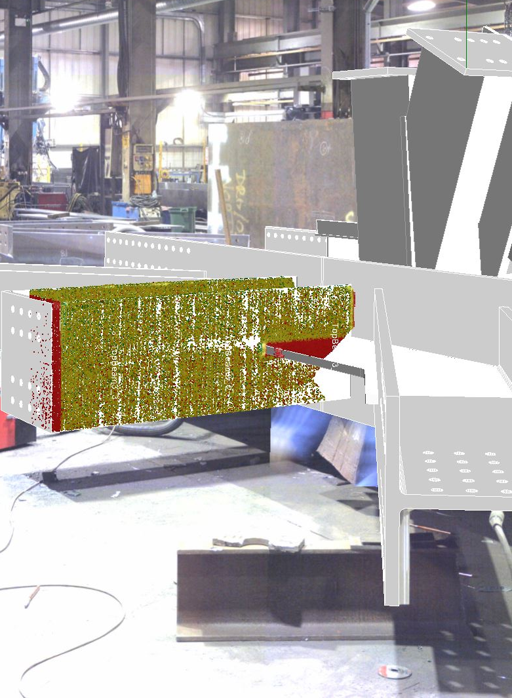
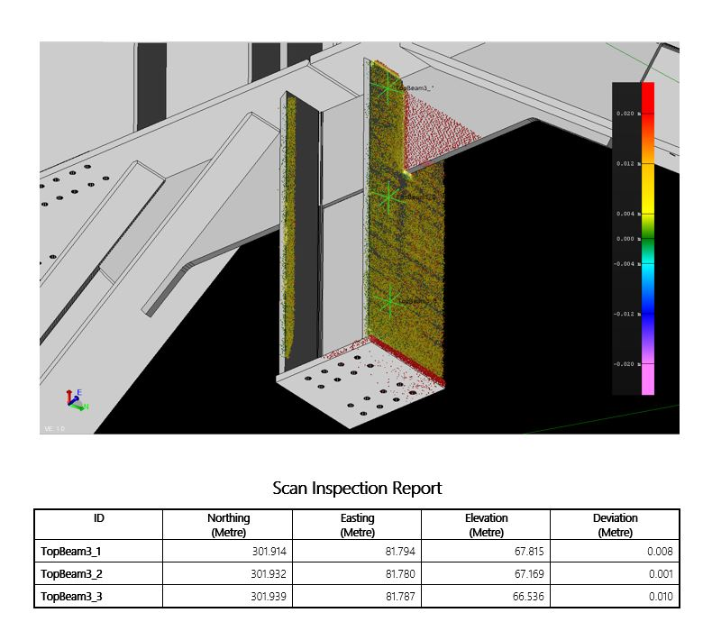
TBC Office Inspection
Object oriented station set-up
Scan-scan + Scan-model analysis and reporting
TA Inspections
Reading in heat maps + point clouds regions from Access jobs
TBC Inspections
Scan-scan, Scan-3D objects (IFC, TRB, Meshes and surfaces) comparisons
Reporting deviations/deltas

Slide 21
Trimble Fabrication Workflow Demonstration
Workflow examples from:
Import data from Trimble Connect into Trimble Access
Data interaction (layer handling, properties, etc.)
Data registration using object oriented set up
How to set out using 3D data (AR, pick points, edges, etc.)
Inspection
DR points
Area scan and surface inspection
Live surface inspection
Report creation
Upload data to Trimble Connect for office processing

Slide 22
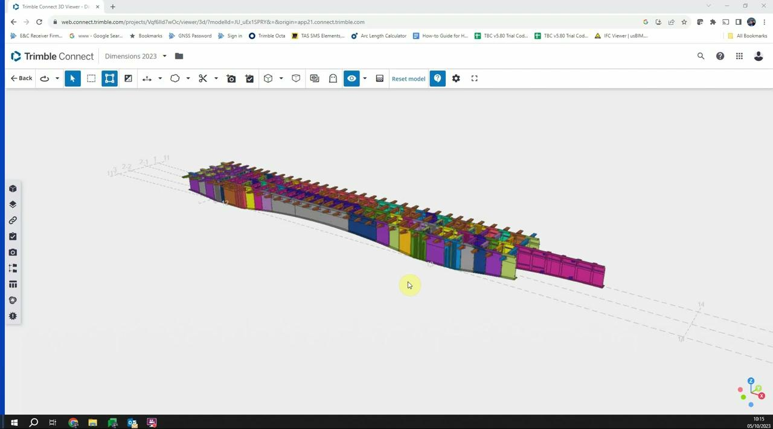
Prepare data on Trimble Connect
(if needed)

Slide 23
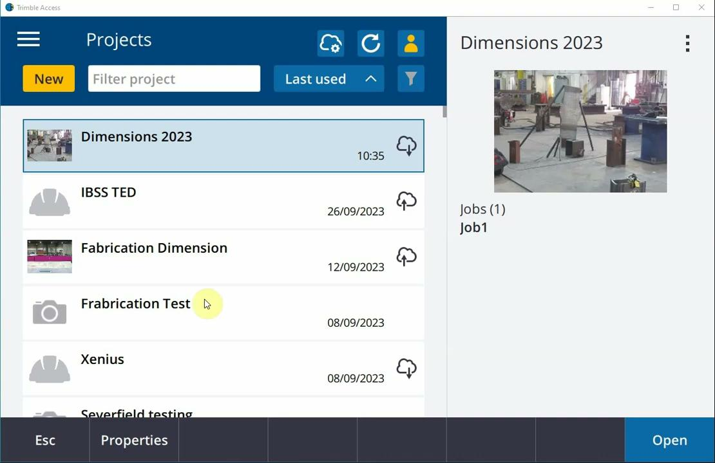
Download data from Trimble Connect to Trimble Access

Slide 24
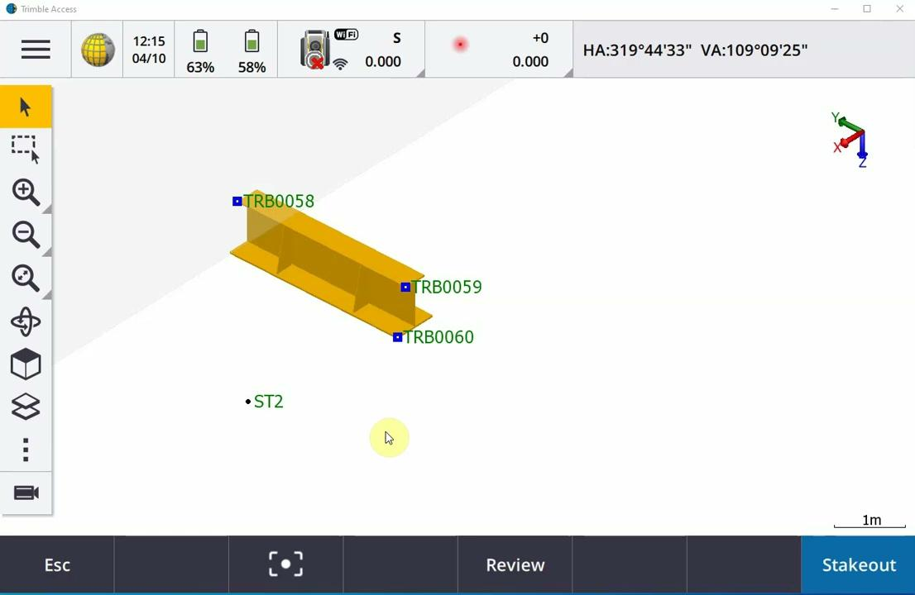
Model Registration using Object Oriented Set Up

Slide 25
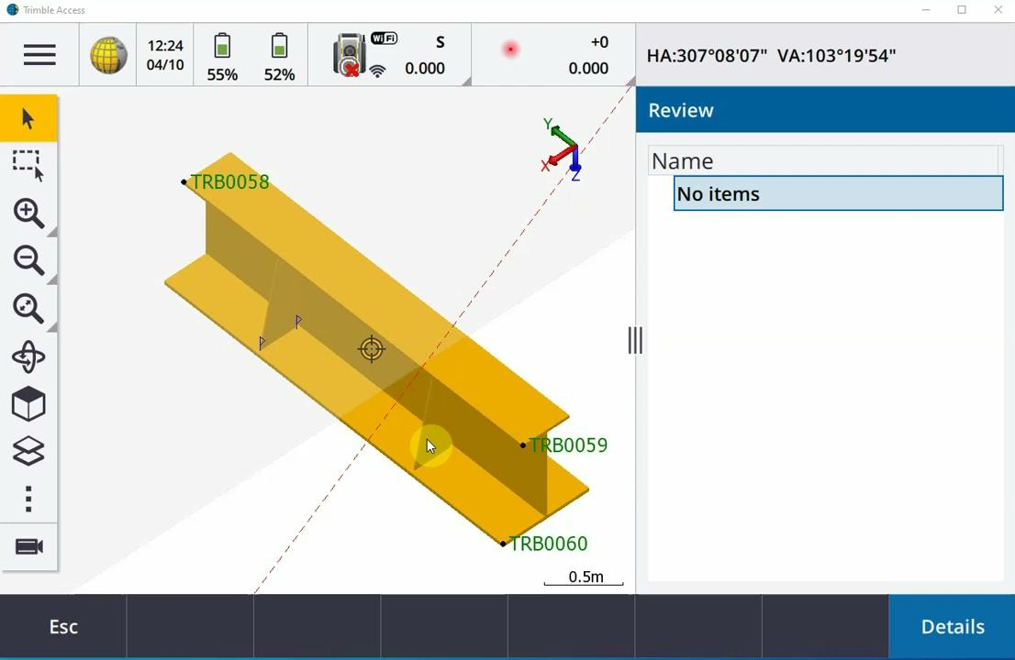
Building/Setting out using model data

Slide 26
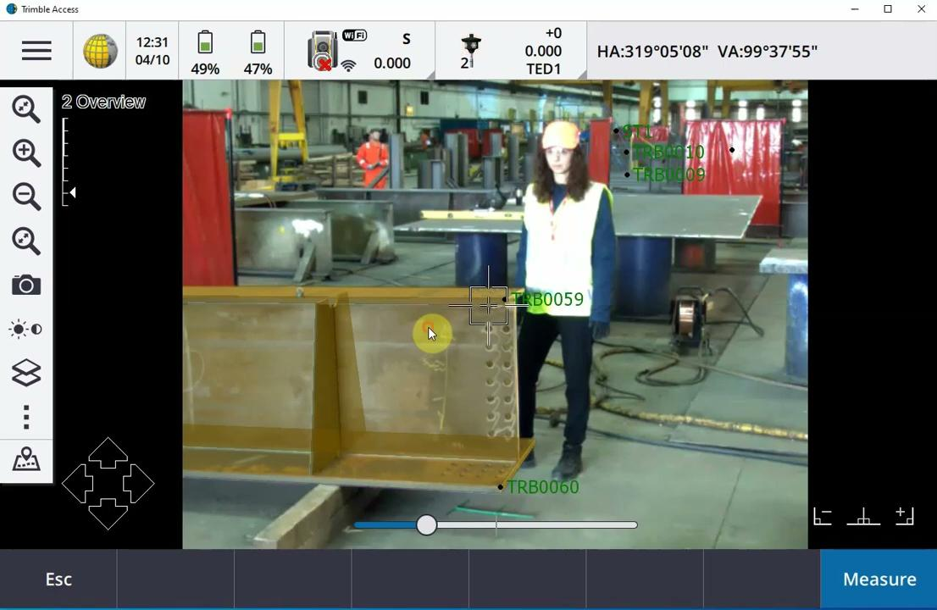
Building/Setting out using model data & a prism

Slide 27
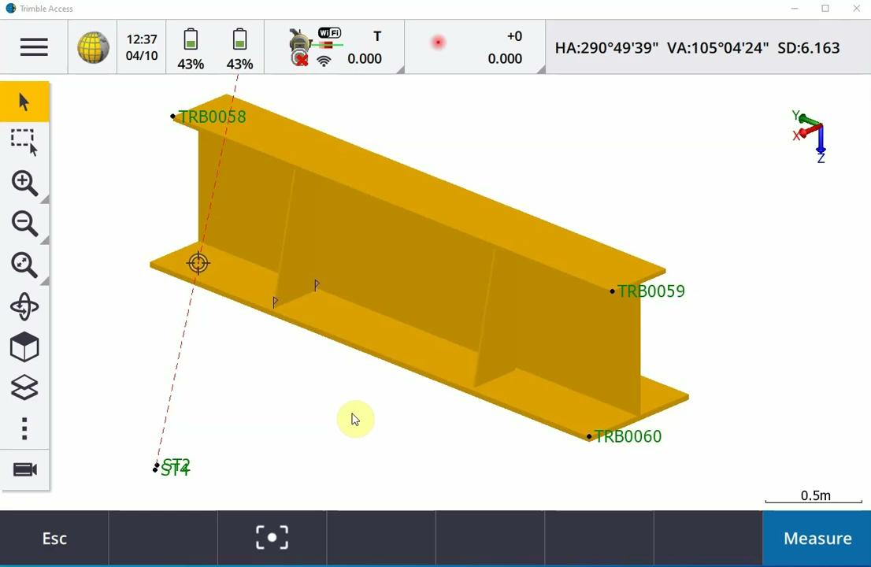
Inspection Process

Slide 28
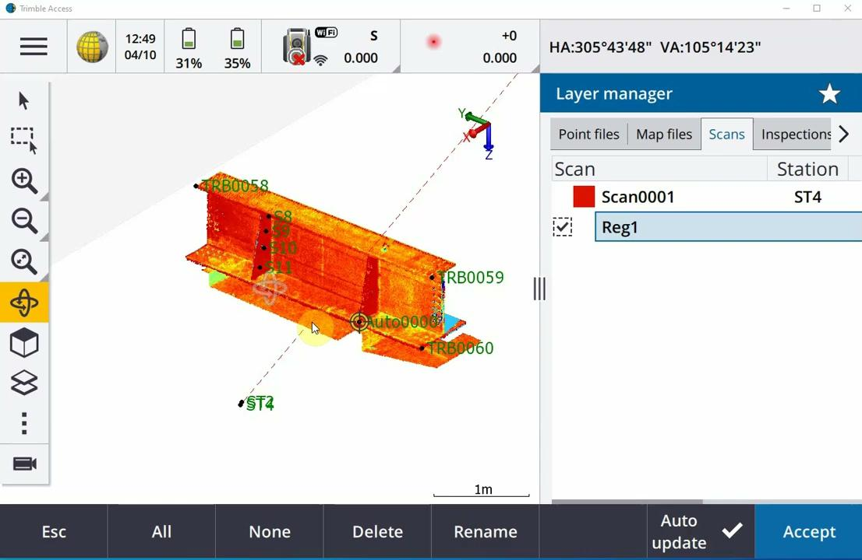
Surface/Area inspection
using scanning data

Slide 29
Upload data to Trimble Connect

Slide 30
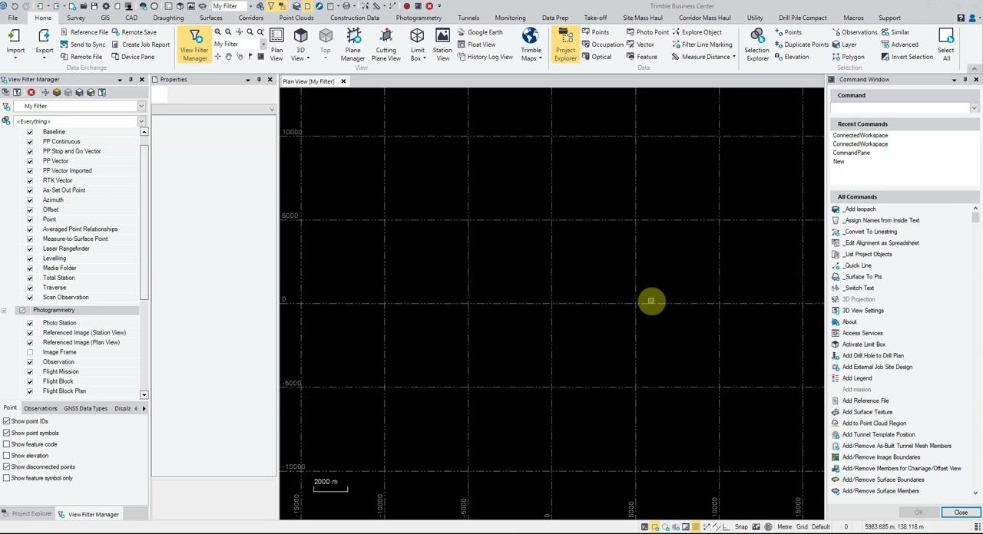
Connecting office and field using TC

Slide 31
Benefits of using Trimble Technology
3D models enable the easy extraction of line, point and surface information with all attribution.
Trimble Connect enables seamless data flow between the field and the office, saving time and boosting productivity.
Object-oriented setup reduces the time to get up and running.
Trimble solution accurately moves model data easily to the shop floor coordinates.
Augmented reality visualization enhances data interpretation that ensures high accuracy.
Area scanning provides precise object targeting and high speed data processing.
Trimble Access provides clear in-field reporting.

Slide 32
Optimising the Manufacturing
Workflow with Technology
Effective use of technology can optimise workflows & increase productivity
by better utilizing 3D data in the field
by better connecting office and the field

Slide 33
User Groups
Current challenges and workflow advantages
Notes:
To change the background image - right mouse click on the image, select “Change background”. Choose the image you want to replace this image with and then click Done.

Slide 34
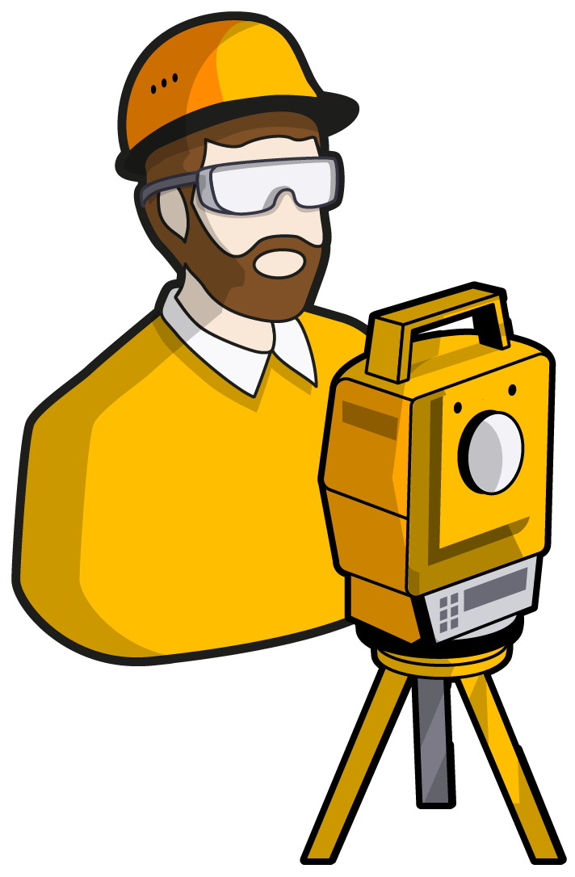
User groups involved
Project Manager
Production Manager
Site Engineer
CEO

Slide 35
Production Manager
Focus
Current challenges
Workflow benefits
Productivity in the shop floor.
Making sure that everything runs smoothly with optimised workload for people, space and machinery.
Optimising workload, space, materials.
Be within schedule.
Making sure that whatever is built is correct and within accuracy.
Complete field-to-finish solution without the need for any pre or post data processing.
Enriched data in the field that can reduce errors and time wasting.
All the toolset & features for increased field productivity and better data interpretation.

Slide 36
Site Engineer
Focus
Current challenges
Workflow benefits
Ability to deliver high quality project.
Improve effectiveness.
Ensure safety.
Implementing solutions in the field.
Lack of timely, quality information.
Making sure that everything is built according to design and plan.
Mistakes that can prove costly and create reworks.
The right data at the right time.
Enriched data in the field that can reduce errors and time wasting.
Features and high quality solution that ensure high accuracy, increased productivity, and enhanced data interpretation that leads to less mistakes.

Slide 37
Project Manager
Focus
Current challenges
Workflow benefits
Management and coordination.
Controlling resources, schedule and quality.
Productivity and efficiency of all processes along the project (design, building and inspection) to meet quality, schedule and cost standards. Operating in all phases of a project.
Decision making on solutions and workflows used in consultation with technical people.
Managing project and deadlines.
Poor communication across the teams and loss of information.
Tight deadlines and not efficient processes that could produce errors and would affect cost and time.
Seamless data flow between the office and the field.
Enriched data in the field that can reduce errors and time wasting.
Increased efficiency and productivity in the field.

Slide 38
CEO
Focus
Current challenges
Workflow benefits
Making sure that projects and workshop are running in an optimised way.
Making sure that company has access to the right technology.
Investing in staff and business to continually improving.
Keeping up with industry trends.
Ensuring profitability.
Ensuring contractual compliance.
Increased efficiency and productivity.
Increase quality and reduction of reworks.
State-of-the-art technology.

Slide 39
Success Stories

Slide 40
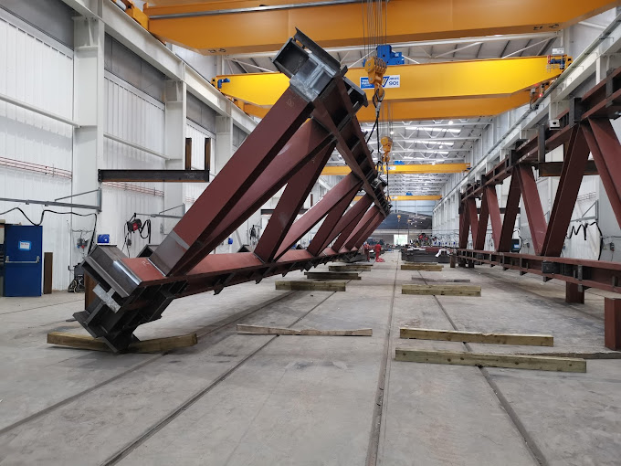
BHC
The value of optimisation and flexibility in steel manufacturing
Challenge
Confidence in manufacturing - if something is wrong that can be very costly!
Solution
Assembling and QA/QC for fabricated elements but also capturing on-site data for manufacturing.
Flexibility of the solution to utilise it both on-site and in the factory.
Seamless data flow (Tekla > Trimble Connect > Trimble Access).
Object Oriented Setup is key to increase productivity.
Confidence that built objects are within required tolerances.
Scan and Topo data in TBC for further deliverables, if required.
Value
Increase in productivity.
Increase in accuracy and confidence of deliverables.

Slide 41
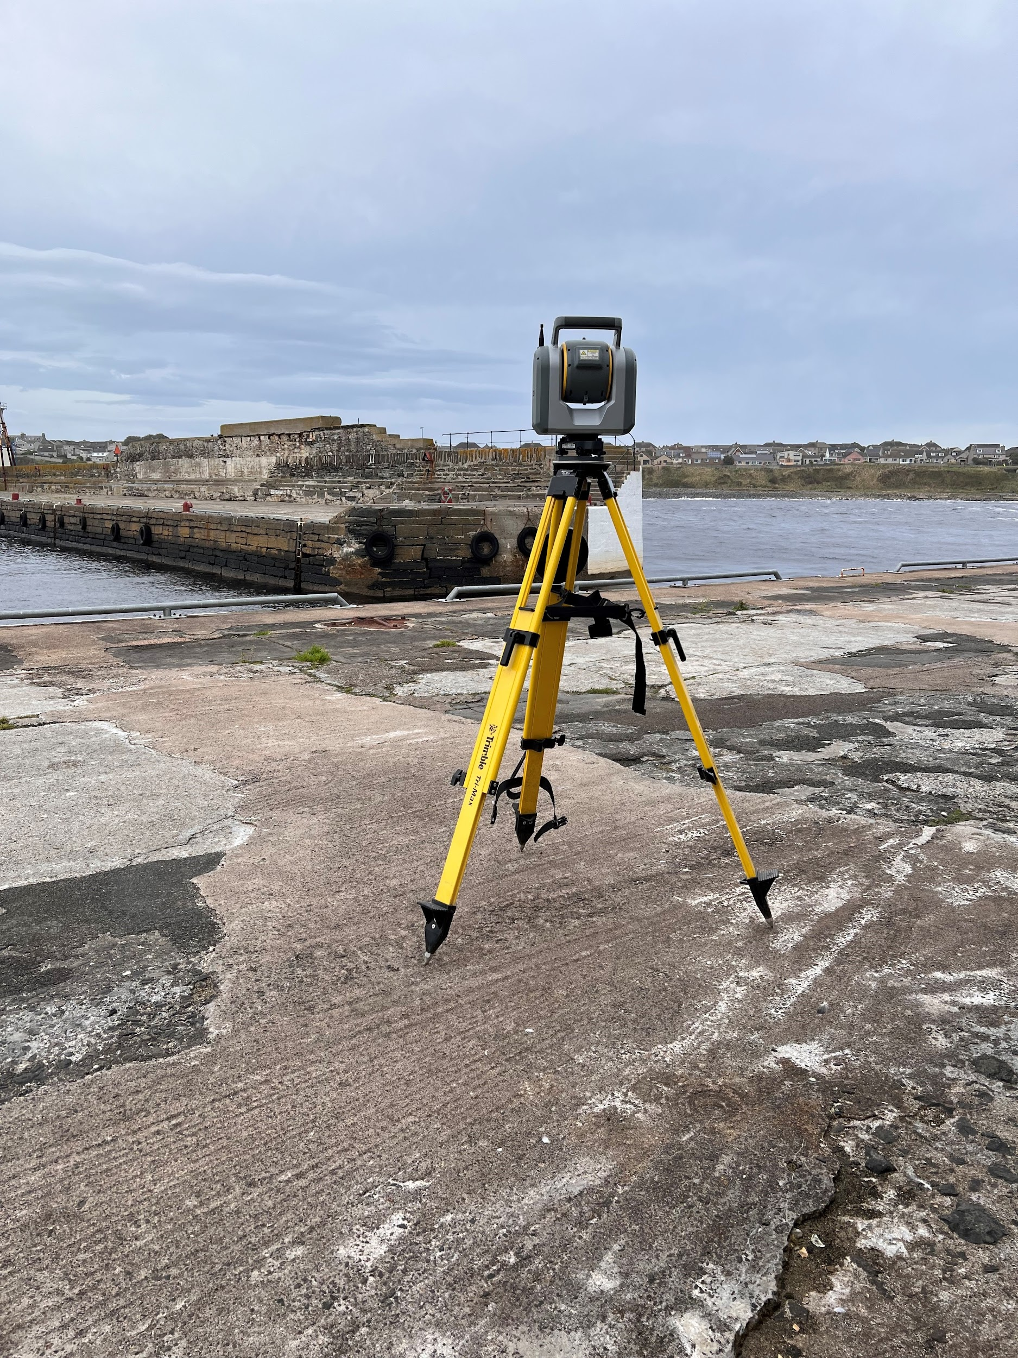
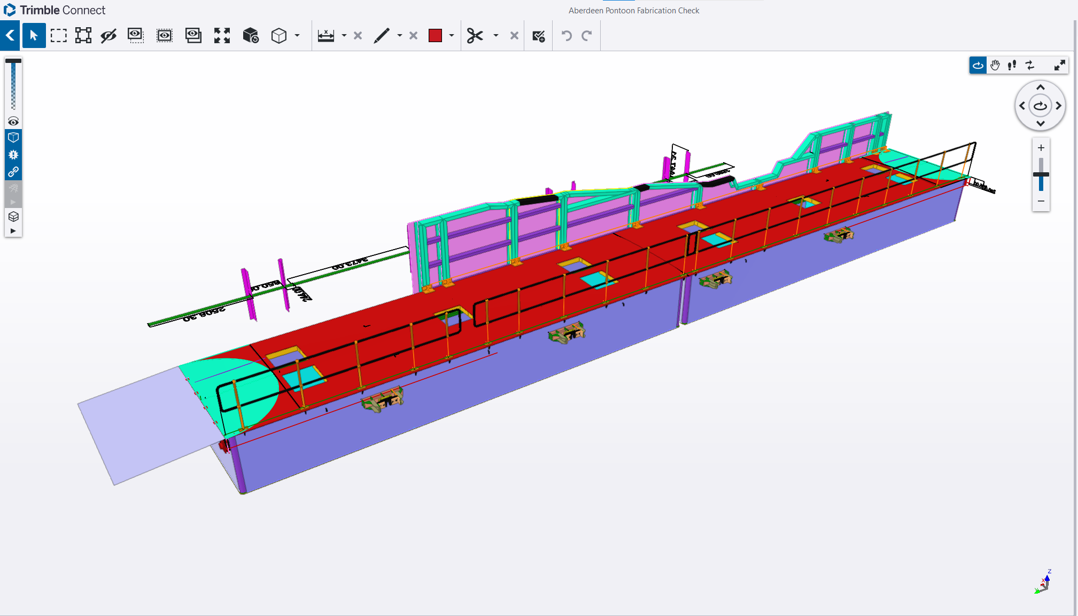
Lochshell Engineering
Productivity, accuracy and confidence
Challenge
They manufacture and install piers and all aspects of steelwork associated with harbour construction.
Confidence that whatever they build can fit together.
They used to pre-assemble every element - many times involving expensive cranes!
Solution
QC to make sure that everything has been built correctly and that will fit in the installation before leaving the fabrication center.
SX12 with scanning capabilities, OOS, and seamless data flow (3D model > Trimble Connect > Trimble Access/TBC) were key to get the confidence they need.
Value
Productivity, efficiency and confidence.

Slide 42
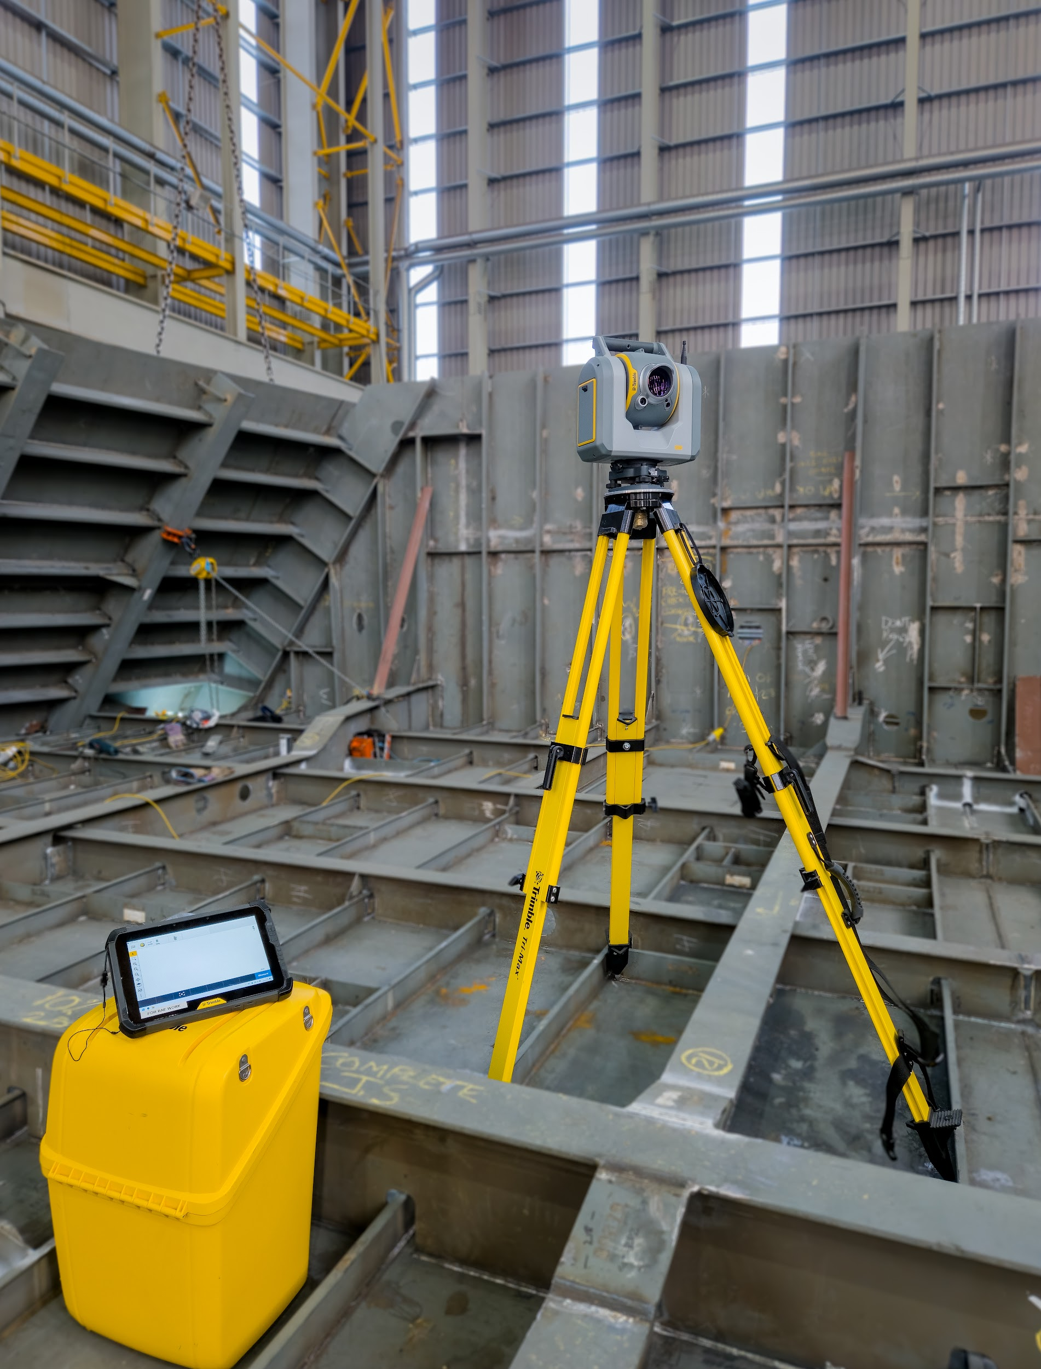
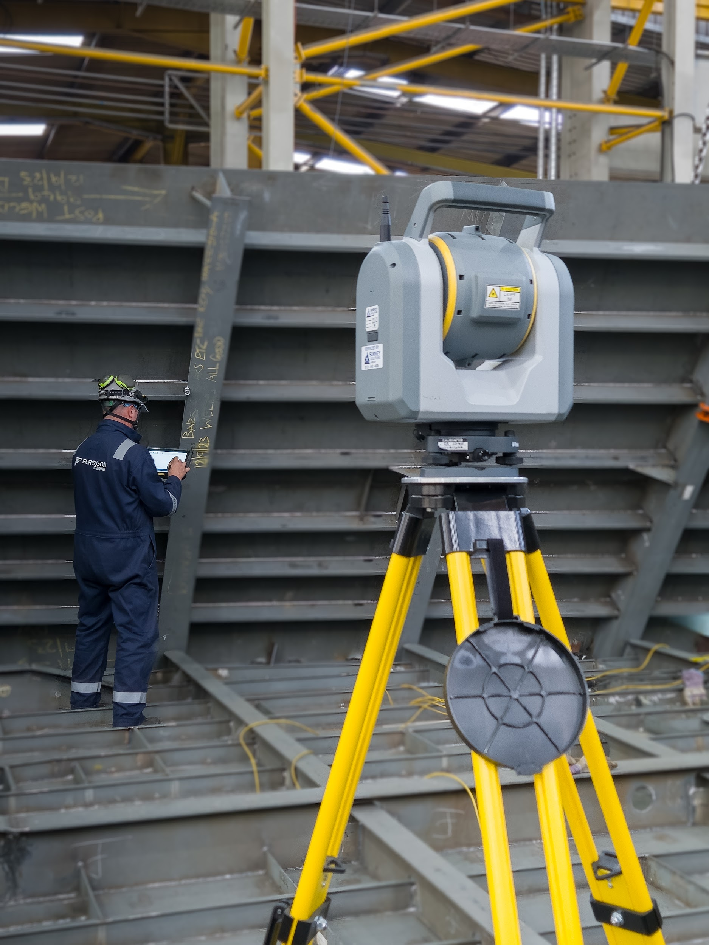
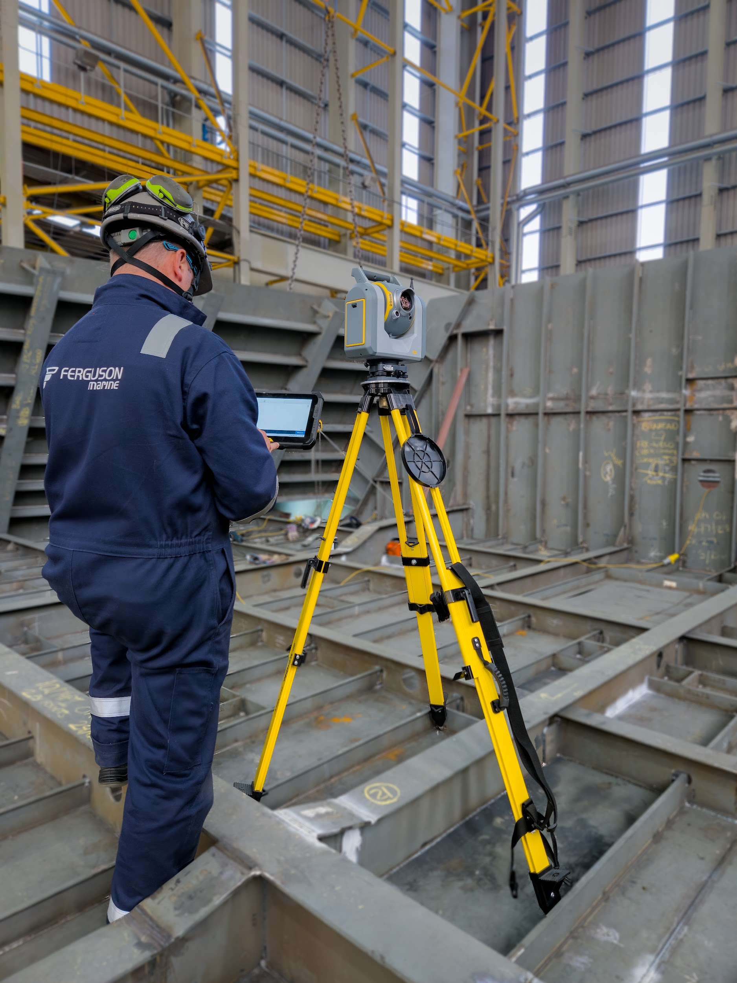
Ferguson Marine
The value of data integration and productivity in ship building
Challenge
Messy solution with scanners and total stations - no integration of data
Solution
Simplified single person operation with SX12s and data loggers. Field-to-finish workflow where everything can be completed in the field and check everything on-site without any pre or post processing needed.
Object Oriented Setup was a critical component where users can just load the data and start working with it.
Scan Inspection also key component for QA/QC but also for productivity since everything can be completed while being in the field.
Value
Increase in productivity.
Less resources needed.
Better confidence in deliverables.

Slide 43
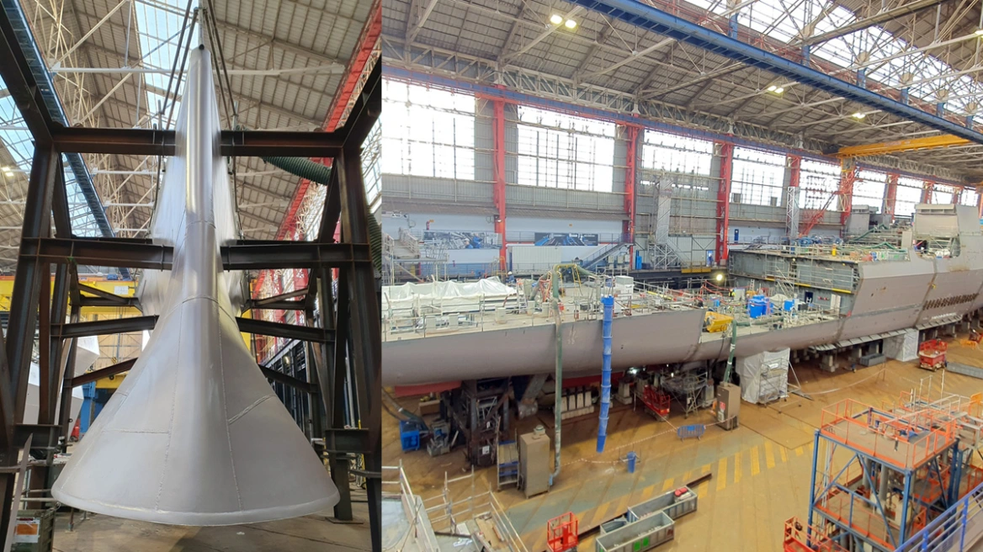
Shipbuilding (2)
The value of utilising 3D models in the field in the shipbuilding industry
Challenge
Accuracy and precision while meeting tight deadlines in productions.
Working in a non-levelled environment.
Checking and addressing deformation in the field.
Solution
SX12 and Trimble Access.
Object Oriented Setup for faster set up that increases productivity.
Scanning capabilities and surface inspection heatmap using the 3D models directly in the field.
Value
Complete field-to-finish solution, including deformation heatmaps and reports in the field.
Less error-prone process utilising 3D models directly in the field.
Productivity and efficiency in field processes.

Slide 44
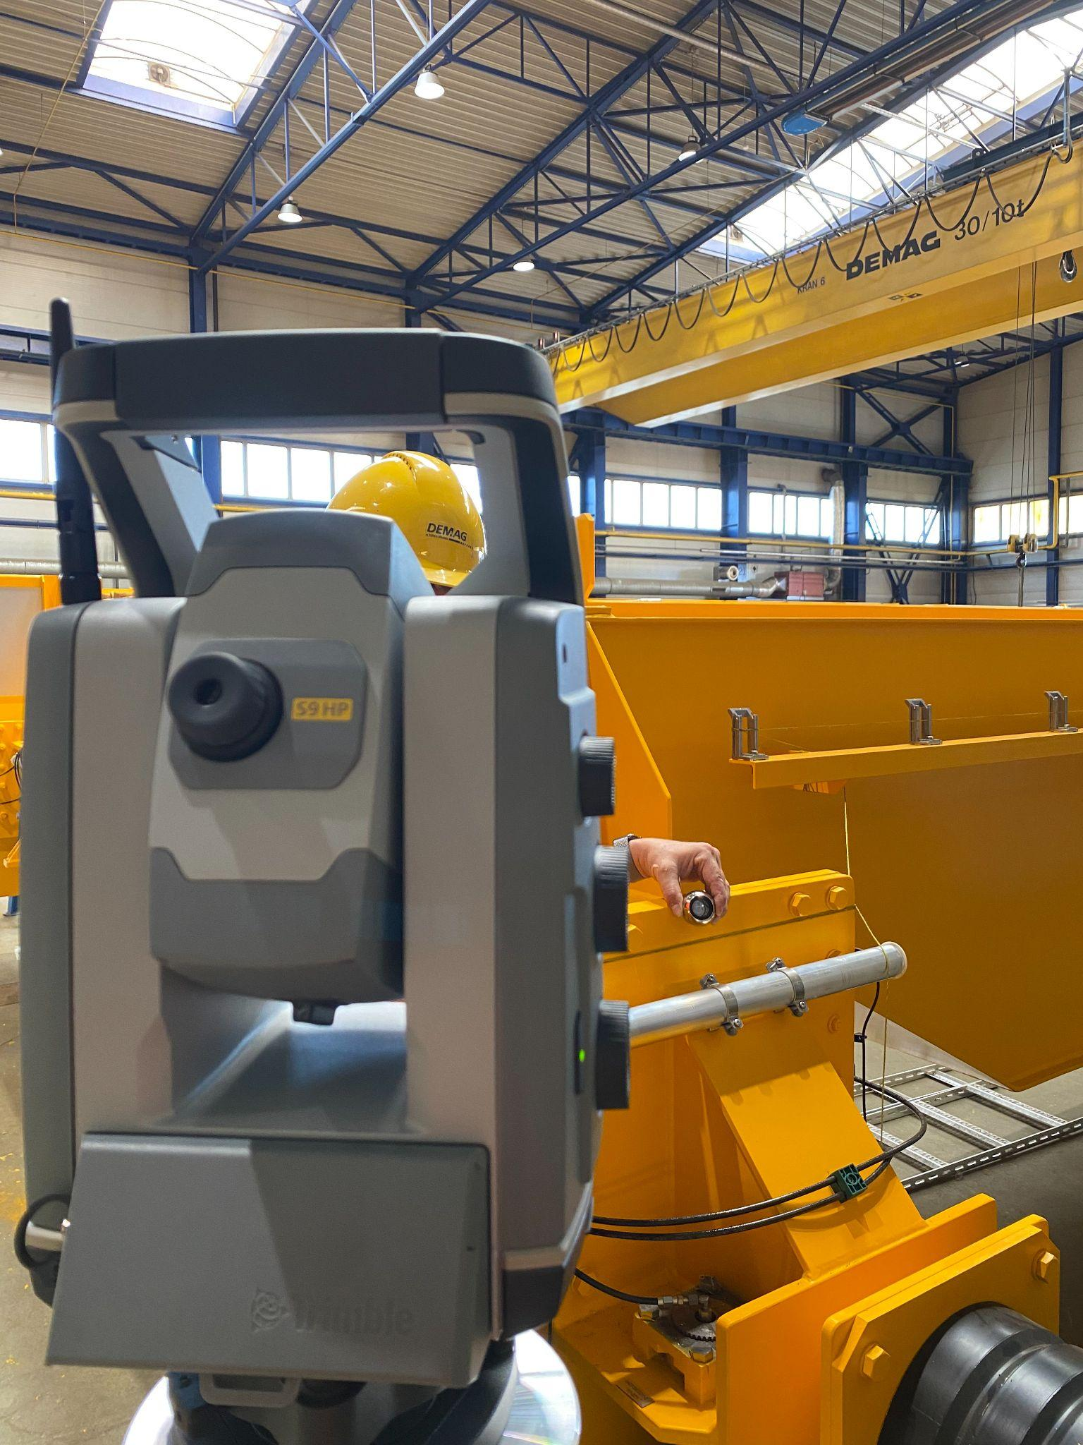
Konecranes
Accuracy and efficiency in crane manufacturing
Challenge
Check deformation of moving parts and whether beams are perpendicular or vertical to the moving parts of a crane.
Solution
Trimble Access & S9 HP
Value
Increased accuracy and efficiency.

Slide 45
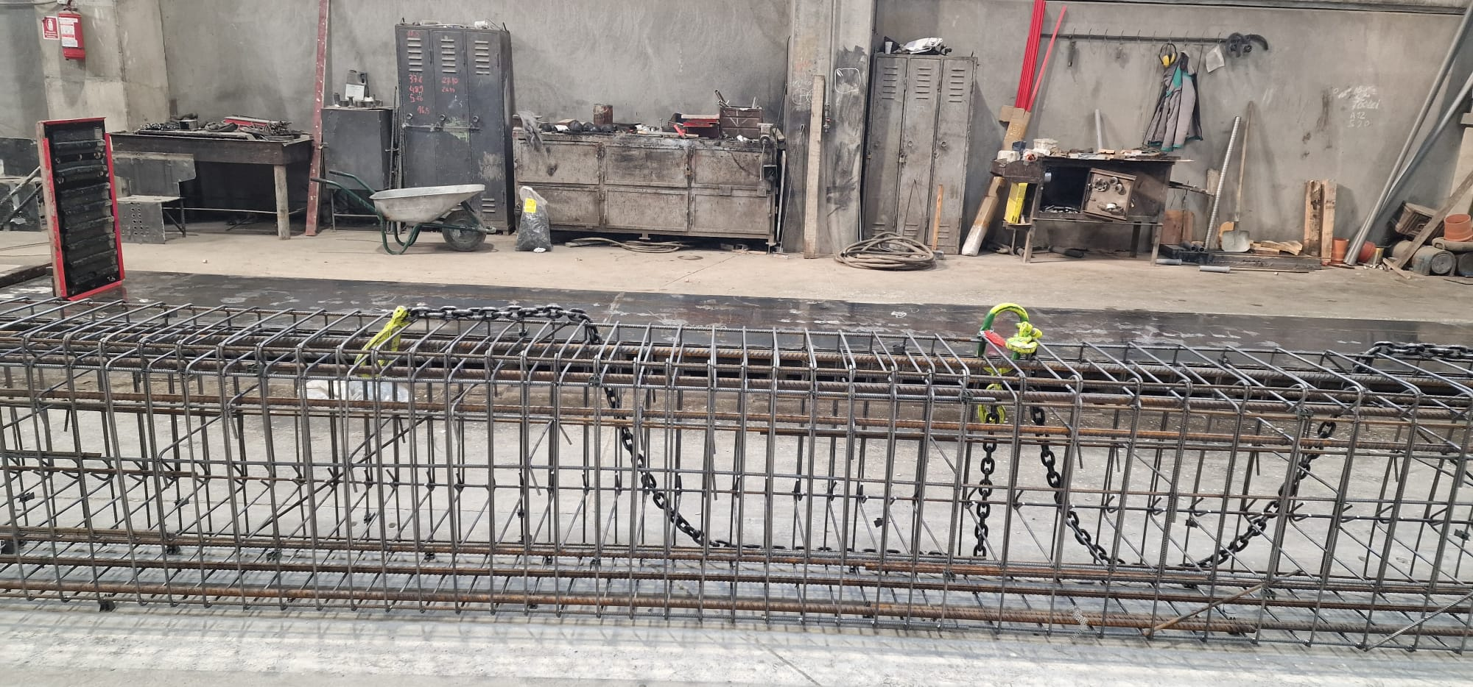
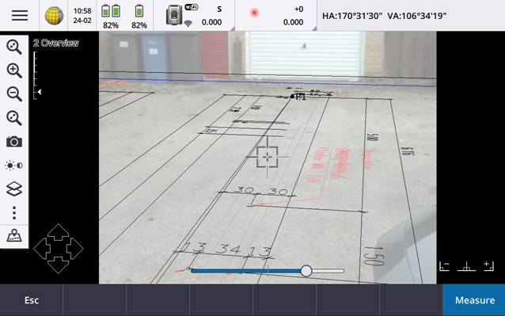
Precast Manufacturing
Accuracy, confidence and productivity in precast manufacturing
Challenge
Precast and concrete elements manufacturer. Main tasks:
Quality check of the built concrete elements while leaving the fabrication site.
Dimensions and alignment control of the precast during the production phase.
Solution
SX12 with Trimble Access IFC surface to scan inspection in the field during production.
Final verification and proving that element was constructed according the specs while leaving the factory.
DXF/IFC precast setout and dimensions control using the Object Oriented Setup, 3D data capabilities of Trimble Access with an S7.
Impact
Increase in productivity since they could have the inspection reports in the field.
Better accuracy and confidence during manufacturing.

Slide 46
Digital Construction/Manufacturing
Conclusions
Notes:
To change the background image - right mouse click on the image, select “Change background”. Choose the image you want to replace this image with and then click Done.

Slide 47
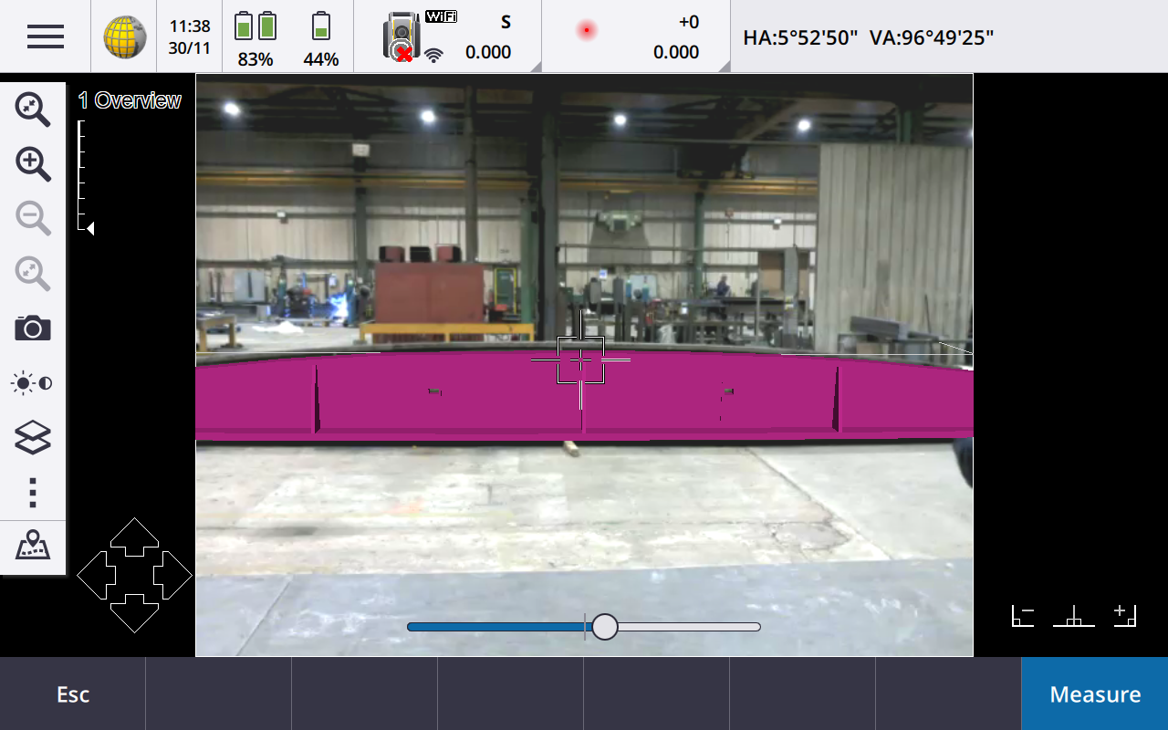
Digital Construction using SX12 & TA
Key advantages
Capabilities that facilitate BIM based workflows:
Cloud Integration for seamless data flow
Object-Oriented Setup (manufacturing environment/moving platform) for faster set up
Viewing IFC in 3D viewer for better data understanding and richer data in the field:
Access model attributes
Layer handling
Pick entities in the model/easier stake out
Extract line, point and surface information directly from model
AR with mm accuracy
Area Scan for better productivity
In-field inspection and reporting

Slide 48
Thank You
Credits
For Questions or Feedback please contact:
marianna_kopsida@trimble.com
tedtorerik_djupos@trimble.com

