Slide 1
Trimble RealWorks
What’s new in version 10

Slide 2
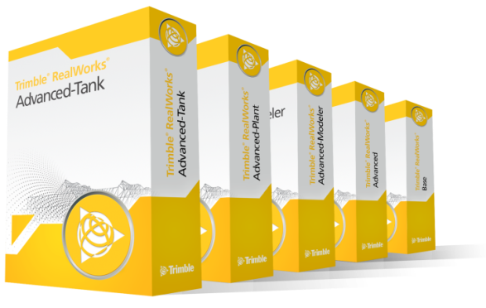
Trimble RealWorks 10
What’s new
Exciting new features and enhancements
Visualization and Navigation
Classification Support
Targetless Registration Enhancement

Slide 3
Key Messages
Improved Usability
Classification
New Storage Tank Tools

Slide 4
New User Interface

Slide 5
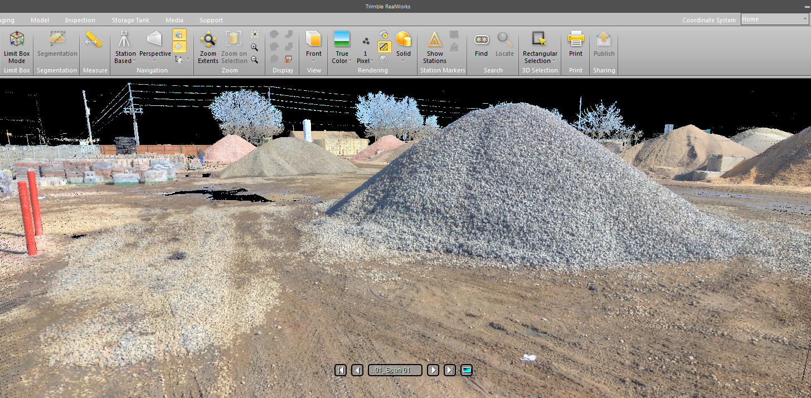
User Interface
Ribbon Menu
Notes:
Trimble RealWorks now incorporates a new ribbon interface as well as new icons. The new user interface and customizable quick access bar is designed to improve efficiency and make the software easier to learn for new users. Tools can now be placed in multiple groups to make them easier to find and quicker to access. Functionalities common between Trimble Business Center and Trimble RealWorks start to share icons and locations in the software to help users using both software products to quickly find common tools.
In the Support menu users can find the option to revert to the old menu if needed.

Slide 6
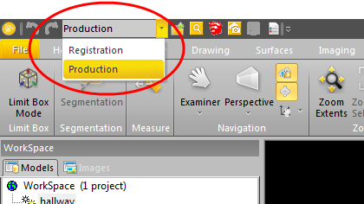
User Interface
Two working modes
Notes:
Along with the new User Interface TRW now has only to modes of operation, Registration and Production. This is to simplify the ease of use of the software and has no effect on licensing.

Slide 7
Classification

Slide 8
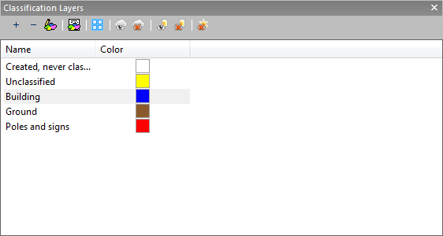
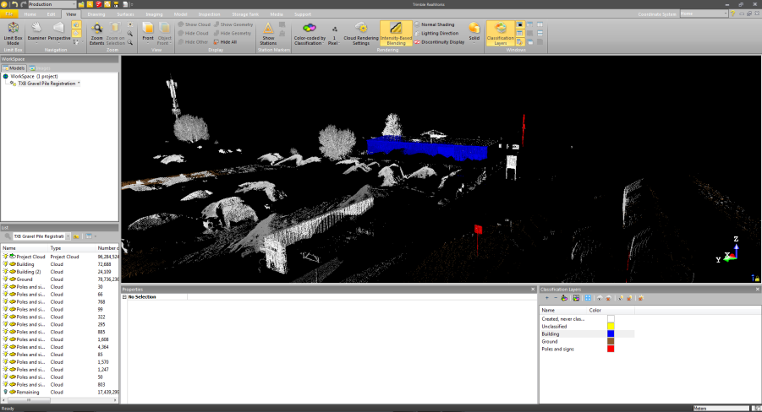
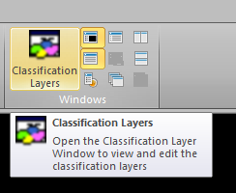
Classification
Import and manage LAS files supporting classification.
Notes:
The ability to import and create classified point clouds adds great benefits that can only be achieved by being able to work with a smart point cloud. Having the ability to display or process specific point cloud classification layers improves efficiency and enhances the visual experience.

Slide 9
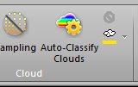
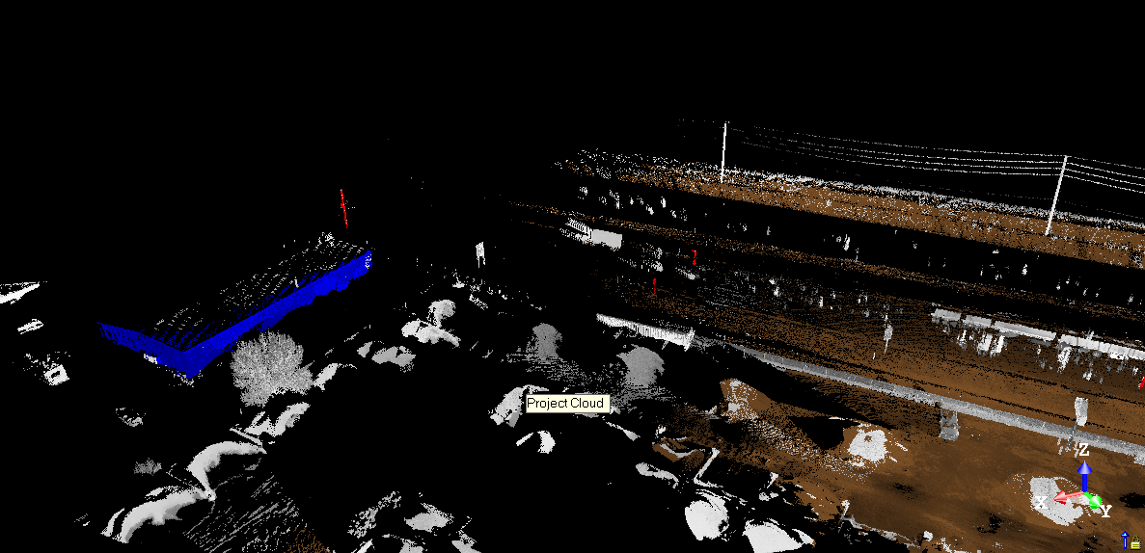
Classification
Auto classification
Buildings
Ground
Pole and sign shapes
Notes:
The Auto-Classify clouds function is in TRW Advanced and higher. It can process the point cloud and automatically classify objects as buildings, ground, pole and sign shapes or as other. The process can be lengthy and is best used with smaller or sampled datasets or to specific areas of the project.

Slide 10
Registration

Slide 11
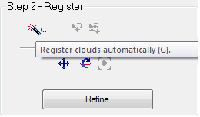
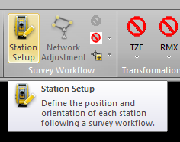
Registration
Improved cloud based registration
Survey workflow
Notes:
Two new workflows for registration.

Slide 12
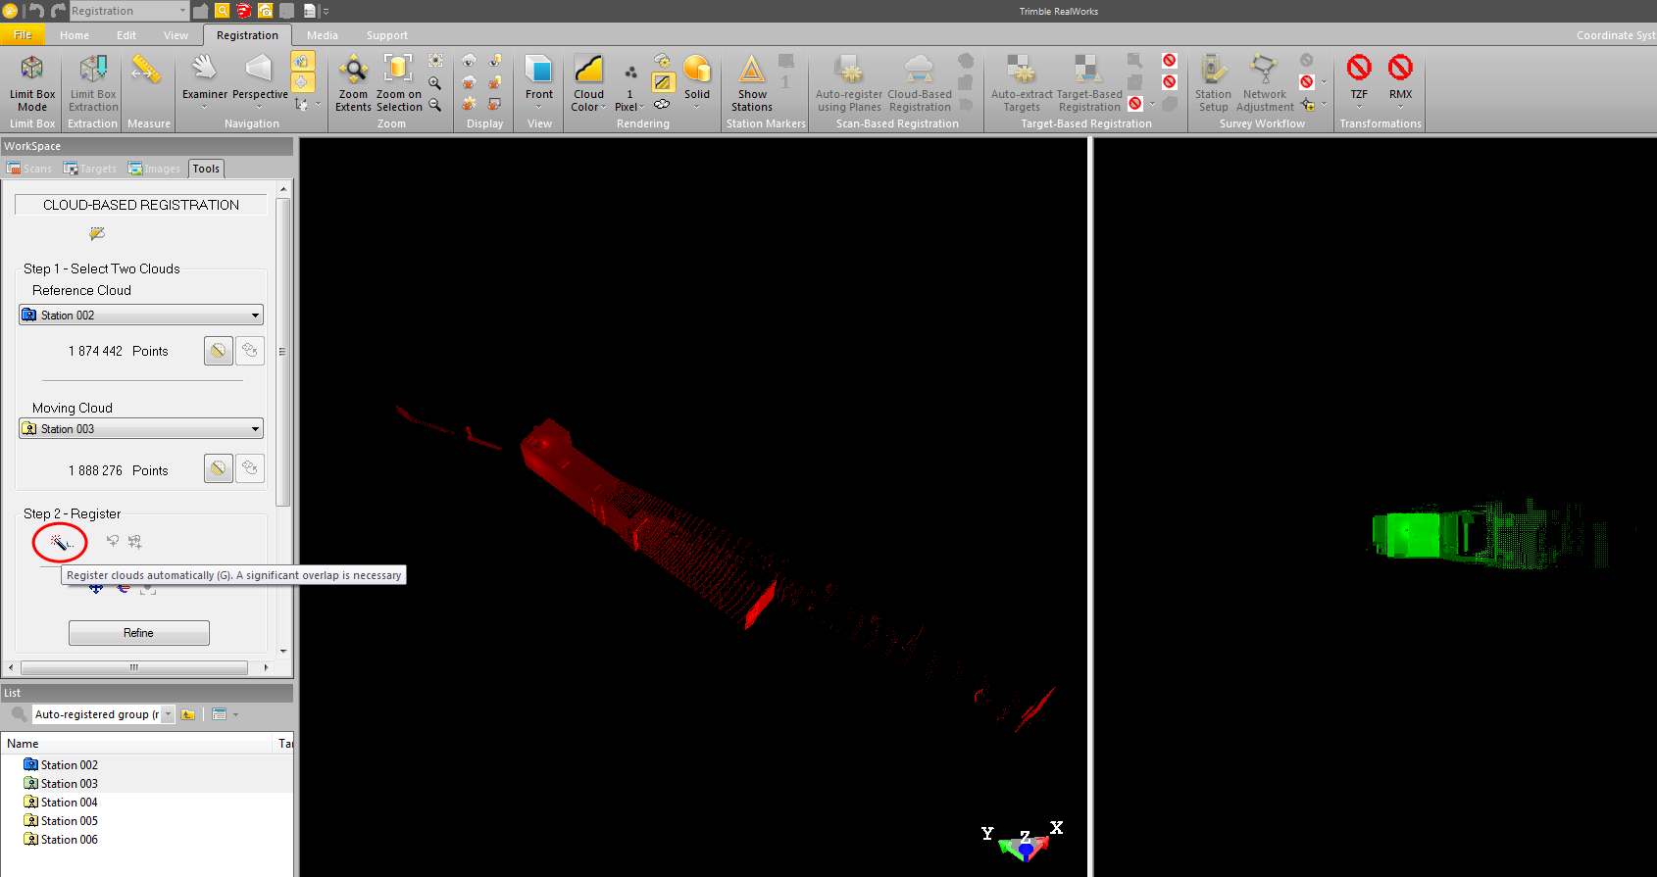
Registration
No need to select a common point
Notes:
This functionality adds to Trimble RealWorks industry leading targetless registration tools. Now you have the option to let TRW try to find the correct match between two stations rather than clicking on a common point in the two scans. The function works when the reference and the moving stations are approximately leveled and have a significant overlap. It takes approximately 16 seconds to reach a solution and is ideal for situations where the person registering the data may not be the person that captured it I the field and is not familier with the placement of the scanner during the survey.

Slide 13
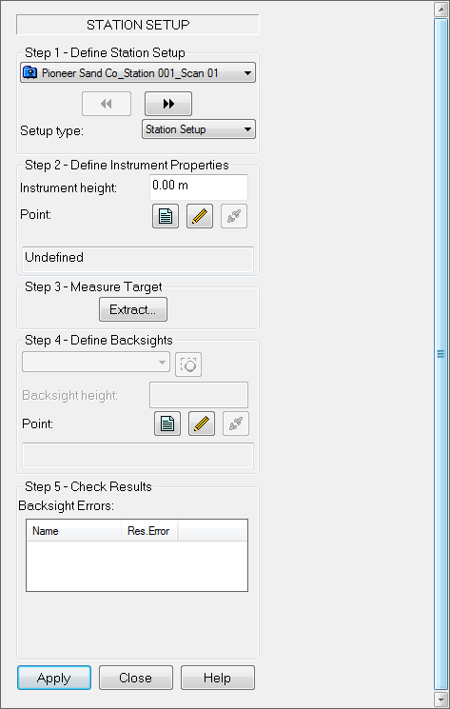
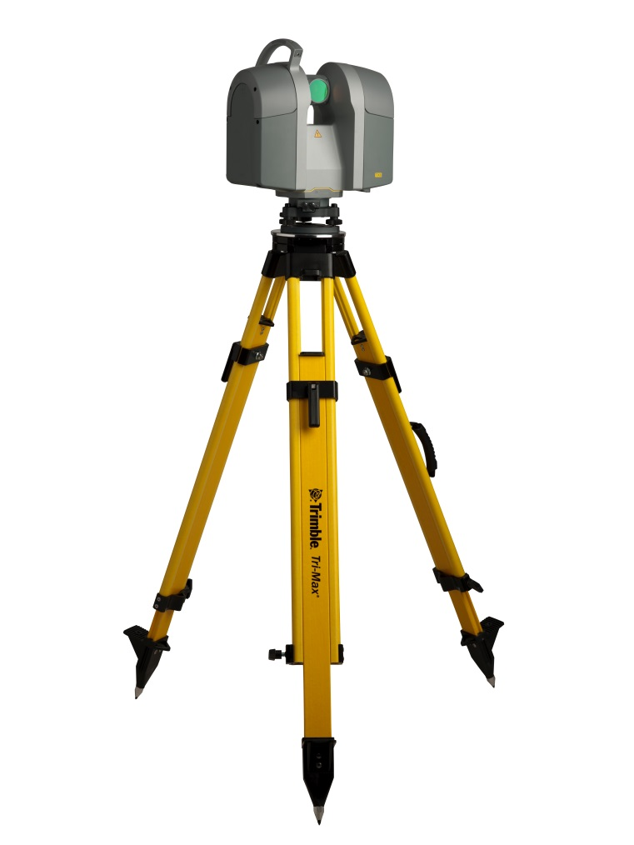
Registration
Post Survey Workflow for laser scanners like the Trimble TX8
Notes:
Solution for performing a traverse type station setup workflow using laser scanners without an onboard station setup routine. Keep manual survey notes to perform the station setup information and perform the station setup in the office. Ideal for users wanting to use a laser scanner for long corridor type applications where they would like to use a single backsight and foresight or perform a resection.

Slide 14
Scan Explorer

Slide 15
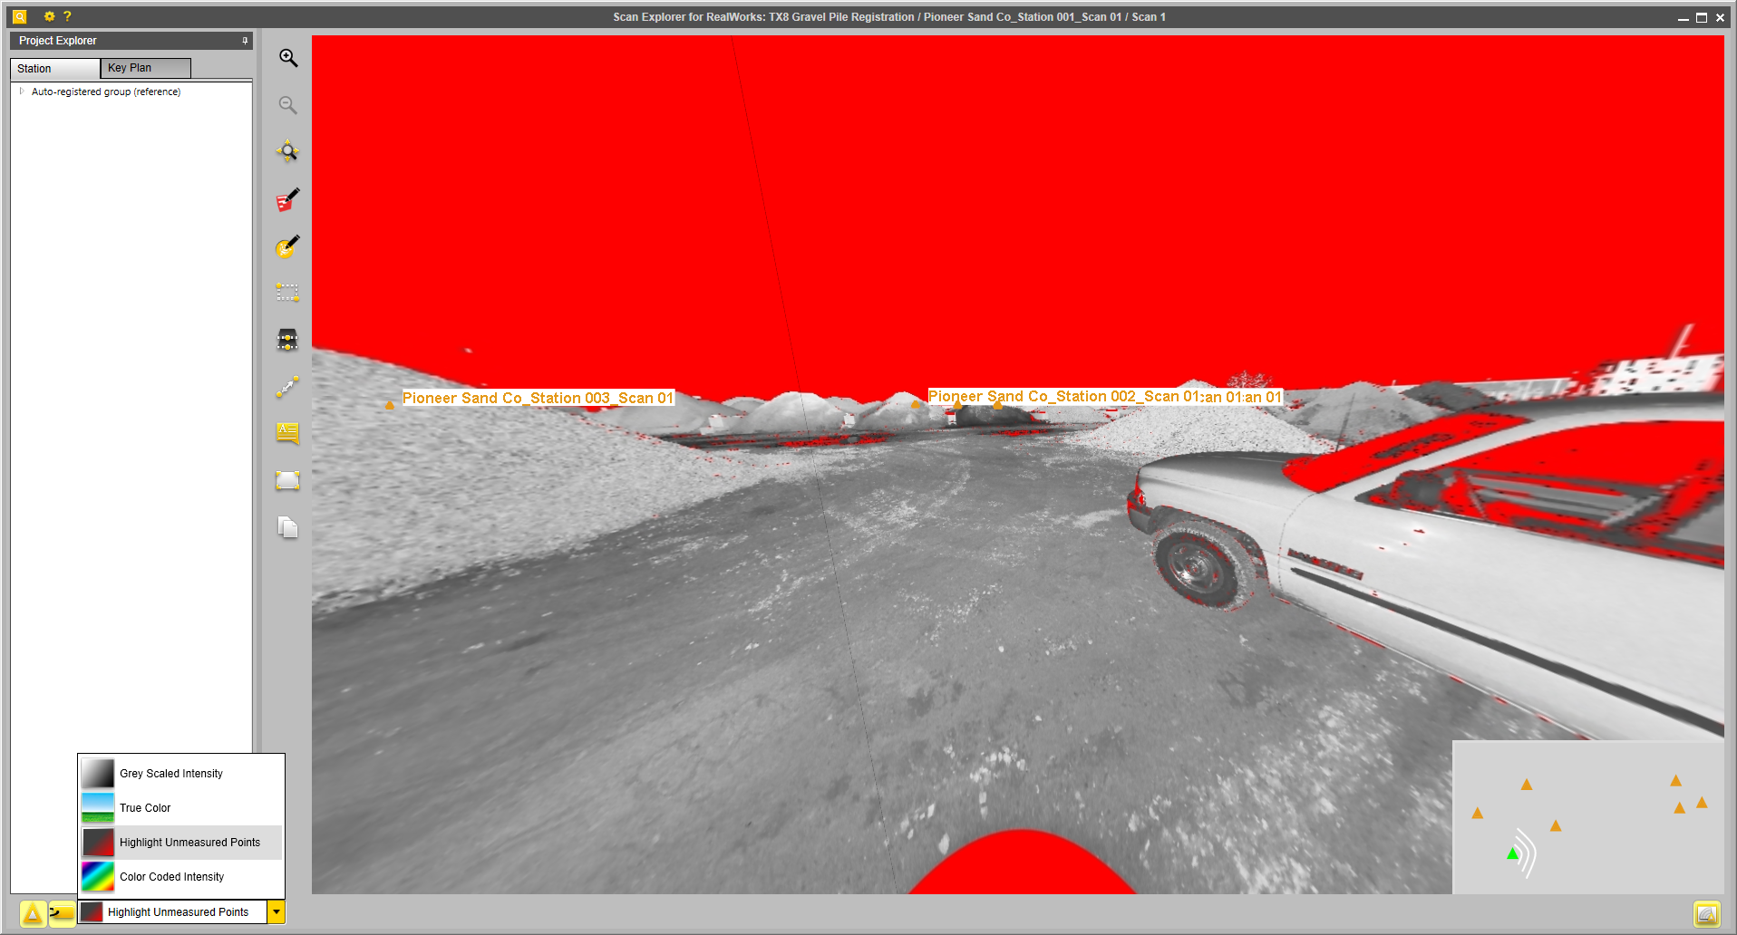
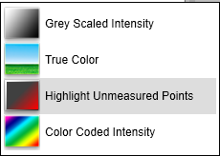
Scan Explorer
New visualization options
Notes:
Two new options for visualizing tzf files in Scan Explorer:
1) Highlight Unmeasured Points – useful for seeing which points where actually scanned.
2) Color Coded Intensity- useful for identifying different objects or features in the scan.

Slide 16
Advanced Storage Tank

Slide 17
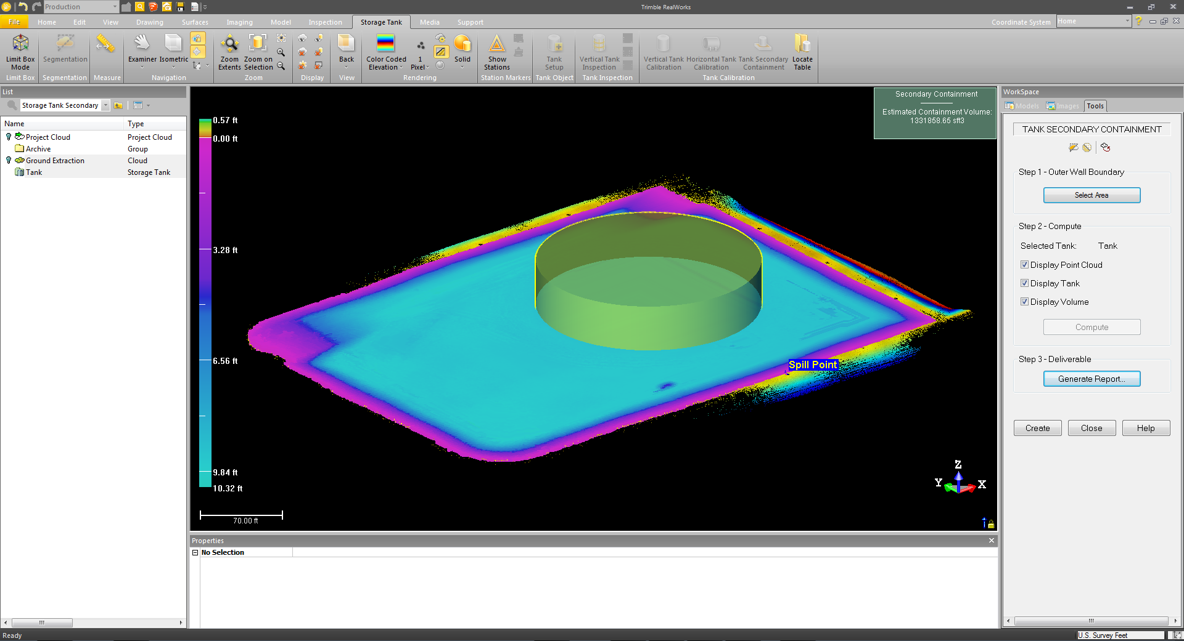
Secondary Containment
New tool for secondary containment capacity
Notes:
New tool for calculating the capacity of a secondary containment system and comparing it to the storage tank volume potential. The tool requires you to first have a cleaned up point cloud to remove noise points especially those created under the ground level due to water reflections. A combination of manual and using the ground sampling tool are good. Select the cleaned point cloud and also a tank object created by the tank setup tool to open the Secondary containment tool. Select and area approximately 1 meter outside the secondary containment wall. It is best to have a completely scanned dirt wall on both the inside and outside. Vertical walls such as concrete containment structures are not supported at this time. An estimated rainfall can be input as well the percentage of the desired storage capacity to generate a report.

Slide 18
Ordering/Availability
Availability 15 September 2015
No new part numbers for this release
Download from the support and downloads link at http://www.trimble.com/3d-laser-scanning/realworks.aspx

Slide 19
Resources
All information will be posted on Partners including:
What’s New PPT
Videos
Release Notes
Support Notes Edition Content

Slide 20
Trimble RealWorks 10

Slide 21
Resources
All information will be posted on Partners including:
Product Bulletin
What’s New PPT
Videos
Release Notes
Support Notes

Slide 22
Resources
OfficialTRW - YOUtube

