Slide 1
GEDO NovaTrack. Introduction Trimble Geospatial Track Survey & Scanning
Linas Maciulevicius | Trimble Geospatial
FEBRUARY 13, 2023
V.2.2.2

Slide 2
AGENDA
Short intro into GEDO NovaTrack software
Key features
Standard workflows & special case
Live demo
Reference & Support information
Questions

Slide 3
Goals within track maintenance and renewal
Route re-construction
New track layouts
Plain line renewal
S&C renewal and refurbishment
Maintenance works
Sidings renewals / maintenance
Control by Design
Reduction of maintenance/renewal cycles
Avoid issues with the clearances to the structures
Increase in life of track infrastructure
Track improvements by detecting geometry irregularities
Always known the initial track position
Increase construction asset utilization

Slide 4
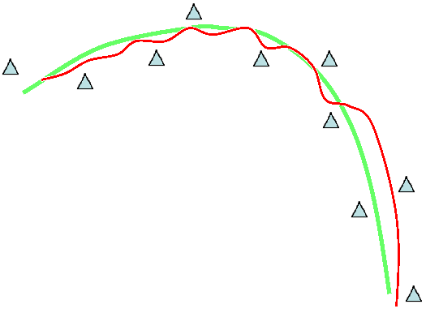
Typical issues with alignment data
Challenges with track design alignments:
Design alignment data is not available or partial
Transition tangents are moved due to the relative tamping process
Both vertical and horizontal radii are drifted from the original design
Cant alignment is off from design
No control of clearances before and after re-alignment
Track alignments:
Initial design
Existing

Slide 5
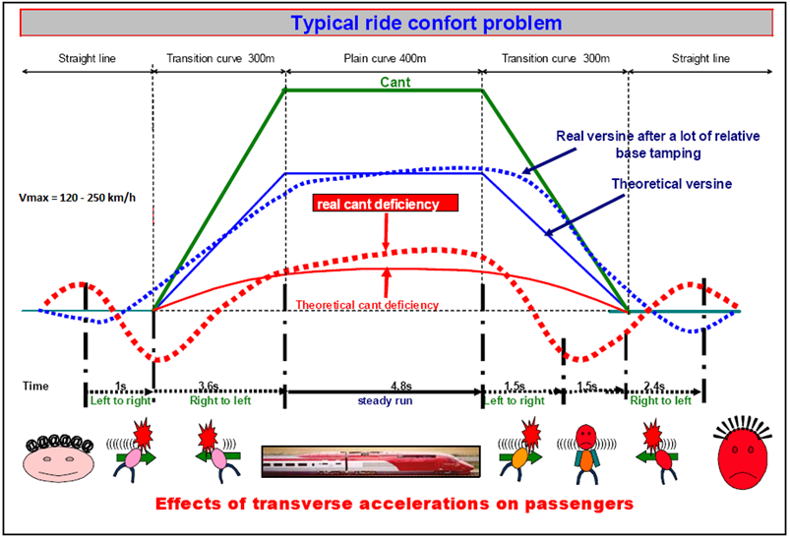
Consequences of bad* track maintenance
Source: UIC
* - relative

Slide 6
What is Trimble GEDO NovaTrack ?
Trimble GEDO NovaTrack – software for analysis of existing track geometry and approximation with best fit design alignment geometry elements
Primary applications
Create design alignment data for track maintenance (design tamping)
Evaluation of existing track geometry parameters
Checking historical alignment data against existing track position
Adjustment of old design alignment to match with existing track

Slide 7
GEDO NovaTrack - finding best-fit alignment solution
Key functionality and features:
Automatic alignment fitting based on existing track measurement data
Curvature prediction using 1/R curvature and Direction Analysis
Clearance info during alignment adjustment process
Calculation of design speed and cant
Check alignment conformity against design regulations

Slide 8
GEDO NovaTrack workflows - from measurement to a specific application Trimble Geospatial Track Survey & Scanning
02
V.2.2.2

Slide 9
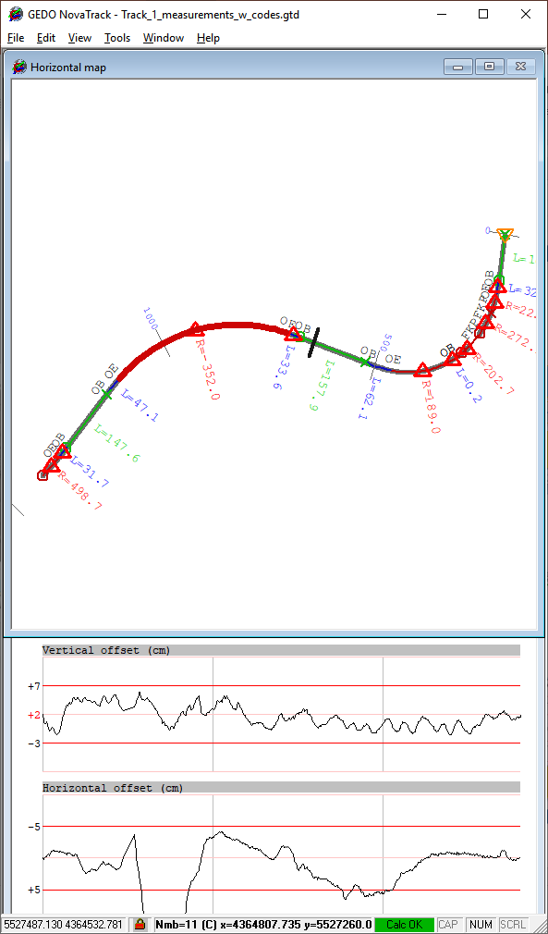
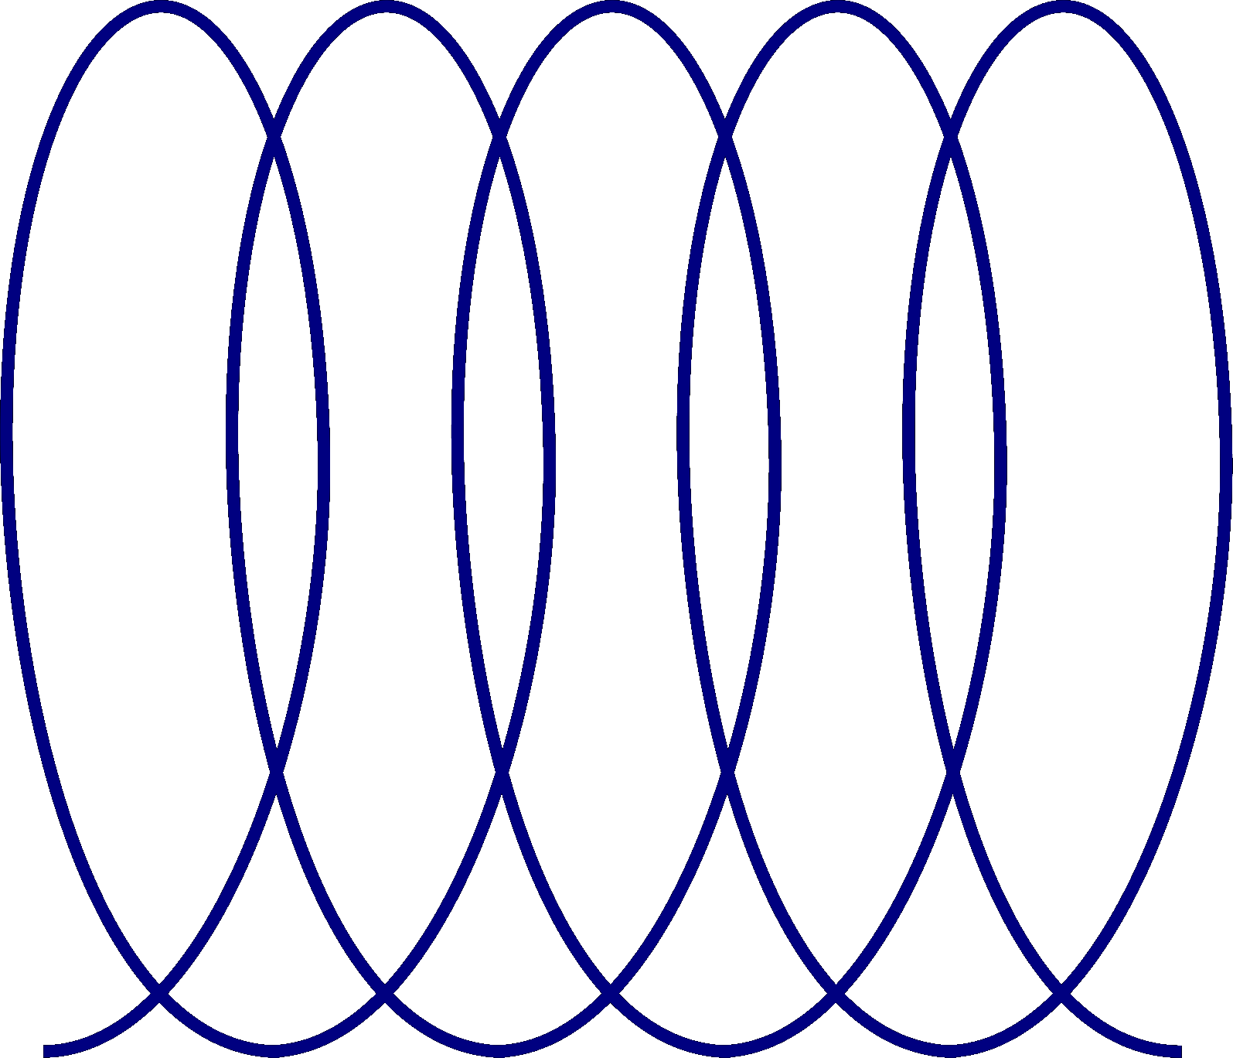
Data flow - from field to rail specific application
Measurements/Scan
Processing
Re-Alignment
Analysis applications
Production applications
GEDO NovaTrack
GEDO Office
GEDO REC
GEDO IMS
GEDO VORSYS
GEDO Office
Tamping/QA
Measured existing tracks
Machine Control
Best-fit alignment processing
HA/VA/CANT/SPEED
TA Track
Gauge Survey
TBC
Deformation Monitoring
Measured existing track (rail) points
GEDO Scan Office
Dynamic clearance analysis
GEDO Scan Office
OHL lines
GEDO IMS SCAN
Measured tracks
Structures & Platforms
Extracted existing tracks
Trimble MX9/MX50 (Mobile Mapping)
CAD/BIM Software
Topographical objects
Detail track design

Slide 10
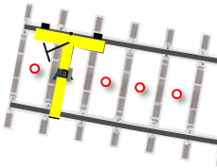
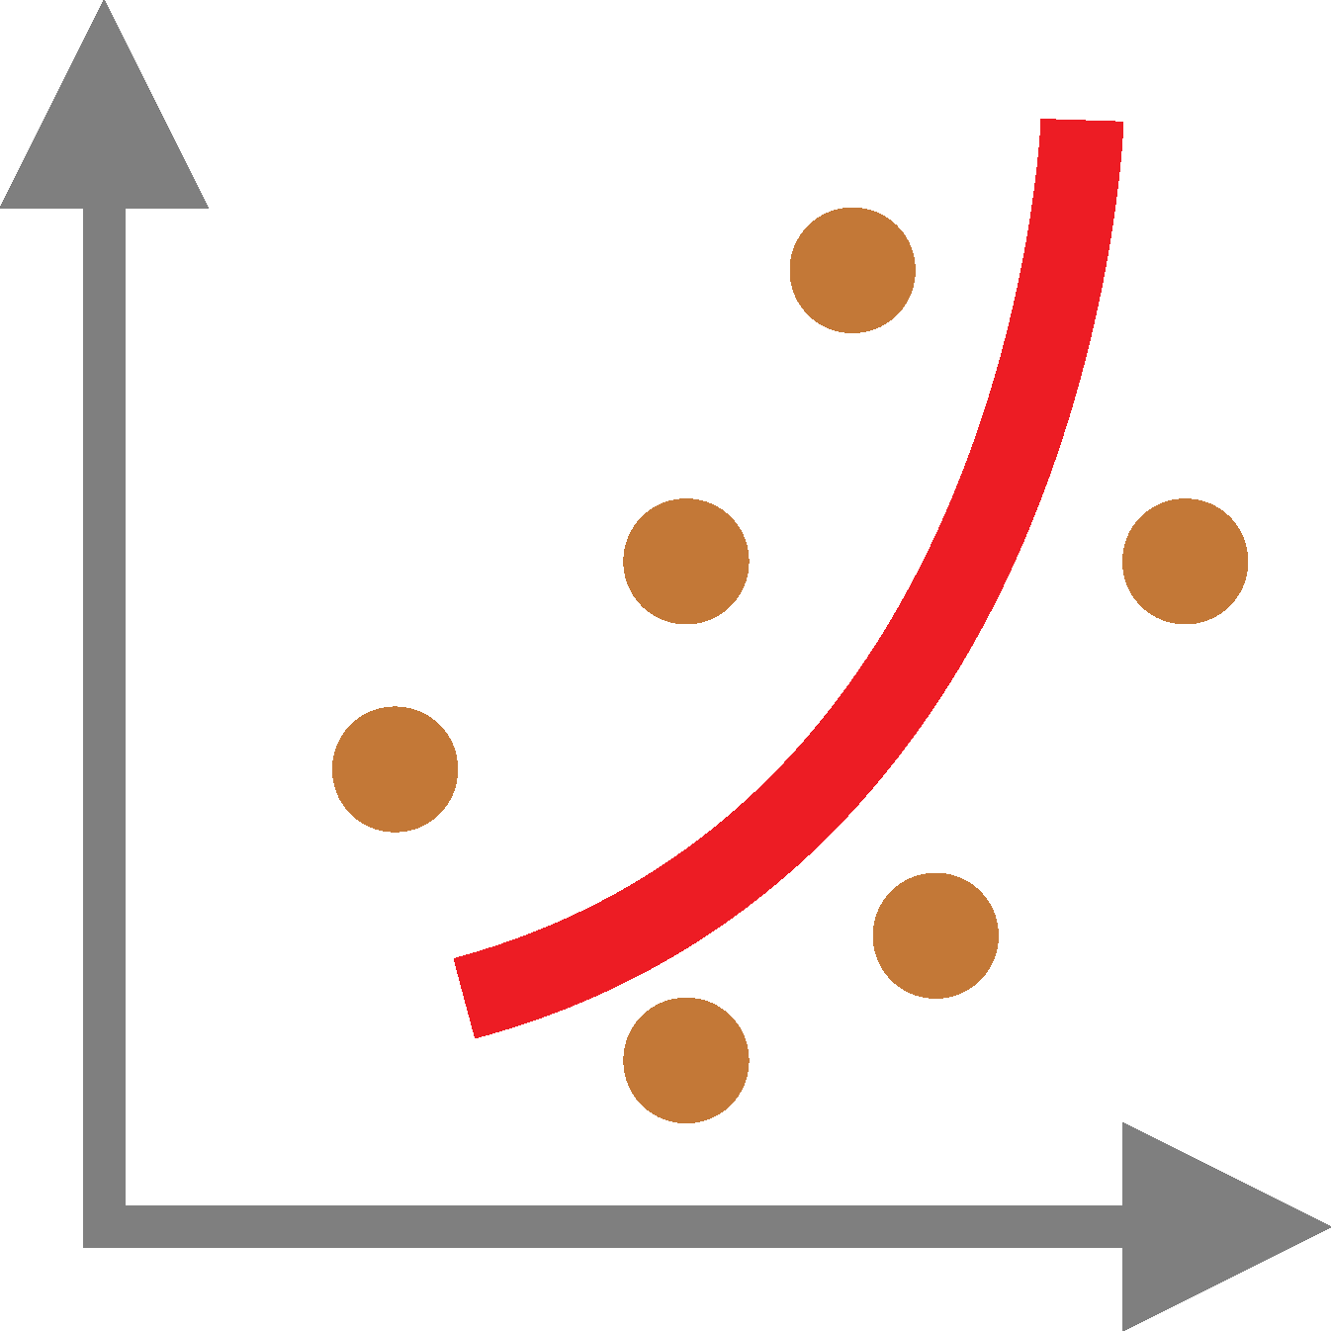
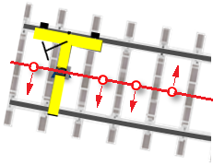
Alignment processing workflows
Recommended workflows for track re-alignment
A
Complete
re-alignment
.TDT
.HDT
.UDT
.GTD
HA/VA method
B
Horizontal
re-alignment
1
Import .GTD track data
C
Vertical
re-alignment
D
Verification of alignment
2
Semi-automatic or automatic HA fitting
HA method
3
Adjustment HA elements. Reduction HA offsets
1
Import .GTD track data
VA method
Verification method
4
Automatic VA fitting, reduction of VA offsets
2
Semi-automatic or automatic HA fitting
1
Import .GTD track data
1
Import .GTD track data
5
Cant and speed calculation (optional)
3
Adjustment HA elements. Reduction HA offsets
2
Automatic VA fitting
2
Import design alignment
6
Design alignment export to .TDT/.HDT/.UDT files
4
Design alignment output to .TDT file
3
Design alignment output to .HDT file
3
Check HA/VA offsets and compliance with rules

Slide 11
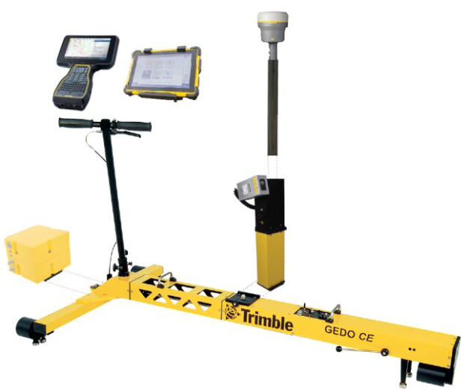
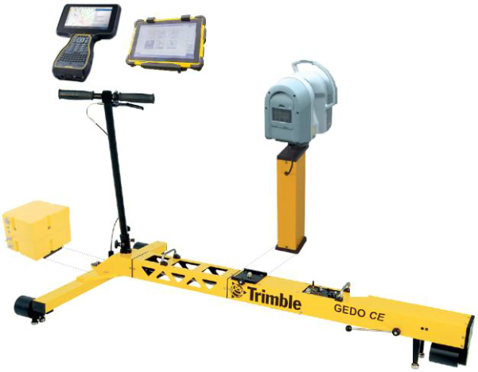
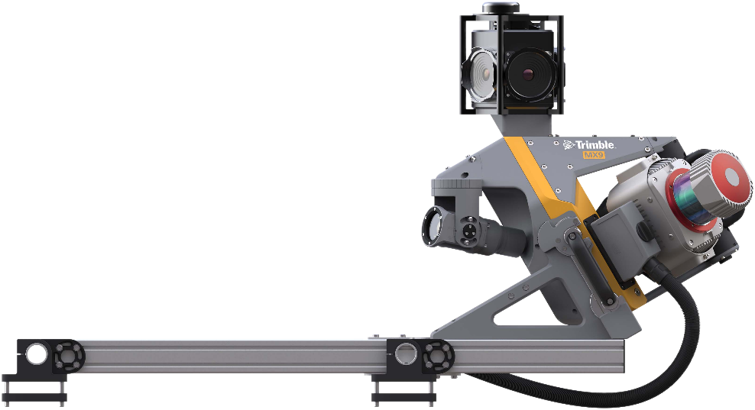
Track survey data input. Option #1
Input measurement data:
Track measurements in the GEDO Track Data .GTD format:
Center line (X, Y)
Elevation (H, lower rail)
Measured Cant

Slide 12
Track survey data input. Option #1
Data input from track survey and scan:
Measured track trajectory in .GTD format:
point name and code
center line (X, Y, H)
measured gauge (meters)
measured inclination (radians)

Slide 13
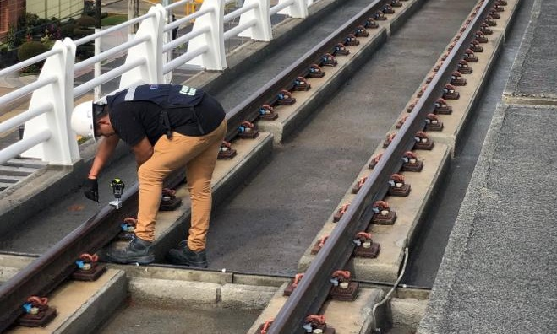
Track survey data input. Option #2
Data input from other track survey sources:
Track points in .XML (.cgPoint) or .CSV format:
point name and code (code for left/right rail or axis)
point coordinates (left/right rail or axis)
coordinate precision 5 decimals or more

Slide 14
Requirements for track measurement data (input)
Input data specification:
Interval between measured points
depending on track quality/complexity/application: 0.5 – 3 m
Measured point coverage:
measurements must start/end in a straight or radii element (at least 50 m)
measurements should not start/end in the transition
the gaps are allowed in the measurement data

Slide 15
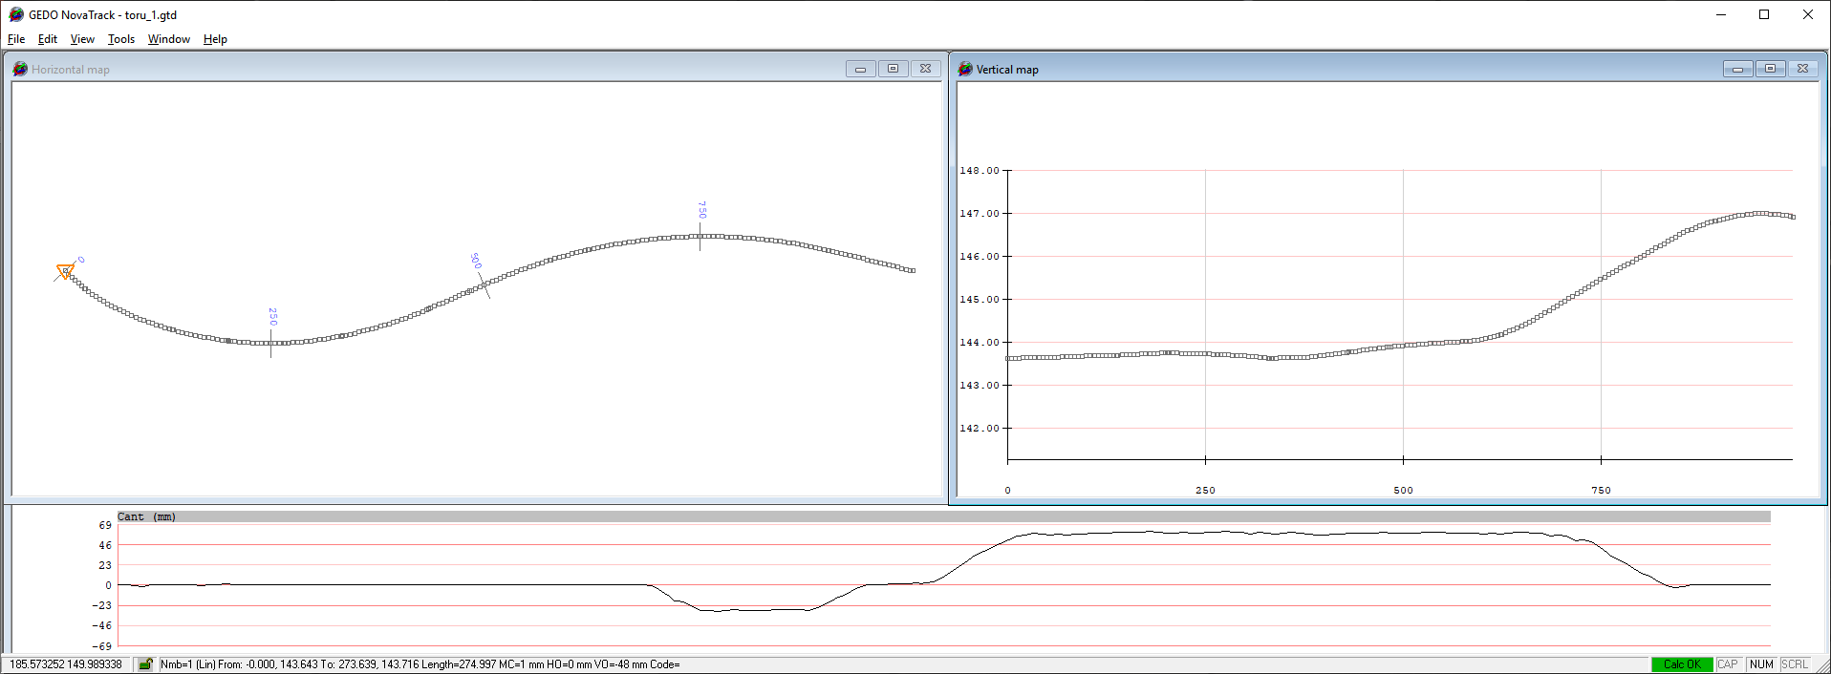
Workflow. Step 1. Data input.
Import of measured track data (.GTD)
Horizontal view
Vertical view
Cant diagram view

Slide 16
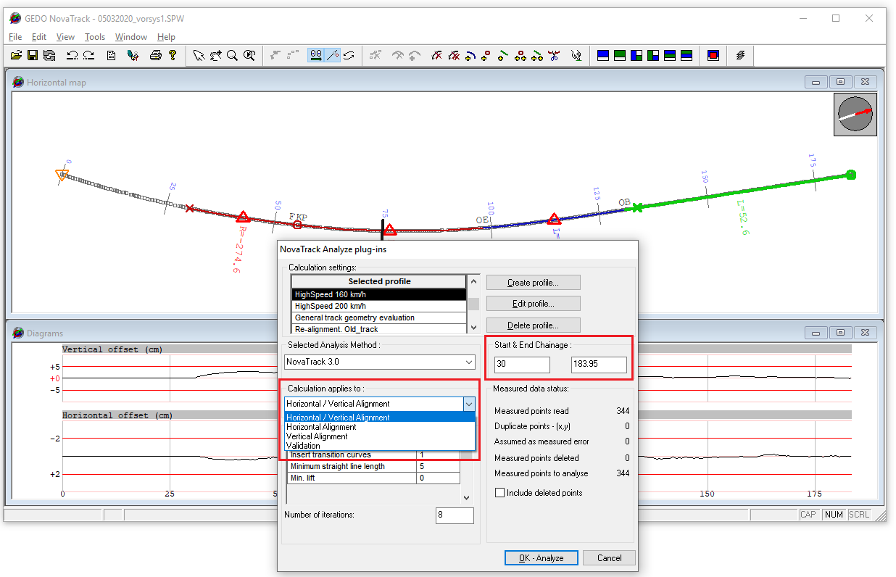
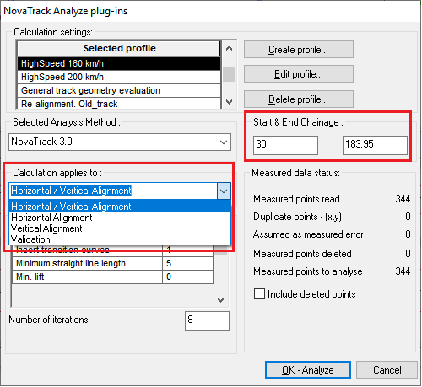
Workflow. Step 2. Selecting calculation settings
Selecting chainage range: from – to chainage
Selecting calculation profile (based on application or track type)
Selecting alignment calc. scope: HA/VA, HA, VA or Validation

Slide 17
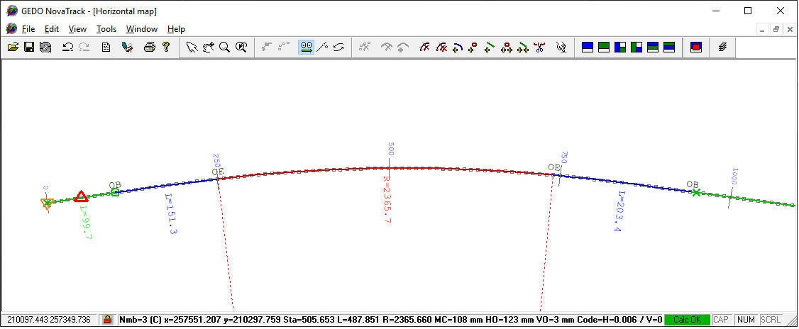
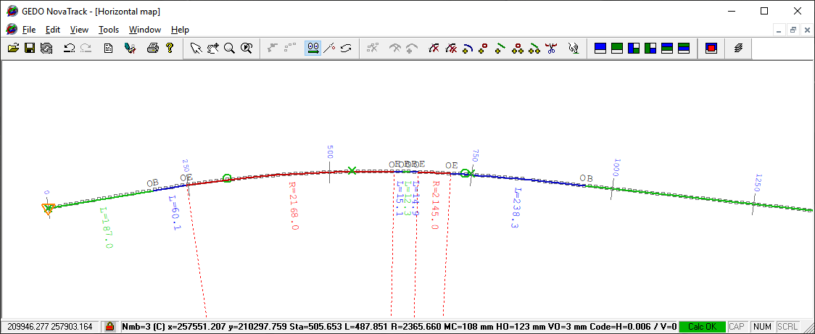
Workflow. Step 3. Automatic alignment fitting
Point approximation with alignment elements
A
Novatrack 3.0
Regression w/ Transitions
B
´Pre-design´
´Smoothing´
1
Better automatic prediction
1
Follows existing track
2
Consistent geometry
2
Erratic combinations of elements
3
Aimed for re-construction
3
Suitable smoothing tamping

Slide 18
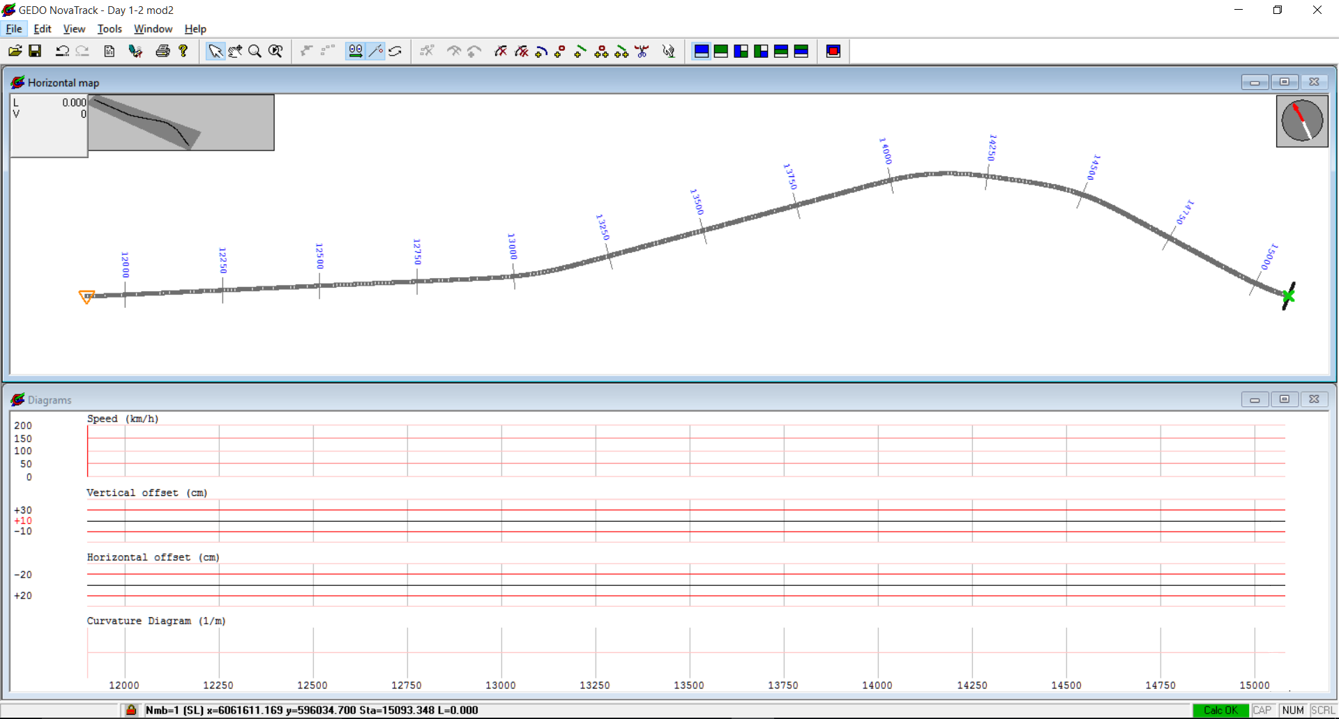
Workflow. Step 4. Automatic fitting result
Design alignment result after automatic alignment fitting
Straight line
C
C
TC
Transition
TC
TC
TC
SL
Radius/Arc
SL
SL
C
Invalid fitting
Speed/ Cant diagram view
VA alignment offsets
HA alignment offsets
1/R curvature band

Slide 19
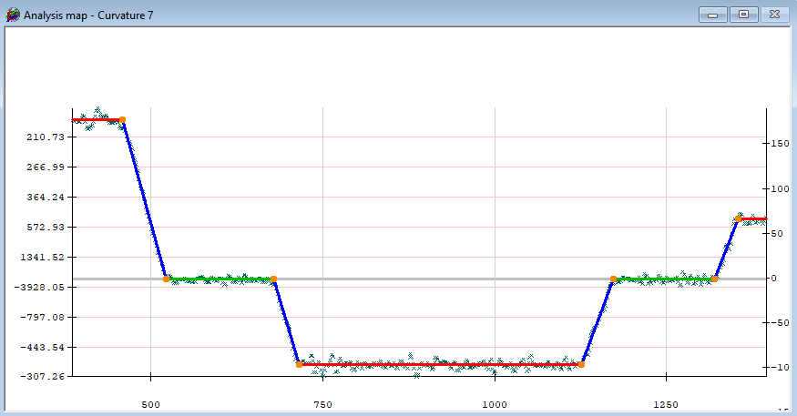
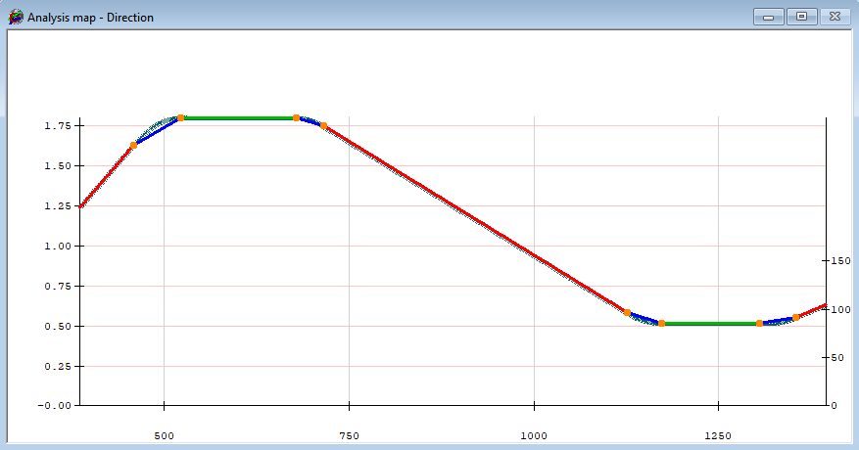
Workflow. Step 5. Semi-automatic alignment fitting
Using HA curvature/direction analysis diagram:
to adjust proposed HA alignment configuration
to set preliminar element configuration & tangent point positions
1/R curvature analysis
Direction change analysis
Straight line (A)
Radius/Arc (A)
Transition
Invalid fitting
Preliminary tangent location

Slide 20
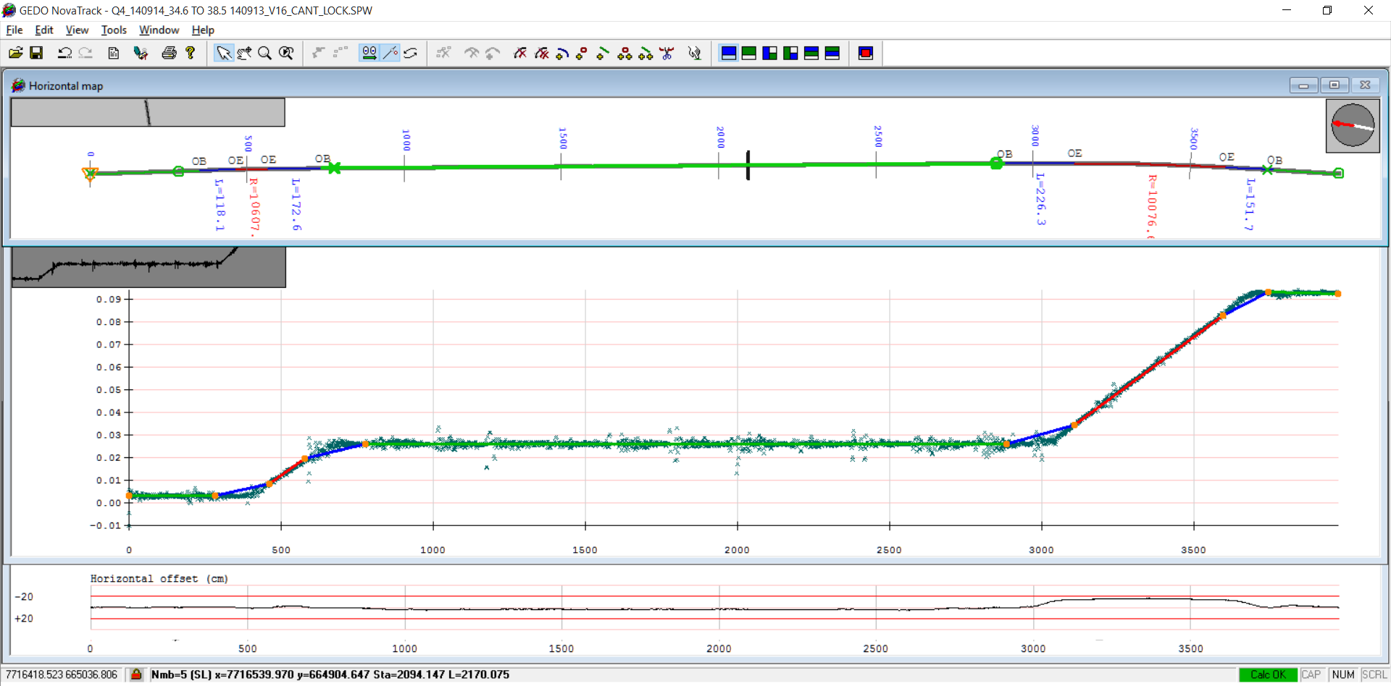
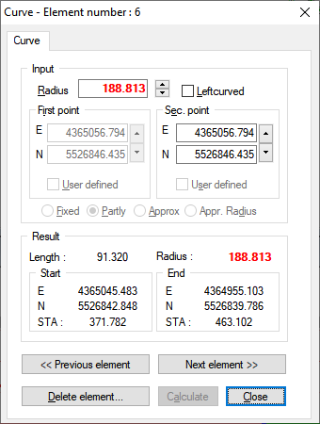
Workflow. Step 5. Semi-automatic alignment fitting
Adjusting HA alignment configuration in Analysis Diagram
Precise HA/VA editing in order to reduce offsets

Slide 21
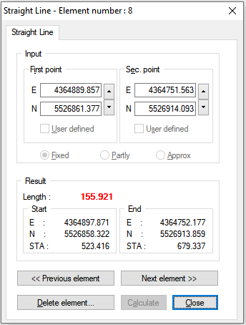
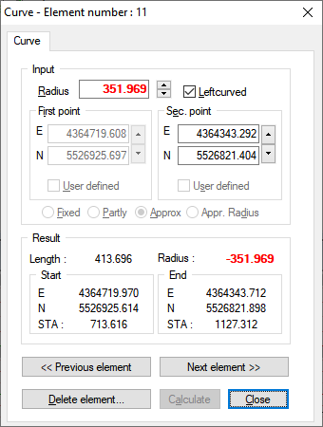
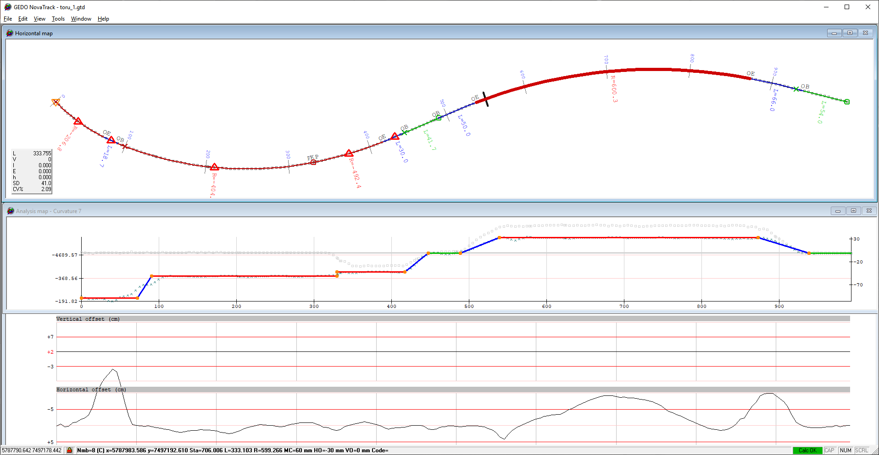
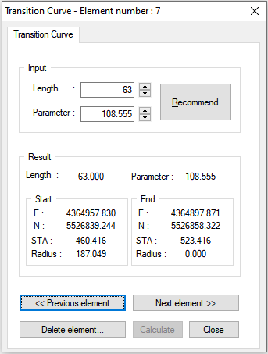
Workflow. Step 6. HA alignment fine-tunning
Adjusting HA elements to minimize horizontal offsets:
direct element editing using parametric data
Horizontal view
Straight line (A)
Radius/Arc
Analysis diagram
Offset diagrams
Transition

Slide 22
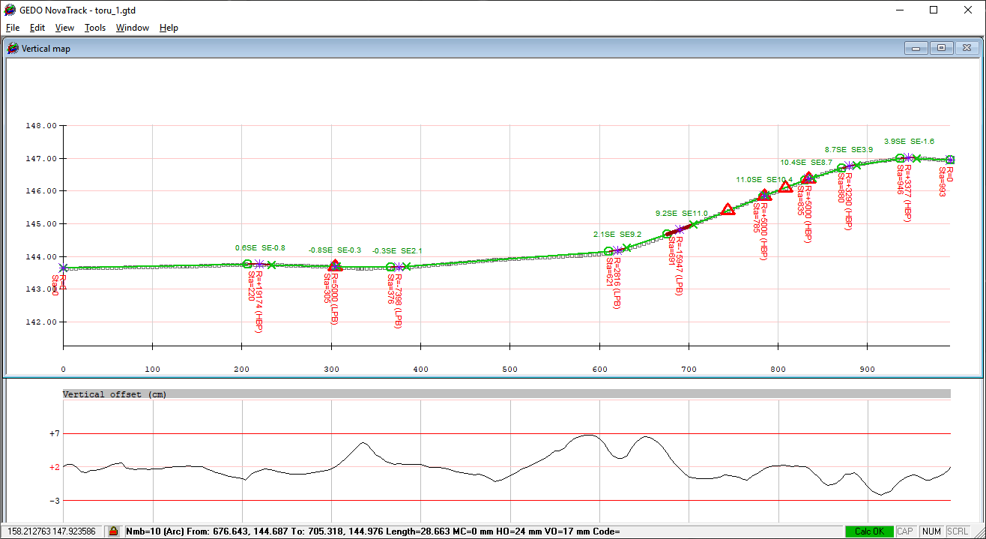
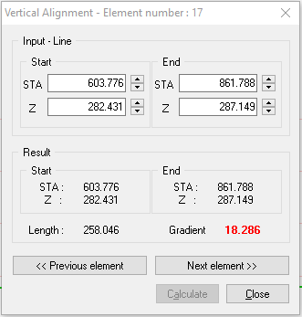
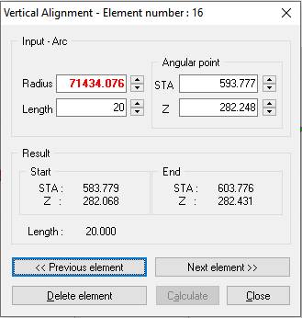
Workflow. Step 7. VA alignment establishment
Establishment and adjust of VA elements :
draft VA alignment smoothing using calculation profile setting
VA element parametric editing to minimise vertical offsets
Straight line (A)
Radius/Arc (A)
Calculation profile settings

Slide 23
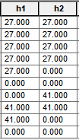
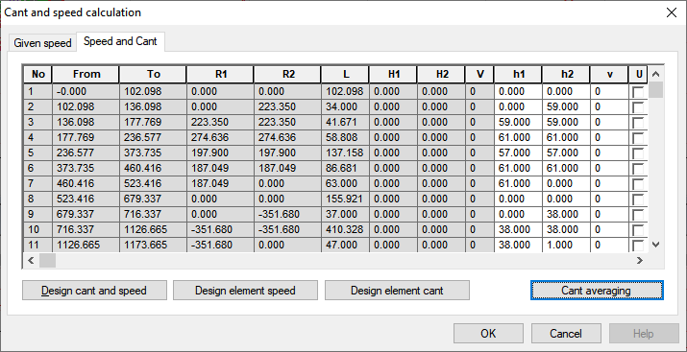
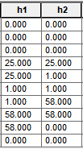
Workflow. Step 8. Calculate design Cant
Calculate design Cant using one of the available options:
Cant calculated based on user profile settings
Cant calculated as an avarage of measured cant
Existing cant
Design cant
Cant based on user profile
Existing cant
Design cant
Cant based on average existing cant

Slide 24
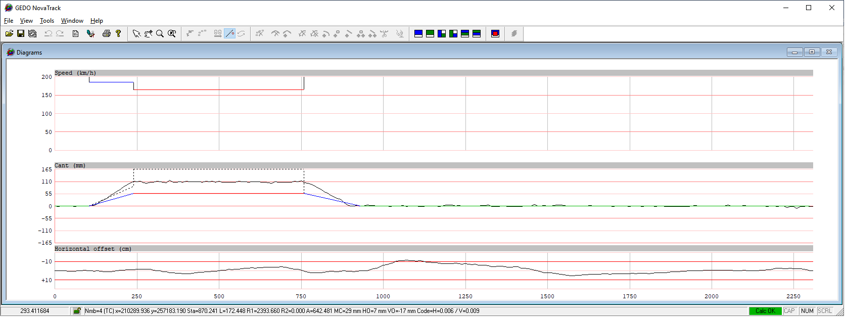
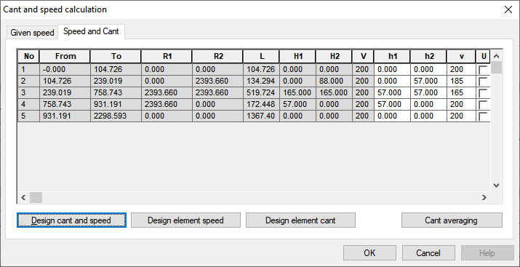
Design speed & cant calculation options
Cant averaging and based on measured cant
Cant and speed based on the rule settings
Speed/cant calculation for individual elements

Slide 25
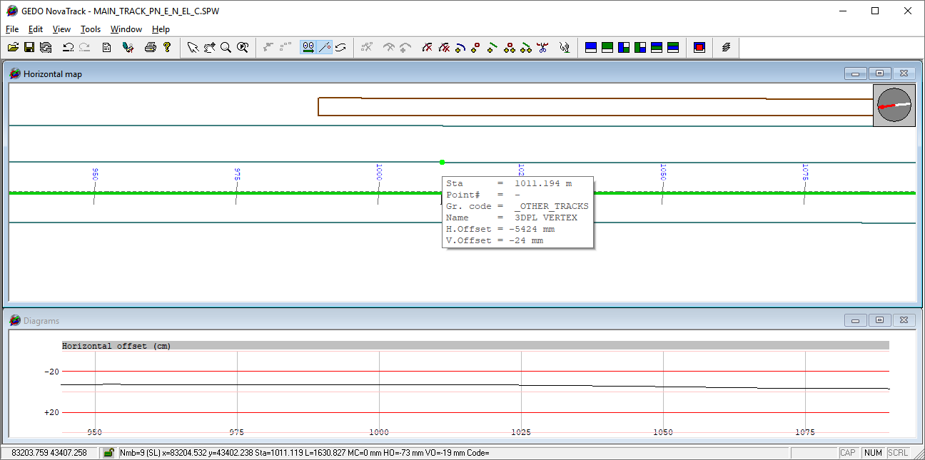
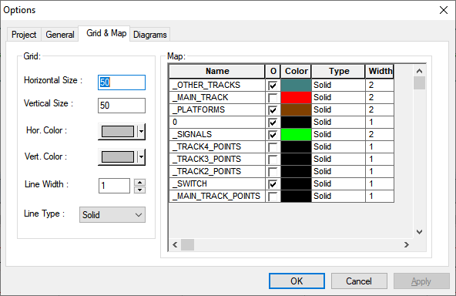
Workflow. Step 9. Adding supportive map information
Optionally import an external track or map data
supported format: .GTD, .DXF, .CSV and .LandXML
available tooltip information: offsets, chainage, layer code

Slide 26
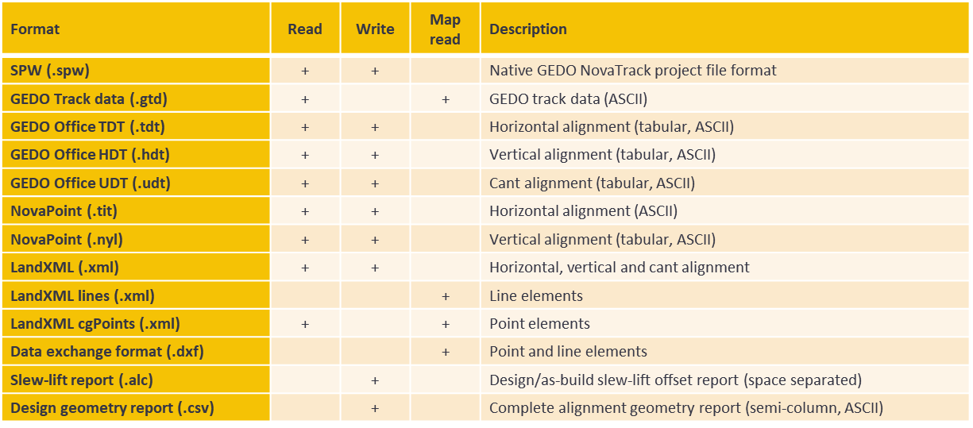
Data exchange
Supported file formats

Slide 27
GEDO NovaTrack Live
03
Live software demonstration

Slide 28
Questions?

Slide 29
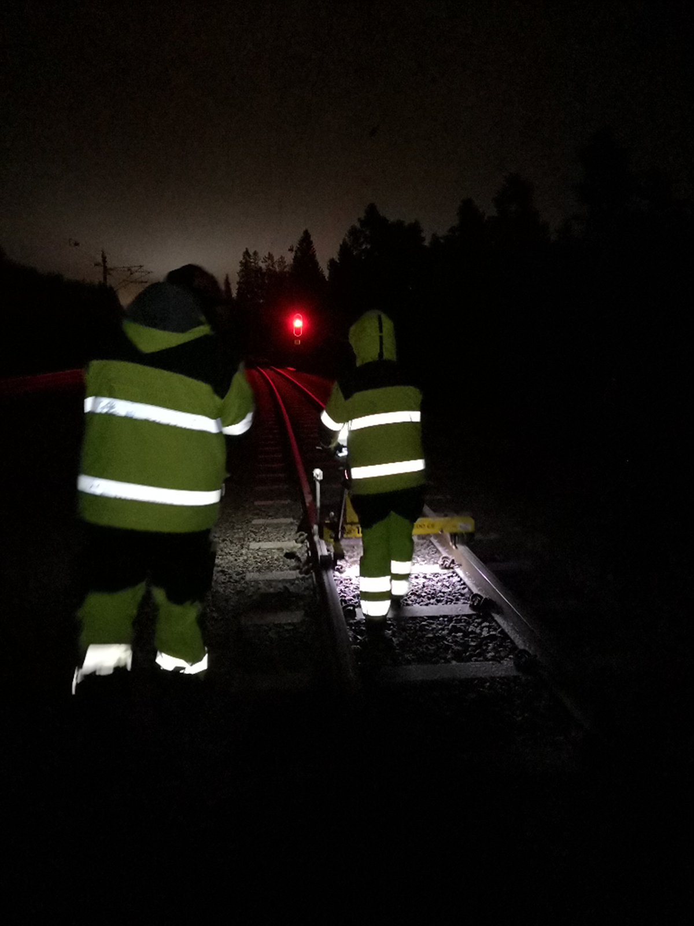
Thank you!
February 13, 2023

