Slide 1

GEDO Applications Overview
Presented By:
Linas Maciulevicius | Trimble Geospatial
Trimble GEDO solutions for track planning, design, construction and maintenance applications

Slide 2
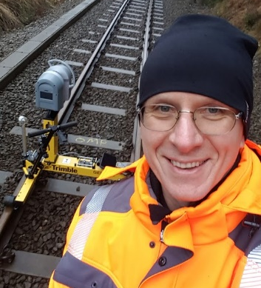
Speakers
Introductions
Linas Maciulevicius
Sales Application and Support Engineer
Wiesentheid
Germany
linas_maciulevicius@trimble.com

Slide 3
01
Agenda
02
03
04
05
06
07
Introduction
Introduction to Trimble and Geospatial Track Survey & Scanning division
Review of primary railway applications
Trimble Track Survey
and Scanning Overview
Track information for railway engineering works
Relative track quality inspection
GEDO solutions for relative track quality inspection
Track survey and control in absolute coordinates
GEDO solutions for existing track survey in absolute coordinate system
Railway scanning and point cloud analysis
GEDO kinematic railway scanning and point cloud analysis solutions
Configurations & Productivity Examples
Summary of available Trimble GEDO solutions and productivity
Questions & Answers
Ask your Questions

Slide 4
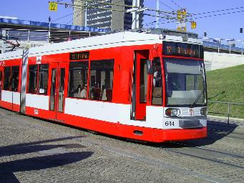
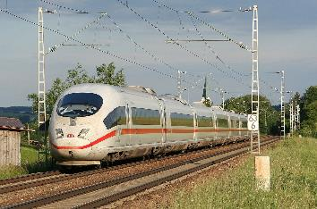
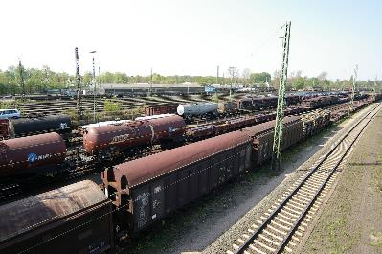
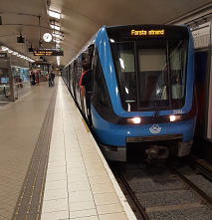
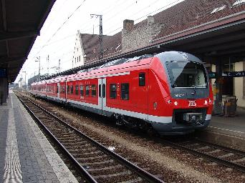
Railway infrastructure
High speed
Tramway
Freight
Intercity & LRT
Metro

Slide 5
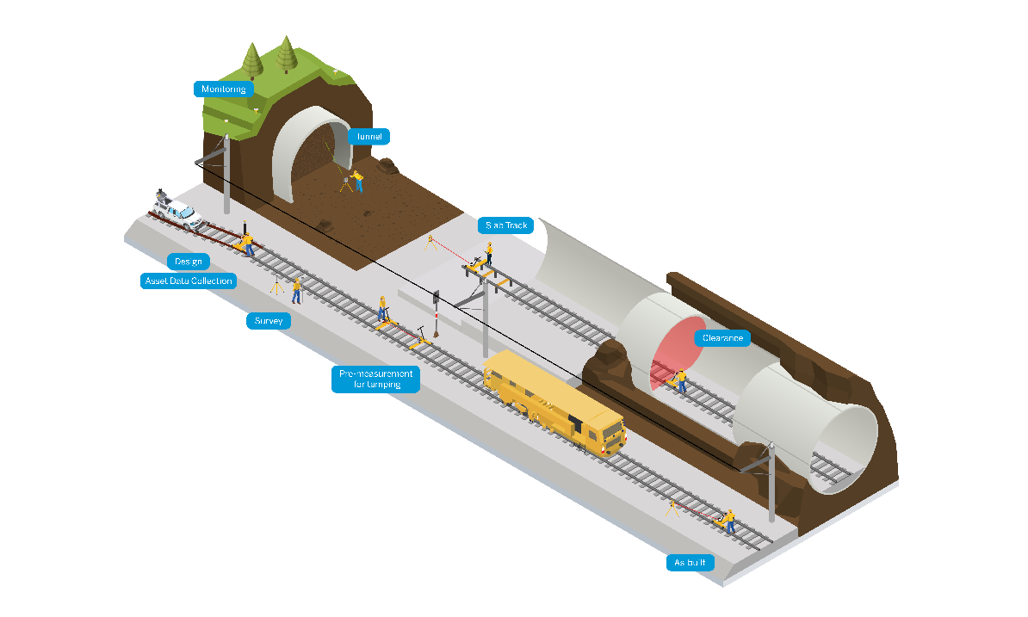
Rail Infrastructure Applications
Monitoring
Tunnel construction
Slab Track Installation
Planning & Design
Asset Data Collection
Survey
Clearance check
Pre-Measurement for tamping
As-built and quality check

Slide 6
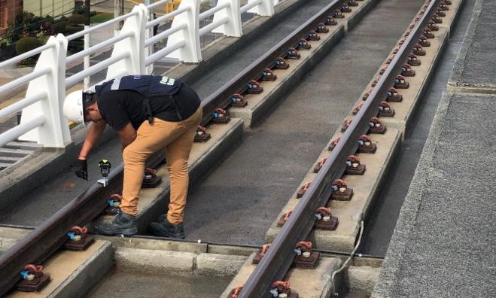
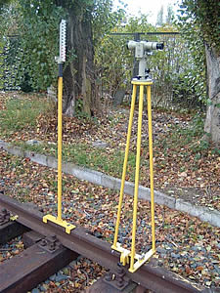
Classic Approach to Track Surveying
Source: ITARQ
Survey rail coordinates with rail shoe
Source: www.gleisbau-welt.de
Survey rail chords/versines

Slide 7
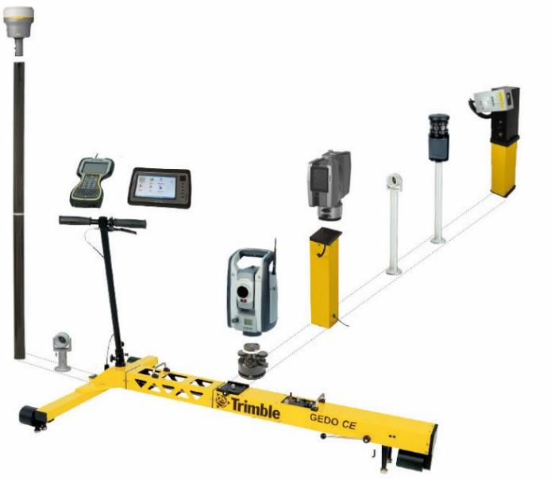
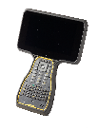

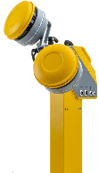



GEDO Hardware
Modular system which grows with your tasks and requirements
GEDO CE 2.0 base unit
Precise cant and gauge sensor
Odometer
Communication
Illumination
Gauge adapter
Total station, GNSS and adapter
Scanner tower
Profiler
Compatible with Trimble instruments

Slide 8

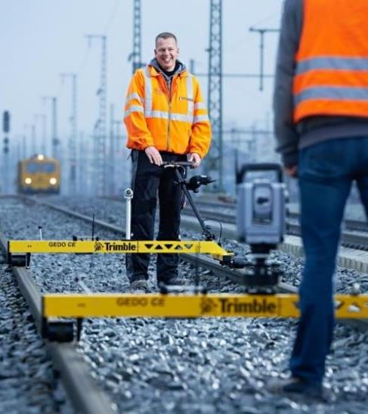
GEDO Applications
Relative Measurement
Simple track quality check
Track Survey
Collect data for design and control
Track Stakeout
Stakeout track postion
Slab Track Construction
Track installation
Pre-Measurement for Tamping and Re-construction
Data for the tamping machine
Clearance and as-built
Check clearance for safety and final as-built
Asset Data collection
Collecting object information

Slide 9
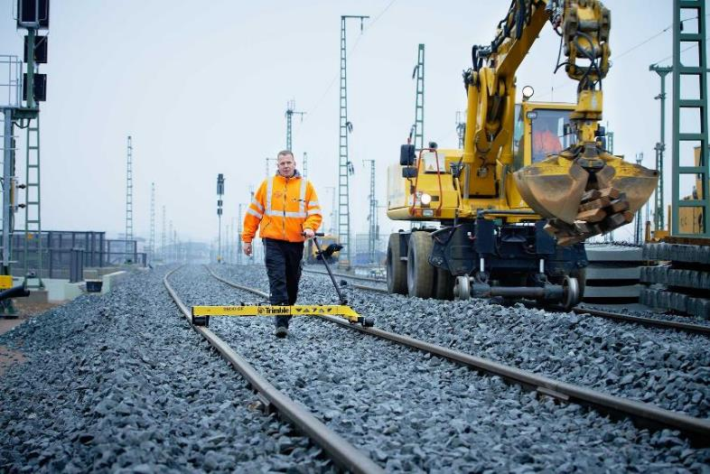
Track Gauge Inspection - GEDO Doc
Easy way to check inner track quality
TRACK DATA
Chainage
Cant
Gauge
Twist
APPLICATIONS
Inner geometry inspection
Gauge and cant documentation

Slide 10
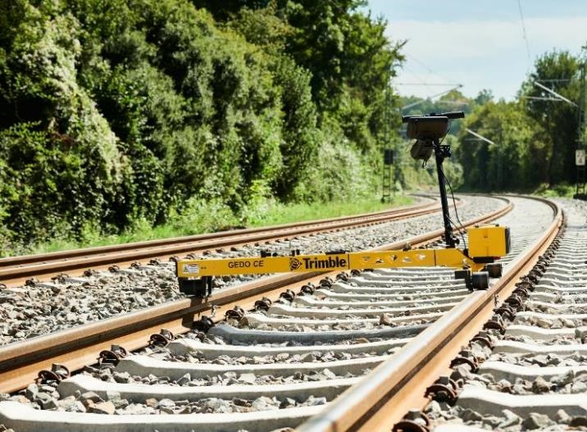
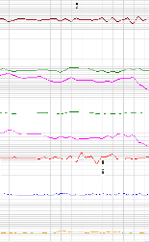
Track Geometry – GEDO IMS
Enhanced track geometry measurement and analysis
TRACK DATA
Chainage
Cant
Gauge
Twist
H/V Curvature
APPLICATIONS
Inner geometry inspection
Gauge and cant documentation
Curvature band assestment
FEATURES
Compliant with EN 13848-4 “Repeatability & Reproducibility”

Slide 11
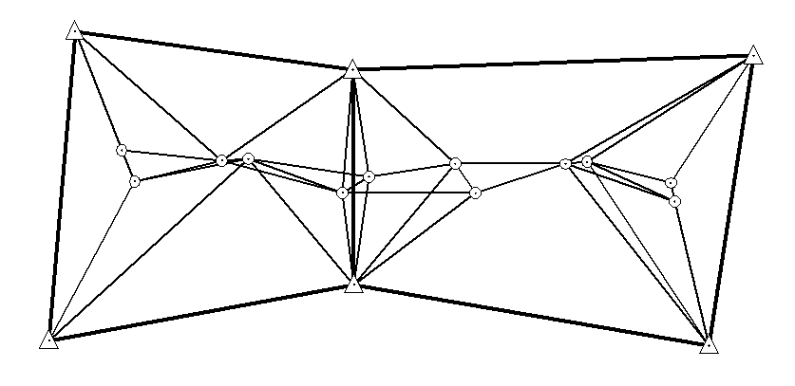
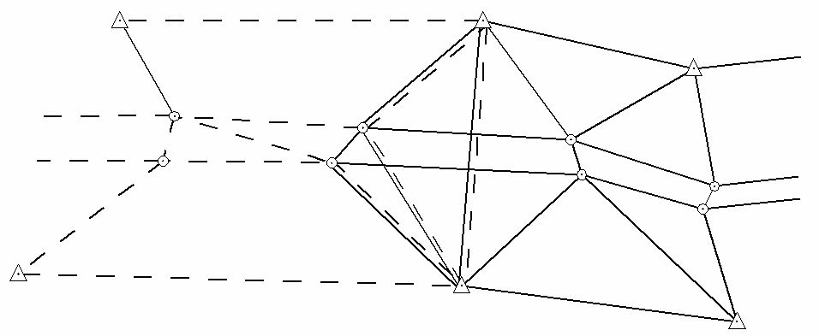
Trimble GEDO solutions
Survey supportive infrastructure
Connecting reference point network
Connecting reference point network along the railway corridor
Ground or mast marking
Distance to national grid reference points – 10-15 km (CP1)
Distance between reference point pairs – 4-5 km (CP2)
Distance between pair reference points – 1-1,5 km (CP2)

Slide 12
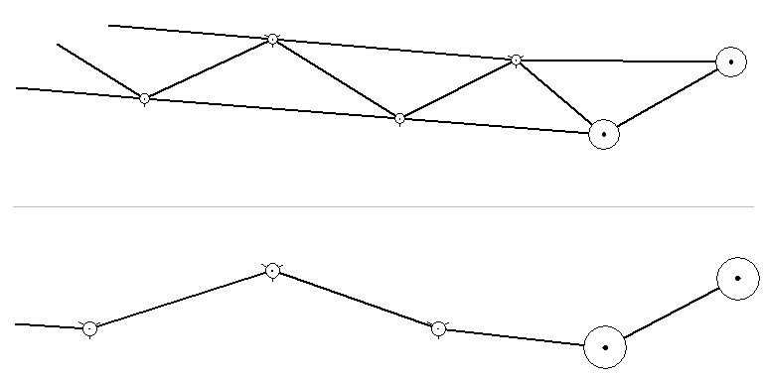
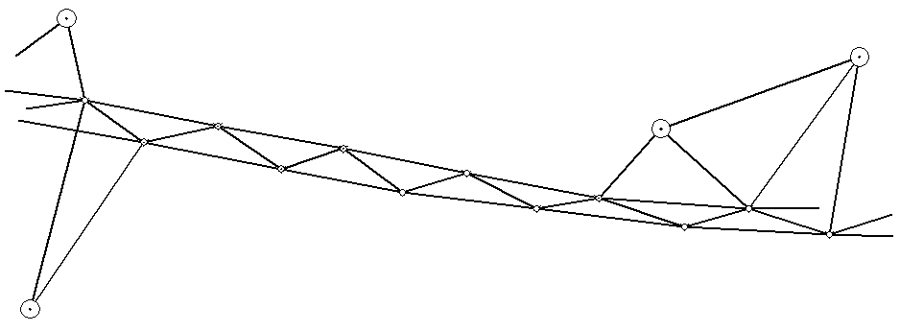
Trimble GEDO solutions
Survey supportive infrastructure
Production reference point network
Ground or mast/ catenary marking
Distance between connecting ref. point pairs – 4-5 km (CP2)
Distance between pair reference points – 60-200 m (CP3)

Slide 13
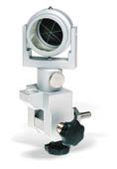
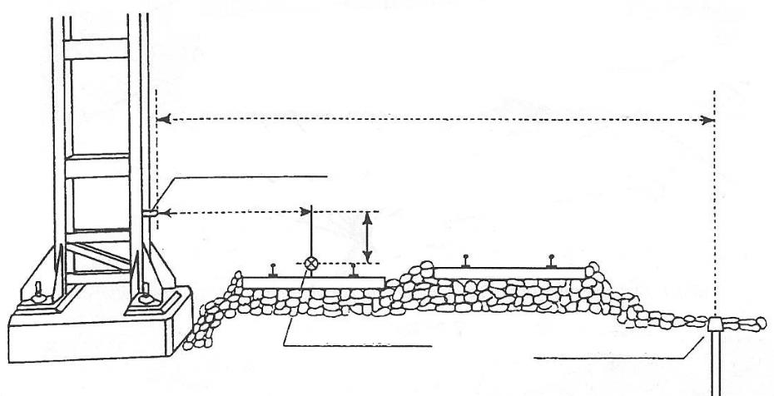
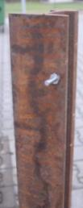




Trimble GEDO solutions
Survey supportive infrastructure
Production reference point network
Marking points at the catenary masts
Ground marking points
Typically every ~ 65 m (other regions every 100 - 300m)
  range distance
  catenary marking point
  center line
ground marking point
Source: Handbuch Gleis, 3. Auflage, DVV Verlag, S. 431

Slide 14
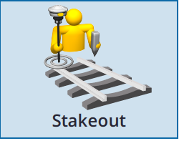
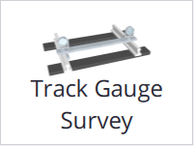
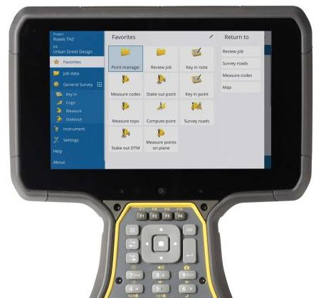
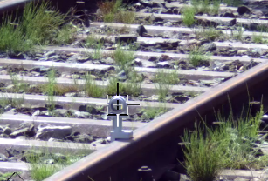
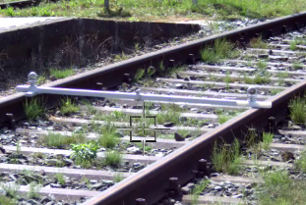
Track Stakeout – Trimble Access Rail
Software for track survey and stakeout survey
TRACK DATA
Real time transformation to offsets
Supports rail specific transistion bends and chainage lines
APPLICATIONS
Stakeout
Track & topo survey
Track adjustment
Control

Slide 15
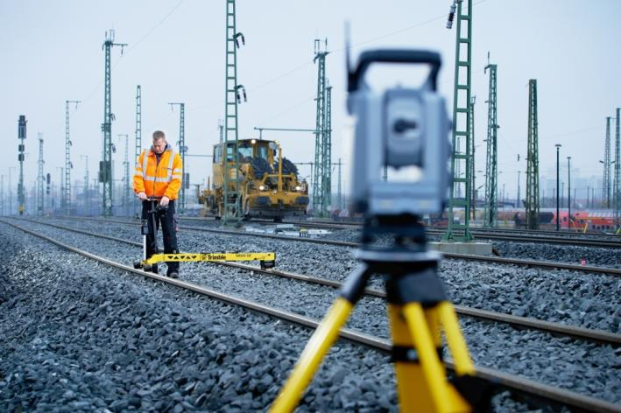
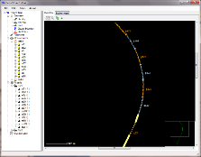
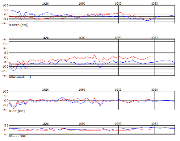
Geodetic Track Survey – GEDO Rec
Precise track survey with total station
TRACK DATA
Coordinates (L,C,R)
Cant & Gauge
Twist
Curvature
APPLICATIONS
Re-design
As-built
Quality check
Monitoring

Slide 16
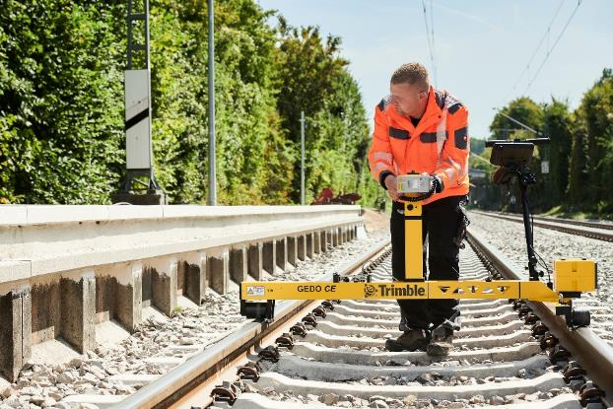
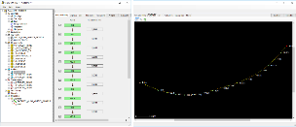
Enhanced Track Survey – GEDO IMS
Highly productive track survey
TRACK DATA
Coordinates (L,C,R)
Cant & Gauge
Twist
Curvature
APPLICATIONS
Re-design
As-built
Quality check
Monitoring

Slide 17
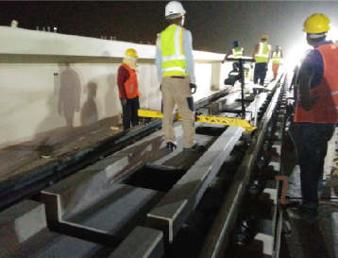
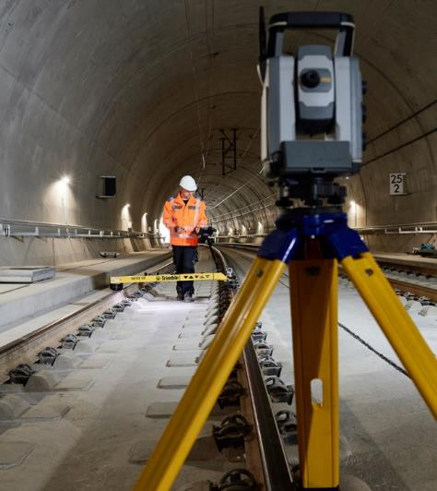
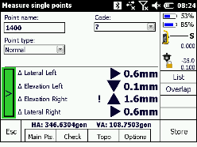
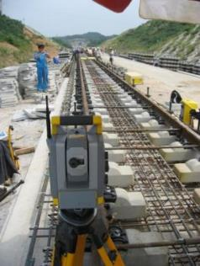
Slab Track Construction – GEDO Track
Technology to support slab track installation
TRACK DATA
Live offsets during installation
FEATURES
Highest precision
For direct fix and other slab track systems (e.g. Porr, Rheda 2000)
APPLICATIONS
As-built survey
Final quality check
Quality report

Slide 18
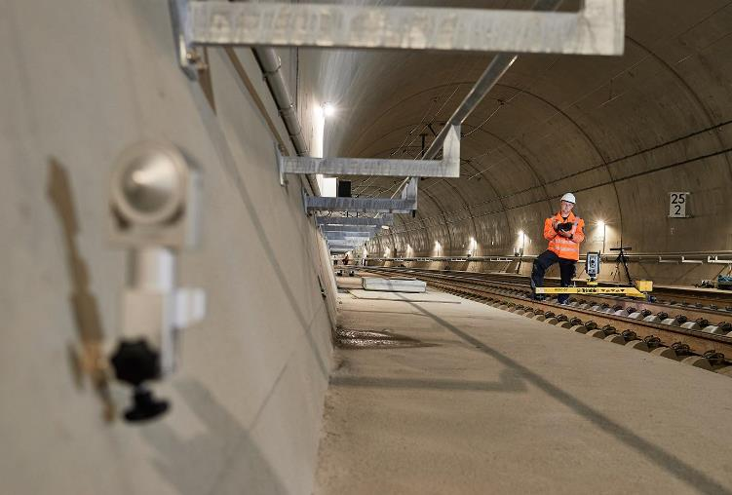
Slab Track Control – GEDO IMS
High productive final control for slab track
TRACK DATA
Track offsets and coordinates
FEATURES
Integration of total station
Automated free station setup
Precise and high productive
APPLICATIONS
As-built survey
Final quaility check
Quality reports

Slide 19
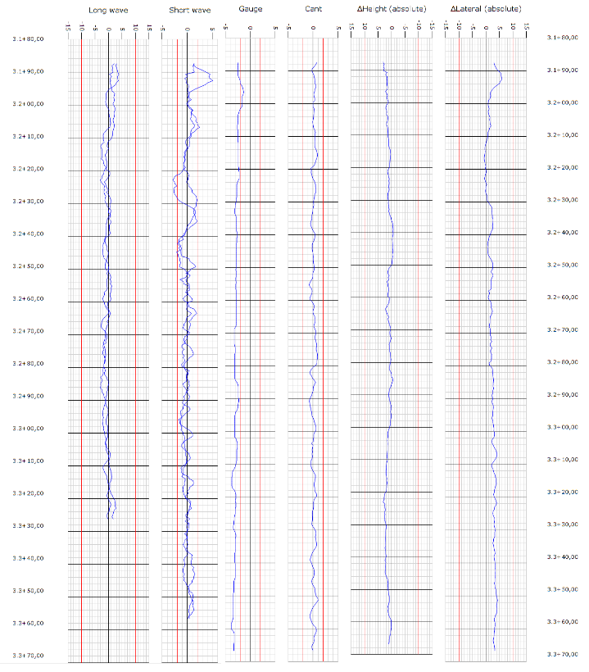
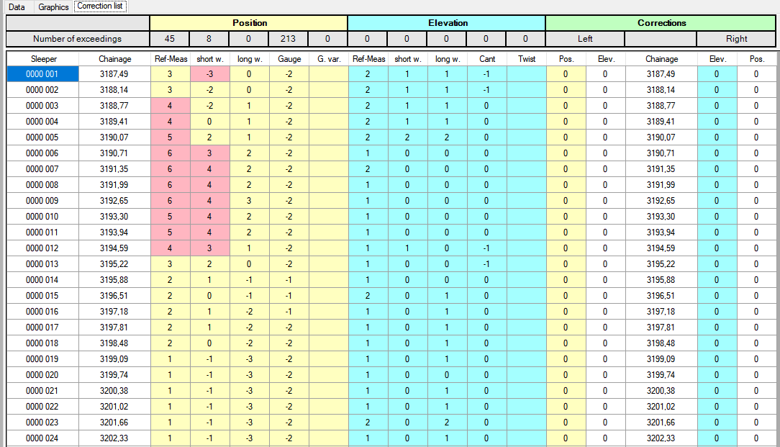
Slab track quality evaluation
Data processing and analysis
  Long chord / short chord comparison with design
  Track quality reports in table / graphical formats
  Rail correction list at each sleeper

Slide 20
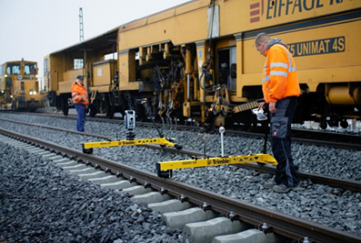
Pre-Measurement for Tamping
Track survey for ballast track construction and maintenance
FEATURES
Full integrated survey & tamping workflow
Add-on profiler or scanner for clearance check
Seamless data flow - from survey - design – pre- measurement - construction
APPLICATIONS
Pre-measurement for tamping during construction, re-construction and maintenance
As-built check according to design and local tolerances
Platform survey and as-built control

Slide 21
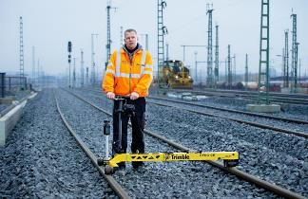
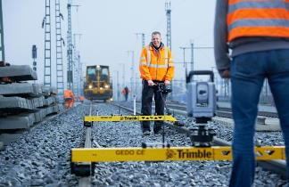
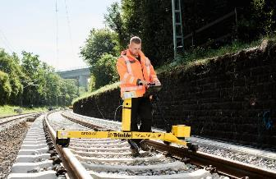
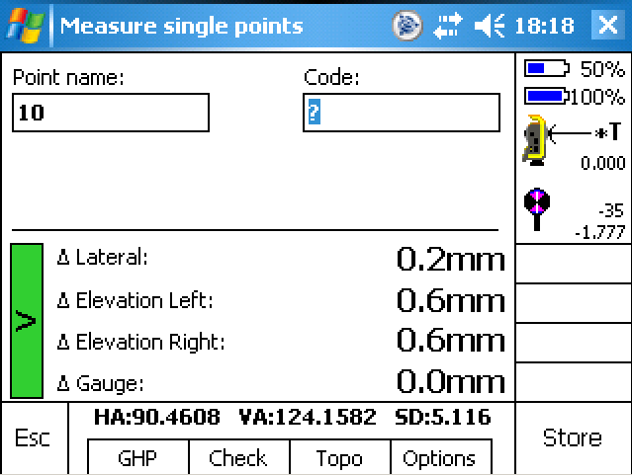
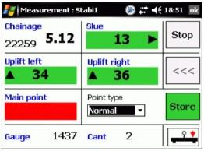
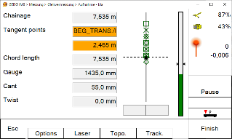
Pre-measurement for Tamping
GEDO Track
Geodetic setup
Track alignment data
Live results
GEDO Vorsys
High productivity and flexibility
Long chord method
Live results after tamper
GEDO IMS
Highest productivity
Flexible work planning
Inertial technology

Slide 22
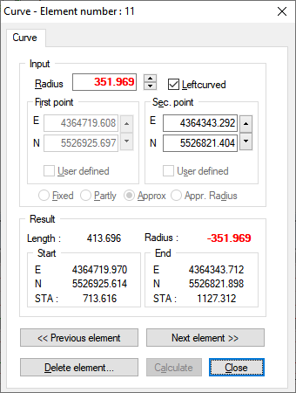
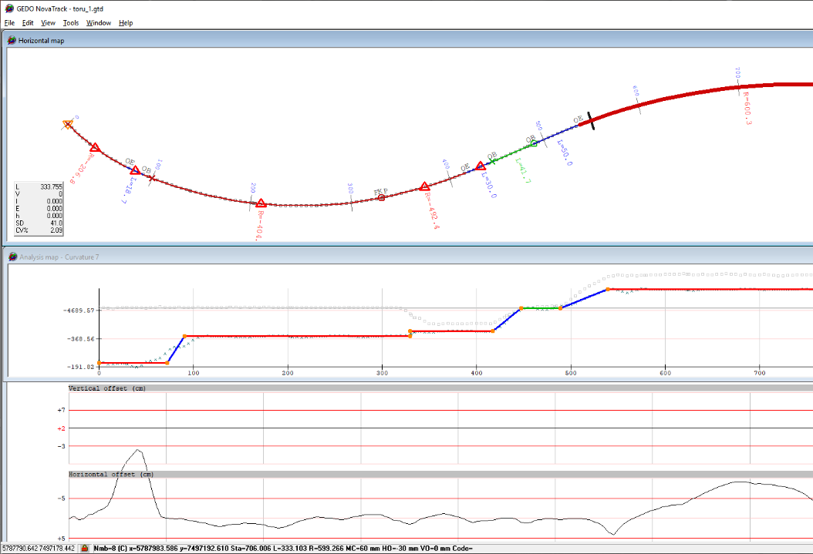
Track realignment – GEDO NovaTrack
Alignment calculation for track optimization
FEATURES
Automatic or semi-automatic reverse calculation of alignments in absolute
Advanced track analysis using regression
Alignment element calculation with Best-fit-to-Limitations option
APPLICATIONS
Track alignment reconstruction for design and tamping
Track geometry assessment
Track condition monitoring

Slide 23

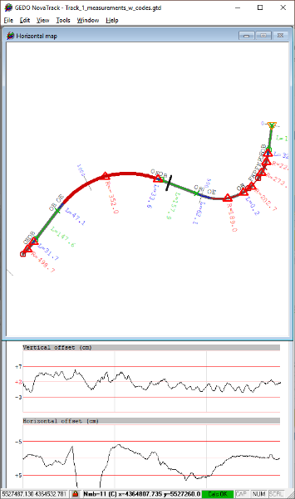

Track realignment - from track measurement to a design alignment
Measurements/Scan
Processing
Re-Alignment
Analysis applications
Production applications
GEDO NovaTrack
GEDO Office
GEDO REC
GEDO IMS
GEDO VORSYS
GEDO Office
Tamping/QA
Measured existing tracks
Machine Control
Best-fit alignment processing
HA/VA/CANT/SPEED
Deformation Monitoring
GEDO Scan Office
GEDO Scan Office
Dynamic clearance analysis
GEDO IMS SCAN
Measured tracks
OHL lines
Extracted existing tracks
Structures & Platforms
Trimble MX9/MX50 (Mobile Mapping)
TX8/SX10/SX12 (Terrestrial scans)
Topographical objects
CAD/BIM Software
Detail track design

Slide 24




Pre-Measurement for Tamping
Improve tamping quality and productivty
DATA PREP & ANALYSIS FEATURES
Tamping data preparation
Definition of tamping transitions - ramps
Export to all relevant tamping machines and guidance systems (Plasser, Matisa, Harsco, etc.)

Slide 25
Productivity compared
Estimated survey productivity based on system configuration
GAINING THE PRODUCTIVITY WITH IMS
Eliminated time for totalstation setup
No need for line of sight
Refraction and environment conditions are irellevant
Reduced time for accessing the track
Flexible work during night time
System | Measurement Speed [m / h] | Survey crew
GEDO Rec | 600 – 1.000 | 2
GEDO Track | 600 – 1.000 | 2
GEDO Vorsys | ~ 1.600 | 2
GEDO IMS | 3.500 | 1
GEDO IMS + Profiler | 2.500 | 2
GEDO IMS + GNSS | 3.000 | 1-2
GEDO IMS + GNSS + Profiler | 2.500 | 1-2
GEDO IMS + TS (resection) | 1.500 | 2-3
GEDO Rec + GEDO Scan | 500 – 1.000 | 2-3
GEDO Vorsys + GEDO Scan | > 1.200^{(*)} | 2-3
GEDO IMS + GEDO Scan | > 2.000^{(*)} | 2
^{(*)} Depending on Scan resolution

Slide 26







GEDO track survey solutions for planning, design and construction
Track Survey
Re-Design
As-Built mapping
Quality Check
Track installation
Tamping
Trimble GEDO Rec / Track
Geodetic Trolley Setup
Trimble GEDO Vorsys
Twin Trolley Setup
Trimble GEDO IMS
Based on inertial positioning
(without or with GNSS or total station)
Customized GEDO solutions (GEDO SPS)
Installation of Slab Track plates

Slide 27





Inertial GEDO IMS track survey solutions
Trimble GEDO IMS Profiler
Referencing using profiler
60 – 300 meters between ref. points
With/ without known coordinates
Trimble GEDO IMS GNSS
Mixed referencing
60 – 300 meters between ref. points
Track and topo survey
Ideal for track without ref.points
Trimble GEDO IMS TS
High accuracy geodetic referencing
Resection ≥ 3 points
Totalstation as profiler

Slide 28

GEDO railway scanning solutions
Applications and configurations
Notes:
Replace the picture with different.

Slide 29






Trimble Scanning and Mapping Portfolio for Railway Applications
Trimble Terrestrial Scanning
Trimble GEDO Scan Systems
Trimble Mobile Mapping

Slide 30



Clearance and Asset Data Collection
Get detailed information by using kinematic laser scanning
GEDO Rec-Scan
Relative
Geodetic
GEDO IMS-Scan
Combination with IMS
Geodetic referencing
GEDO IMS-GNSS-Scan
Full integration

Slide 31







Trimble GEDO GX50
Laser Scanning System

Slide 32

GEDO Scan Office
Open interface (LAS, LAZ, e59)
Navigation along the track
Extensive clearance check
Cross section generation and plot
As-built and Design track
Track detection
Railway specific measurements
Point and object registration
Overhead line reporting tool

Slide 33




GEDO Scan Office.
Dataflow and vertical applications
GEDO SCAN OFFICE
Measure/Scan
Processing
Data model
Analysis
Reporting
GEDO REC
GEDO IMS
GEDO VORSYS
Ctrl. Point data
As-built tracks
Single data model
Rail Application
External files
Object registration
Registered point data
GEDO SCAN FIELD
GEDO IMS SCAN
Pt Cloud
As-built track extraction
2D/3D clearance profiles
Platform/edge extraction
As-built track trajectories
MOBILE MAPPING /
TERRESTRIAL SCANNING
Ref. Pt Cloud
OHL extraction
3D OHL lines
Clearance analysis
Platform/edge point data
GEDO NovaTrack /
TBC / QUADRI BIM
Sectioning
Point cloud data
Design Alignments
Clearance documentation
Clearance reports

Slide 34

External Point Cloud Data handling in GEDO Scan Office
3D point cloud data exchange and merge
.TDX format for 3D point cloud as primary
Point cloud analysis using application tools
Mobile mapping or terrestrial scanning
MX9/ MX50/ SX10/ SX12
GEDO Scan Office
Track as-built geometry extraction
Scan processing
Object registration and extraction
TBC
TRW
Clearance analysis
Point cloud exchange Trimble native .TDX
Clearance documentation

Slide 35


Clearance
Precise modeling of track safety
FEATURES
Relative and absolute mode
Clearance profiles defined by
2D Envelope
3D Wagon (dynamic)
Authority specific rules
Cross section export for documentation

Slide 36




Clearance modeling
Analysis of possible clearance infringements
  As-built track clearance
  New train clearance simulation
    New type of rolling stock clearance analysis
    Customized 3D dynamic clearance analysis
    Clearance analysis based on design alignment
  APPLICATIONS
  As-built track clearance
  New train clearance modeling
    New type of rolling stock clearance analysis
    Customized 3D dynamic clearance analysis
    Clearance analysis based on design alignment

Slide 37



Track analysis and extraction
Buiding track geometry from scan data
FEATURES
Track geometry extraction from the point cloud
Based on user defined rail types
Automated process with confidence settings
Further track data can be used for clearance, design, quality evaluation

Slide 38


Linear object shape tracing
Automated tracing and extraction of
FEATURES
Extraction of linear objects and surface breaks
Automatic process with extraction confidence control
Linear object referencing to the track
Support of user defined shapes

Slide 39



Overhead lines extraction
Extraction and analysis of overhead lines
FEATURES
Automated extraction process
Extracts OHL cables as 3D polylines
Extracts catenary pole positions
Supported extraction in both directions
Process handles gaps in OHL point cloud
APPLICATIONS
Documentation of OHL cable position
Checking OHL cable clearance before/after tamping
Extraction OHL position for track design
Source: https://www.railengineer.co.uk/

Slide 40


GEDO Scan
Scan2BIM for a railway station

Slide 41





GEDO GX50 track corridor scanning solutions
GEDO Scan
Relative positions only
Entry level solution
GEDO Rec-Scan
Geodetic solution
With Total Station or GNSS
GEDO IMS-Scan
Highly productive & versatile
Optional GNSS

Slide 42
06
Questions & Answers
Ask your Questions

Slide 43

Danke
Thank You
Paldies
Trimble Track Survey & Scanning
For Questions or Feedback please contact:
info_railway@trimble.com

