Slide 1

Utilizing Trimble point cloud data for railway applications
Presented By:
Linas Maciulevicius | Trimble Geospatial
27th July, 2023

Slide 2
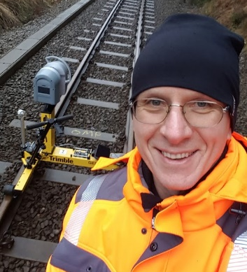
Speakers
Introductions
Linas Maciulevicius
Sales Application Engineer, Trimble Track Survey & Scanning
Wiesentheid, Germany
linas_maciulevicius@trimble.com

Slide 3
01
Agenda
02
03
Railway Applications - Overview
Primary application based on MX50/MX9 point cloud data
Data processing and flow
Utilizing Trimble point cloud data for railway applications
Delivering data to Trimble GEDO Scan Office
Trimble GEDO Scan Office
Matching point cloud analysis and railway applications
04
Questions & Answers
Ask your Questions

Slide 4
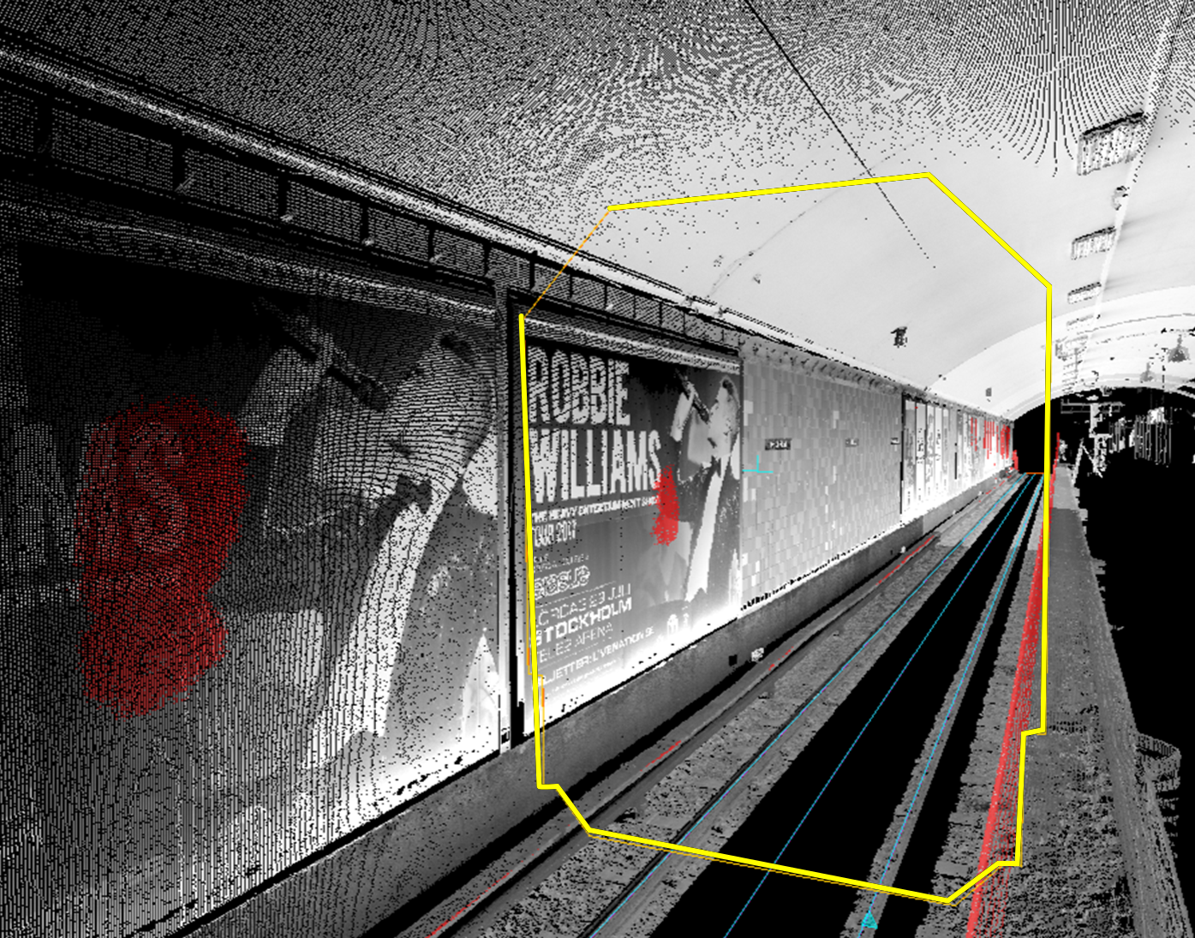
Railway Applications
Overview
01
Primary application based on GX50/MX50/MX9 point cloud data
Notes:
Pakeisti vaizda

Slide 5
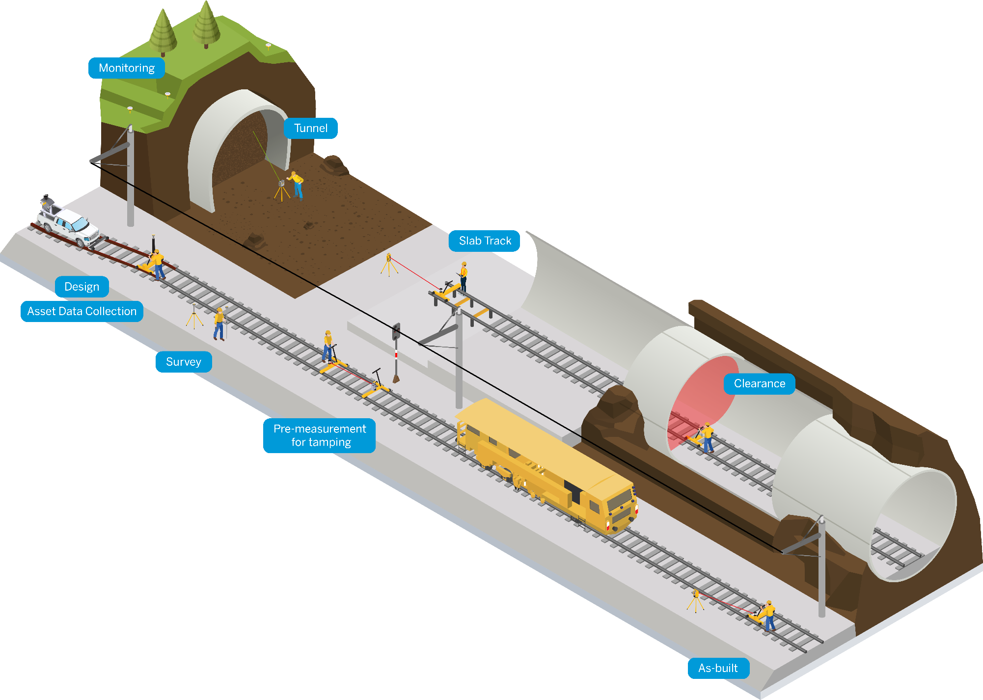
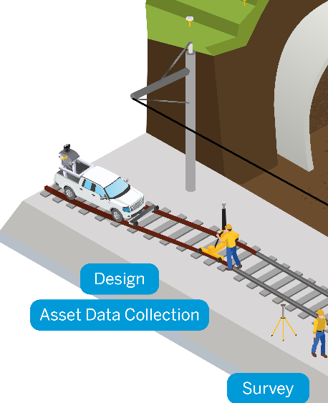
Rail Infrastructure Applications
Notes:
Areas where scanning technology gets used:
Design phase and asset data collection – As-built during and after construction – Clearance check for all phases of the railway lifecycle

Slide 6
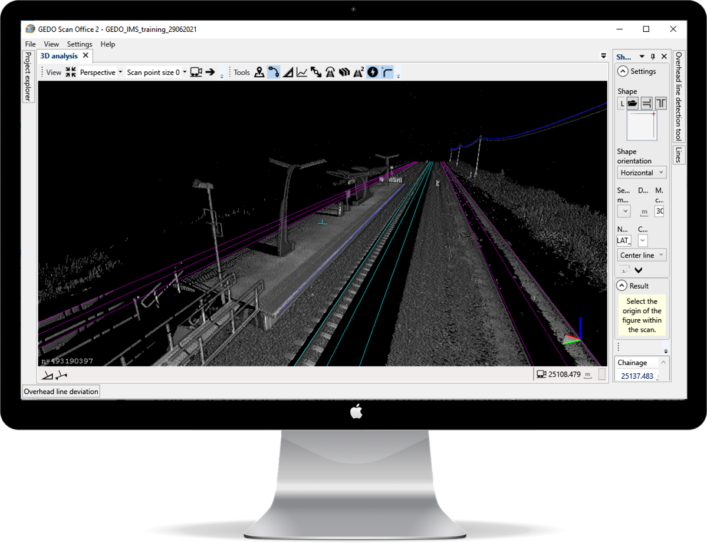
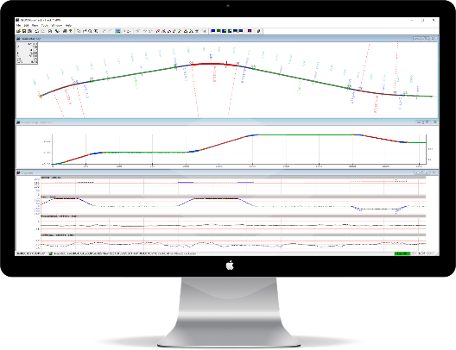
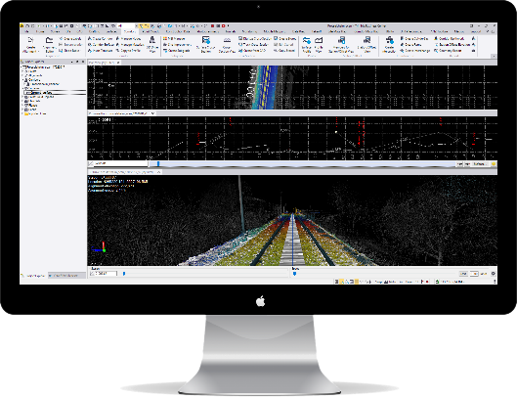
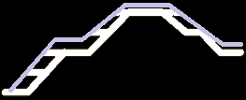



Planning & Design
Accurate track spatial data to comply with today’s BIM standards
Key Applications
Point cloud data for railway environment modelling
Mapping of existing tracks for re-planning
Track structure conditions with assessment for rehab strategy
Material volumes pre-estimation
Overhead cables and catenary positional deviation evaluation

Slide 7
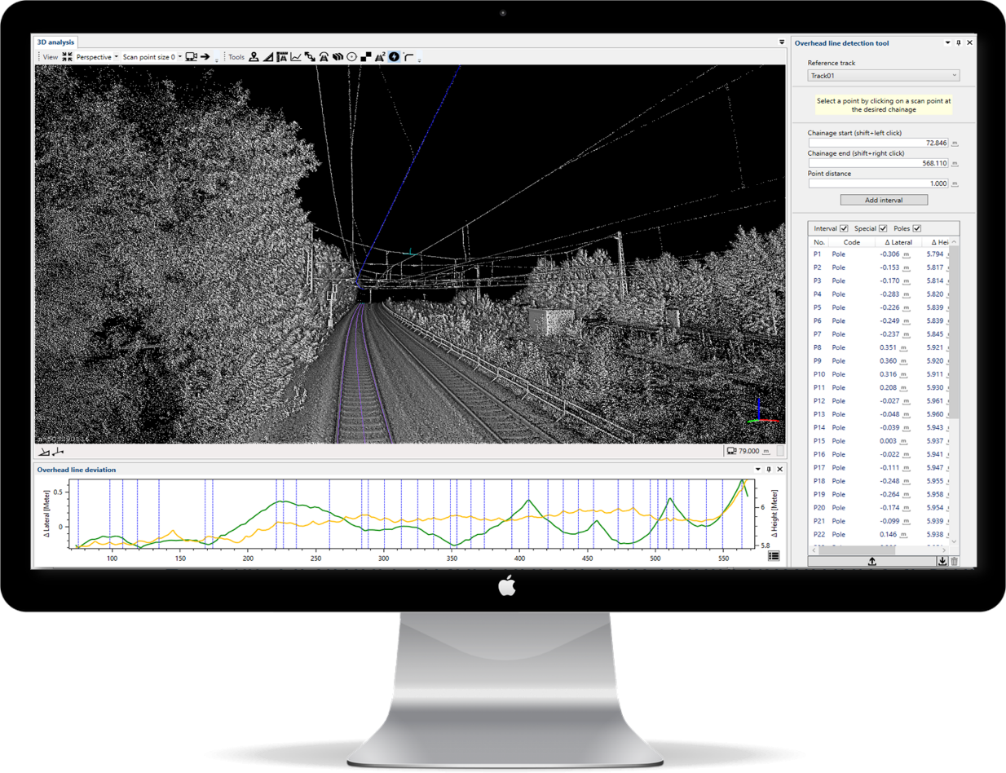
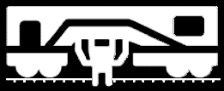
Construction
Detailed information to support construction phases
Key Applications
Object extraction for as-built comparison with BIM model
Platform verification (lateral and vertical offsets from track)
As-built surface (ballast) mapping for volume calculation
Heights & Stagger as-built for overhead cables

Slide 8
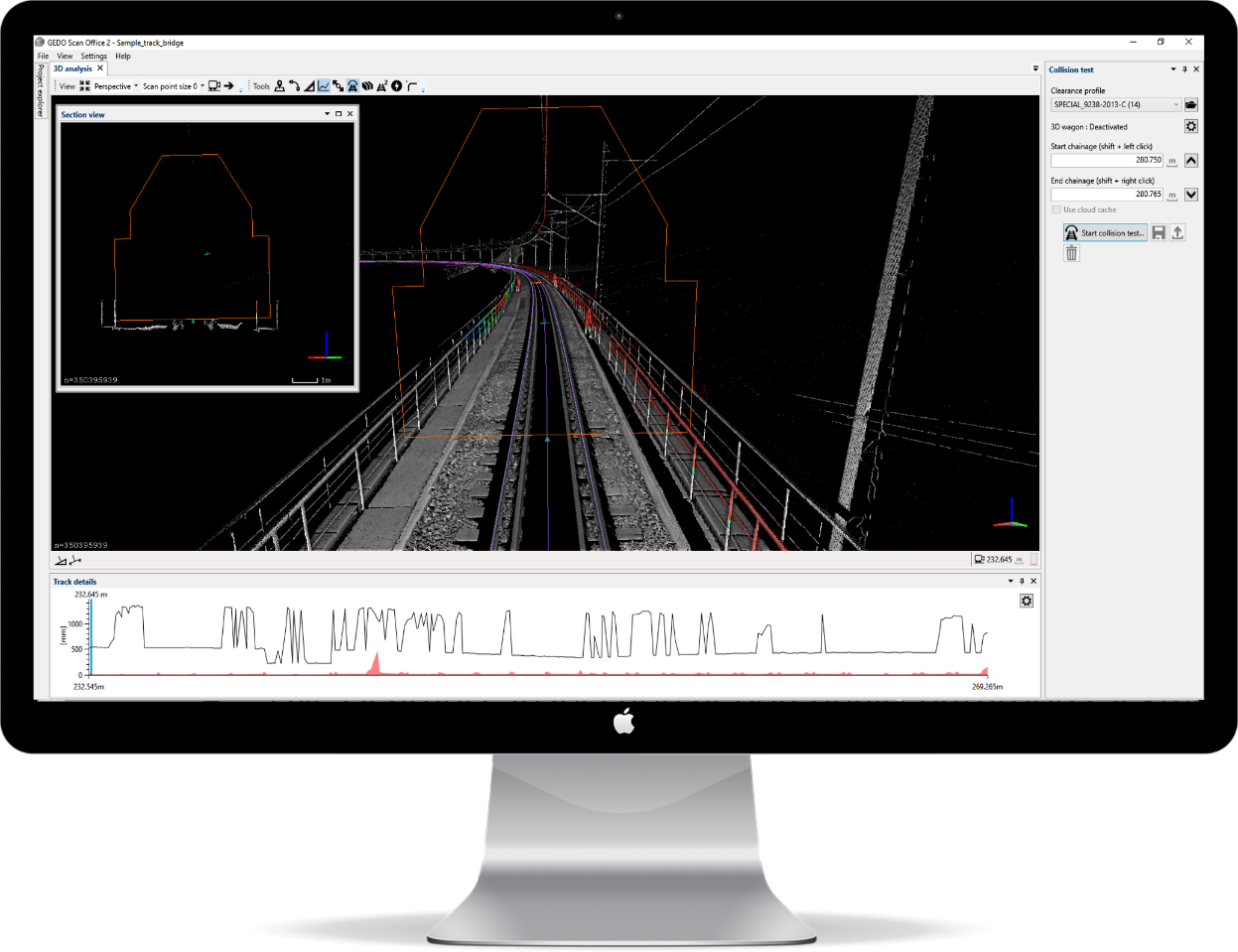
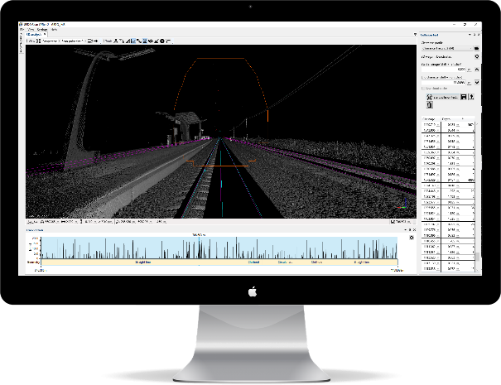
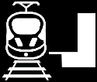
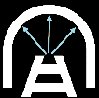
Maintenance & Operations
High quality data for safe infrastructure operations
Key Applications
Structural clearance inspections during operation
Periodical platform gauging inspections in station areas
Clearance check for rolling stock and corridor safety approvals
Evaluation of track geometry and deviations from design

Slide 9
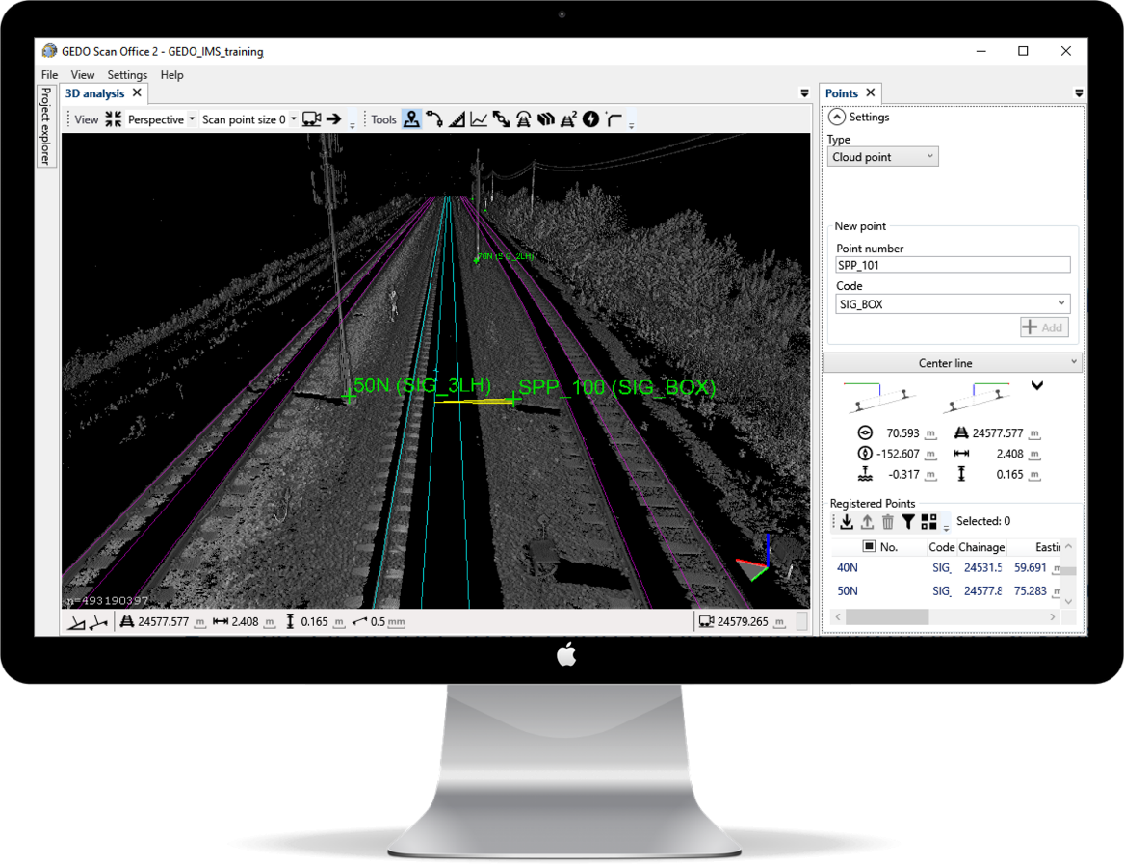
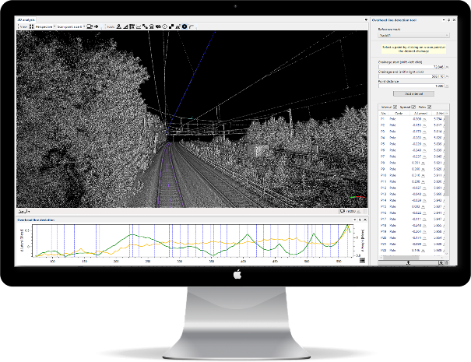
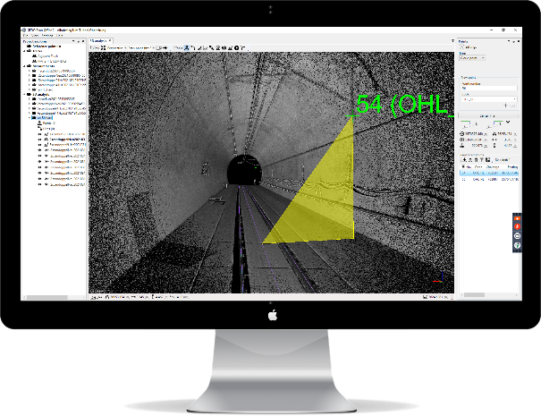



Rail Asset Inventory
Transparent data from track asset mapping & condition assessment
Key Applications
Track corridor data for railway GIS and Asset
Management Systems
Asset data verification

Slide 10
02
Data processing and flow
Delivering data to Trimble GEDO Scan Office
Notes:
As mentioned at the beginning it‘s not just about a laser scanner. It‘s about a complete system. For this it‘s important to look at the workflow and the applications the system can be used for.

Slide 11

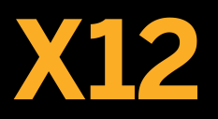


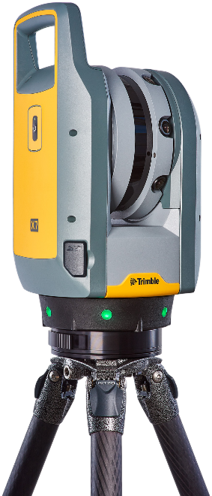
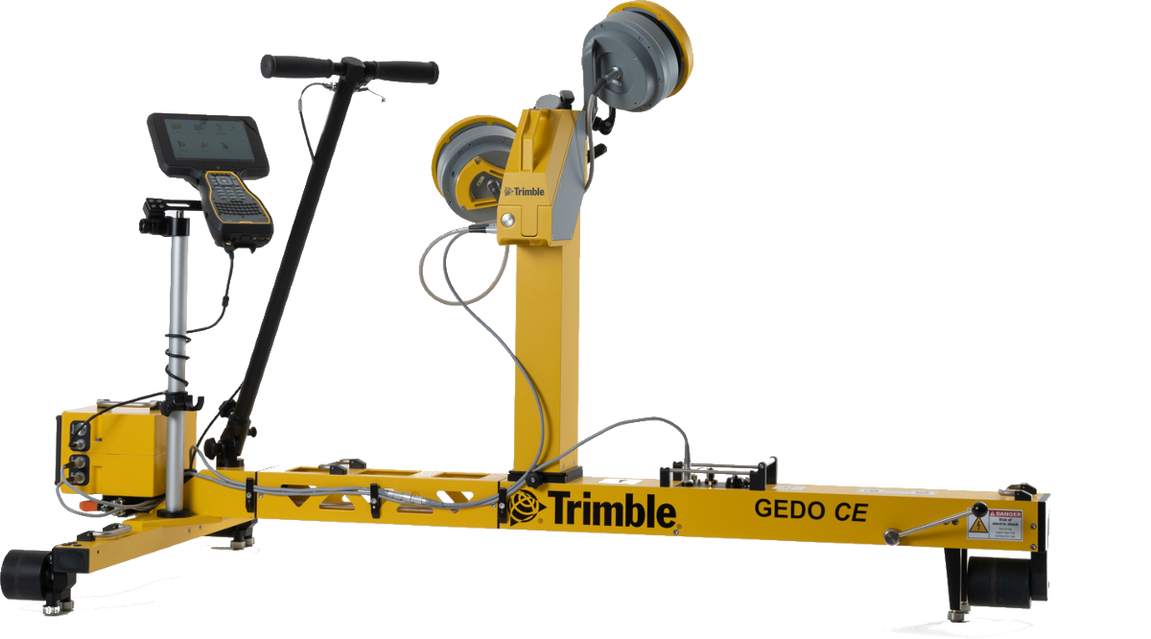
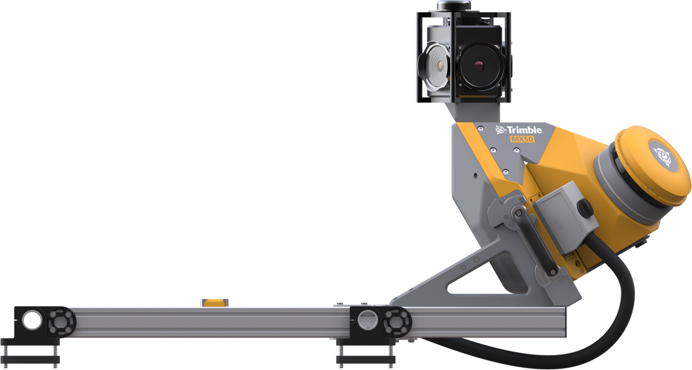
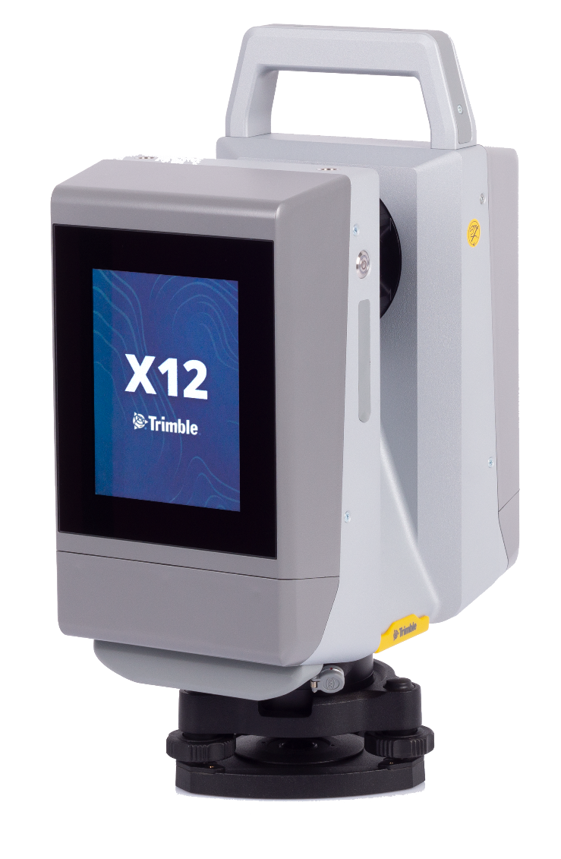
Trimble Scanning and Mapping Portfolio for Railway Applications
Trimble Terrestrial Scanning
Trimble GEDO Scan Systems
Trimble Mobile Mapping

Slide 12



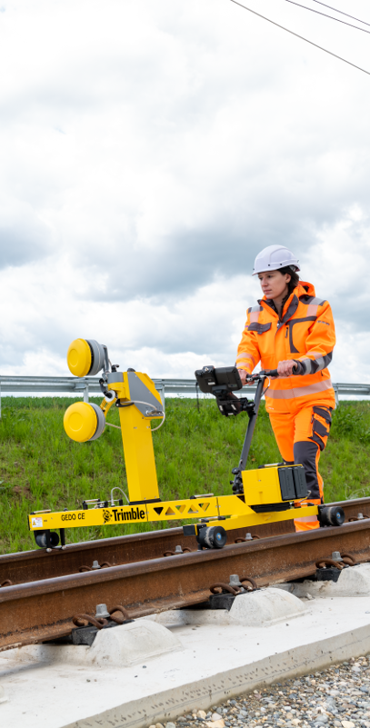
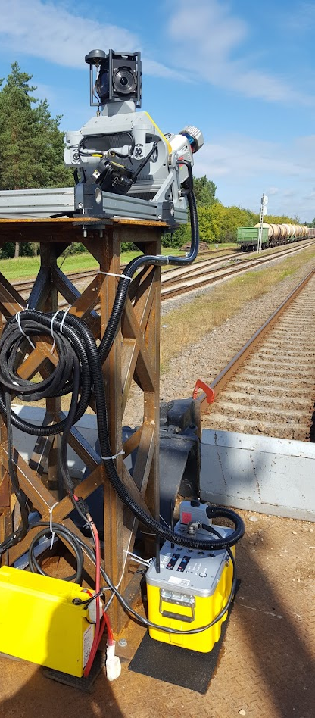
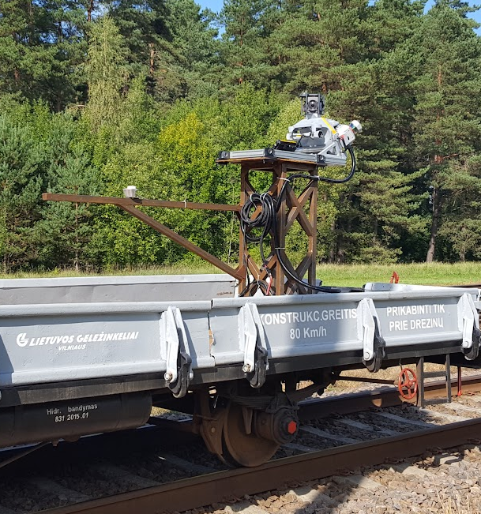
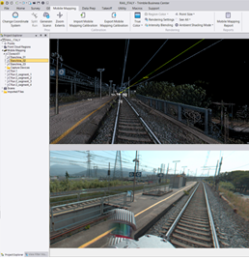
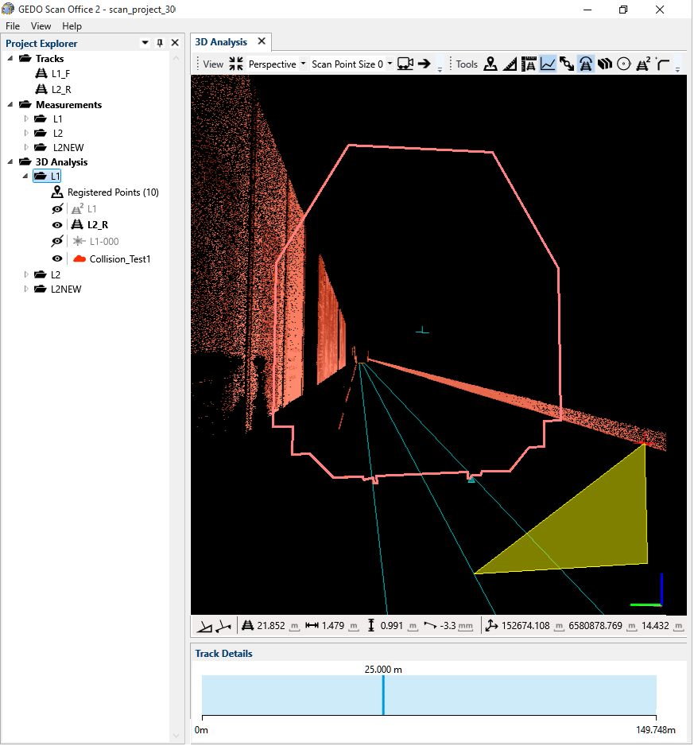
Railway point cloud data – workflow from field to office
Scan
Process
Analyze & Deliver

Slide 13
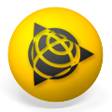

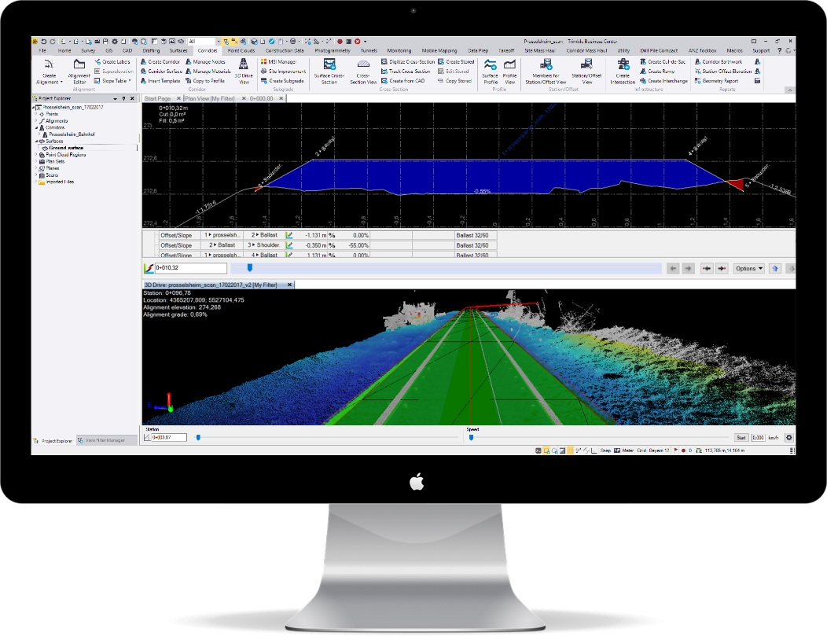
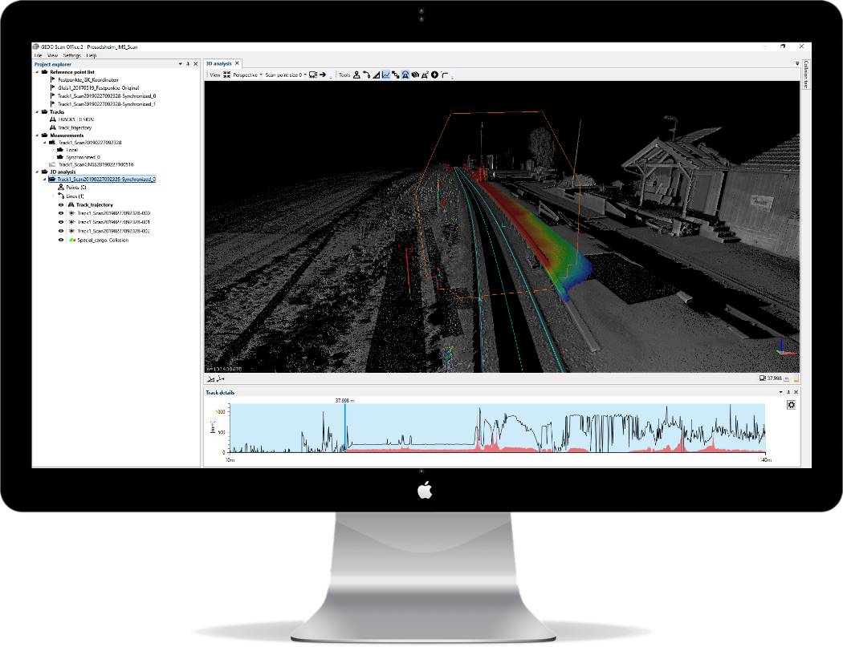
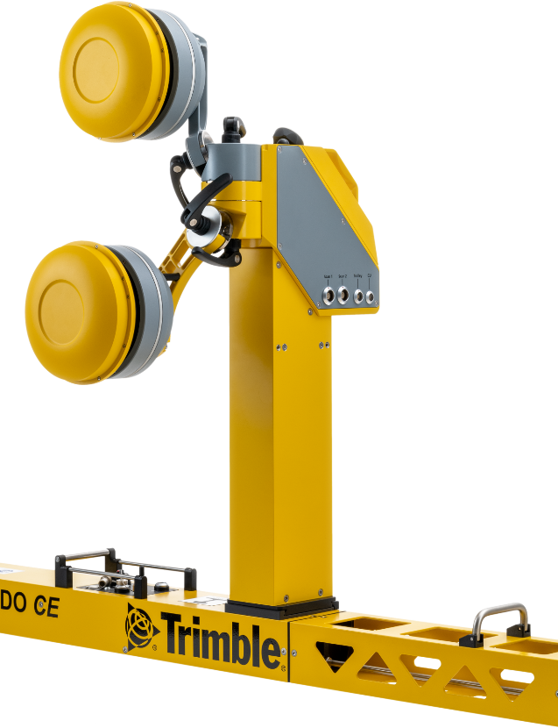
Railway point cloud data
Data Flow
Trimble scanning systems for railway
Trimble Business Center &
Trimble RealWorks Software
Trimble GEDO Scan Office
Software
General data filtering, classification, feature extraction, design, volumes
Rail based analysis, track classification, rail infra extraction, documentation

Slide 14
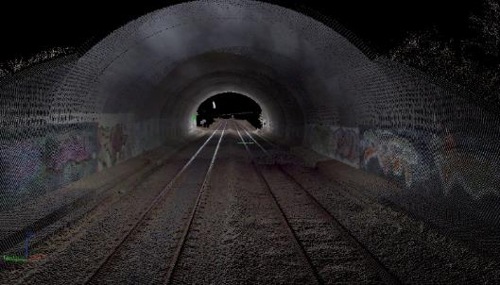
Point Cloud analysis and rail feature extraction
Railway scan data
MX9/ MX50
GEDO Scan Office
Track extraction
CAD/BIM/GIS
    3D Point Cloud
    Trajectories
    3D Point Cloud
    Trajectories
Linear/point rail feature extraction
Quadri CDE
Scan processing
TBC
TRW
ESRI ArcGIS
Rail classification
    3D Point Cloud
GEDO Office
Processed point cloud
(.LAS / .LAZ)
Clearance point cloud

Slide 15
03
Trimble GEDO Scan Office
Matching point cloud analysis and railway applications

Slide 16
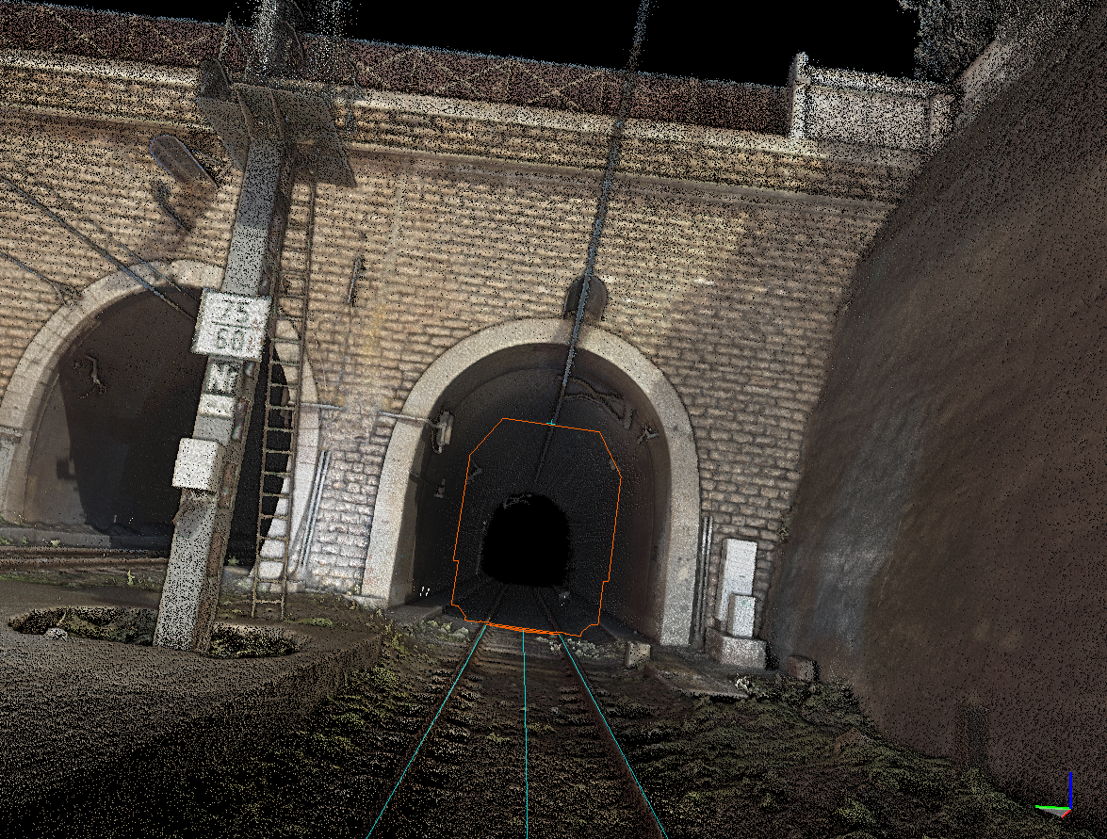
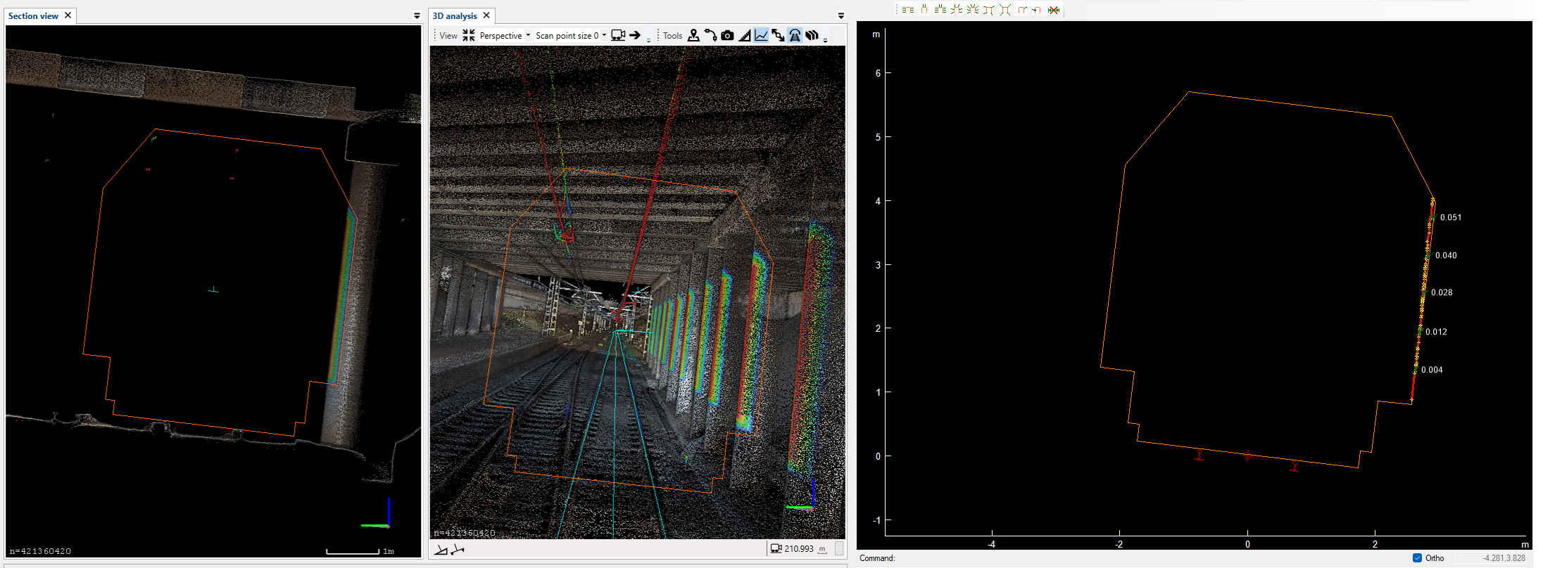
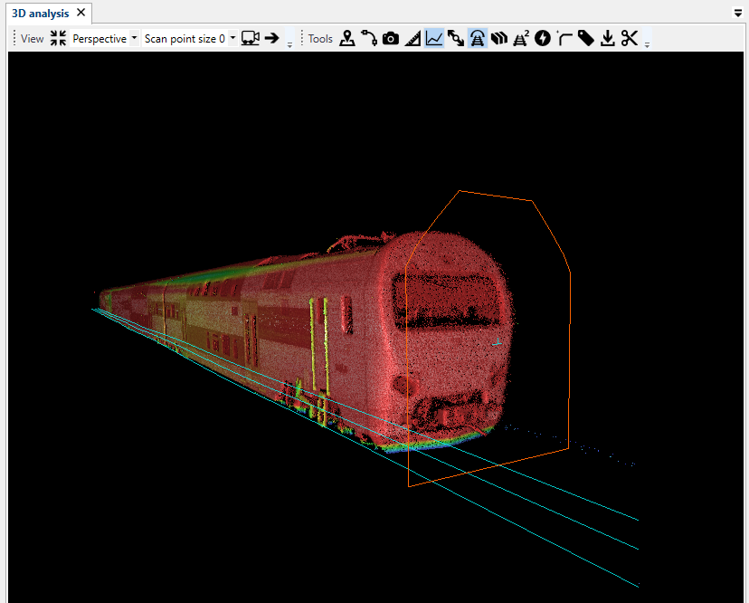
Trimble GEDO Scan Office – solution for handling rail point cloud data
Key functionality and features:
Single and uniform project environment
Highly intuitive UI and clear workflows working within railway corridors
Trajectory locked navigation and 360° field of view
Special engines for rail data extraction, modeling and classification
Support of rail specific entities – OHL, tracks, linear objects and chainages
Support of a large volume point cloud projects - 100 km and more
Data interoperability based on CAD, point cloud and report formats

Slide 17
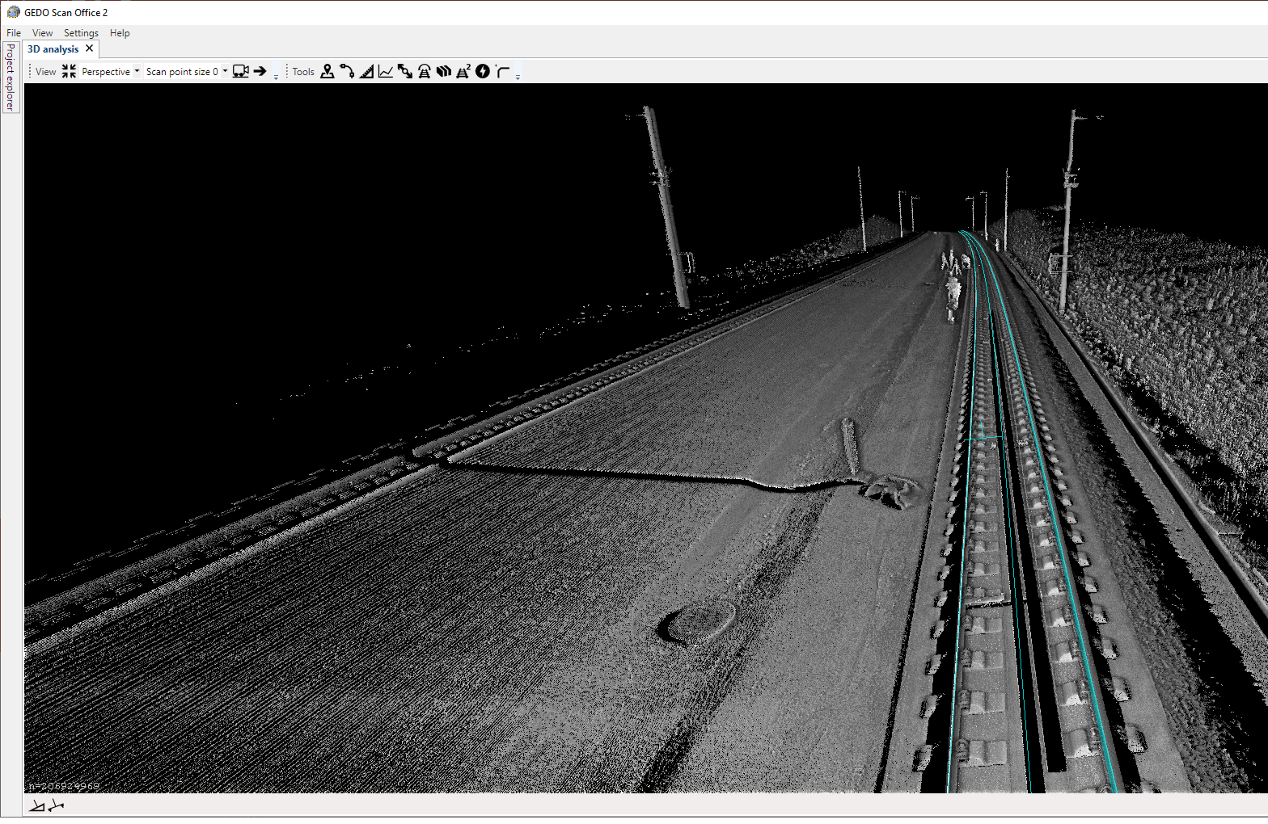
Trajectory based navigation
Track trajectory-based navigation and object selection
360° view around the current position at the track
Actual or design track as reference
Global & local coordinate system

Slide 18
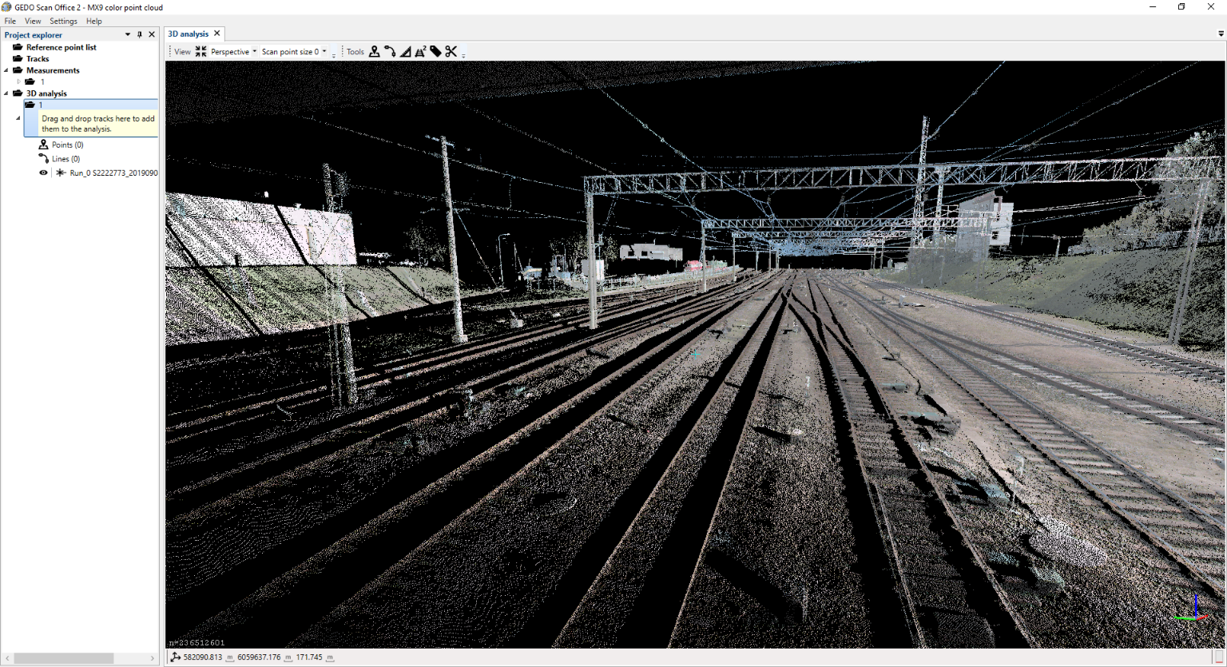
Colorized visualization
Supported RGB and grey-shade colourization
Possible to switch between intensity and color mode
Independent colourization for collision and classification point cloud groups

Slide 19
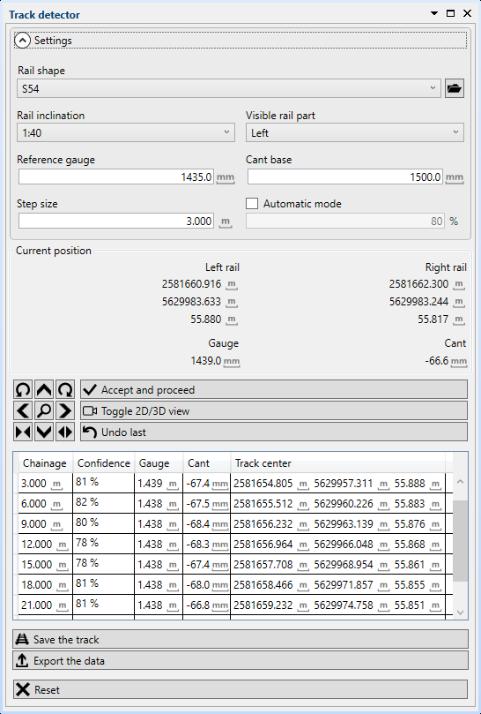
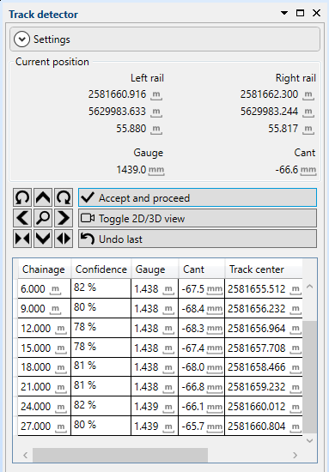
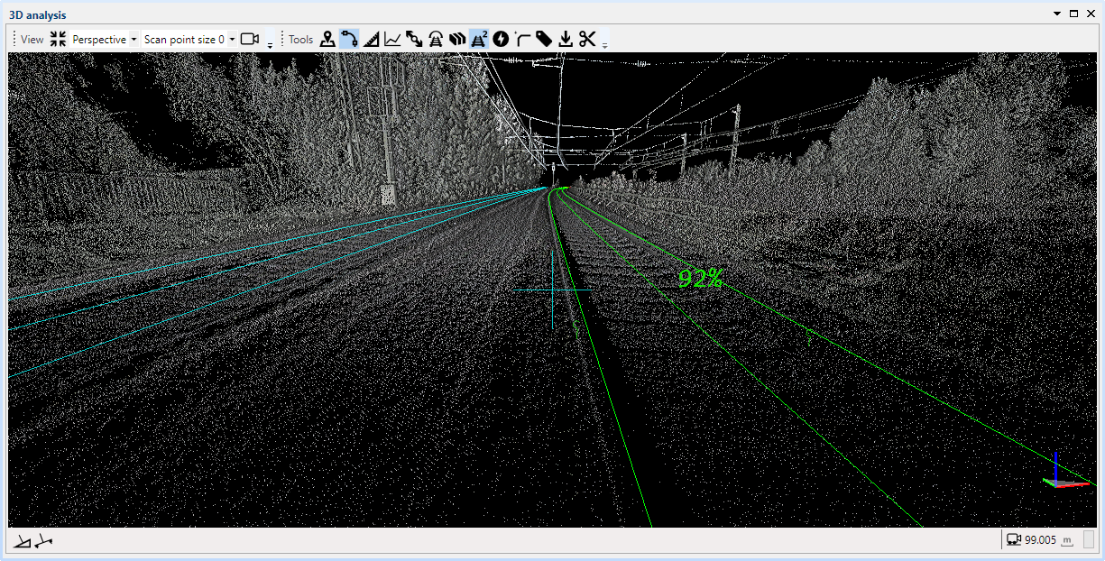
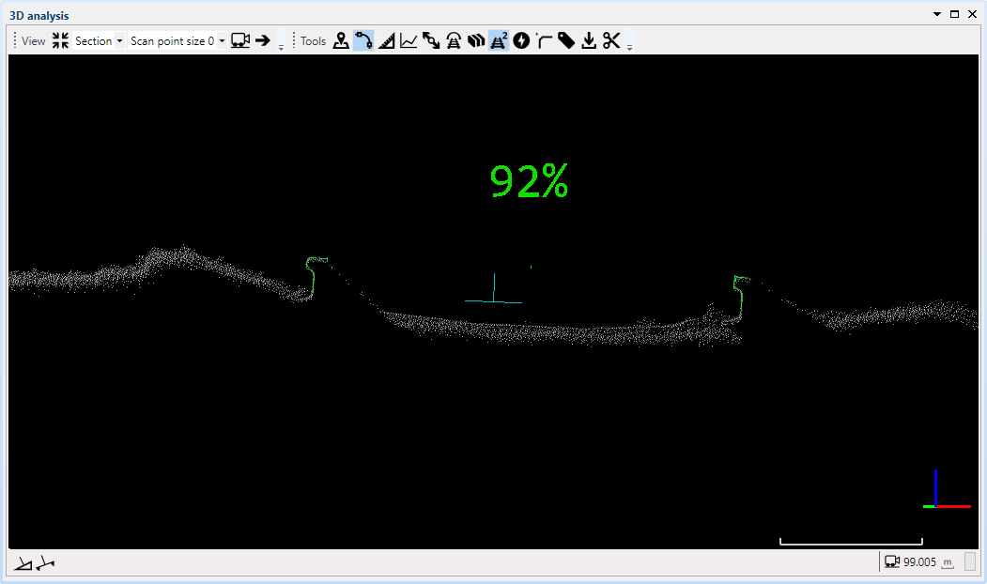
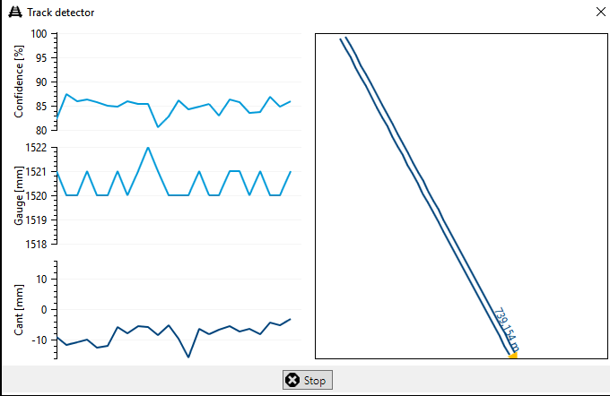
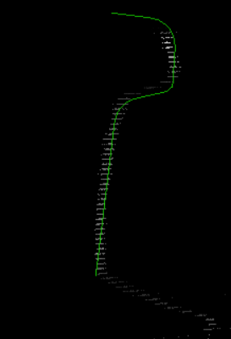
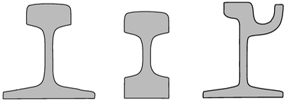
Mapping track trajectory
Automatic track geometry extraction from the point cloud
Rail shape matching based on IPC approach
Gauge fitting based on a user defined settings
Accuracy depends on rail distance, visibility and definition:
  Height ~ 3-7 mm
  Lateral ~ 5 mm

Slide 20
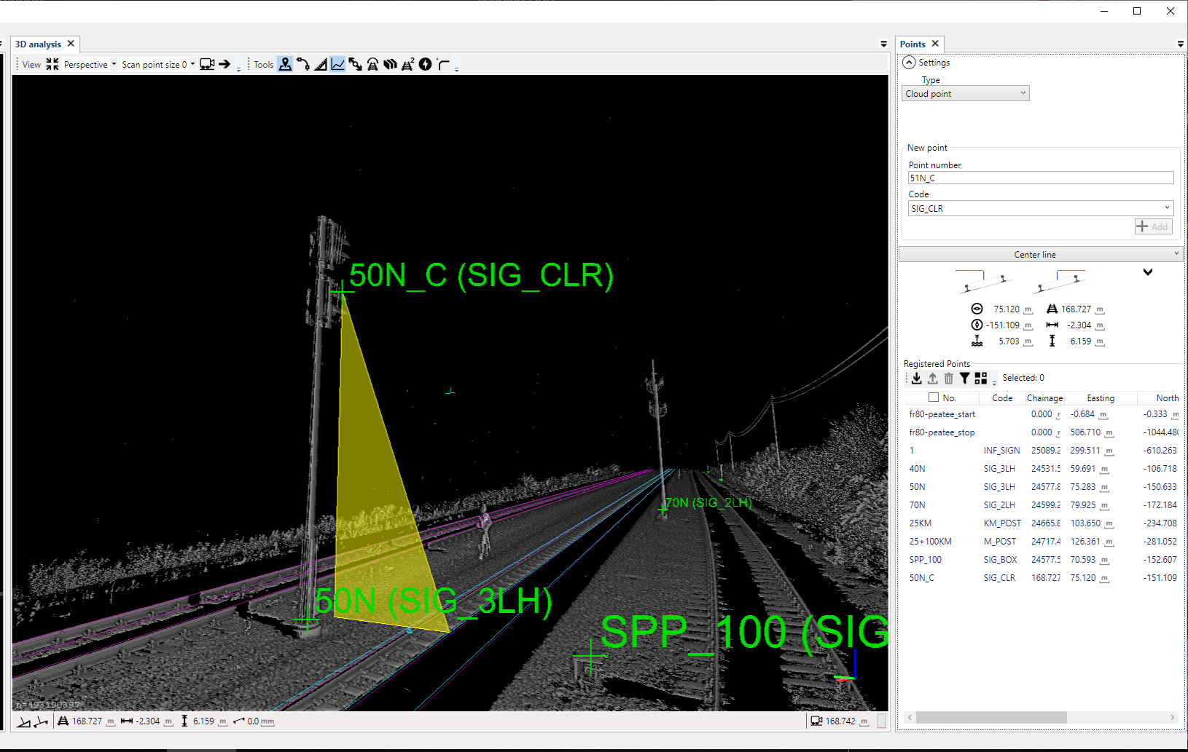
Mapping rail specific objects
Offsets between track and objects
Perpendicular and vertical deviations
Relative information to the track
Referencing to existing or design track trajectory
Snapping to the plane, SP, CT and single point

Slide 21
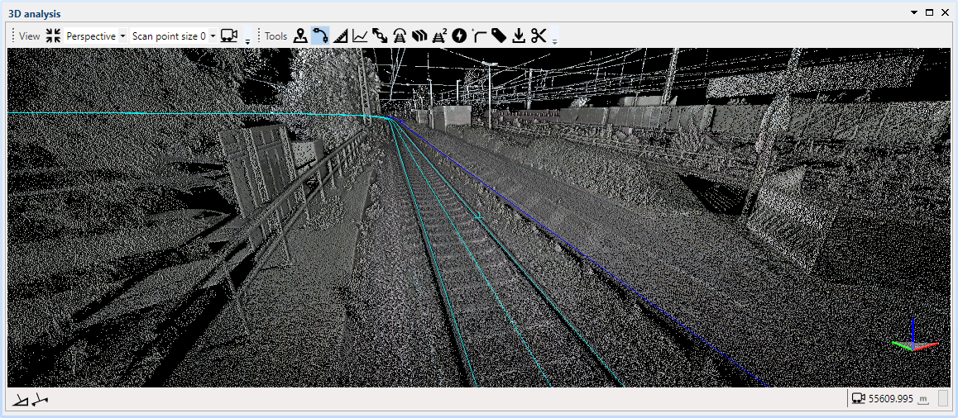
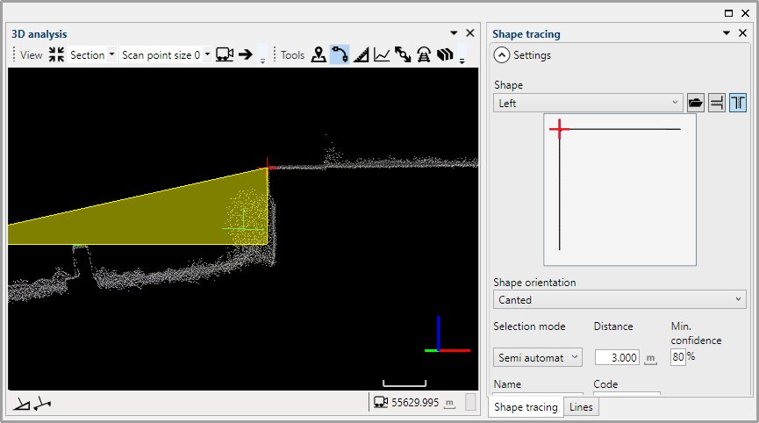
Mapping linear infrastructure
Automated surface edge/break recognition and extraction
Extraction is guided by user defined object shapes and QA index
Extracted data is referenced to the track
Result export to .DXF and .CSV file formats

Slide 22
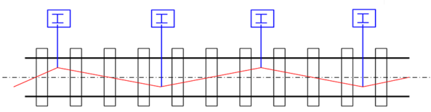
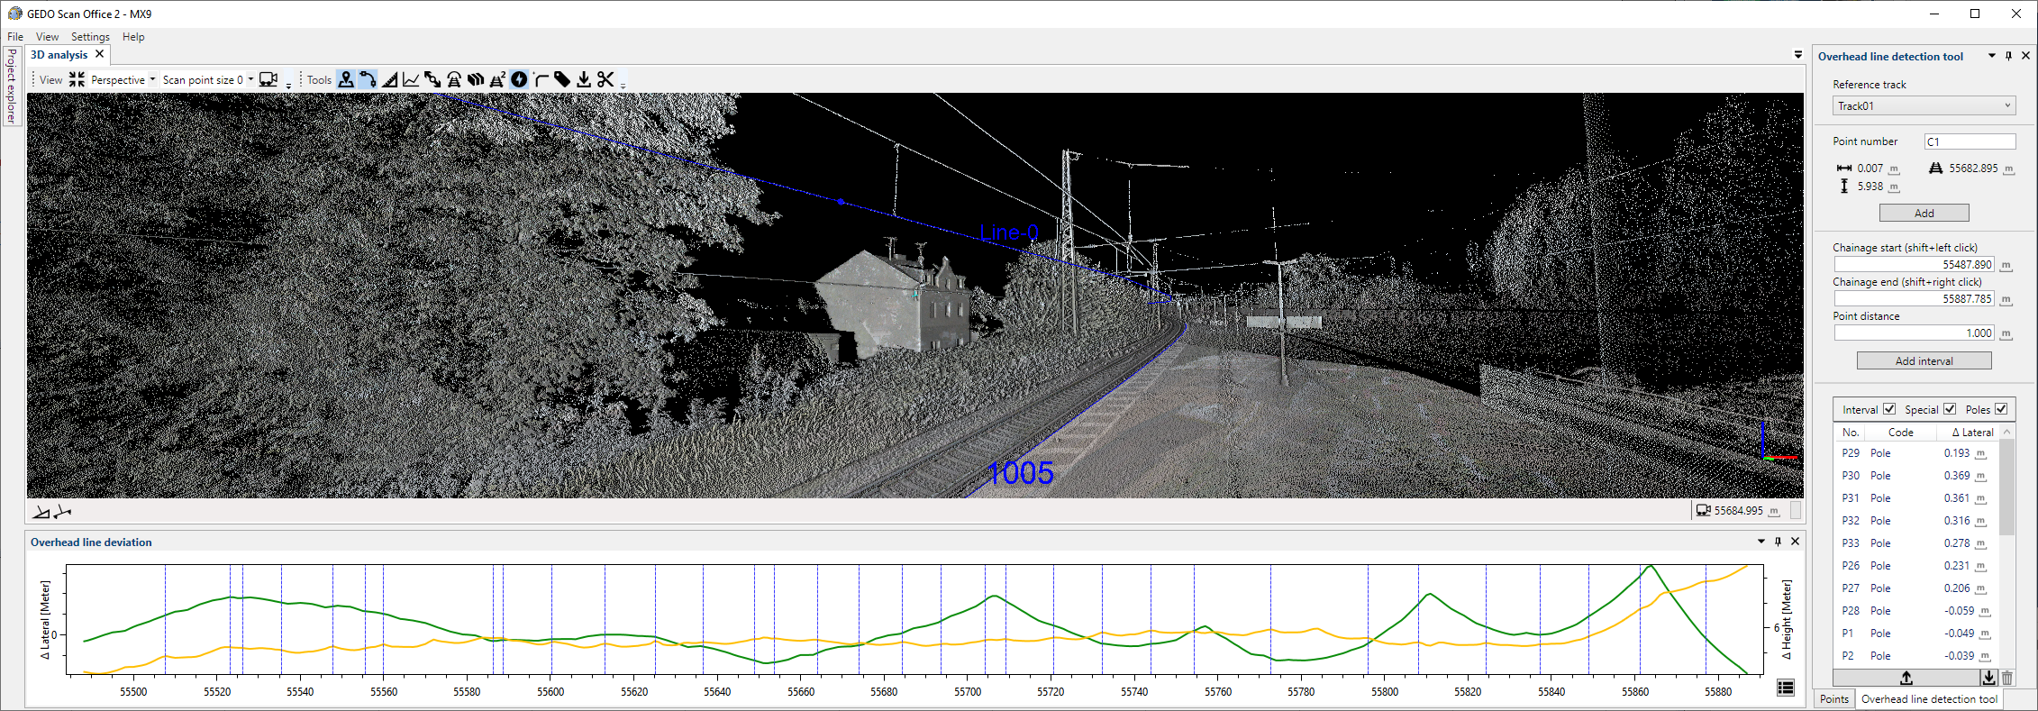
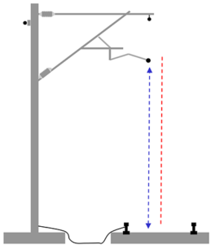
Mapping overhead lines (OHL)
Automated OHL contact wire tracing
Absolute and relative OHL referencing to the selected track
Detection of OHL mounting points
Result export to .DXF and .CSV file formats

Slide 23




Clearance and free space analysis
Automated clearance check based measured or design trajectory
3D dynamic profile based on cant and curvature
Automated collision profiles
Rolling stock library
http://www.chronik-berlin.de/bvg_u-bahn-2.htm
http://www.br.de/nachrichten/
mittelfranken/inhalt/neue-u-
bahn-zuege-vag-nuernberg-100.html

Slide 24

Image support and orthophoto
Orthophoto at position of the collision
Combined image
Images from Mobile Mapping systems^{(*)}
^{(*)} Image from mobile mapping system from terra vermessungen AG

Slide 25

Clearance reporting
Vectorized collision sections
Automated infringement dimensions
Report export to 2D, 3D DXF and .CSV format
Special reports for DB, BaneDenmark, NetworkRail, Stockholm Lokaltrafik

Slide 26


Optimal track alignment fitting
Retro-fitting design alignment in the GEDO NovaTrack
Adjacent map data for further constrain and alignment lateral and height offset control
R=199,4
R=187,0
L=63,5
L=156,0

Slide 27



Colission data for design
Vectorization of the collision point cloud areas
Exchange collision results with Quadri/Novapoint or GEDO NovaTrack software to correct HAL/VAL/CANT

Slide 28

Railway specific classification
Automated classification process along the track corridor
Parametrical control
  Width
  Density
  Selectable groups
Classification groups
  Sleepers with positions
  Ballast
  Rails
  Poles (catenary)
Machine learning and AI
algorithm

Slide 29


Ballast volume & cut/fill calculation
Ballast classification point cloud
Import design ballast DTM from GEDO Office
Ballast Cut/Fill map and volume reports in TBC

Slide 30


Box filtering for modelling
Select area and share with modelling software

Slide 31








Point cloud data for
Railway Applications
Material Volumes
Planning & Design
Overhead Lines
Clearance Check
As-Built Check
Applications
Rolling Stock
Track Maintenance
& Inspection
Platform Gauging
Deformations
Asset Data

Slide 32
04
Questions & Answers
Ask your Questions

Slide 33

Thank You
gedo.trimble.com
For questions
or feedback
please contact:
info@trimble-railway.com

