Slide 1
Company Profile

Slide 2
About us
Company Proﬁle
JGC was established on February 1st 1999 by C. Vagias (Dipl. Eng, M.Sc Eng), I. Mougiakos (Dipl. Eng, M.Sc Eng), G. Billiris (Dipl. Eng, M.Sc EPDP).
In 2008 the company legal form converted from partnership to SA.
JGC elaborates solutions in several engineering applications of modern society.
The company is organized in two sectors:
The Commercial sector that is involved in the distribution of leading solutions (HW & SW) in the fields of AEC & Surveying, GIS, Hydrography, Law Enforcement, Energy and Environment for the domestic and neighboring countries markets.
A service and support sector which is involved in servicing the sold equipment, training and supporting the end user in the use of the equipment and in other technical issues.
Both sectors cooperate to achieve high customer satisfaction.
The company is conducting sales both directly to end users for the private and the public
sector and has established a strong network of resellers in some business segments.
Especially for the public sector, JGC retains a specialized department with extensive
experience in public tender procedures.

Slide 3
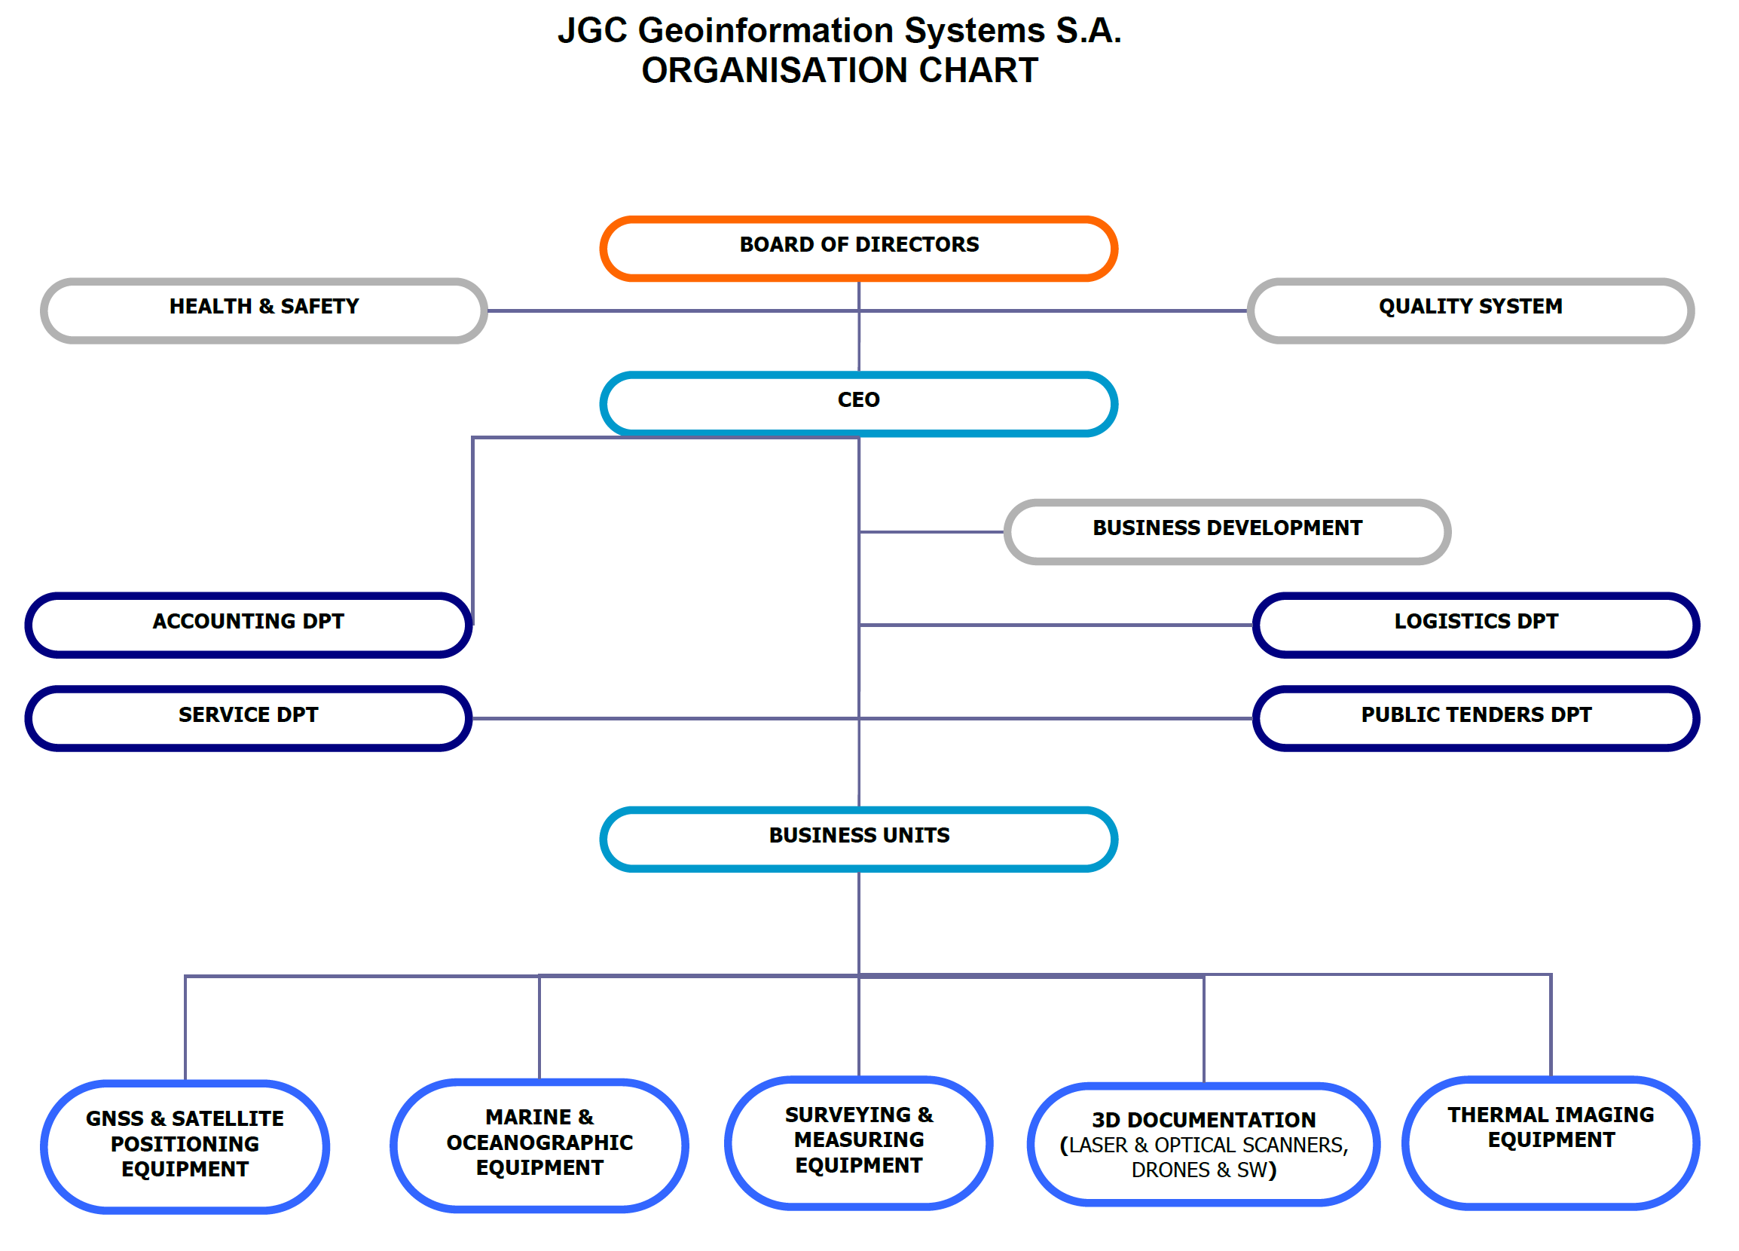
About us

Slide 4
Suppliers

Slide 5
Quality
Financial Skills
Quality Control
The total company revenue from 1999 to 2021, is € 39.855.394,07.
The company revenue of the last 3 financial years is € 11.028.064,55.
Our company has proved its
ability delivery, of the tenders
to successfully manage the
training and technical support
products it represents, public
and private markets and has a Quality Management System in compliance to the international standard EN ISO 9001:2015 and Environmental Management in compliance to the international standard EN ISO 14001: 2015.
EN ISO
EN ISO
14001:2015
27001:2008
EN ISO
9001:2015

Slide 6
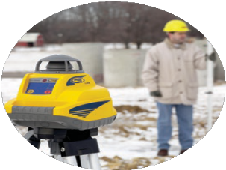
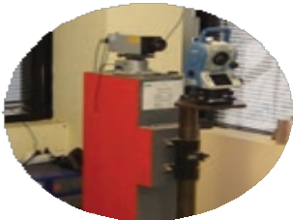
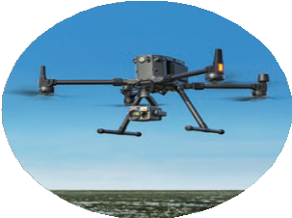
Service
After sales support
As part of the ongoing support and cooperation with customers, JGC offers a complete range of support services based solely on the smooth use of equipment and increase of their productivity. We offer innovative services in all areas, ensuring the proper use of the systems.
Training
Service
All equipment is offered with training for the proper usage. The duration of the training program depends on the type of equipment supplied to the customer. Our company also provides on demand training sessions and seminars.
Our company has a fully certified
Service department for most products we represent in the Greek market. The technicians are constantly trained by the manufacturers for servicing the products. The service department follows EN ISO 9001:2015 quality standard procedures.

Slide 7
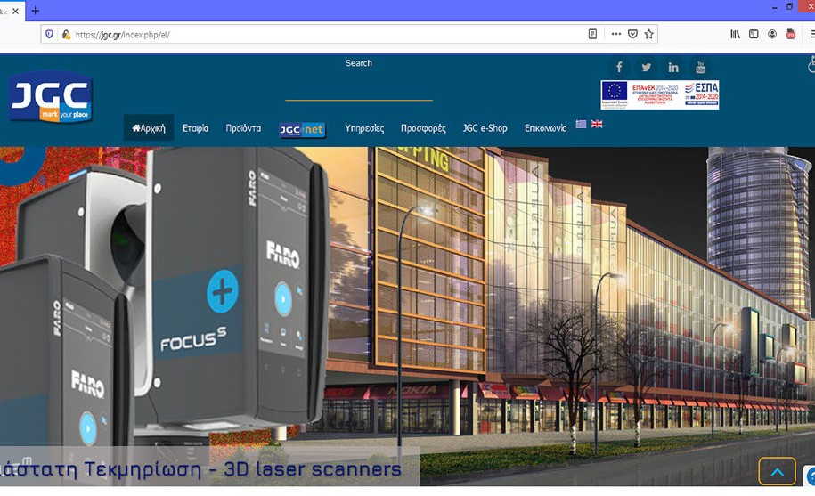
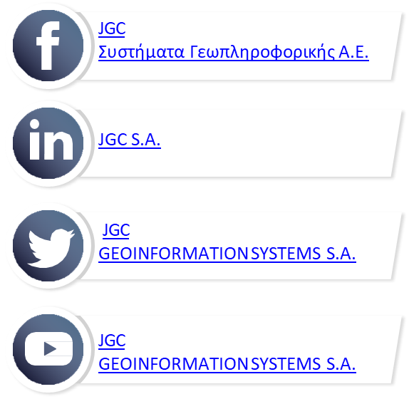
www.jgc.gr
JGC on INTERNET
Starting November 1999, JGC was one of the first companies of its kind to establish a web page to promote the products. The page has detailed information about the suppliers and their products.
JGC maintains an interactive relationship with the customers, providing information and news about the capabilities and use of the distributed products via periodical info-bulletins. JGC maintains a strong digital presence through the website www.jgc.gr, the eshop www.e-jgc.gr and active presence in social media.
www.jgc.gr
www.e-jgc.gr
Company Profile

Slide 8
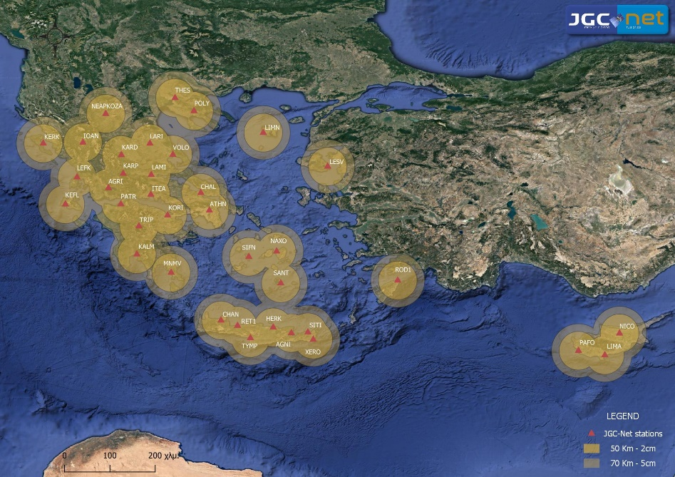
Network
JGC-Net
JGC was the first company to introduce TCP/IP CORS RTK service in Greece, late 2005, with its reference station network, JGC-Net.
JGC-Net is currently consisting of 40 Trimble CORS supporting all available signals and constellations.
The investment has proved to be an excellent marketing tool for GNSS/GPS sales.
JGC is #1 in GPS/GNSS sales in Greece for the past 10 years, in terms of units sold.
Company Profile

Slide 9
Customers
Key Customers
Academic Institutes (NTUA, AUTH, TUC, etc)
Ministry of Finance
Ministry of Agriculture
Ministry of Environment and Energy Ministry of Culture
Hellenic Army, Hellenic Air Force, Hellenic Navy, Hellenic Police Vodafone, Wind, Cosmote
HELPE, Motor Oil Foreign Embassies Consulting companies
Land Surveying companies Marine Surveying companies Engineers and Professionals
Public Power Corporation Municipalities Prefectures
and over 8000 more customers...
Reseller Network
JGC maintains and runs a network of 15 resellers for certain products in order to best cover the assigned territories
Company Profile

Slide 10
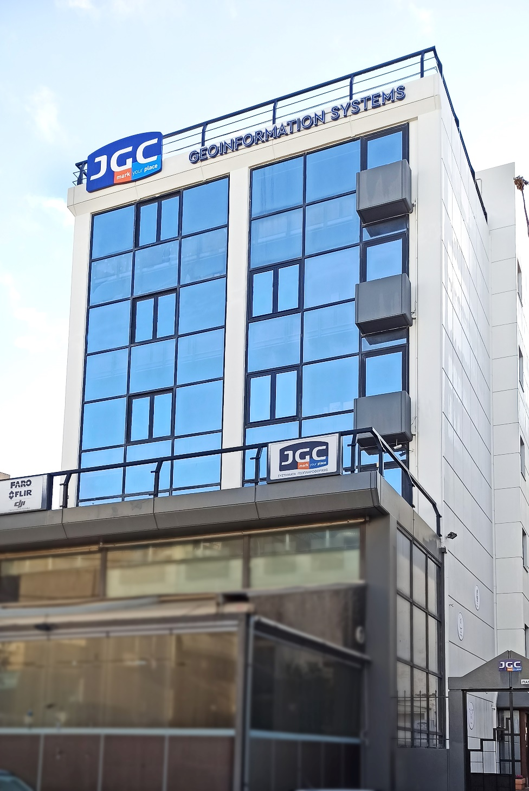
Location
Company Oﬃces
Our offices are in the center of Marousi, Athens. Four floors, 480 m² in total, in a contemporary office building with underground parking space. The premises houses the Sales and Marketing Department, the Accounting Department, Warehouses, Service Laboratory, Exhibition space, meeting rooms and the Presentation and training room.
JGC maintains demonstration units of the products available for sale.
Company Profile

Slide 11
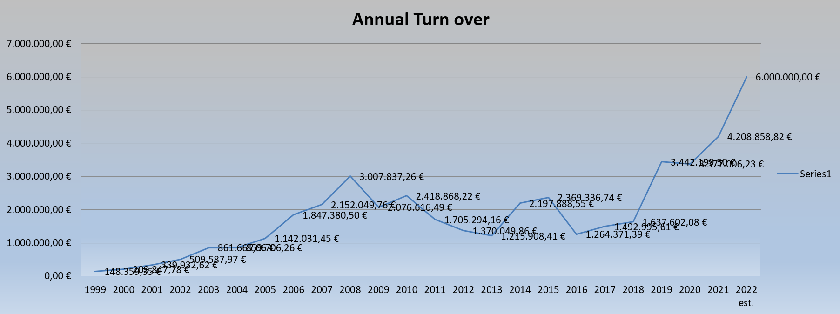
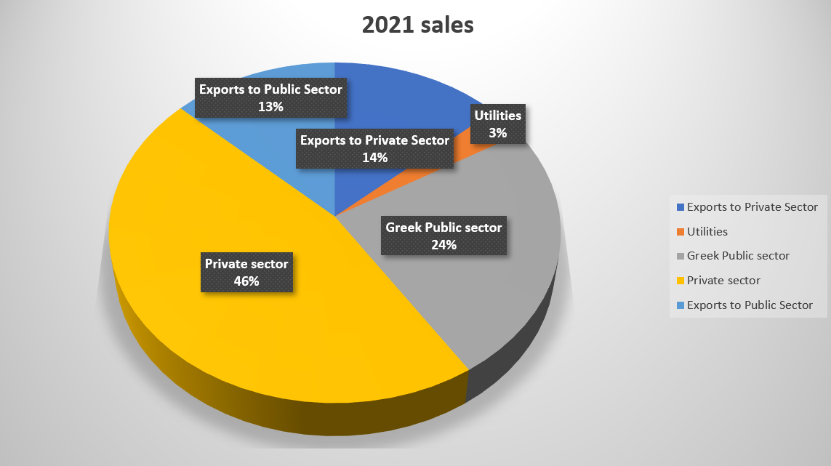
Financial data
JGC in
numbers
The company has maintained a high percentage of growth since it’s establishment and was always been profitable. Typically, 40% - 50% of the company’s turn-over originates from public tenders.
In 2019, 2020 and 2021 JGC invested in the employment of new personnel and in addition with the efforts of the hard work done the previous years, resulted to a boost in sales. For 2022 the target is set for 6 million euros.
Company Profile

Slide 12
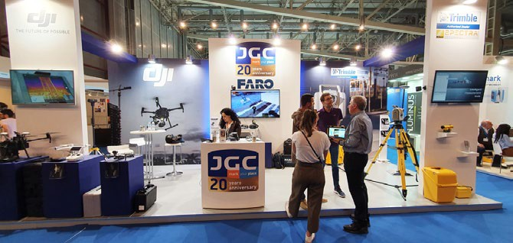
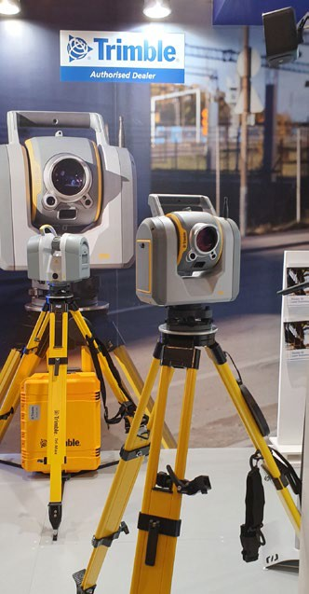
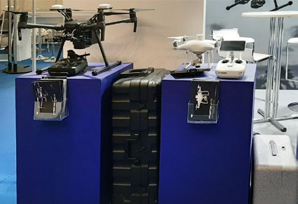
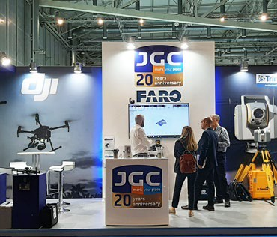
People
Marketing and
Sales Organization
JGC has an aggressive plan to promote the represented products by all means of advertisement and continuously provide information about the advantages and benefits they incorporate.
With permanent advertising collaborators JGC promotes the products through specialized technical magazines. The company is participating in all technical exhibitions in Greece (METEC, Infacoma, Digital Constraction) and in conferences. JGC’s sales personnel performs hand-on demos all around Greece, at private companies, public organizations and Institutions.
1.5% of the annual turnover is dedicated to promotional actions.
JGC applies a Management System in line with the EN ISO 9001:2015 standard for the scope of Trading, Service, Maintenance, Technical Training and Technical Support of Geoinformation Systems & Equipments, Land Surveying Instruments and Satellite Positioning Receivers.
JGC’s International Company Profile (ICP) is available by U.S. Commercial Service.
Our aim is to provide the best possible support to customers, in order to decide about the most suitable equipment for their needs, always keeping in mind the growing demands of the market.
Company Profile

Slide 13
People
Company Personnel
Vagias Christos (ΑΤΜ, MSc Eng)
President
Bachelor
Rural and Surveying Engineer N.T.U.A. (1994)
Bachelor›s thesis: «Deformation control on the Peraeus Silo»
Postgraduate studies
Master of Science Degree, University of Nottingham (1995) Engineering Surveying and Space Geodesy
Master thesis: “High Precision Differential GPS using new hardware”
The Scientific personnel of JGC consists of Engineers with thorough knowledge of both theory and practice.
Through continuous training programs our personnel
extend their knowledge in deep parts of new technology.
JGC employs highly trained engineers (currently 9) capable of providing pre- and after sales support to the customer.
Mougiakos Ioannis (ΑΤΜ, MSc Eng)
Vice President
JGC’s permanent personnel is 18 people.
Bachelor
Rural and Surveying Engineer N.T.U.A. (1994)
Bachelor›s thesis: «Recording road networks using GPS»
Postgraduate studies
Master of Science Degree, University of Nottingham (1995) Engineering Surveying and Space Geodesy
Master thesis: “Positioning On-The-Fly with new hardware”
Furthermore JGC has strategic collaborations –
external partnerships with individual engineers who are pioneers at their sectors.
Billiris Gregory(ΑΤΜ, MSc Eng)
Chief Executive Officer & General Manager
Bachelor
Rural and Surveying Engineer N.T.U.A. (1994)
Bachelor›s thesis: «Recording road networks using GPS»
Postgraduate studies
Master of Science Degree, University College of London (1995) Property Developing and Planning
Master thesis: “Quality and evaluation of the EIA
statements: The case of D. Plakentias motorway project in Athens”
Company Profile

Slide 14
People
Tsonakas Nikolaos (ΑΤΜ, MSc Eng)
Flir & Faro Brand Manager
Eleftheropoulos Neoklis
Service Manager Specialisation Electronics
Bachelor
Rural and Surveying Engineer N.T.U.A. (2007)
Postgraduate studies
Master Mention Finance: Management
de la banque et de l’assurance΄΄ - Paris Nord – Paris 13. ΜΒΑ – Full Time - AUEB
Daliani Aggeliki
Αccounting Department
Bachelor
In Accounting and Finance, Chalkida university (2005)
Tsalimi Irene (ΑΤΜ)
Dji & Artec Brand Manager
Bachelor
Rural and Surveying Engineer N.T.U.A. (2002)
Dimou Vasilis
Warehouse Manager
Bachelor
Undergraduate Naval Engineer , University of Patras
Kalfas Ioannis (ΑΤΜ)
Trimble & Spectra Brand Manager
Bachelor
Rural and Surveying Engineer N.T.U.A. (2005)
Kontostathis Christos (ΑΤΜ)
Technical Support
Bachelor
Rural and Surveying Engineer N.T.U.A. (2015) Master of Science Degree, UniWA
Master thesis: “Geospatial Technologies”
Dounias Konstantinos
Vivax-Metrotech, GSSI & JGC.Net Brand Manager
Bachelor
In Physics, University of Pavia (1990)
Liakata Nicky
Secretariat Department
Specialisation
Graphics design and visual communication (2004)
Paraskevopoulou Sapfo
Account Manager
Bachelor
In Philosophy, Cretan University (2001)
Atzaraki Anna
GIS Brand Manager
Bachelor
In Geography, University of Aegean (2019)
MSc, National Technical University of Athens – Cyprus University of Technology (2022)
Geoinformatics and Geospatial Technologies
Paraskevopoulou Eleni
Legal Department
Bachelor
In Law, Law School of Athens (1995)
Company Profile

Slide 15
Contact us
3Α P. Tsaldari & Aristidou St. Marousi
JGC
Συστήματα Γεωπληροφορικής Α.Ε.
+30 210 8023917
JGC S.A.
www.jgc.gr
JGC
GEOINFORMATION SYSTEMS S.A.
@
info@jgc.gr
JGC
GEOINFORMATION SYSTEMS S.A.
www.jgc.gr
Company Profile

